Slide 1
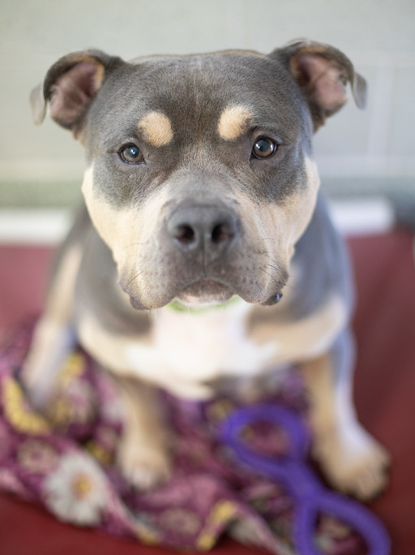
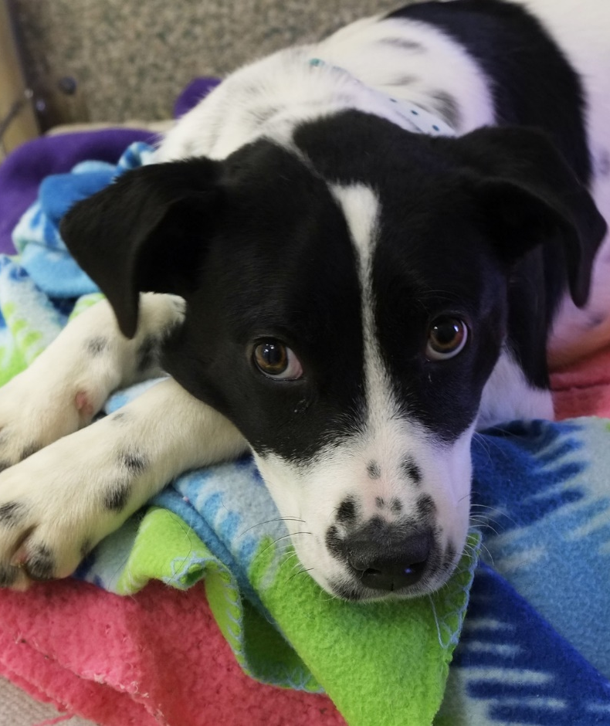
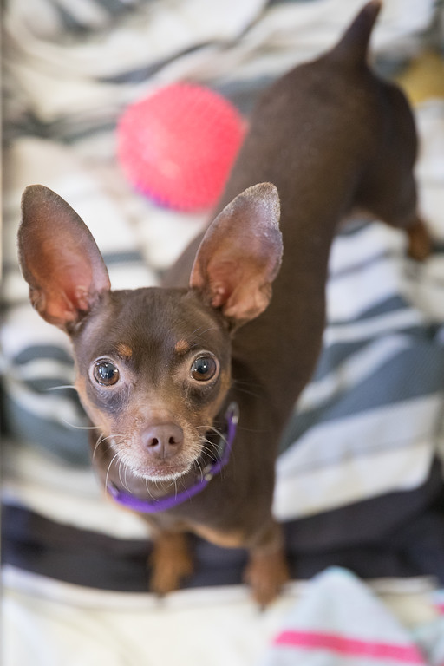
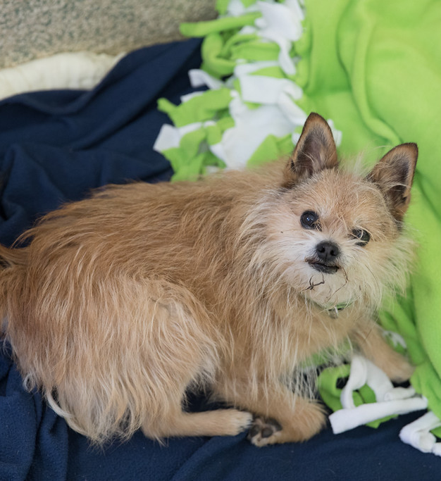
Junior Volunteer
Dog Visitation Training
Day 1

Slide 2
Schedule
Introductions
Dog body language
Dog visit time
How to visit the dogs
Questions

Slide 3

Dog Body Language
Eyes
Mouth
Tail
Body Position

Slide 4
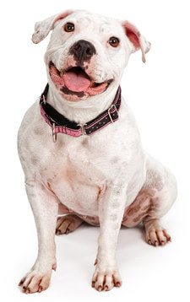
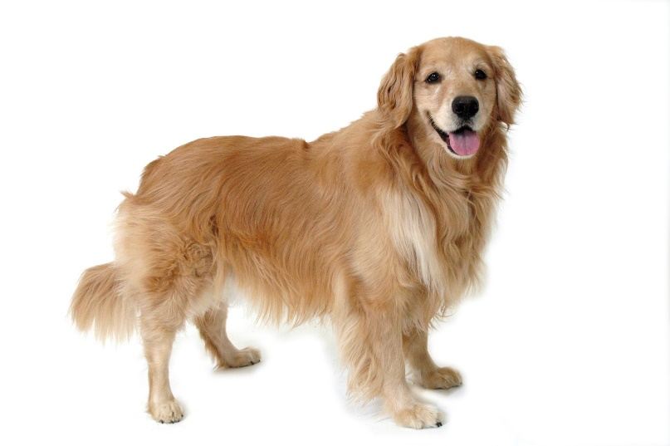
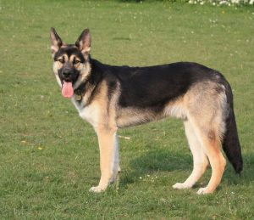
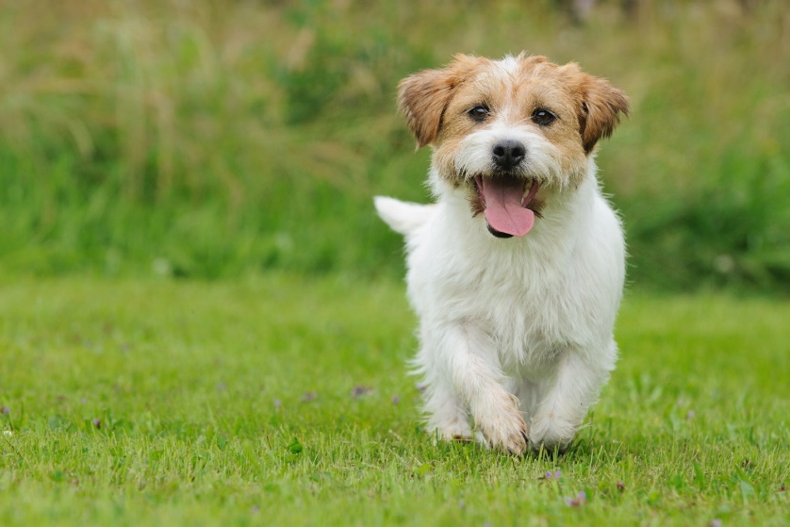
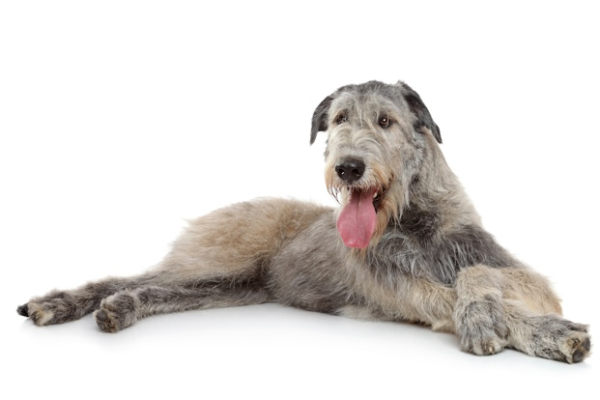
Happy/Relaxed Dog Behavior

Slide 5
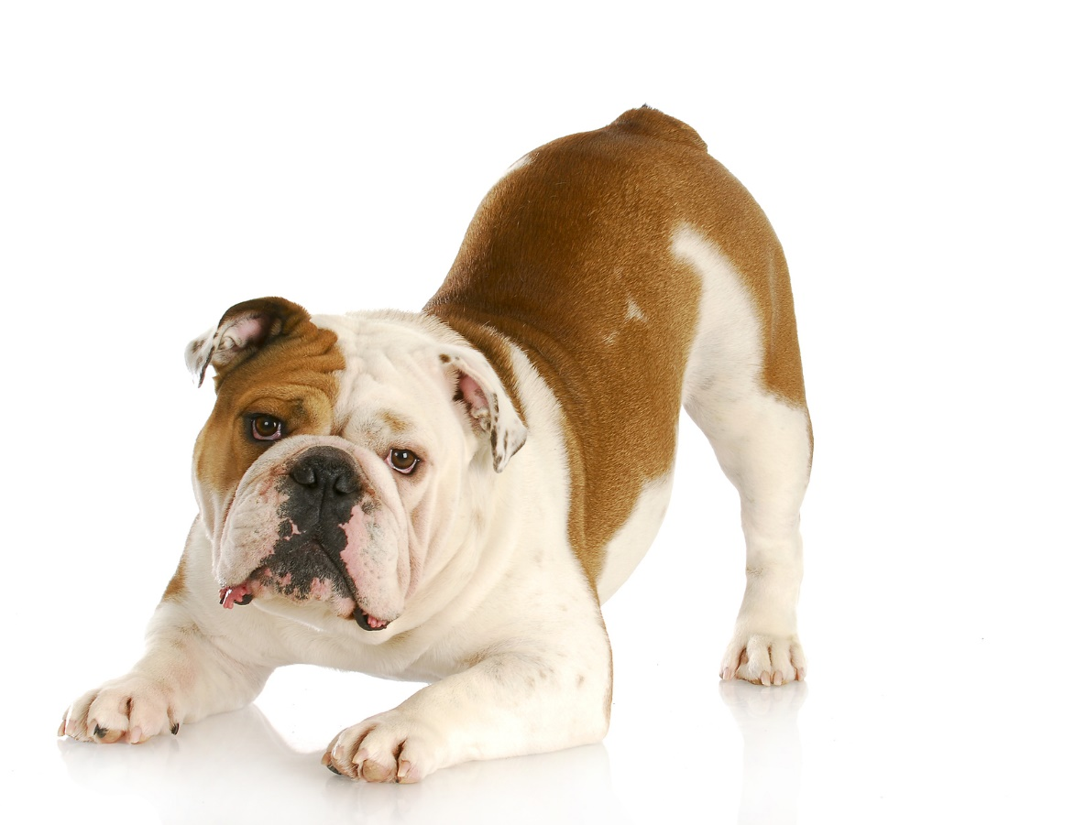
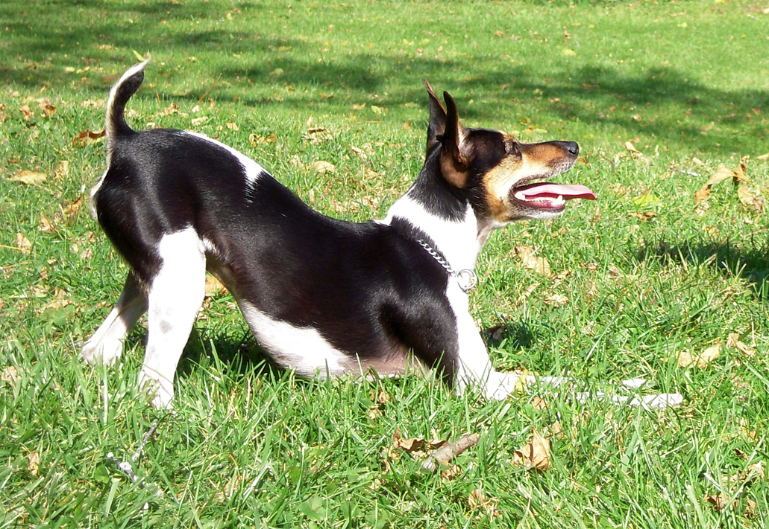
Playful Dog Behavior

Slide 6
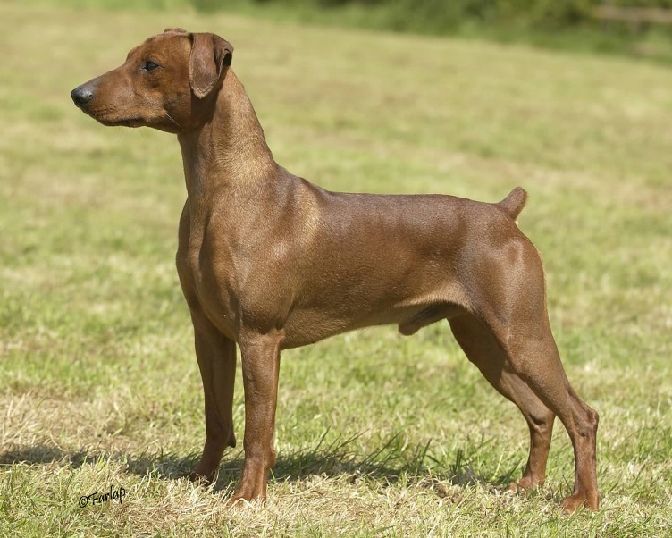
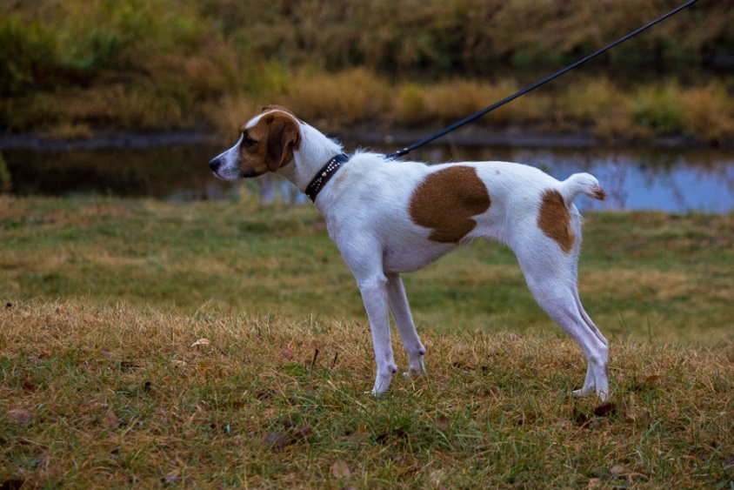
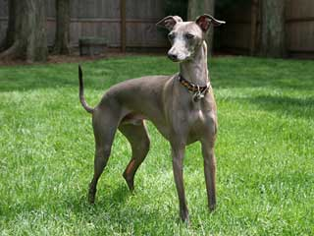
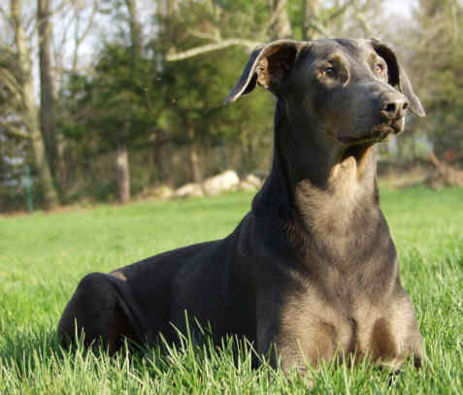
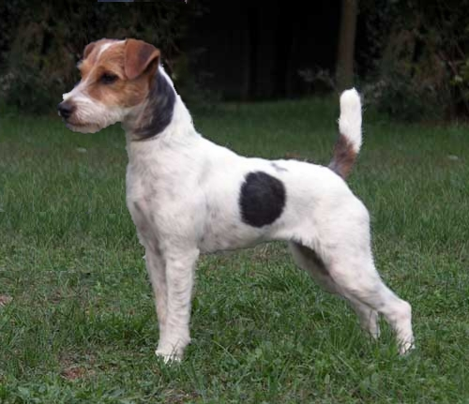
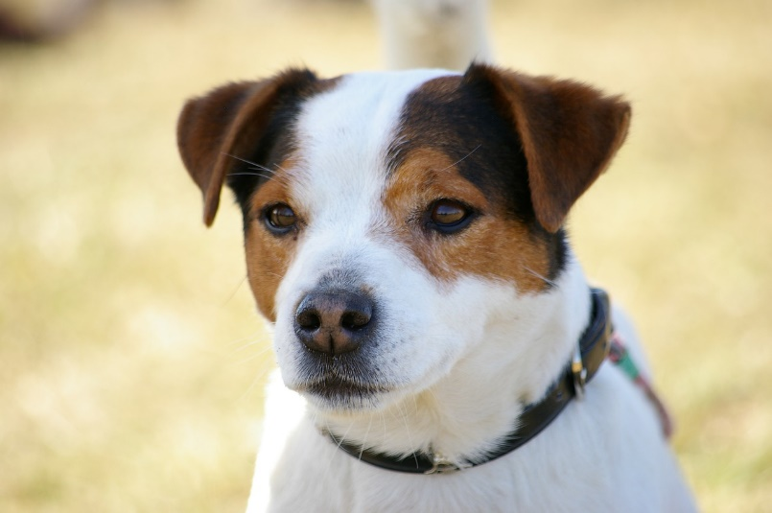
Focused Dog Behavior

Slide 7
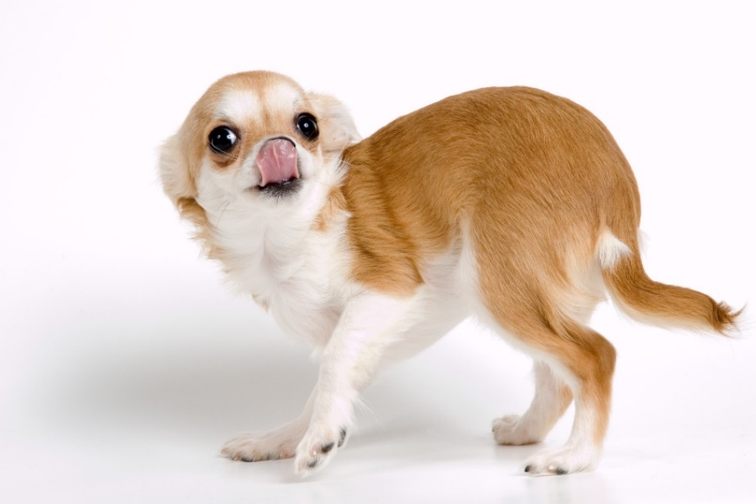
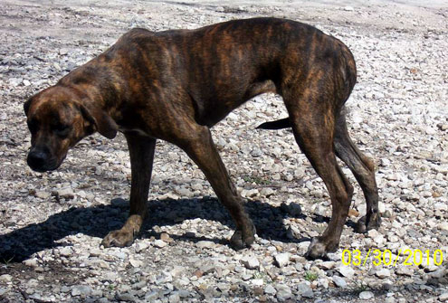
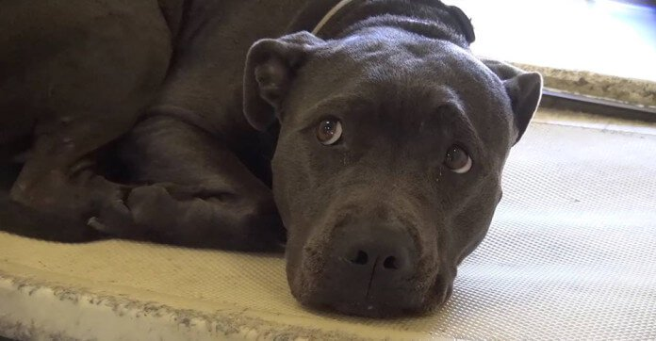
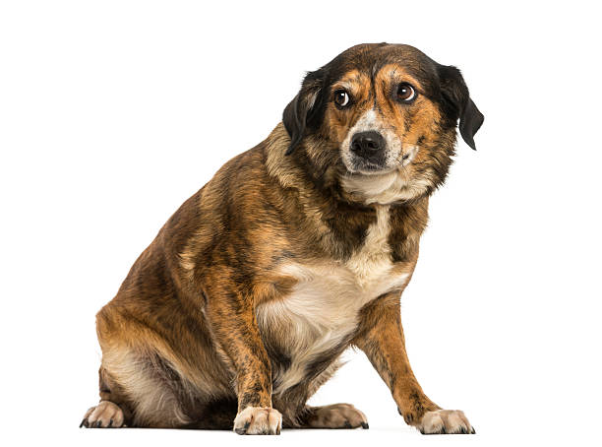
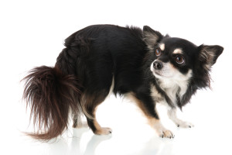
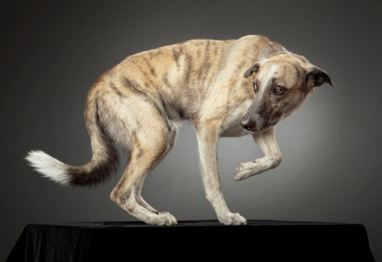
Scared/Nervous Dog Behavior

Slide 8
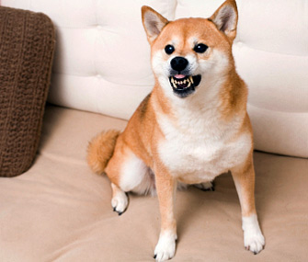
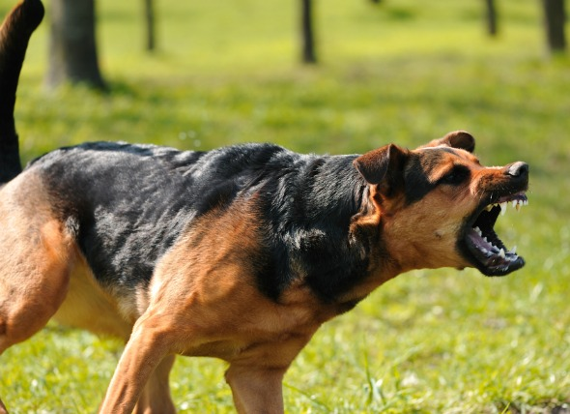
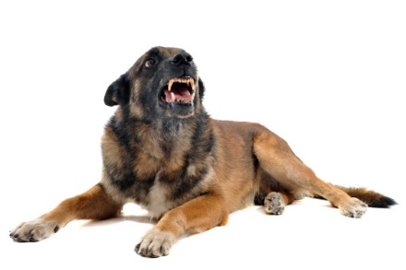
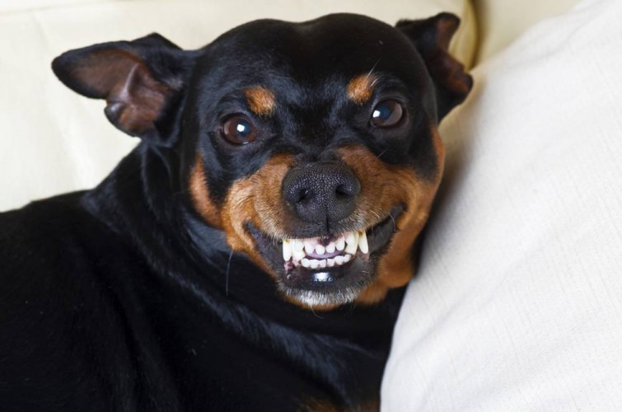
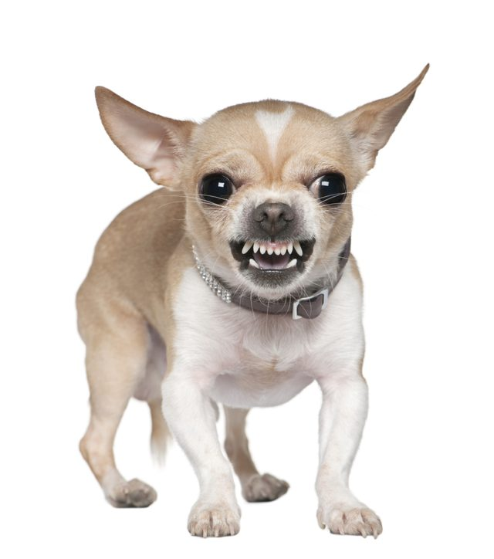
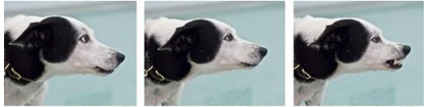
Aggressive Dog Behavior

Slide 9
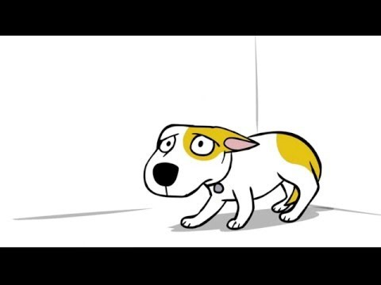
Dog Bite Prevention Video

Slide 10
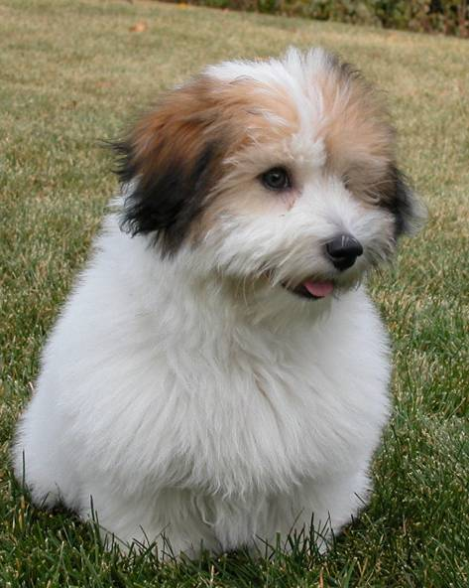
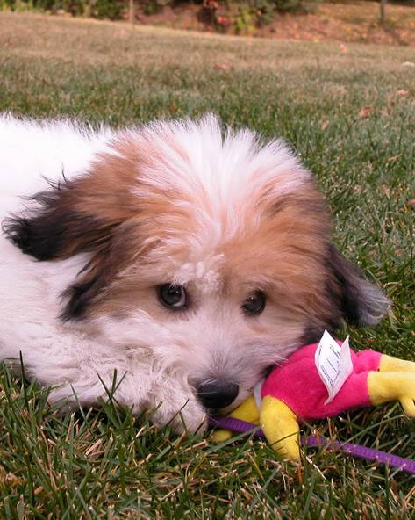
Who’s ready for a visit?

Slide 11
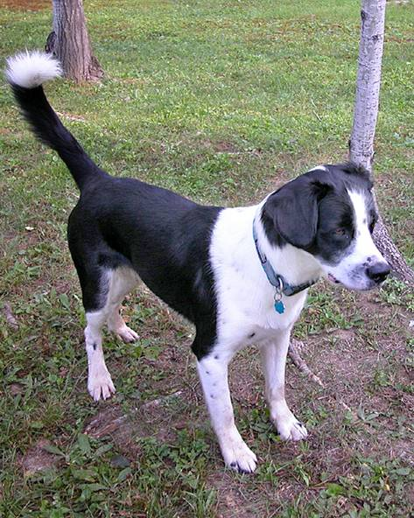
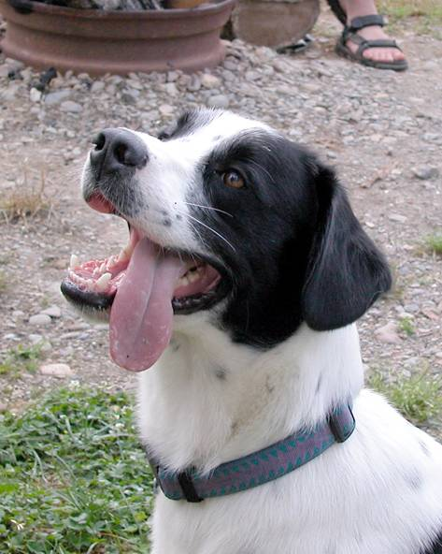
Who’s ready for a visit?

Slide 12
Beware of your own body language!
Move slowly (no sudden movements)
Do not make direct eye contact with dogs
Approach at the animal’s level
Do not reach over an dog’s head
Use a calm, quiet voice
Allow the dog to sniff you before petting them
Allow the dog to come to you

Slide 13
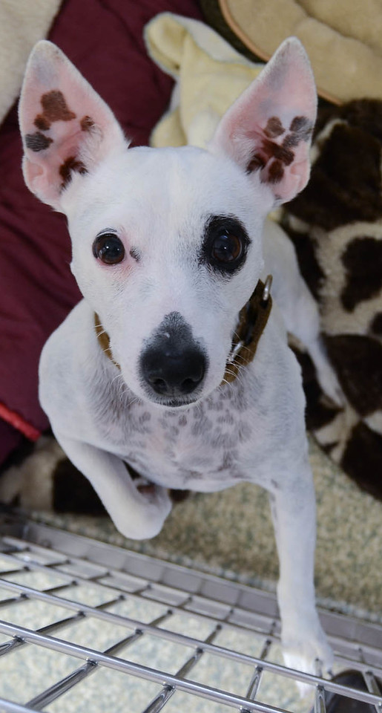
What do you need?
Clean Towel!
Confidence!
That’s it!

Slide 14
Keeping everyone (you + animals) healthy
Towels!
ALWAYS get a new towel in between every animal visit
Hand Sanitizer!
ALWAYS sanitize in between every animal visit (wherever the animal touched)
Clothing!
ALWAYS wear closed toe shoes
Make good choices (pants, hoodie strings, etc.)
Actions
ALWAYS keep the animals calm and happy, no rough play

Slide 15
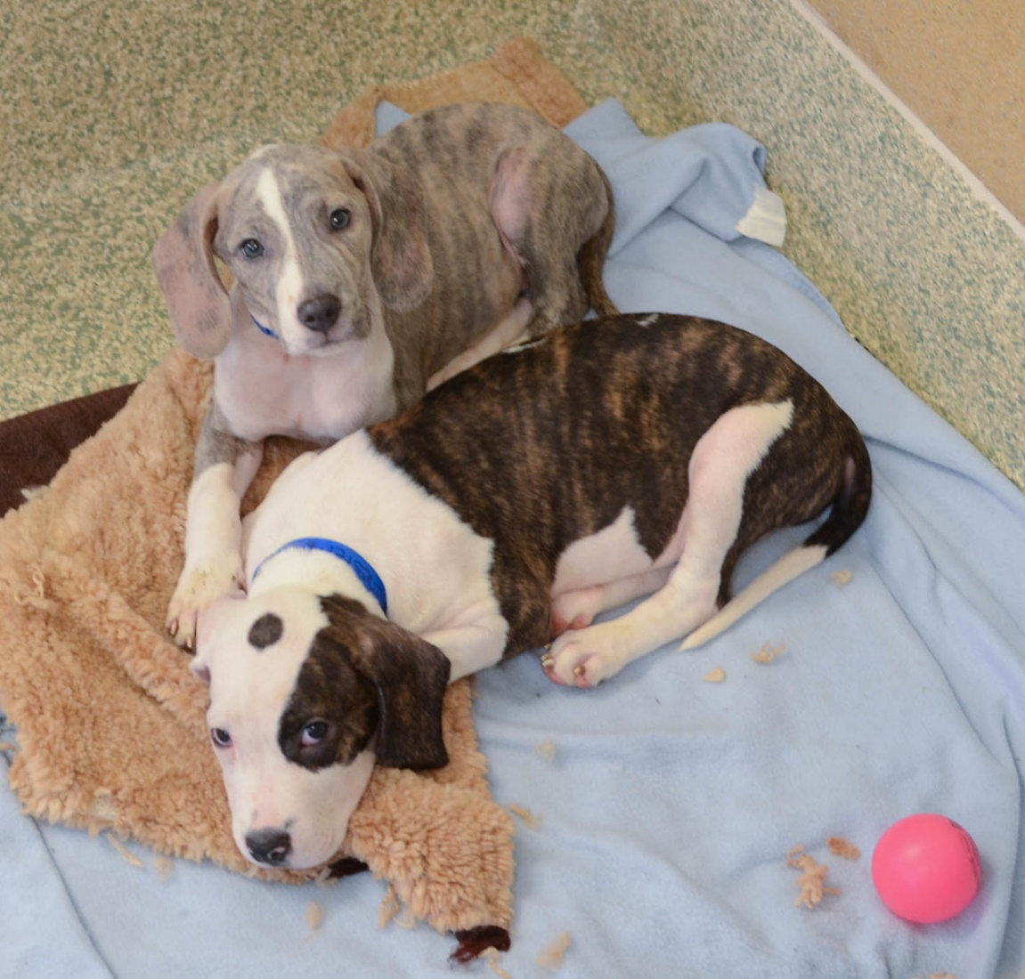
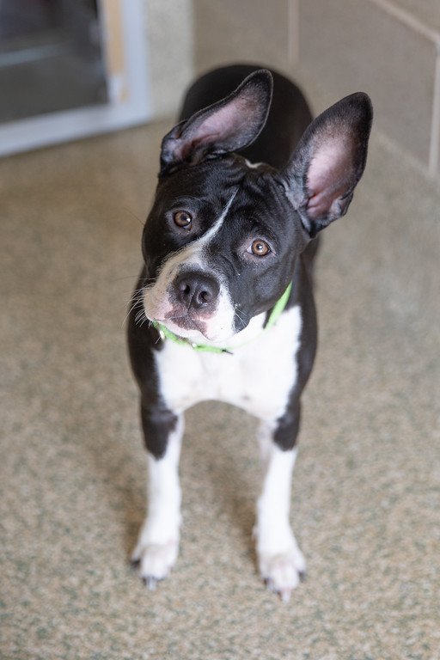
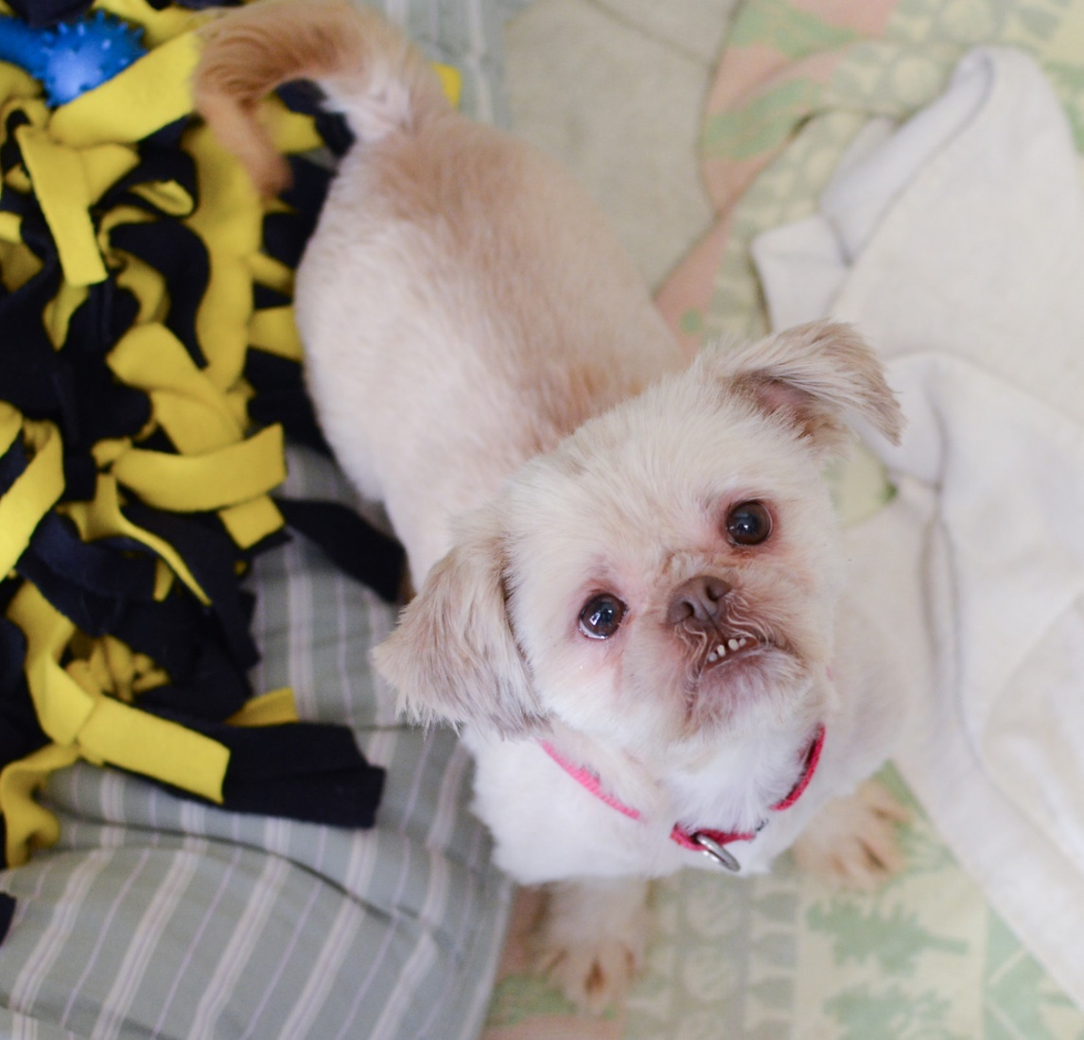
Let’s visit the dogs!

Slide 16
Questions?
See you back again for session 2!

