Slide 1
Communal housing at hshv: Who, what, why and how?
3100 Cherry Hill Road | Ann Arbor, MI | 48105
(734) 662-5585 | www.hshv.org

Slide 2
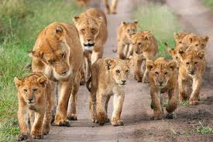
Social structure of cats
Cats in the wild:
Solitary predators
Don’t live in socially structured groups (lions being the exception)
Domestic cats:
Many more variables
  Density of cats
  Availability of resources

Slide 3
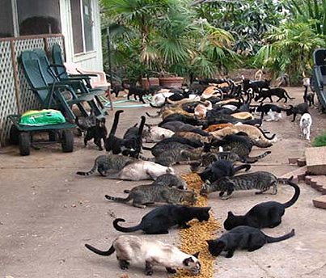
Domestic Cats living communally
Highly adaptable
Retain roots as solitary hunter
Can adapt to communal living both natural and artificial
Create social structures based on need

Slide 4
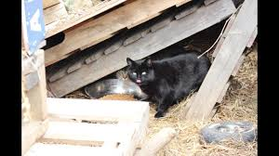
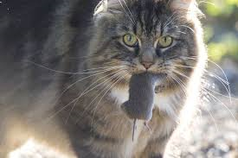
Territorial needs of cats
Territory:
  Hunting
  Den (eat/ sleep/ play)
  Marked by scent
  Can overlap in the wild- neutral areas
  Unknown cats are chased off

Slide 5
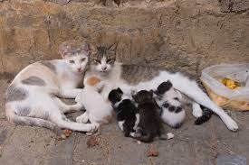
Hierarchies within Feral colonies
Colonies formed around resources
Some cats still live singly
Most commonly cooperating females and offspring
There is no distinct hierarchy
Complex relationships
Stronger affiliative relationships seem to be genetic

Slide 6
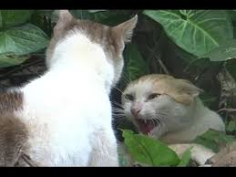
Why can’t they get along?
Cats have no need for complex social interactions
They lack signal appeasement to other cats
Conflict more often ends in fighting
Must have proper access to resources to be successful

Slide 7
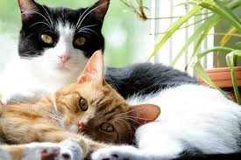
Benefits of Communal Housing… the why’s
Stress reduction
Serves both health and social needs
Chance to exhibit natural behaviors
Express personality- closer to true behavior than in cage
More natural interaction with people
Cats can learn from one another- social behaviors
Adoption appeal

Slide 8
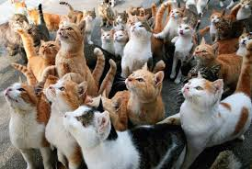
Who is Eligible?
All cats!
Age/ energy level
Past history with other cats
Personality type
On meds?
Prescription food/ special diet
Other medical issues
Eating well/ firm stool

Slide 9
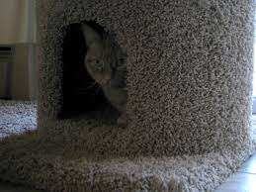
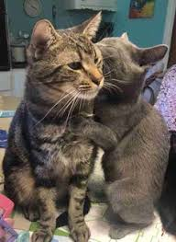
Specific room for specific need/ type of cat
Shy cats
Older cats
Easy going/ calm cats
Energetic cats
Young cats
Male vs female
Case cats
URI room
Diarrhea room ☹
Treatment room

Slide 10
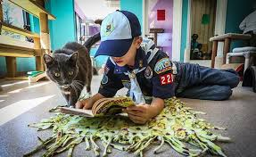
Big communal vs Small communal
Meow Meadows and Purrs Plaza:
Can be more stressful
Tours and camp kids
Much larger groups of cats
More space to stretch out
Prefer more confident cats
JV involvement

Slide 11
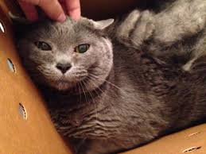
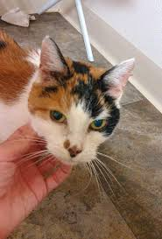
Big communal vs Small communal
Visitation rooms and larger condos:
Can be much less stressful
Preferred for very shy cats
Great for small groups of older/ calmer cats/ pairs
Tours and camp kids
JV involvement

Slide 12
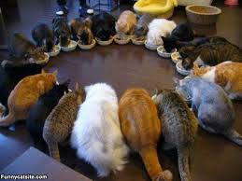
Practical Considerations
Sterilization status
Ratio of male to female
General temperament of the room
Number of cats in room
General health of the room
Needs of the population as a whole

Slide 13
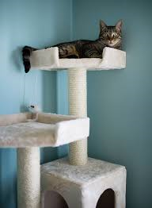
The process… simplified
Decide on cat
Wrap in towel
Move cat to desired communal space
  Away from other cats
  Higher up, if possible
  Move away
  Observe
  Intervene only if necessary
  Give them time!

Slide 14
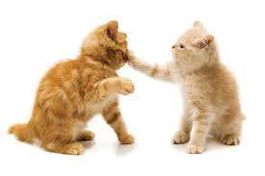
Quirks of Communal living…
Tolerates cats in communal does not mean good with other cats
Stress bonding
Suppressed behaviors inherent to shelter living
“They’re trying to kill each other!!”
Mating behaviors

Slide 15
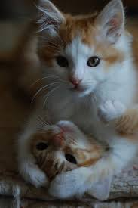
Cat VS Cat
The good:
Mutual grooming
Cooperative behaviors
Socialize with other cats
Rehab inappropriate behaviors
The bad:
Stalking/ chasing
Hoarding resources
Personality suppressed

Slide 16
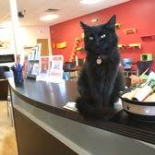
Tiny Lions Café
Separate but intertwined
TLC staff role:
  Pick cats to go
  Manage their care
  Handle adoptions
  Determine who needs to come back
  My role:
  Adoption follow ups
  Support TLC staff as needed

Slide 17
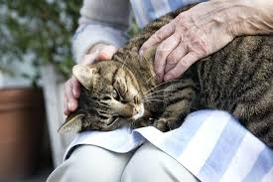
Working with Social Cats in Communal
Lap time
Read to Calm
Clicker training
Play time
Try to give everyone time
More than one comforter can be ok
Limit handling
  Over touched!

Slide 18
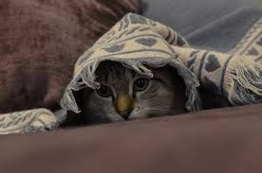
Working with Fearful Cats in Communal
If Blue Dot, will have an observation book
More than one comforter can be useful
Can focus on one cat
Use all of your fearful cats tools
  Quiet, slow, intentional
  Food motivators
  On their terms

Slide 19
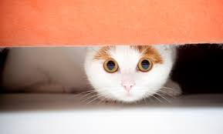
Working with Fearful Cats in Communal
Read to Calm
Talk only
Clicker training
Get on their level
Be aware of where the other cats are
Distractions for more social cats

Slide 20
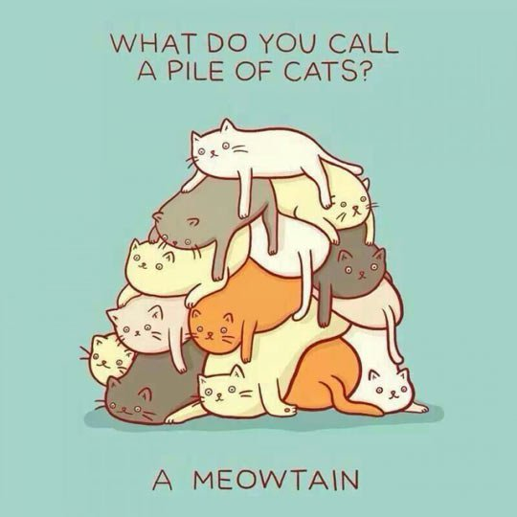
The “Cat Pile”
Two or more cats, generally laying on top of one another
Stress response
Familiarity
Safety in numbers

Slide 21
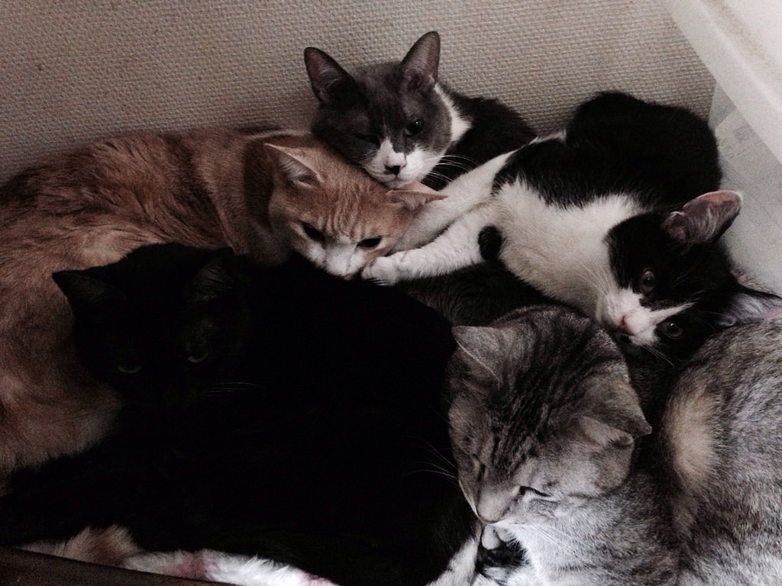
Working with the “cat pile”
If working with the whole group:
Start here if you’re new to the group
Good food motivators
Talk only
Read to Calm
Hands off
Desensitize to your presence

Slide 22
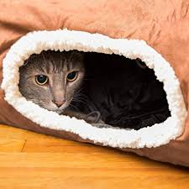
Working with the “cat pile”
If working with a specific cat:
Use all of your shy cat tools
  Focus efforts on that cat alone
  Talk to all
  Can leave food motivators for all at end of session

Slide 23
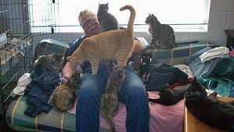
Questions?

