Slide 1

Ten things dog trainers want people to know about dog behavior
Angela Schmorrow, CSB-D, KPA-CTP, CPDT-KA
3100 Cherry Hill Road | Ann Arbor, MI | 48105
(734) 662-5585 | www.hshv.org

Slide 2
Challenging assumptions
These are all commonly held assumptions/beliefs that science has since proven wrong
You are likely to see things here that you have believed, and that’s OK
The point is not to criticize, but to continue to learn so we can continue to do better
Humane Society of Huron Valley | (734) 662-5585 | www.hshv.org

Slide 3
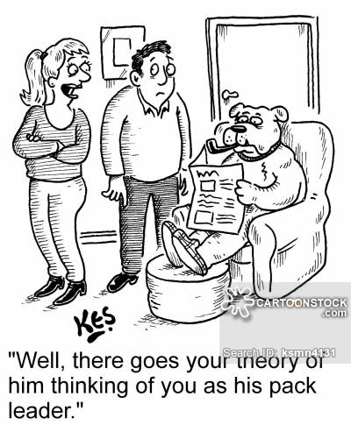
it’s not about dominance
Dogs are not pack animals
We aren’t dogs, and they know that
Dominance describes social interactions, not individuals
  Not a personality trait
What we attribute to “dominance” usually is quite the opposite
  Examples – aggression, humping, etc.
Dominance has nothing to do with how dogs learn.

Slide 4
Animals learn in two ways
Learning by association
  When something is in the environment, do they feel safe/unsafe?
Learning by consequences
  What behaviors result in good things? In bad things?

Slide 5
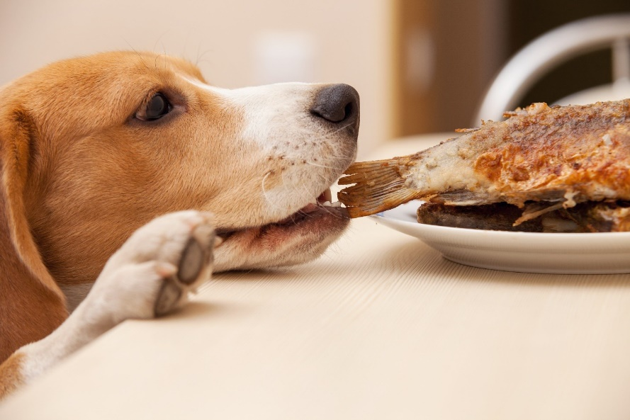
Behavior Is about consequences
Dogs do what works!
Behavior serves to get to something one wants, or get away from something one doesn’t want
We can influence behavior by changing the environment and/or changing the consequences

Slide 6
There is no shame in management
The best way to not have a problem behavior is not to let it start in the first place.
Be proactive, not reactive.
Some behaviors are easiest to change by simply managing the environment.

Slide 7
Reinforcement drives behavior
There are multiple ways of changing behavior, but the methods we use have an impact – remember animals are always making associations!
”Positive reinforcement works, and coercion is dangerous.”
Reinforcement | Punishment
Builds confidence | Erodes sense of safety
Lowers stress | Creates fear and avoidance
Creates strong behaviors | Suppresses behavior
Builds relationships | Damages relationships
Creates enthusiastic learners | Slows learning

Slide 8
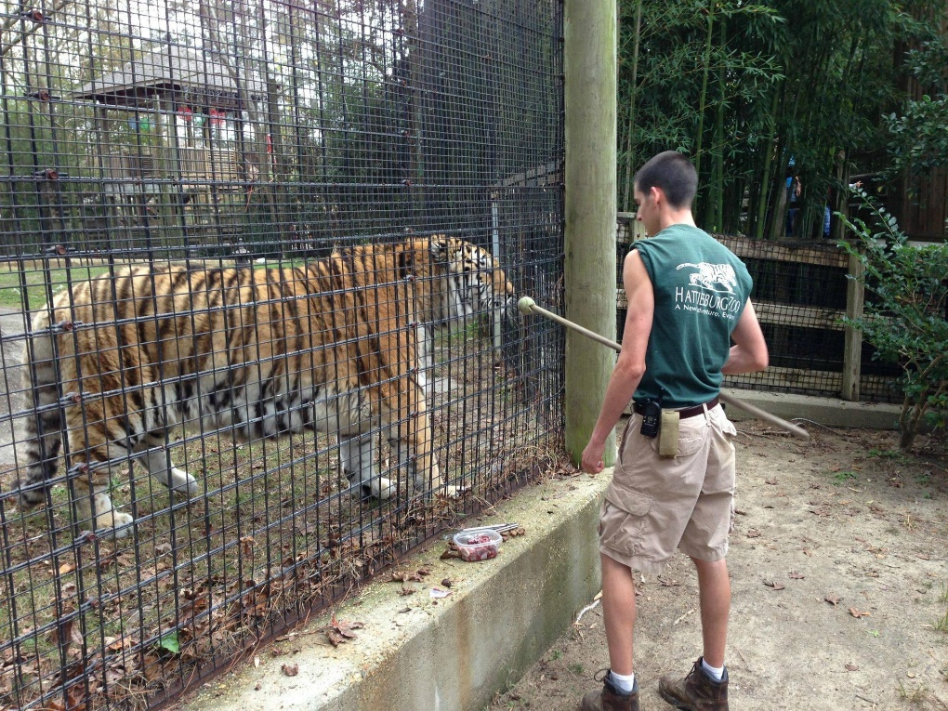
Challenging animals don’t just need a “heavier hand”
Most aggression and reactivity is caused by fear
Aversive methods are likely to make things much more dangerous
All animals learn through reinforcement

Slide 9
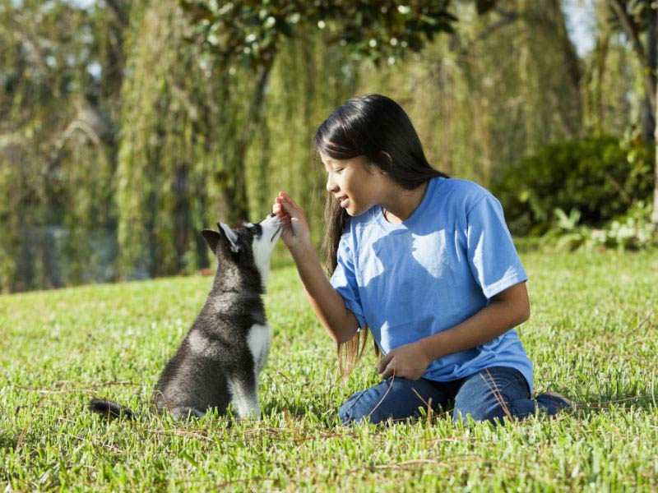
It’s not “all in how they are raised”
Behavior is influenced by genetics, the environment, and learning – both “nature” and “nurture”
Many dogs from unfortunate backgrounds can still be very resilient
Not all behavior problems are the result of abusive pasts
“See the dog, not the story” – work with the dog in front of you

Slide 10
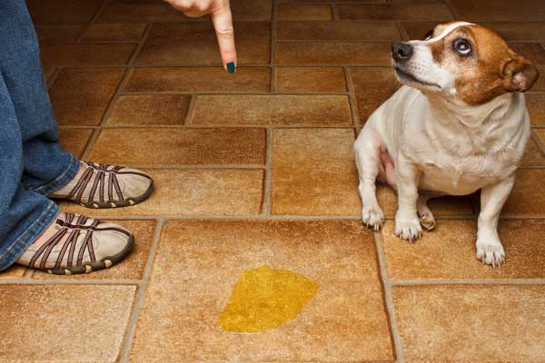
It’s not a “guilty look.”
Behavior is communication
Dogs don’t think of it as “good” or “bad,” “right” or “wrong”
That look is an appeasement response meant to avoid conflict
All they know is you are upset – they don’t “know they did something wrong” and they don’t know why you are mad

Slide 11
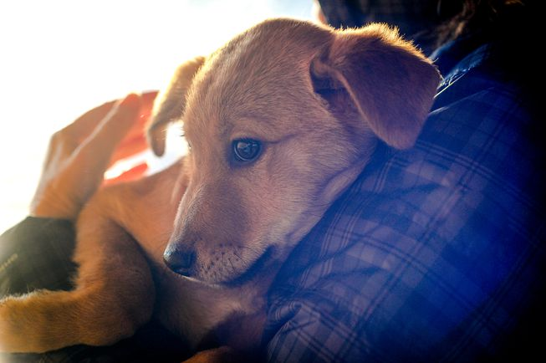
You can’t reinforce fear
Fear is a reflexive response – the animal can’t control it
Comforting won’t make it worse
Change associations by offering good things in the presence of the scary thing
  Example: dogs barking in kennel when worried about new people
When fear goes away, the fear-based behaviors will go away as well

Slide 12
Dogs need to exercise their minds, not just their bodies
Mental enrichment – the opportunity to use their brains, problem solve, and engage in natural dog behaviors (tracking, foraging, etc.).
Ditch the bowl!
  Puzzle toys
  Scatter feeding
  Reward-based training

Slide 13
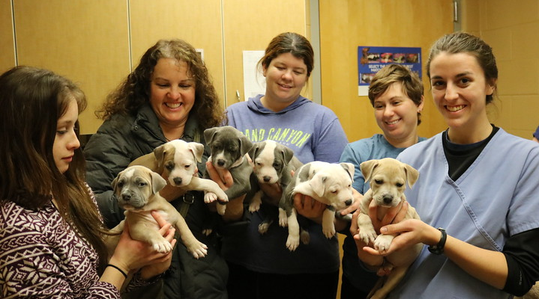
Questions?

