Slide 2
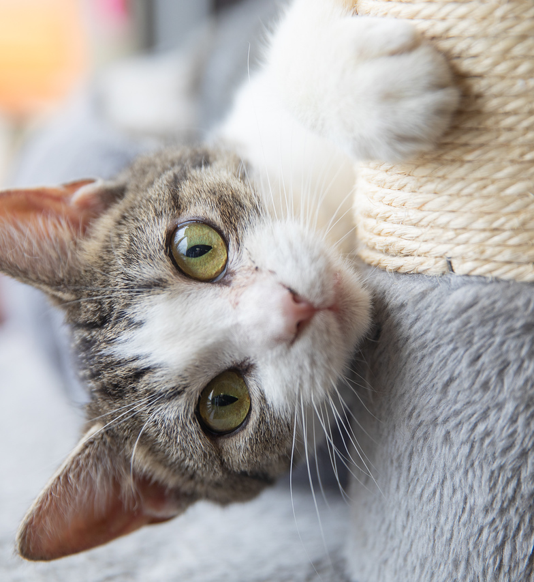
Managing Behaviors in the Shelter
Working with fearful cats
Managing high arousal
Managing low handling threshold or body handling sensitivity
Depression/ URI cats

Slide 3




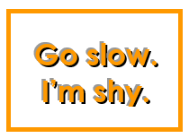
How Will I Know a Cat Has Specific Needs?
Signs on cage
  “Go Slow”
  “In Cage Only”
  “Keep Calm”
  Blue Dot
Previous comforter notes
Notes from behavior staff in Comforter Logs
Observation

Slide 4
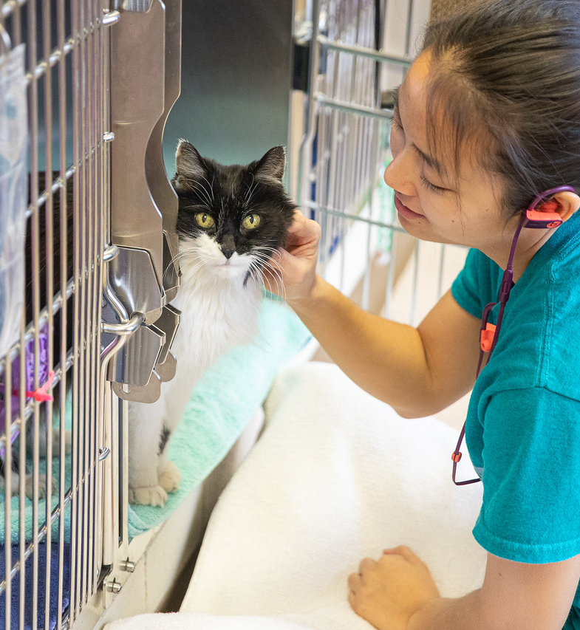
For Each Visit
Check cage signs
Check previous notes
Look for any behavior staff notes
Assess each cat before entering cage
Approach each cat slowly
Interact at their pace
Record visit objectively

Slide 5
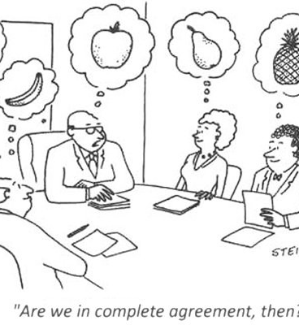
Quick Note on Objective Language
Record observable behaviors
  What was their tail doing?
  Pupils?
  Body loose or tense
  How did they respond to you?
  Objective vs subjective
    Fearful
    Sassy
    What body language leads us to that description?

Slide 6
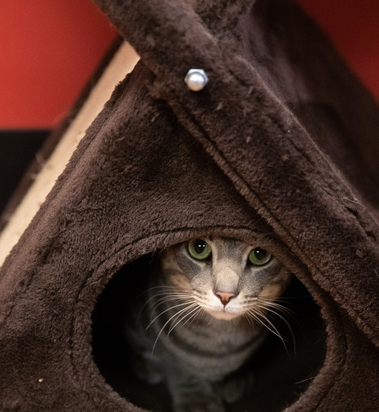
Fearful Cats
We’ll do another session on shy cats, so we’ll keep this brief!
Body language
  Wide pupils
  Clenched body
  Frozen
  Staring
  Unresponsive to attention

Slide 7
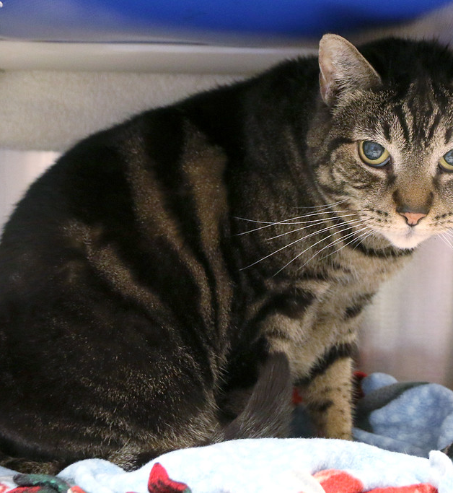
Working with Shy Cats
Assess before moving into their space
Move slowly and deliberately
Offer treats
  Reward for any brave movement
Speak quietly
Limit handling
Offer play
  Can be scary for some cats

Slide 8
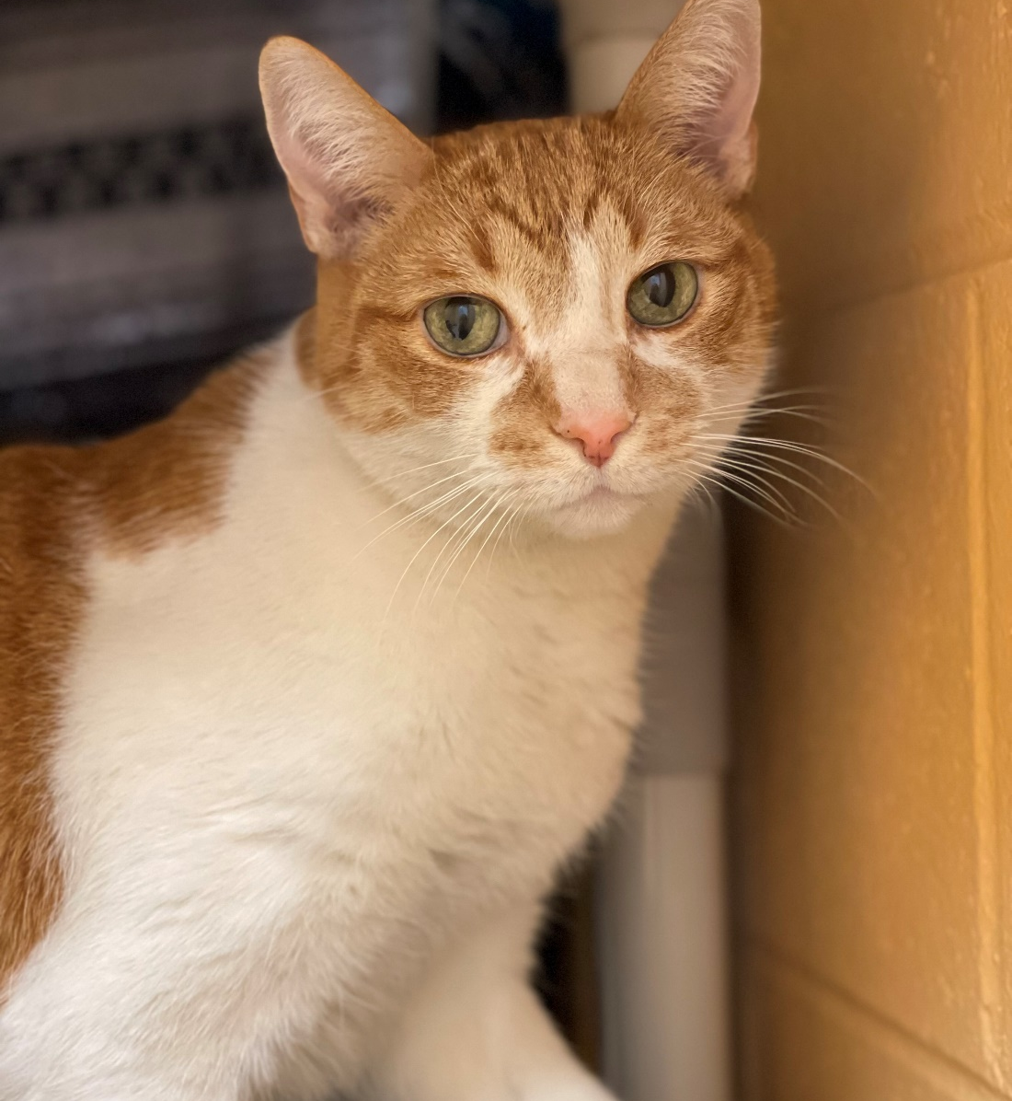
Using Treats
Look for food bowl stickers
  May have prescription treats
  Can try to use their food if no prescription treats available
Reward for eye contact
Forward movement
Loosening of body/ face
Leave treats if they won’t eat

Slide 9
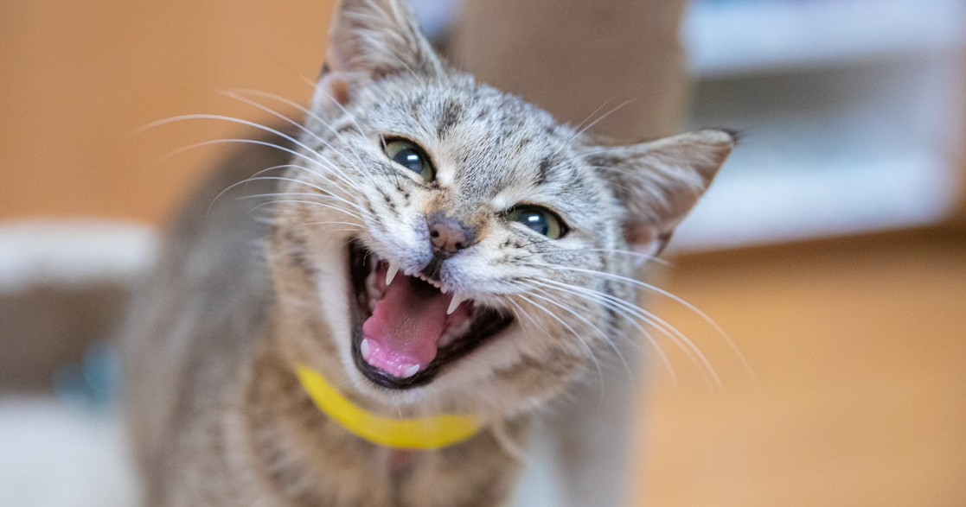
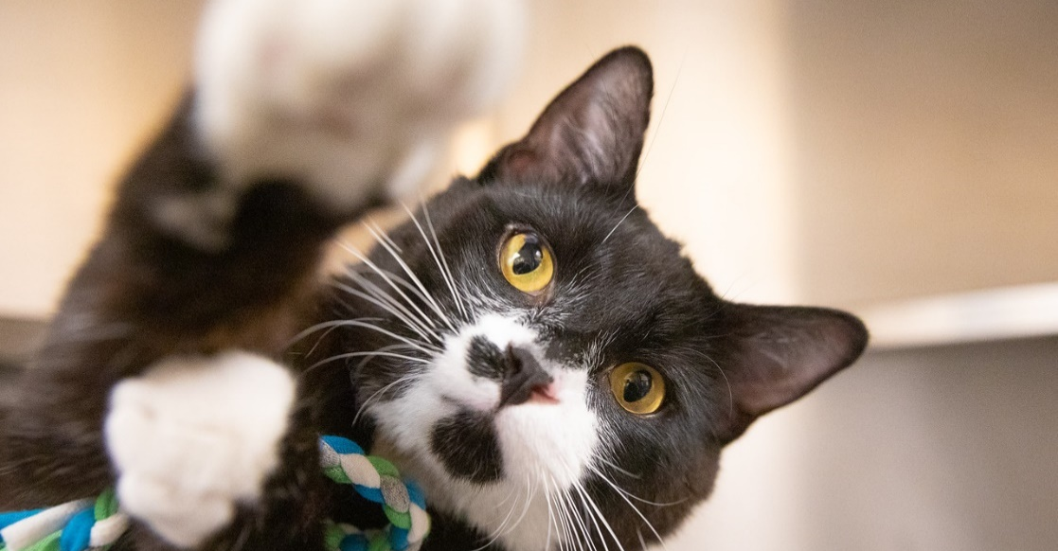
Cats with High Arousal
Arousal refers to the cat's emotional arousal. A highly aroused cat quickly becomes emotionally aroused in response to stimuli, which may result in “aggressive” behavior.
Other language we use for these cats:
  Easily overstimulated
  Frustrated
  Play aggressive

Slide 10
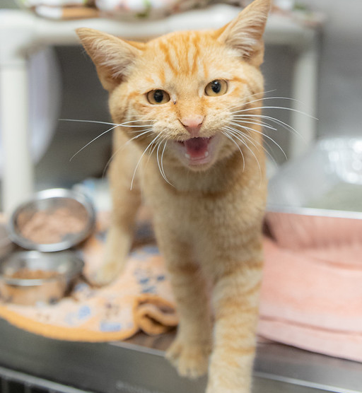
What to Expect
Often start loose and attention seeking
Watch for:
  Tail twitch
  Piloerection/ coat twitching
  Pupil dilation or constriction
  Increase in energy, play or attention seeking
  Using paws to seek more interaction
  “Love nips”
  Licking
  Fixating on place/ thing in cage
  Vocalizing

Slide 11
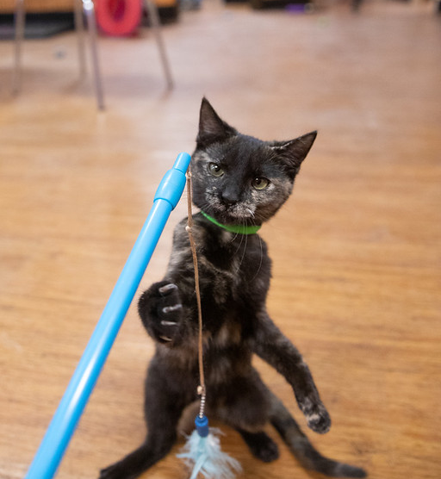
Working with Overarousal
Read previous comforter notes and behavior staff notes
  Look for:
    Notes of overstimulation
    Notes of body language changes
    Sudden behavior changes
    Make good notes for next comforter
Be prepared to redirect
  Toys
  Treats
Limit handling
Offer mental stimulation
  Clicker work
  Games in cage
    Hide and seek, foraging…

Slide 12
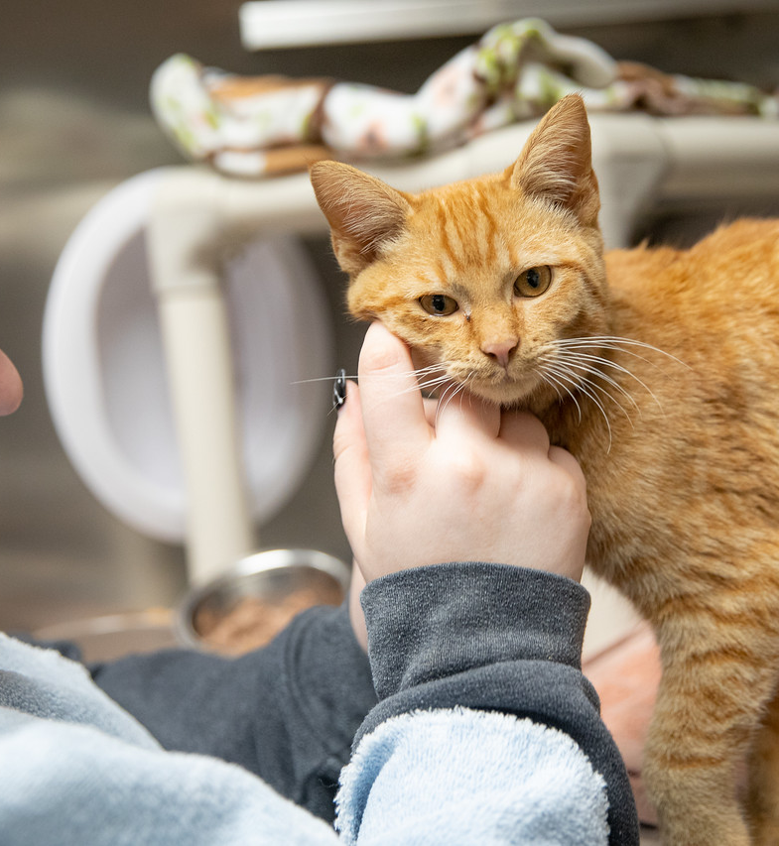
Low handling threshold/ body sensitivity
Cats who respond to certain forms of handling with fear, anxiety or aggression may be considered “handling sensitive.”
Handling sensitivities can lead to forms of aggression such as snapping or biting if left unaddressed or unmanaged
With a little education in cat body language and by preventing unpleasant experiences, we can change the way a cat feels about and responds to handling

Slide 13
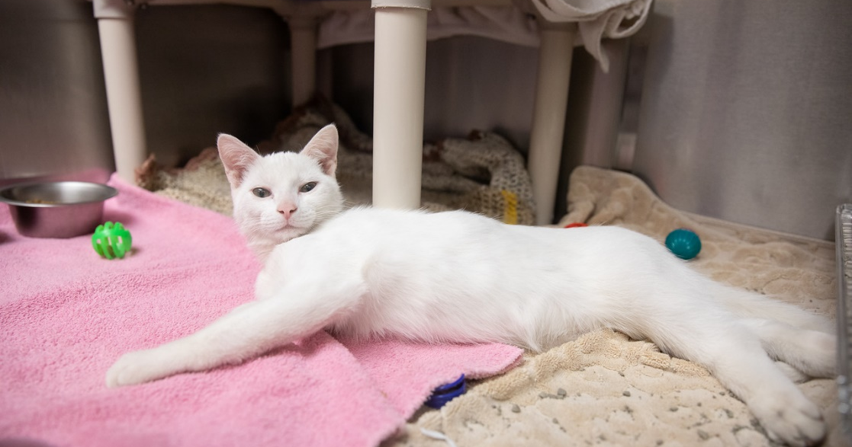
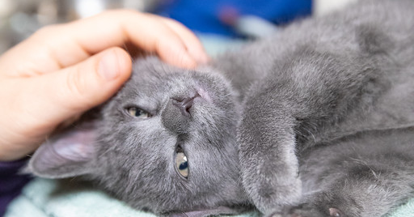
Who is this Cat?
Other language we use for these cats:
  Sassy
  Petting related aggression
  Easily overstimulated
  Attention seeking aggression
Bites or attempted bites seem to come out of nowhere

Slide 14
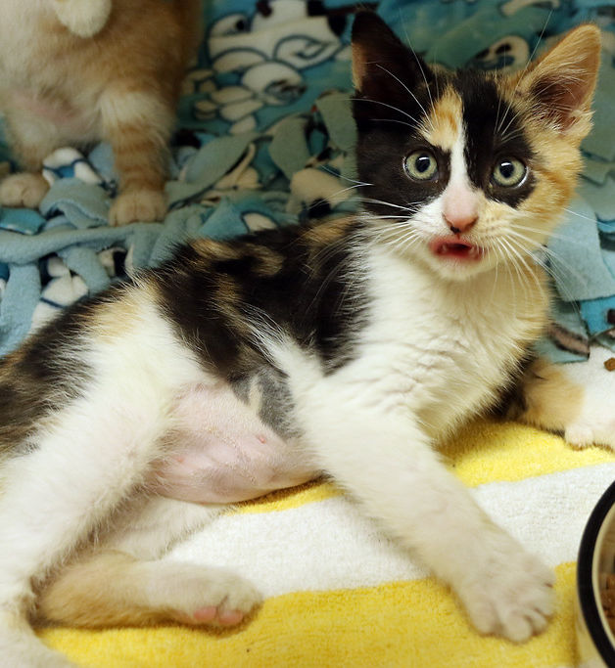
Body Language to Look For
Often relaxed and attention seeking for some or all of the visit
Red flags
  Tail twitching
  Avoidant at any part of the visit
  Coat rippling/ twitching
  Head whipping
  Sudden body or face tension
  Change in pupil size
  Focusing on your hands/ arms as they move in the cage

Slide 15
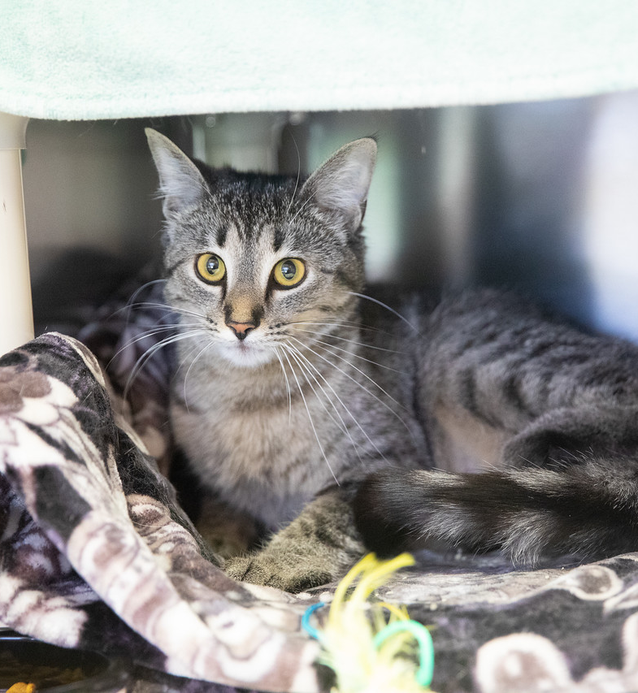
Appeasing or Displacement Behaviors
Common for a cat who’s trying to diffuse an interaction
Offering these behaviors is a way to reduce their stress
For some cats this means:
  Rolling on their side or back and offering belly
  Lip licking
  Feigning sleep

Slide 16
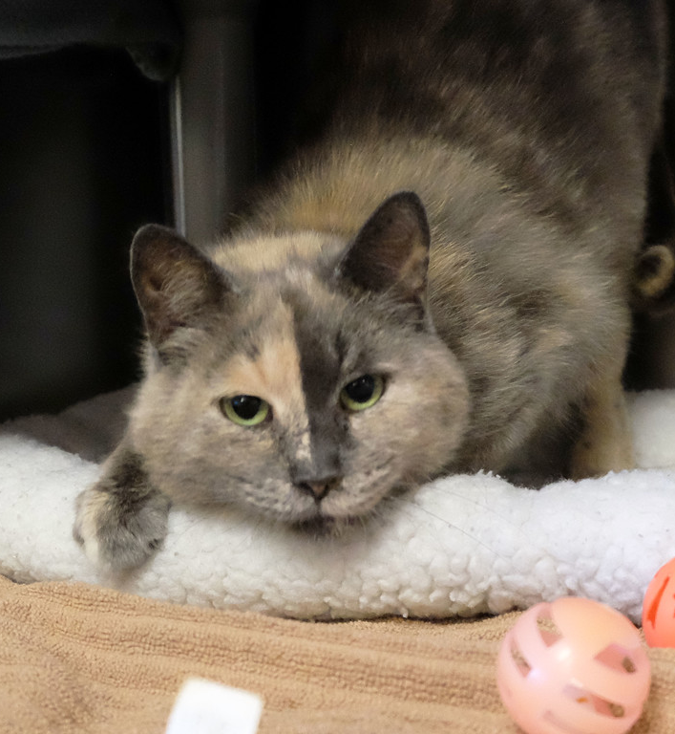
Managing Handling Concerns
Read previous comforter notes and behavior staff notes
  Look for:
    Notes of overstimulation
    Notes of body language changes
    Sudden behavior changes
    Make good notes for next comforter
Assess each cat before visiting
Assess during visit
Pet “safe zones”
Let them self pet
Reward and redirect
Understand thresholds
Talk only visits
Clicker work

Slide 17
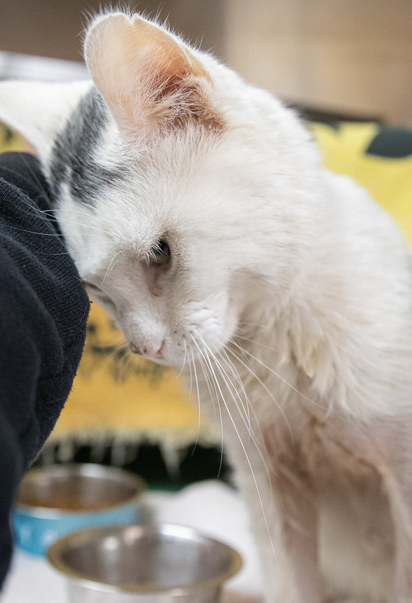
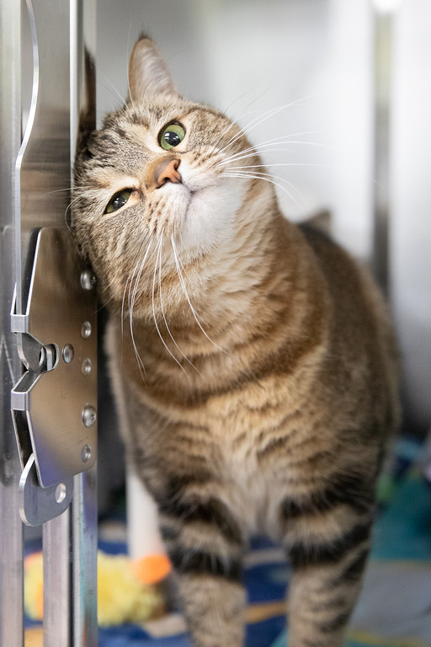
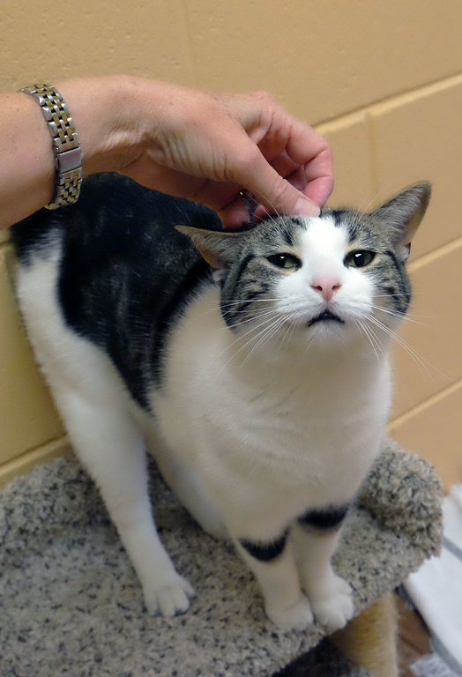
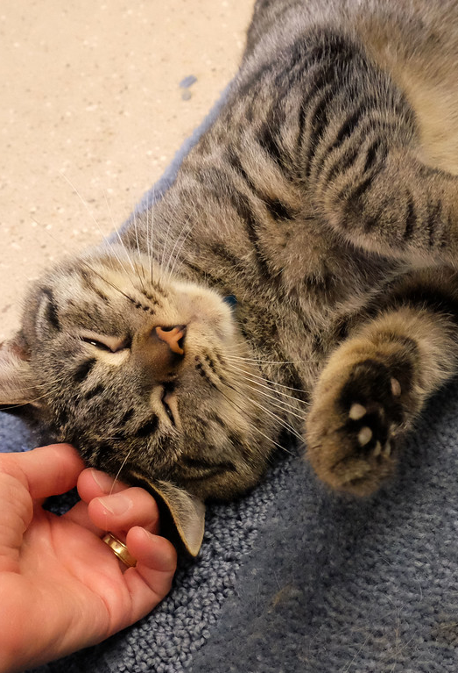
Safe Zones

Slide 18
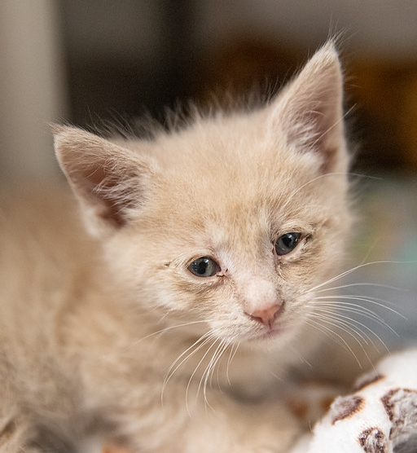
When Cats Have URI or Appear Depressed
Decrease in energy and interest in interaction
Diminished appetite
Increase in negative interactions
  Medical handling
    Meds
    Force feeding
Decrease in positive interactions
  Customer visits decrease
  Comforter visits sometimes decrease

Slide 19
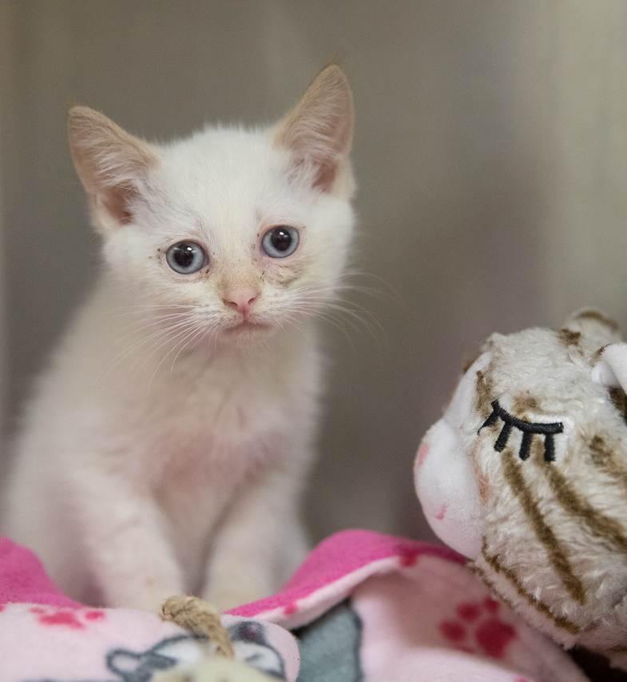
Increase Interest and Connection Through Giving them Space
Treats can go a long way
Talk only
Allow them to control the interaction
  Only pet when they initiate contact
  Don’t move into their space unless asked to do so
They need to control their space
They will recover, we need to be patient

Slide 20
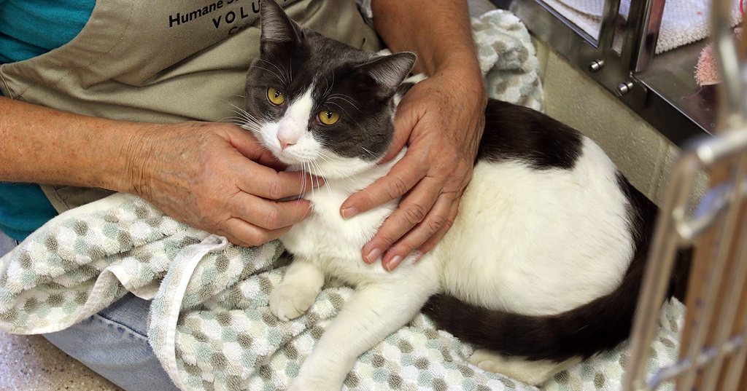
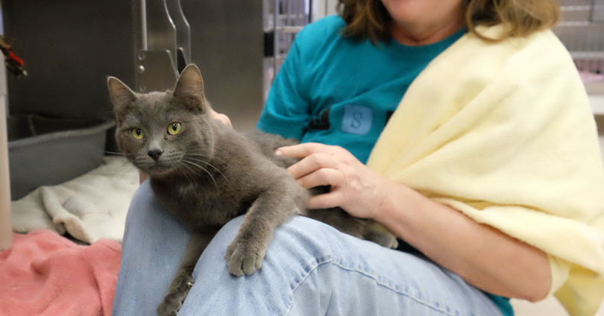
Other Things to Watch For
Door dashers and cats climbing on shoulders
  Redirect
  Offer play instead of pets
Lap cats
  Reactivity
  Overstimulation
New cats/ no notes
  Let them lead the way
  Self pet
  Very non invasive visits
  Note interest in interaction
Reactive cats
  Limit view of other cats
Medically fragile cats
  “I’m broken”
  Amputees, enucleations, flea dermatitis

Slide 21
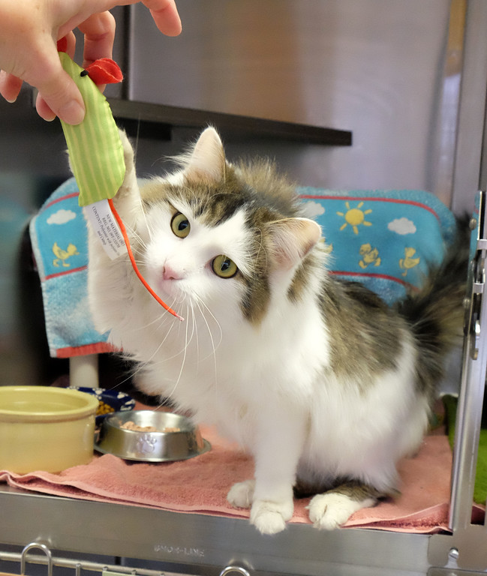
Final Thoughts
Do some research before a visit
  Check notes
  The “getting to know you” visit
Limited handling is always safe
  Talk or play only visits
Always end on a good note
Managing behaviors to get them into homes… cage behavior is not true behavior

Slide 22
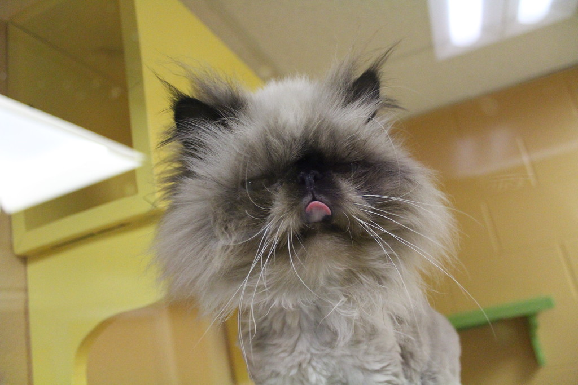
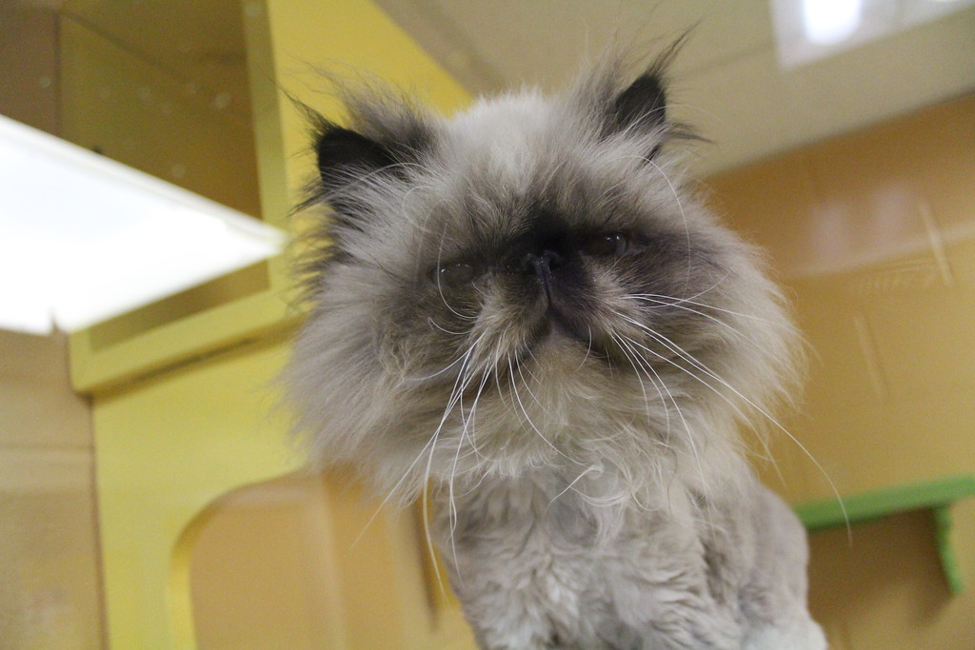
Thank You!!!
Questions?

