Slide 1
Working with shy cats in the shelter
Fear Free Handling of Fearful Cats

Slide 2
Shy, fearful, scared…
These things describe their emotional state. Let’s look deeper!

Slide 3
Why are You Shy?
Some causes for shy, fearful behavior in our cats.

Slide 4
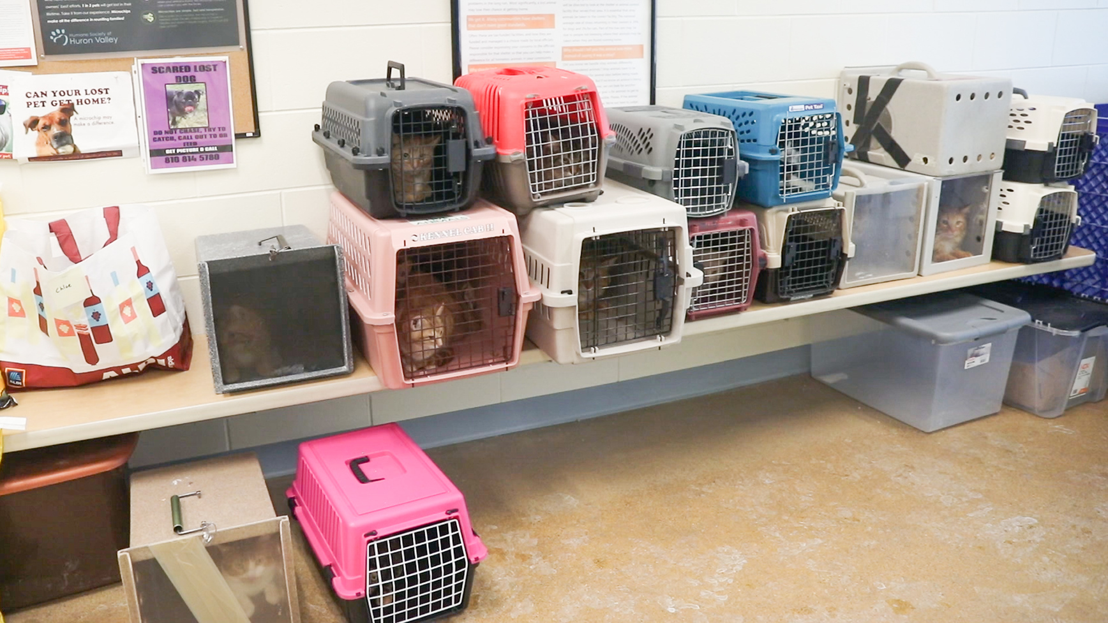
Possible Causes for Shy Behaviors in Shelter Cats
Lack of socialization from mother or littermates
  A social cat does not naturally have social offspring
Genetics
  Generationally feral or fearful
Previous experience with humans
  Veterinary handling
  Lack of handling
  Inappropriate handling
  One caregiver home
  Historical life experience

Slide 5
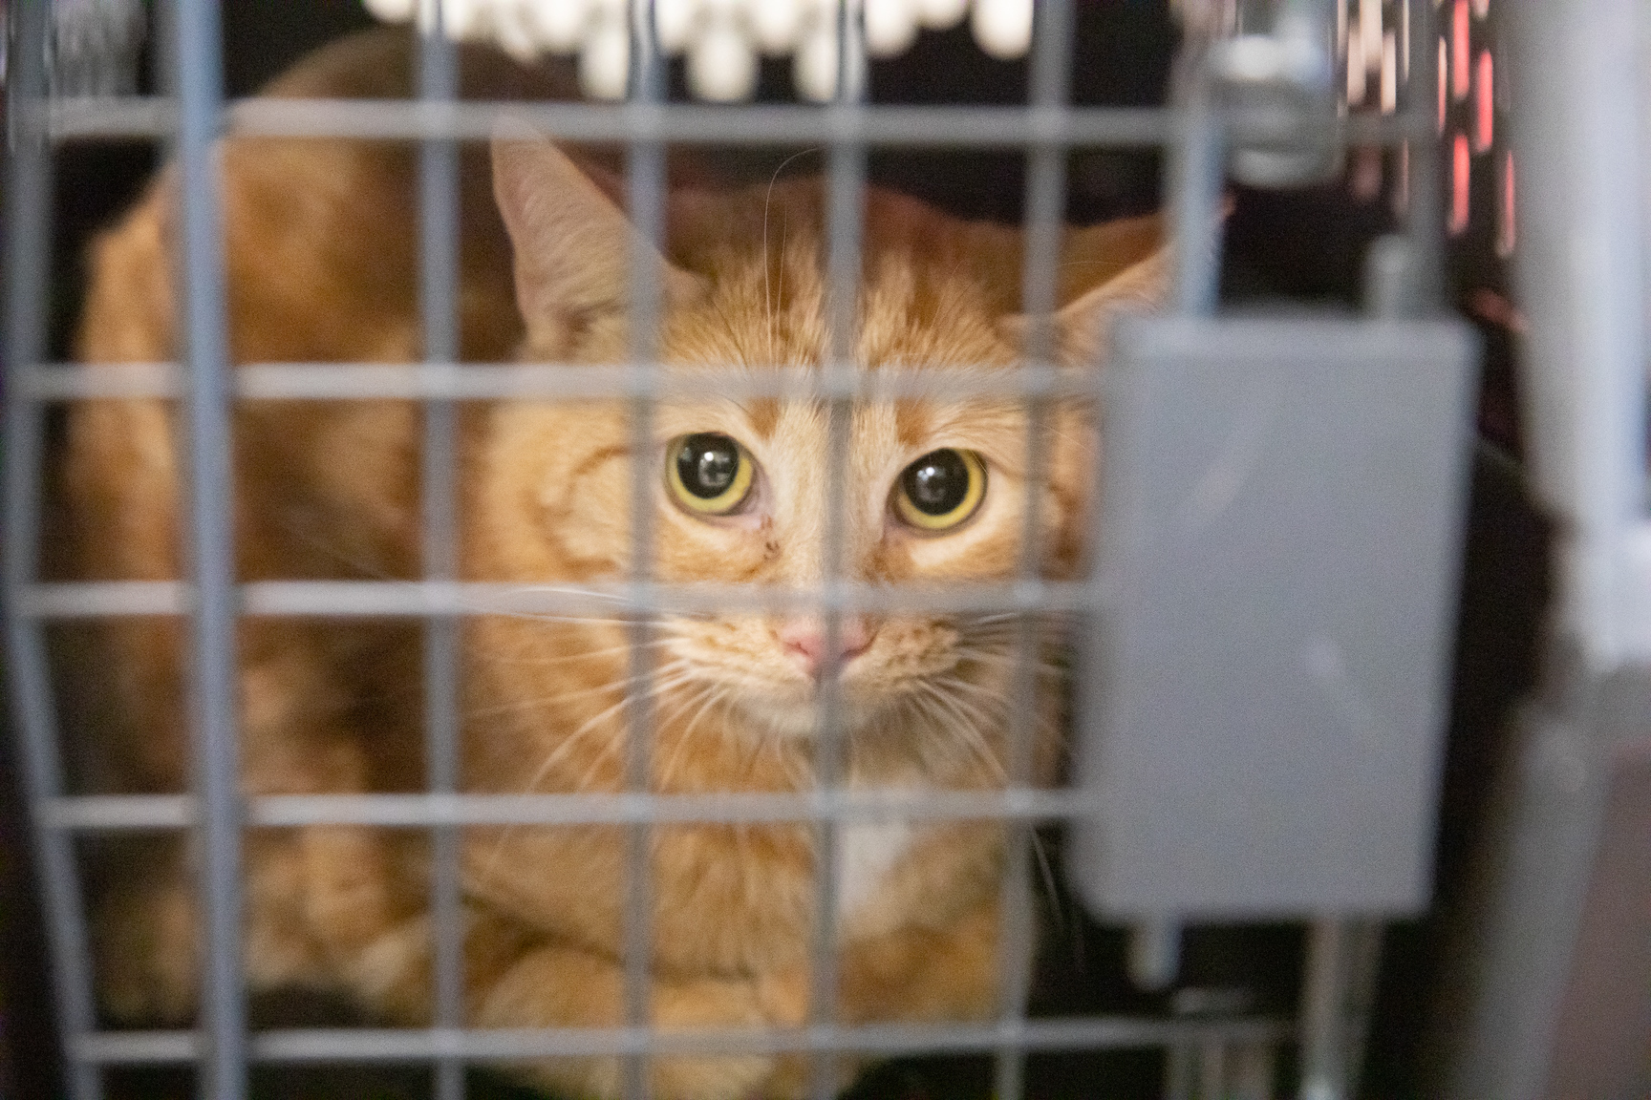
What Type of History Do We Have On These Cats?
Stray
TNR surrender
Owner surrender
Overcrowding situations

Slide 6
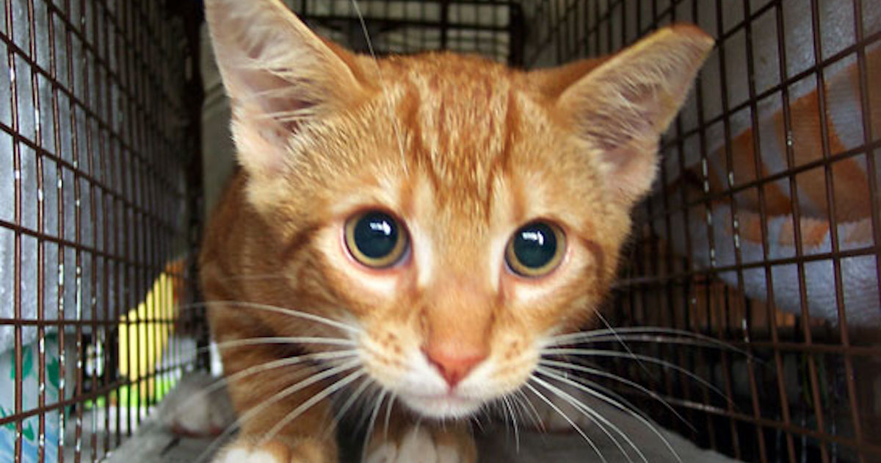
Intake Types
Stray/ TNR surrender:
Very little info
May have been feeding
May have just found the cat
Owner surrender:
May have home history
Overcrowding/ cruelty cases:
Often know very little
Pattern of neglect

Slide 7
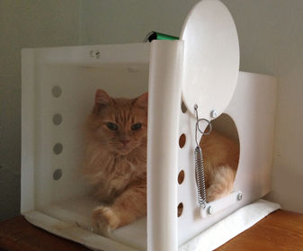
Body Language and Behaviors to Expect
What to expect when entering the cage.

Slide 8
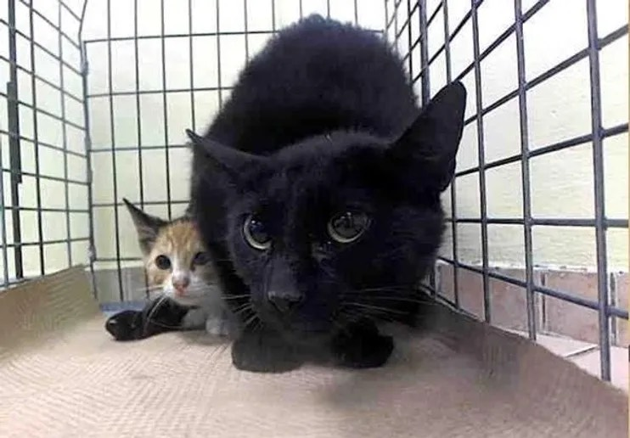
Body Language and Behaviors to Expect
Body clenched
Pupils dilated
Tail tucked around body
Ears alert or flat to head
Whiskers flat against face
Hard stare
May vocalize
  Hiss or growl

Slide 9
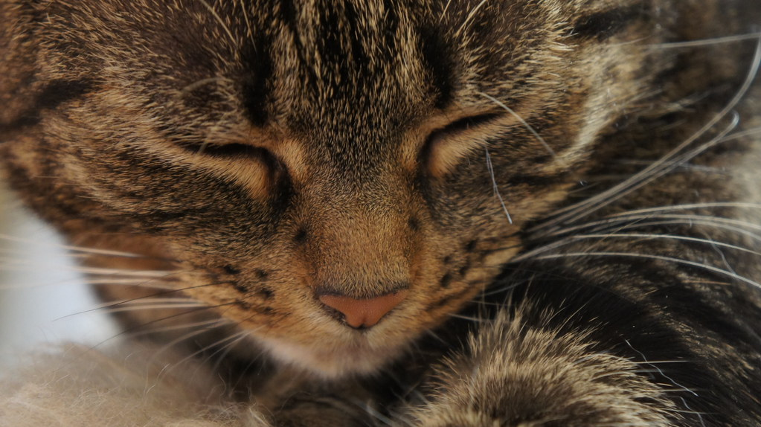
Body Language and Behaviors to Expect
Avoidant, moves away
Feigning sleep
Burrows under towels/ blankets
Avoids eye contact
Visible tension
  Deciding between fight and flight
  If pushed, will have to make a choice

Slide 10
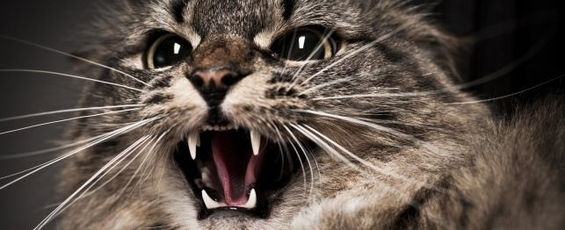
Body Language and Behaviors to Expect
May be unresponsive to your presence
Silent
May vocalize
  Hiss, growl, yowl

Slide 11
The Good News?
We’re going to approach them all the same way, with the same end goal in sight.
History and observable behaviors make no difference in treatment.

Slide 12
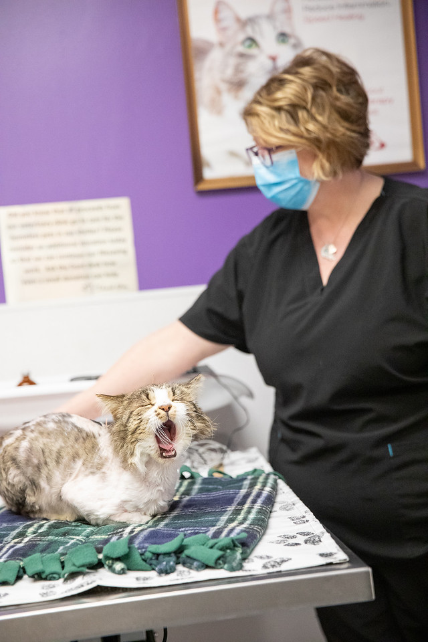
Order of Events
Medical care
Safe housing
  Communal housing
  Single housing
  Housing as pairs
Establish a routine
Quality over quantity
Daily evaluation
Foster?
Barn?

Slide 13
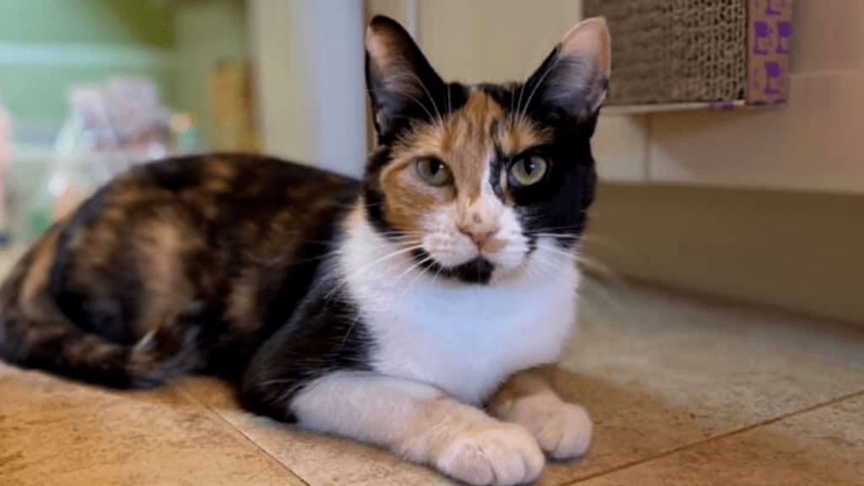
Shelter vs Foster
Exposure to multiple stimuli
Routine
  Directed/ managed interactions
Daily monitoring for adoption
Potential “helper” cats
Exposure to adopters
Save fosters for those we can’t reach

Slide 14
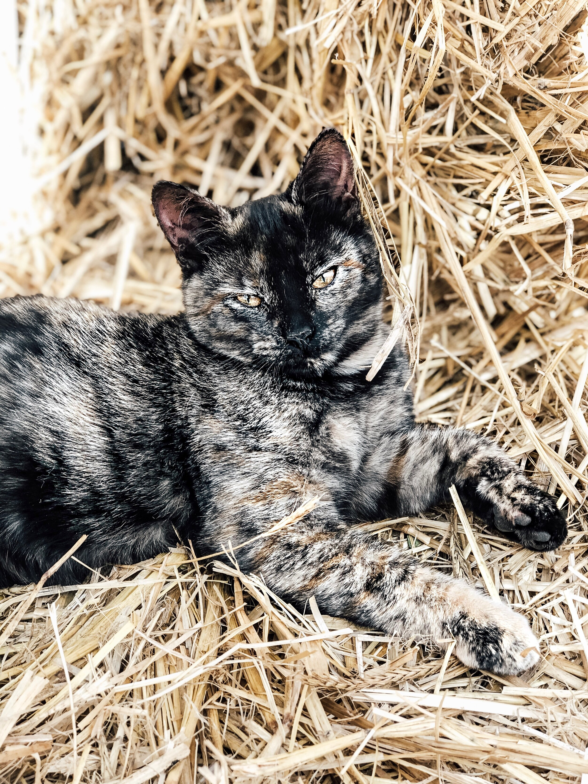
Barn Adoption
Seeing no improvement
  No response to intervention
  No set time limit
  Quality of life
  Illness
History of outdoor living
Overcrowding situations

Slide 15
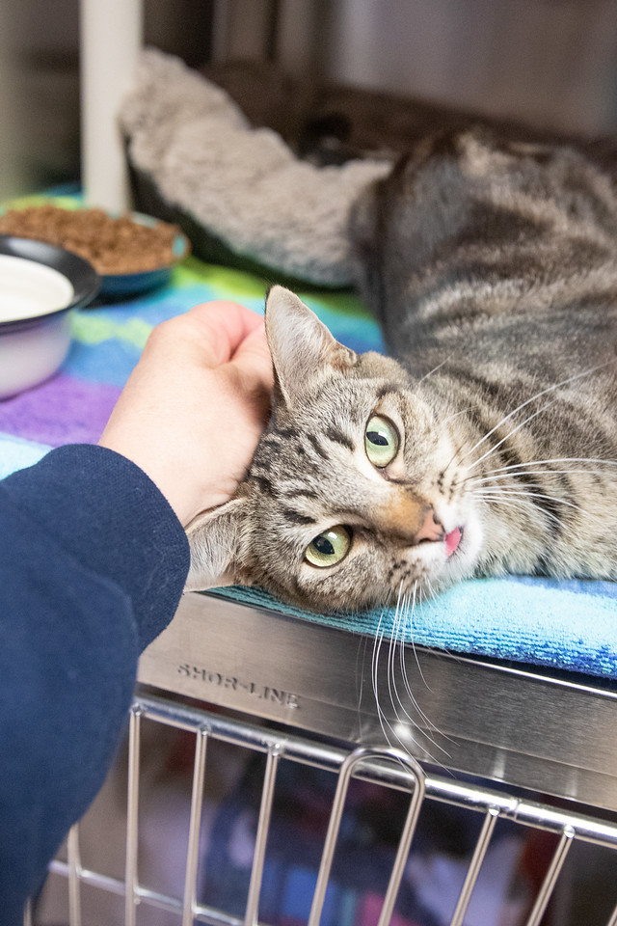
Human Body Language
Be calm/ still
Quiet voices
Move slowly and deliberately
Be predictable
Avoid direct eye contact
Turn slightly sideways
Return any blinks or lip licks

Slide 16
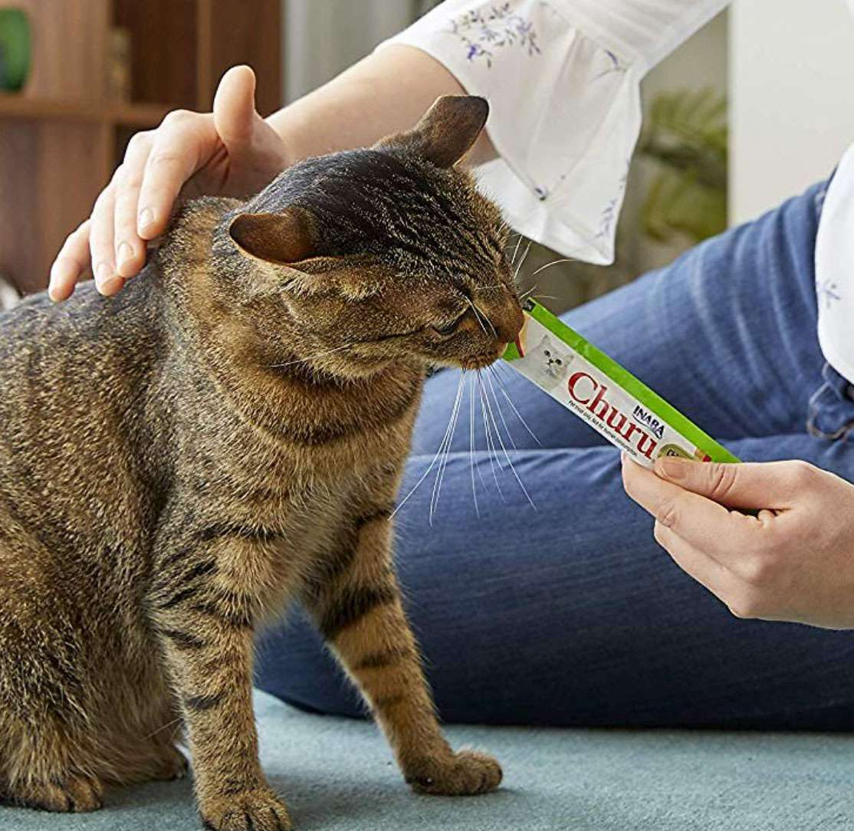
Science Based Treatment
Desensitization
  Exposure to people/ interaction at a level that keeps them under threshold and slowly increasing that interaction as they become more comfortable.
Counter conditioning
  Pairing rewards/ motivators with an emotional response to increase the likelihood of that response reoccurring.

Slide 17
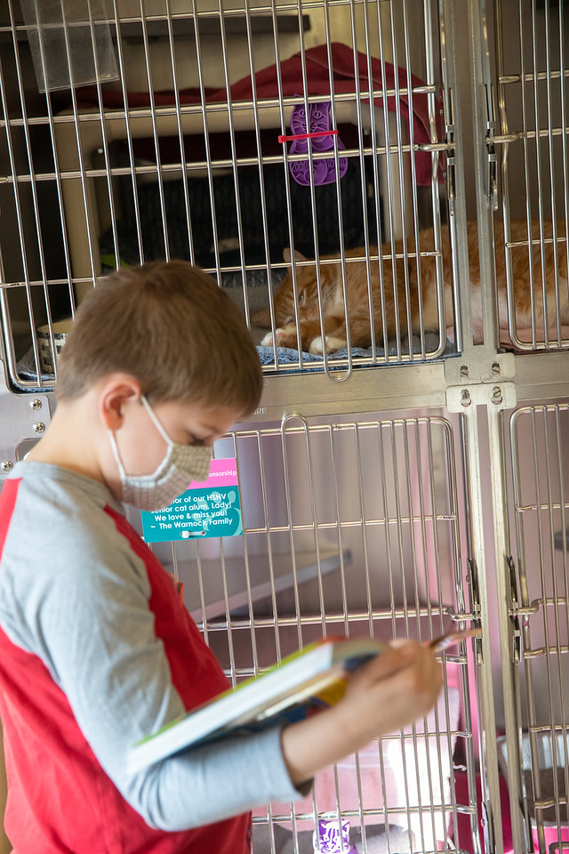
Beginning Desensitization
Toss treats into cage
Read to calm
Talk with the door open
Offer high value treats
  Let the cat decide what’s high value
  Doesn’t need to be paired with a response for desensitization
Don’t reach towards them or touch them unless requested
Leave cage if no response or increased fear response is noted

Slide 18
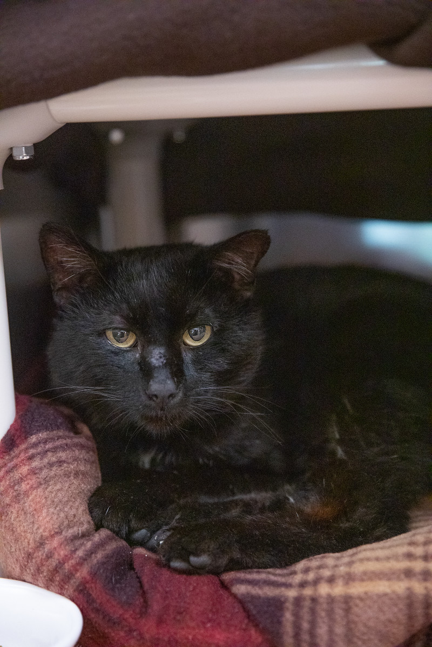
Beginning Counter Conditioning
Reward for:
  Eye contact
  Loosening of face/ body
  Forward movement
  Allowing you in their space
  Treats
    High value, they decide
  Toys
    Wand toys are best, but all are worth trying
    Watch for fear response
  Always be prepared to take a step back

Slide 19
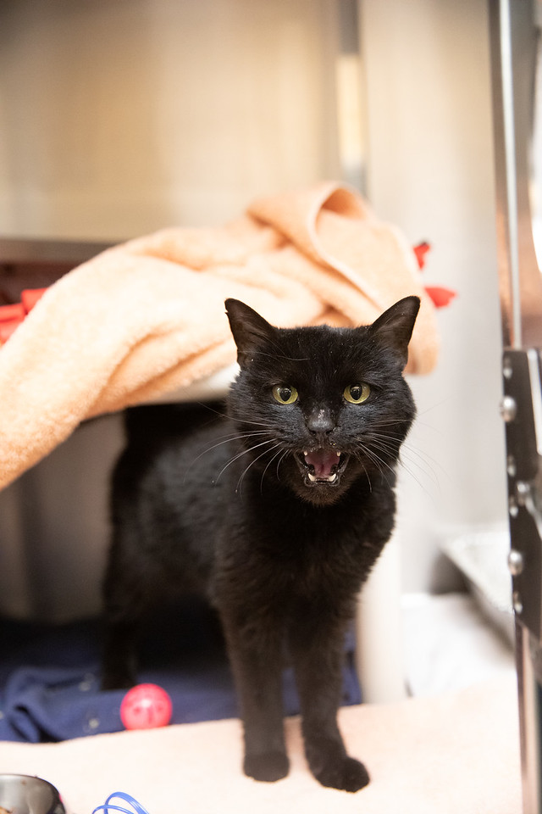
When to Take a Step Back
No response at all
  Consistent lack of response
Visible tension returns or worsens
Shifting away
New or worsening vocalization
  Hiss
  Growl

Slide 20
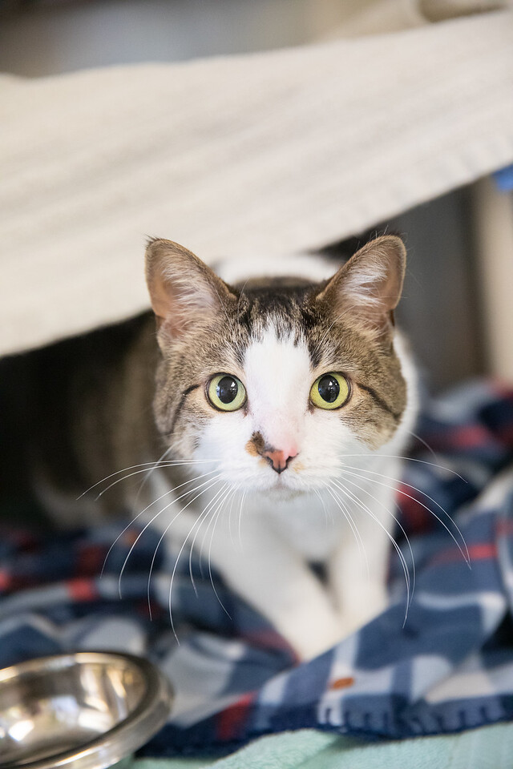
When to Move Forward
Eye contact
Softening of face or body
Responds to your voice
Curiosity
  Eats treats in your presence
  Leans forward to smell hand/ finger
  Shows interest in toys

Slide 21
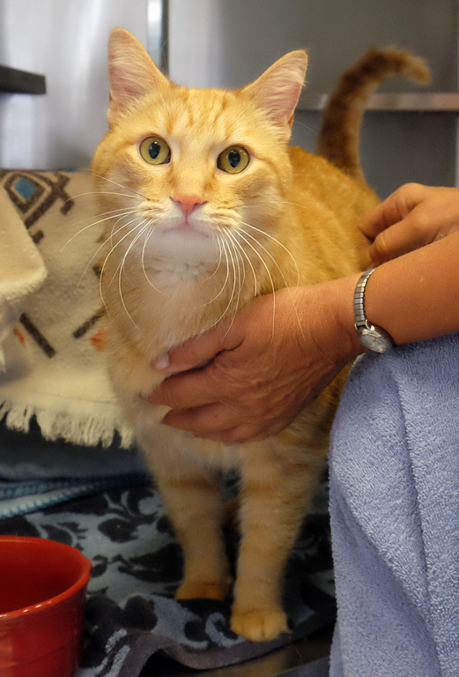
Does the cat seem ready for pets?
Move slowly
Don’t move past face/ cheeks
  Allows them to watch your movement
  Safe zones
Let them come to you, if possible
Stop as soon as body language shifts
Keep pets brief
  Longer sessions when they’re seeking interaction more confidently
Offer food/ play to end session

Slide 22
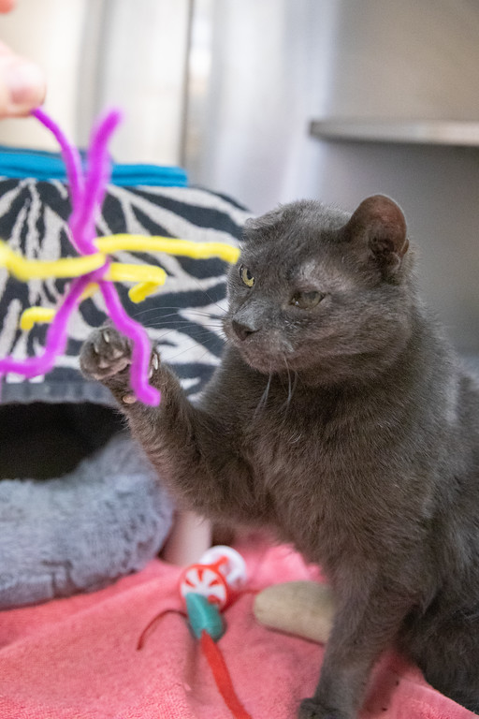
Play Therapy
For cats who aren’t scared of toys
Interact mostly with toys
Let them “win”
  Capture their prey
Be careful of moving them too far from their hiding space
Confidence building
End session by giving them the toy
Can leave treats
These should be no pet visits

Slide 23
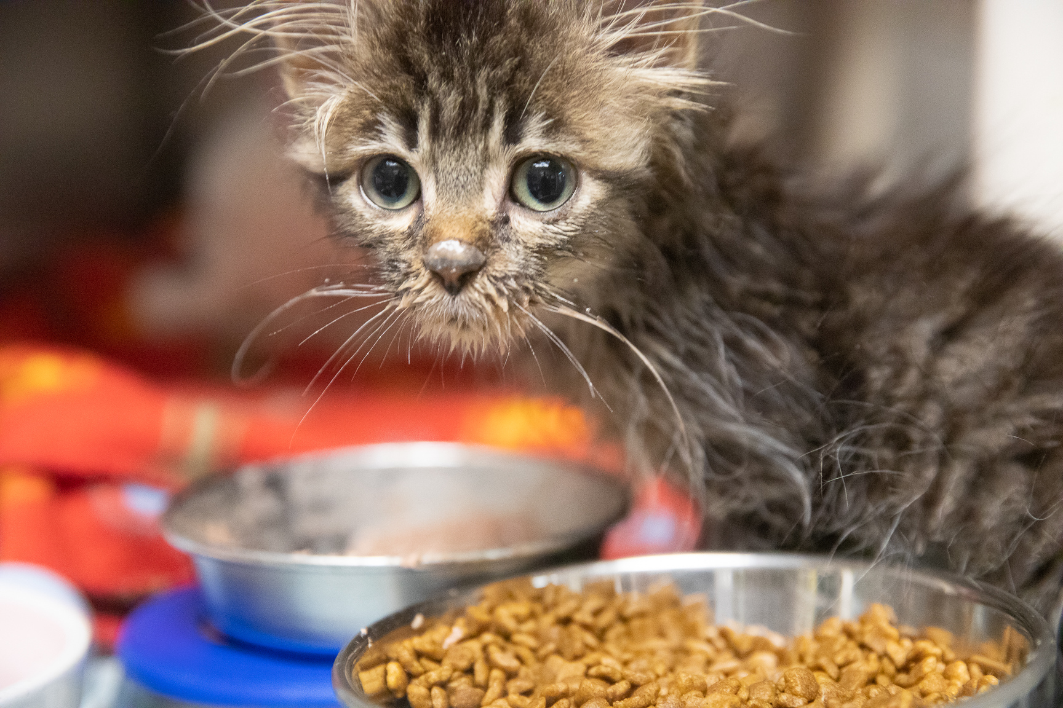
A word on kittens
Fight or flight instinct is stronger
Not as good at diffusing
Need very predictable behavior from humans
Often more food motivated
Also often more toy motivated

Slide 24
They learn to trust because they get to make the decisions!

Slide 25
Important to Remember
Give them space!
Allow them to:
Choose a comfortable distance
Decide when they want to approach or retreat
Choose how they want to interact
Investigate
Watch from a distance
Stay hidden
Choose not to interact

Slide 26
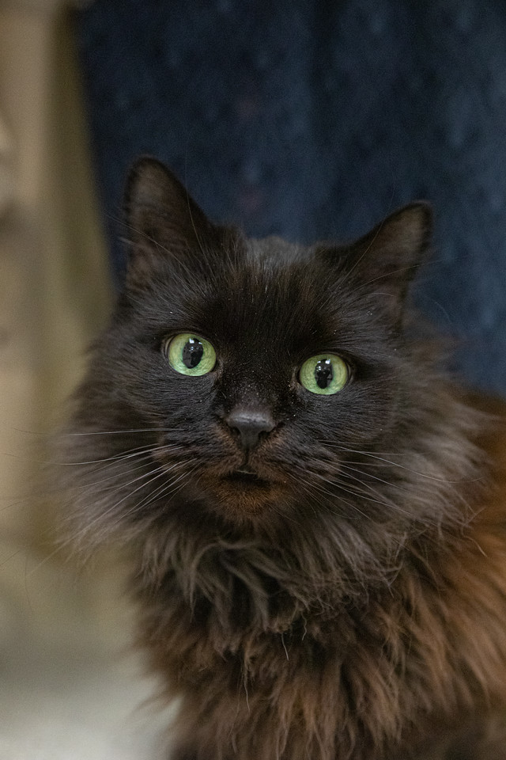
Final Thoughts
Progress takes time
Set small goals
One step at a time, sometimes one step back at a time
Rushing creates more fear
All cats are different!
If we push too hard we lose them, if we don’t push hard enough, we never really meet them. It’s a balance!!

Slide 27
Questions?

