Slide 1
Understanding and Working with Reactivity
Volunteer Information Session
April 2023
Angela Schmorrow, CSB-D, KPA-CTP, CPDT-KA
HSHV Dog Behavior Specialist

Slide 2
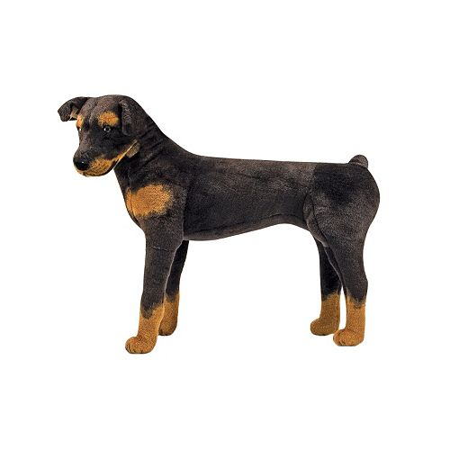
Understanding Reactivity
All living things are reactive – just means they respond to stimuli in environment.
What varies are triggers and thresholds.
Reactivity is normal dog behavior.
But, doesn’t feel good to dog or handler.

Slide 3

Unlabel Me!
Behavior is communication.
Behavior is responding to the environment to get one’s needs met.
Behavior is not “good” or “bad.”
Behavior continues because it works.
A dog is NOT his or her behavior.

Slide 4
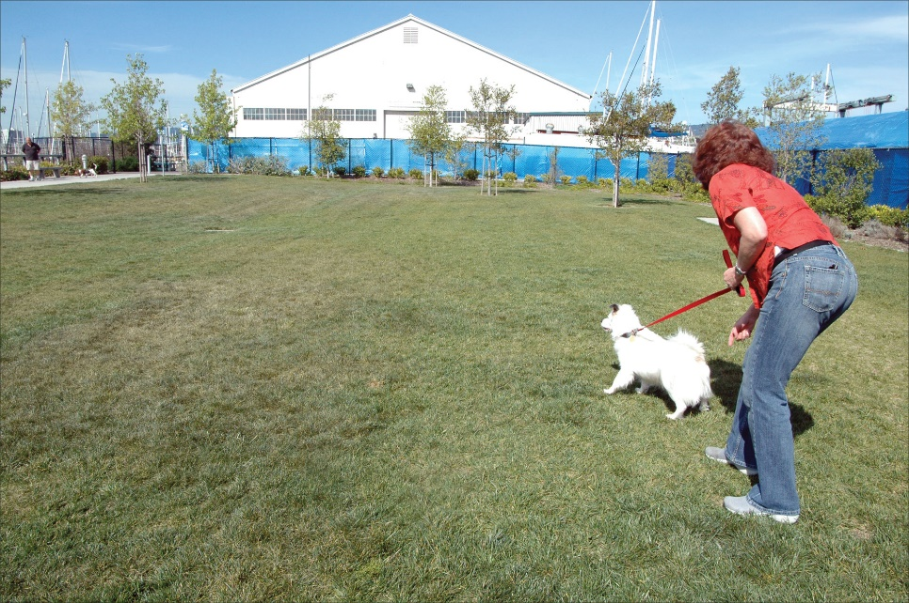
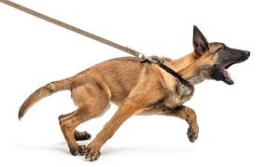
What do we mean by reactivity?”
Staring
Freezing
Mouth closing
Whining
Pulling
Head up
Body forward
Muscle tension
Barking
Lunging
Growling

Slide 5
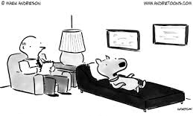
What makes dogs reactive?
Fear?
Anxiety?
Frustration?
Poor socialization?
Genetics?
Poor social skills?
Ambivalence?
Excitement?
Since we can’t ask them, we need to look at the context and the function of the behavior.

Slide 6
What is possible?
Genetics and early development play a role in temperament – it isn’t just “how they are raised.”
Temperament may “set the boundaries,” but training and environment can move the line.

Slide 7
ABC’s of Behavior
Antecedent: context, what happens right before the behavior occurs
Behavior: observable thing that happens
Consequence: what happens next in the environment
If a behavior continues or grows stronger, the consequence has reinforced it.
If a behavior decreases in frequency, the consequence has punished it.

Slide 8
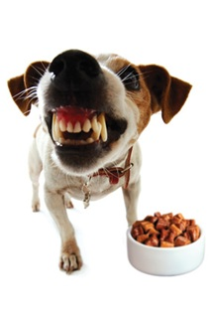
What need does reactivity meet?
Usually considered a “distance-increasing” behavior
Barking/lunging gets the “trigger” creating the discomfort to move away
Even for the “frustrated greeter,” the removal of the source of stress is reinforcing (which we know because the behavior continues to happen in similar contexts)

Slide 9
ABC’s of Reactivity
Antecedent: what triggers the reaction
Behavior: bark/lunge/growl/etc.
Consequence: trigger moves further away

Slide 10
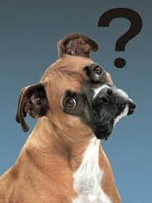
A few things to keep in mind
Not appropriate social behavior – other dogs may rightfully take offense.
Dogs that are social off-leash often behave differently on leash or behind barriers.
Dogs (and all of us) often show their worst behavior with the people/environments they feel safest.
  This does not necessarily mean they are being “protective.”
  This does not mean it is that person’s fault.
  Reactivity/aggression does pose a risk of retaliation from trigger – safest to do if the dog has “back up.”

Slide 11
Frustrated Greeters?
“He just wants to play so bad. He loves other dogs.”
Being friendly with members of your species and being socially anxious are NOT mutually exclusive.
Reactivity is not pro-social behavior.
Even social animals, when highly aroused, can make bad decisions.
Frustration can quickly lead to aggression.

Slide 12
Body language

Slide 13
The progression of aggression
Reactivity is part of a continuum of distance-increasing behavior which can escalate into aggression.
Aggressive behaviors escalate from subtle to impossible to ignore.
Addressing the dog’s needs early can halt/reverse progression.
Punishment can remove rungs causing the skipping of non physical warning signs.
Punishment cannot move a dog back down the ladder because the dog’s needs have not been met.

Slide 14
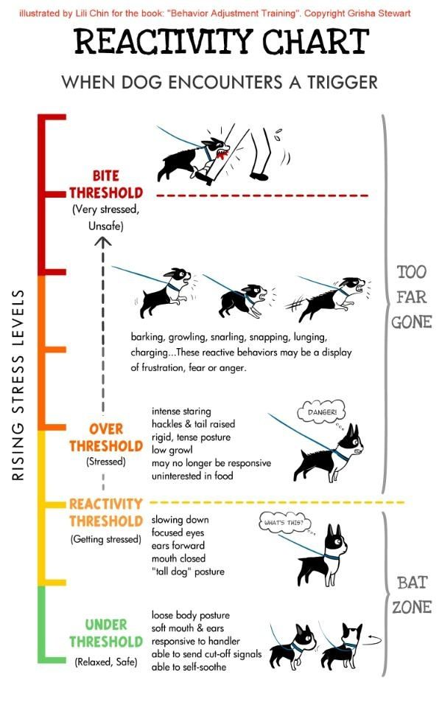

Slide 15
Modifying reactivity

Slide 16
Three keys to changing reactivity
Reduce overall stress
  Environmental management, enrichment, calming aids
Prevent rehearsal of undesired behavior
  Environmental management
Train new responses
  Training/behavior modification

Slide 17
Reducing Stress

Slide 18
Importance of a “stress vacation”
“Trigger Stacking” – stressors are cumulative and ability to cope breaks down.
Dogs need time (perhaps days) after a highly stressful event for cortisol levels to return to baseline.
Animals can’t change associations when already in a state of fear/anxiety.

Slide 19
Enrichment
Reduces cortisol levels
Creates feeling of empowerment – being able to effect change in the environment and influence consequences
Can be an alternate activity if other sources of exercise increase stress or exposure to triggers.
Sniffing especially linked to relaxation in dogs – encourage activities that use their nose (sniff walks, nose work, scatter feeding, snuffle mats, etc.)

Slide 20
Calming Aids
OTC supplements?
Thundershirts or anxiety wraps
Body work (T-touch)
Dog Appeasing Pheromone (DAP or Adaptil)
Calming Caps
Through a Dog’s Ear
Anti-anxiety meds may be appropriate.

Slide 21
Environmental management

Slide 22
Management:
Setting the environment
The more a behavior is practiced, the better the animal becomes at it and the more it will happen.
As we train new desired behaviors, we need the old ones to fall out of practice.
Want to keep dogs below the threshold of exposure where they will start to react.
Need to reduce exposure/intensity to help dog succeed
  Increase distance
  Minimize visual or audible stimulation/exposure

Slide 23
Management in the shelter
Kennel placement
Real life rooms
Visual barriers over kennel
Shelter breaks
Foster placement

Slide 24
Management On Walks
Choose routes and times of day that are less busy.
  Pick least-busy trail, side trails
  Off-site walks
  On-leash walks in upper play yard
Pick locations with good lines of sight, ability to move to the side and avoid tight passes.
Cross streets, change directions, use parked cars/bushes/snow drifts/etc. to create visual barrier, increase lateral distance.
Ideally, walk dog on harness
  Tension on neck increases arousal.
Double points of attachment/walk with another volunteer
Don’t be afraid to ask for space.
Avoid lower yard!!
  Leave leash attached
  Leave yard if fence running begins

Slide 25
What about play groups and group hikes?
Maybe/maybe not
Not going to “cure” or fix reactivity
Not appropriate if sets up condition for extended rehearsal of reactivity or other inappropriate social behavior
Not appropriate if results in continued elevated level of stress hormones
Dogs that are dog-social may enjoy them, but those that are anxious around dogs will benefit more from other enrichment activities.
Unfair to the neutral dogs and can cause their behavior to decline.

Slide 26
Modifying Behavior

Slide 27
What do dogs need?
Safety, predictability, and choice.
New options.
Gradual desensitization and counter-conditioning: Change negative associations to positive ones.

Slide 28
Training New Options
Dog should be “under threshold” during training – can increase challenges as dog is successful
“Look At That”: Engage then disengage; take in information about the environment calmly and move on. https://y outu.be/MmYjZKYbGf8
  With neutral stimulus: https://youtu.be/chc4tZ14Mmg
  With another dog: https://youtu.be/CZgAuKTUVp0
“Find It”: Triggers appearing cause a fun tracking game to start. https://youtu.be/dyh_3XYp1lw
Hand Target: move dog away from trigger, get focus on you. https://youtu.be/B_ZRWjOCB5k
Turn and Go: Make a quick U-turn when a trigger is too close for comfort. https://youtu.be/XDc6j6Z_9-E

Slide 29
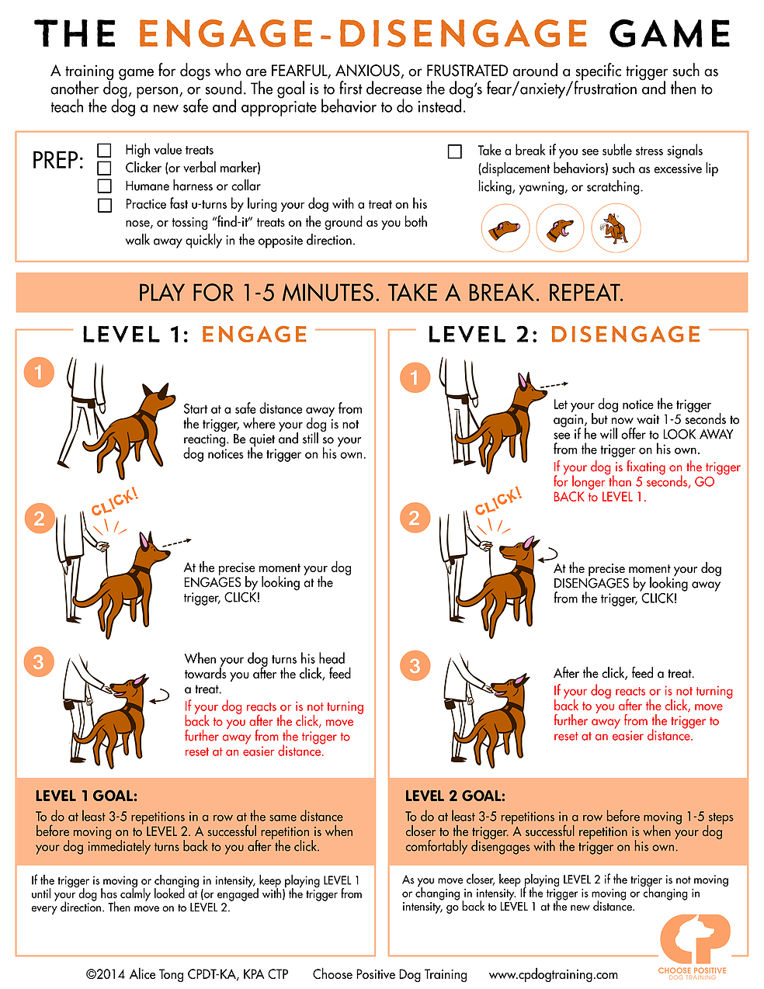

Slide 30
Changing Associations
Exposing dog to a “trigger” at a low enough intensity that the dog perceives, but does not react.
Good things happen every time they are exposed to the trigger.
Gradually increase intensity as the dog is ready.
You are not going to reinforce reactivity if dog does start barking.
  The function of the reactivity is to get distance, not food, so food is not going to reinforce it.
  If anything, you are reinforcing a lesser response and shaping reduced reactivity.
  By changing the emotional response to a positive one, the behavior will change also.
  That said, attempt to keep dog under threshold at all times and change environment if dog is not successful.

Slide 31
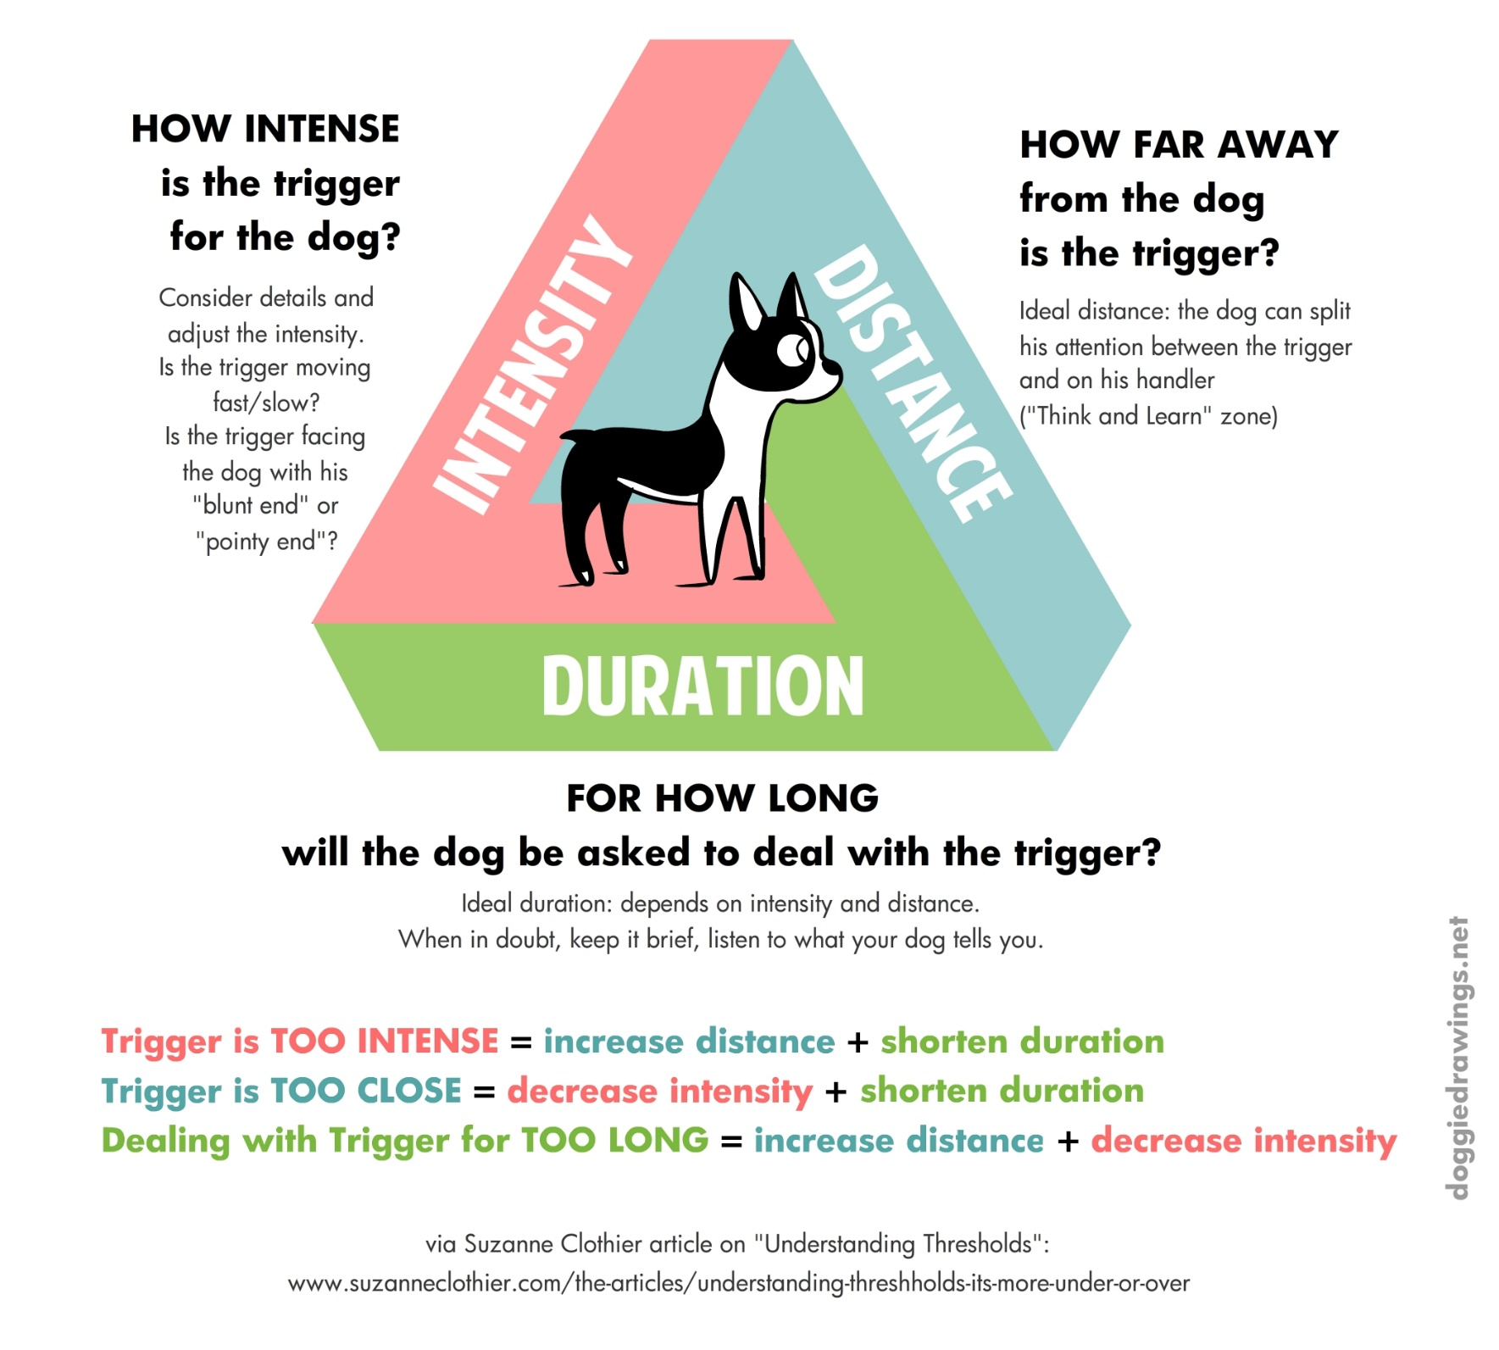

Slide 32
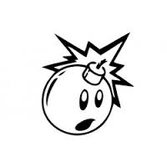
Avoid Aversives
Punishing a dog for reacting may suppress a particular behavior.
But, dog’s needs have not been met – they still feel the negative emotion, which now is probably even worse.
Communication method has been taken away, leaving only option to go further “up the ladder.”
Like talking the batteries out of the smoke detector.
Relies on dog practicing the unwanted behavior in the first place – be proactive instead.

Slide 33
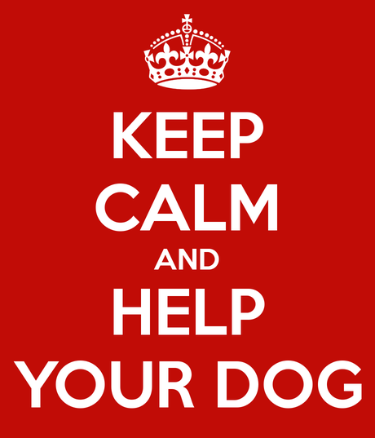
So what do I do when the dog reacts?
Stay calm.
Offer good things – you will not be reinforcing bad behavior, you will be creating a better association with the trigger.
Help dog get out of situation.
Recognize training moments vs management moments.
What can be learned from the event?

Slide 34
Key Points:
Use management to help the dog be successful.
Reduce stress by providing opportunities for choice, natural behaviors, and enrichment.
Work where the dog is at and be patient.
Use positive reinforcement training and desensitization/counter conditioning to improve responses to triggers.
Avoid methods that rely on force, coercion, pain, or discomfort.
Be respectful of the neutral dogs.

Slide 35
Training Resources
Books:
  Fired Up, Frantic, and Freaked Out by Laura VanArendonk Baugh
  Feisty Fido by Patricia McConnell
  Behavior Adjustment Training 2.0 by Grisha Stewart
https://dogsinneedofspace.com/
Thanks for attending – Chairs can be left out! ☺

