Slide 1
Kittens 101
Socialization, training and understanding kittens and their needs

Slide 2
Quick lesson in feline developmental stages
Adapted from “Feline Development, Social Behavior, and Communication” by Debbie Martin, BS, RVT, VTS
Fetal Period | In utero | Maternal nutrition and stress levels can affect the physiological development of the fetus in utero.
Natal Period | Birth to two weeks | Dependent on mother for all aspects of life including feeding, thermoregulation and elimination.
Transitional Period | End of Neonatal to early socialization | Ears and eyes open, kitten is mobile, teeth erupt and kitten can eventually eat solid food. Dependence on mother is intact, but by the end of the transitional period, not as important for survival.
Socialization Period | 2-7 weeks, although can be up to 12 weeks. | Critical period of development for exposure to novel stimuli. Positive experience and environmental enrichment can have an impact on behavioral development. Learn bite and claw inhibition from siblings.
Juvenile Period | 2 months to puberty (4-10 months) | Lasts until sexual maturity around 4-10 months. Continued exploration and testing boundaries. Can test relationships with other cats during this time, seeking place in the relationship.
Adolescent Period | Puberty to social maturity (3-4 years) | Comparable to human teenage years. Can become more confident and demanding; testing to see what’s safe, what works and what they can achieve.. Often leads to bad decision making!

Slide 3
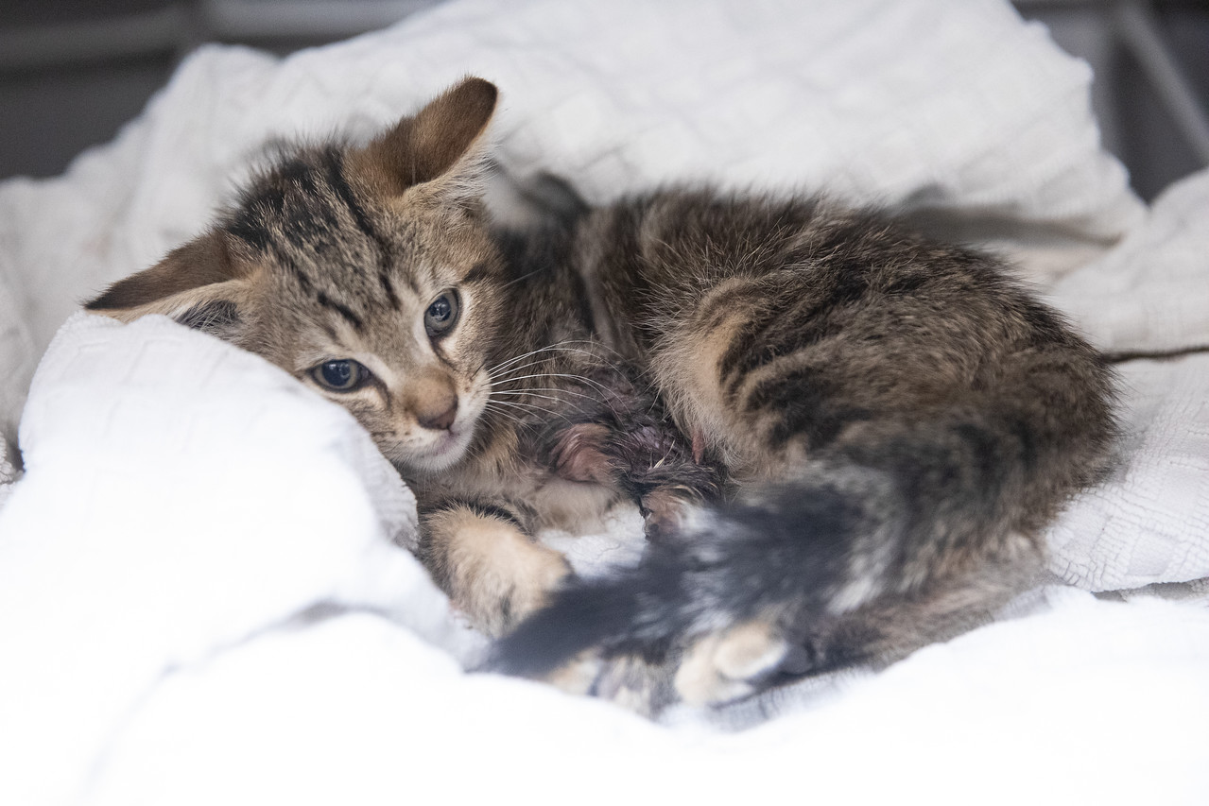
Sociability is a bit of a spectrum
Feral
    No human contact
    How many generations before were feral?
  Unsocialized
    Have lived with people but…
  Poorly socialized
    Learned poor habits
    Limited environment
  Well socialized
    Age appropriate interactions
    Neutral or eager response to stimuli

Slide 4
What is “socialization”?
For our purposes, socialization is the process by which a kitten develops relationships with other living things and stimuli in its environment.

Slide 5
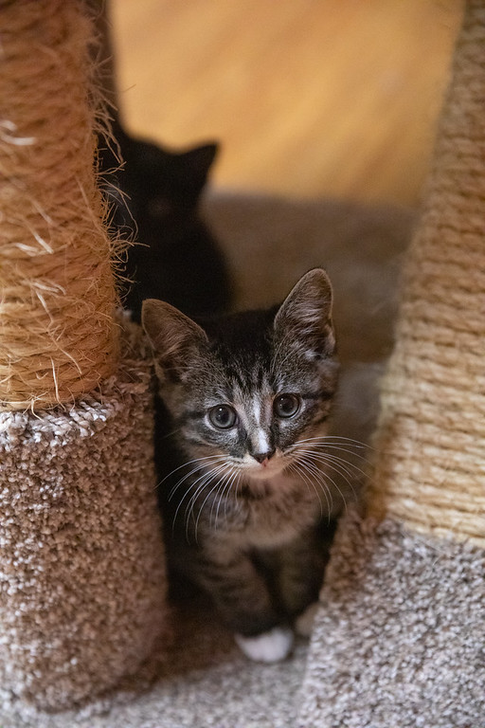
The impact of a poorly socialized kitten
Lack of socialization leads to cats who also lack confidence:
  Fear of people
  Fear of the veterinarian
  Fear of handling
  Lack of resiliency overall
    Change becomes difficult
    Behavior issues related to lack of confidence
      Aggression, litterbox issues, barbering, fear based responses

Slide 6
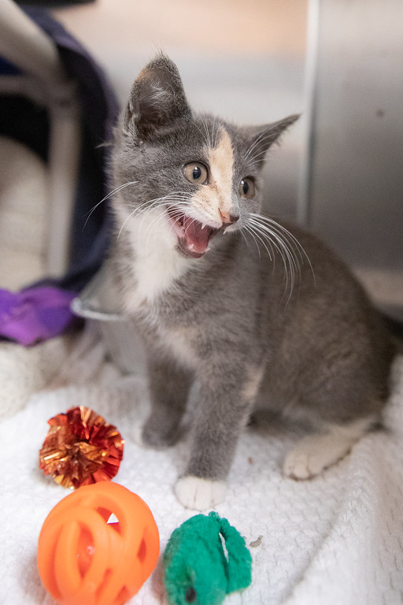
Lack of socialization isn’t just about fear!!
Inappropriate play
Low handling threshold
Excited attention seeking
Lack of bite inhibition
Inability to interact with other species appropriately
Difficult for the average owner or adopter
  Leads to an adolescent cat who’s lived without stability
    Exacerbates all of these issues

Slide 7
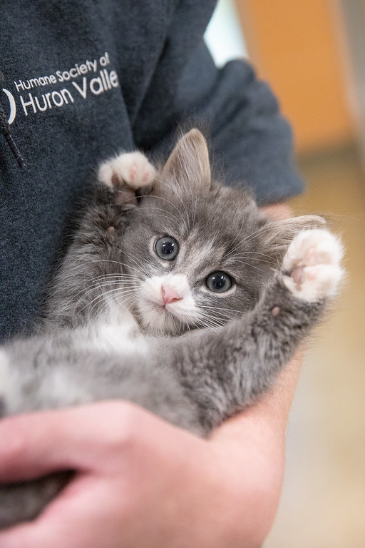
Single kittens
Lack socialization with mom and littermates
  Bite inhibition
  Play style with other cats and people
  Energy levels
Often medical handling involved
Need human intervention to learn appropriate skills

Slide 8
Bridging the gap
How we can help kittens who haven’t had a great start, and support the ones who are already on a good path!

Slide 9
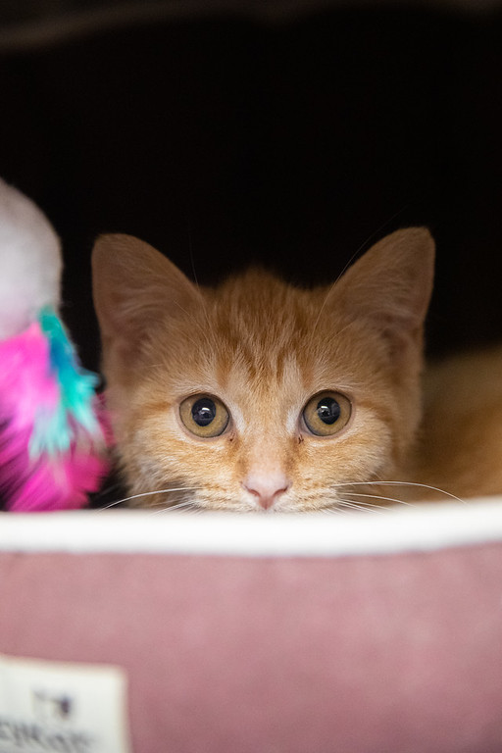
Fearful kittens
Genetic: inherited from mom
Poor socialization
  No exposure to humans
  Limited exposure to humans
  Lack of exposure to a variety of stimulus
Negative experiences
  Trauma
    People, places, things
  Lack of consistency/ routine
  Loss of caregiver
  Change in household
  Cats are sensitive

Slide 10
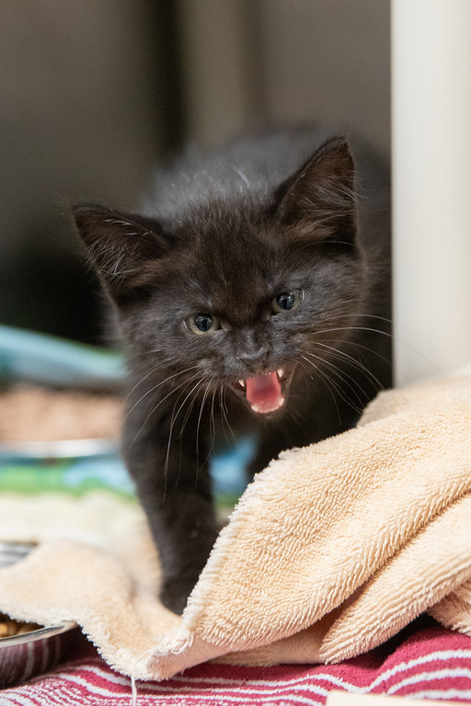
Fearful kitten body language and behavior
  Hissing
  Spitting
  Swatting
  Frozen, staring
  Quick to flight
    Strong fight or flight responses
  Hiding
    Burrowed, buried, invisible!

Slide 11
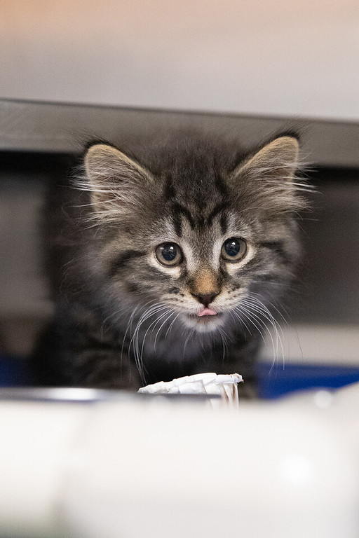
Treatment and behavior modification
Work slowly
  Food is key
    Be their source of food if possible
  Treats aren’t the best choice
    Wet food, churo
      Tend to be more appealing
      Less experience with treats = less enticing

Slide 12
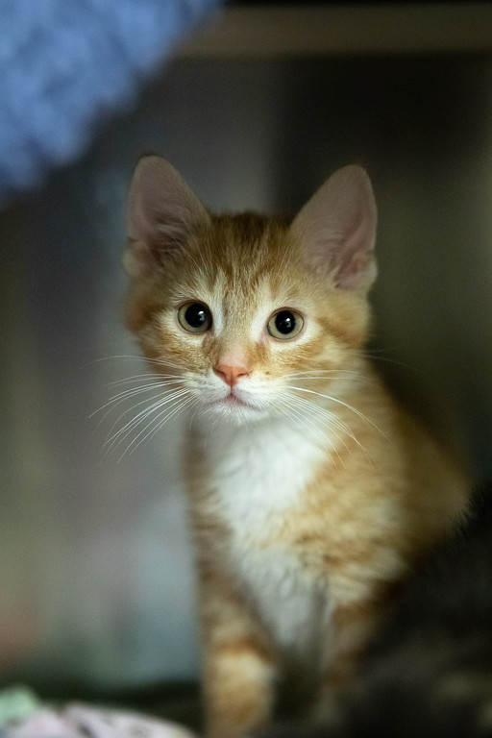
Desensitization without fear
We’re not handling until they’re ready
  Teach them to trust, not fear, people
Tempt close with food
  They may not approach
  Do not touch
    Watch for avoidant or defensive behavior
If they do approach, move slowly
  Touch “safe zones”
  Stop if behavior or body language changes
  Continue to offer food motivator
Build on this as things progress
  Body handling and picking them up

Slide 13
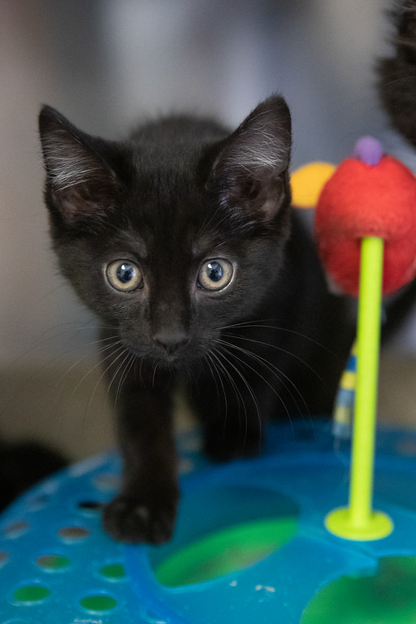
Using toys
Watch for fear response
Step back to food motivator as needed
Wand toys work best
  Offer distance
  Mimic natural prey a bit better
Can combine with food
  End play session with food motivator
Avoid touch, especially if playing hard!

Slide 14
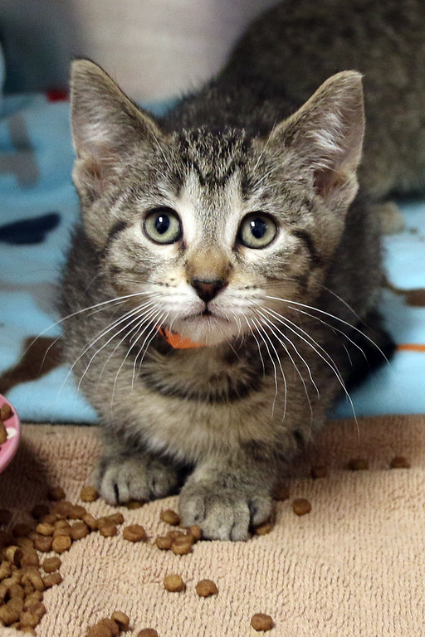
Fearful kittens in the shelter
Adult cages
  Confined space
  Move to flight quickly
In open rooms
  Generally, more fearful
  Effective at hiding
  Avoidant
    Often less defensive
  Kitten adoption
    Watch body language!

Slide 15
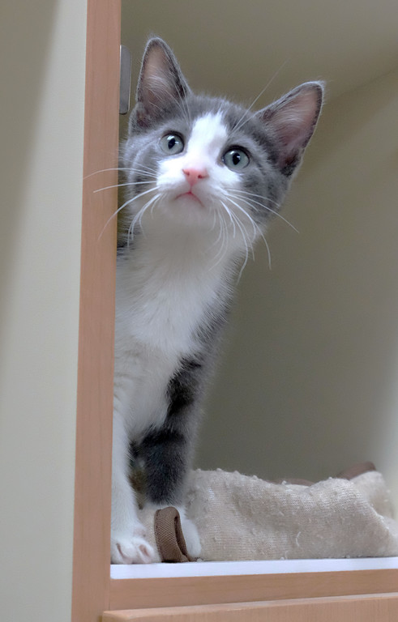
In foster or at home
Safe space
  Bathroom/ bedroom
  Crate (not in busy space of home)
  Make sure they have plenty of resources!
Handling for weight checks
  Food motivator
  Towel wrap
Mindful handling and interactions are the same!

Slide 16
The “rambunctious” kitten
Caused by any of the things previously mentioned
  Lack of appropriate interactions with people or other animals
  Single kittens with medical handling
  Bottle babies
    Single bottle babies!!
Permissive behavior by owner
  Rough housing with kitten
  Small kids
  Ignoring behavior
Kittens who’ve been in the shelter for a long time

Slide 17
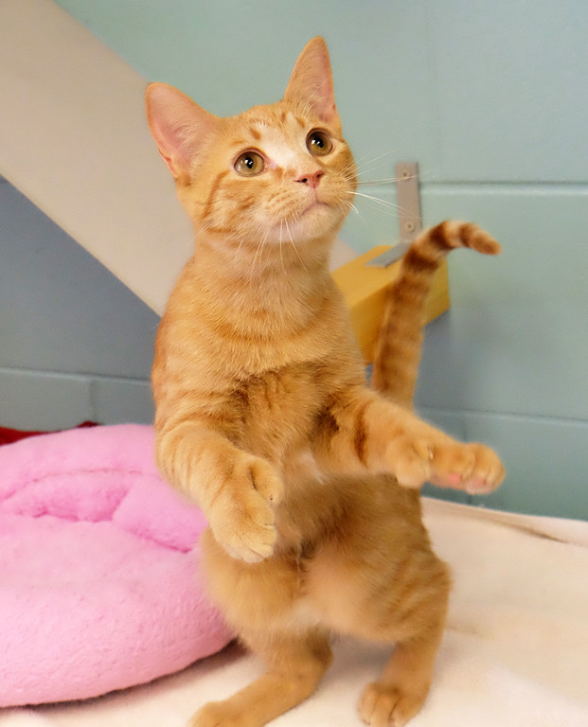
Body language and behavior
Frantic attention seeking
Use teeth and claws
Energy continues when play stops
Unable to calm for handling
  Immediately move to play
Inappropriate with littermates or novel kittens
  Don’t respond to signals
Often seen in singles

Slide 18
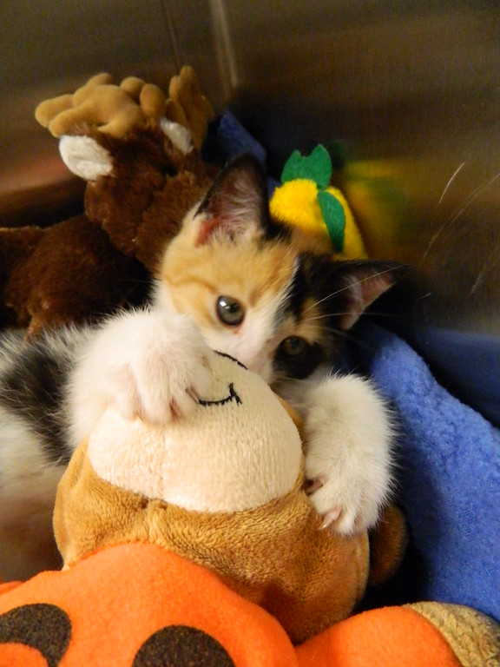
Play, play and more play
Use play to train appropriate behaviors
  Wand toy play mimics prey behavior
    More satisfying!
  Redirection at all times
  High energy
Set up enrichment and mind games
  Hide and seek
  Puzzle boxes
  Clicker training
No handling/ pets unless absolutely calm
  Reward with pets and food motivators
  Move to play immediately if behavior shifts

Slide 19
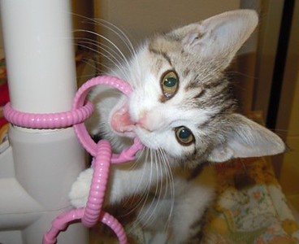
Toys for high arousal kittens
Kick toys
Wand toys
Ball and track
Laser pointer toys
  Use caution!
Battery operated toys
  Learn independent play
    This is high priority
Good scratching and climbing options
Anything they reliably engage with

Slide 20
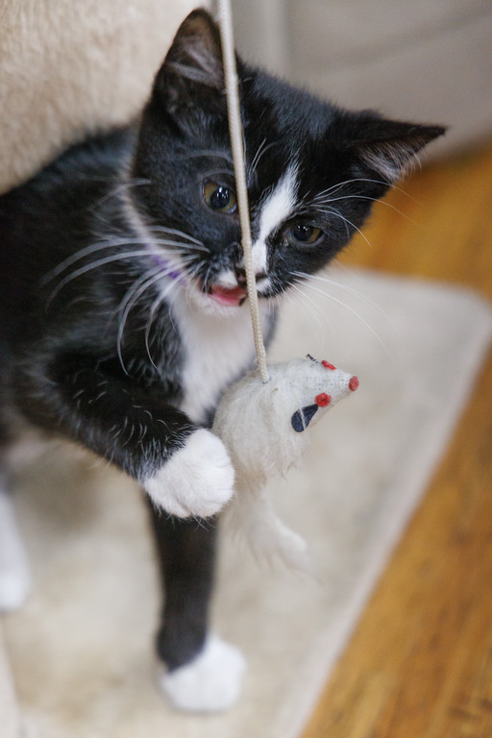
In cages or condos at the shelter
Offer wand toy play first
Do not let them use hands/ arms for play
  Redirect
    Toss toy away from your body
    Wand toy
If behavior persists, end interaction with food motivator
No pets for these kittens!

Slide 21
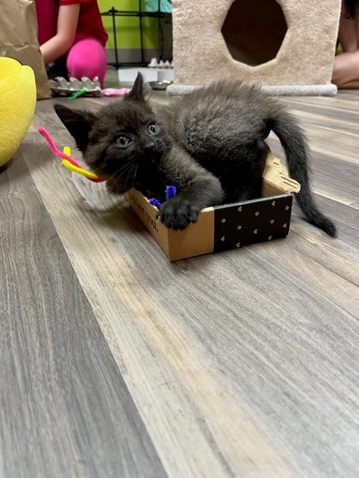
In foster or at home
Leg chasing
  Toss toys
  Use food as distraction
More redirection
  Get them moving!
Set up play opportunities
Play, eat, sleep
Don’t force handling
  They’ll get there! (in time… remember, they’re toddlers!)

Slide 22
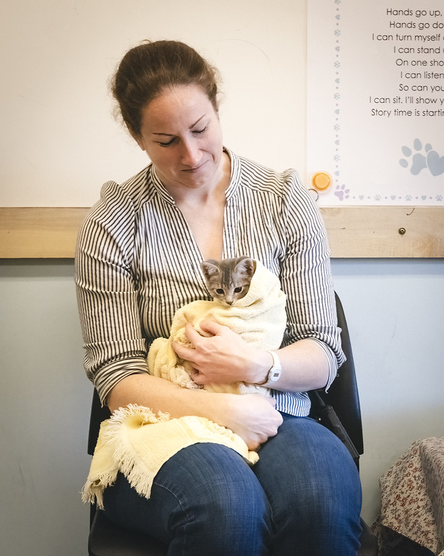
Behavioral needs for all kittens
Cooperative care
  Nail trims
  Medical handling/ medication
  Carrier training
Litterbox basics
Socialization with other animals
Socialization with novel people
Introduction of stimuli
  Noise, movement, typical household activity
Free roam of the home
  Comes with time
Mindful interactions and appropriate play

Slide 23
Thank you!!
My email: jessv@hshv.org

