Slide 1
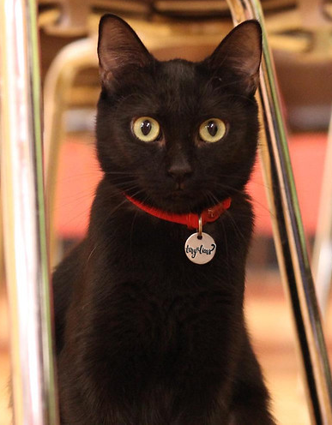
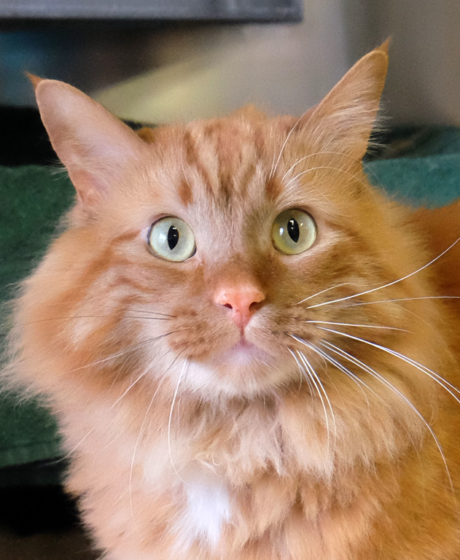
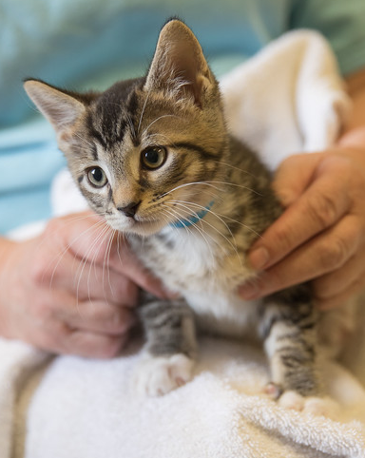
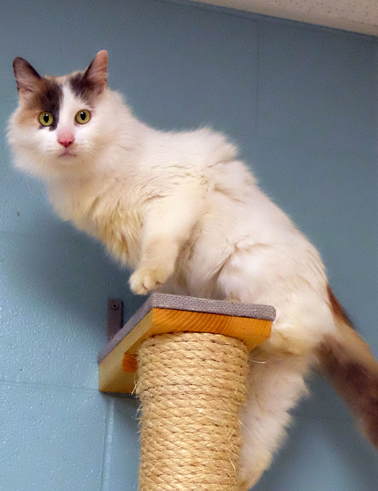
Junior Volunteer
Cat Comforting Training
Day 1

Slide 2
Schedule
Introductions
Cat body language
Cat visit time
How to visit the cats
Questions

Slide 3

Cat Body Language
Eyes
Ears
Tail
Body Position

Slide 4
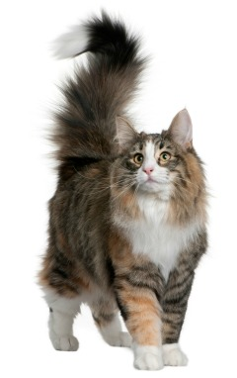
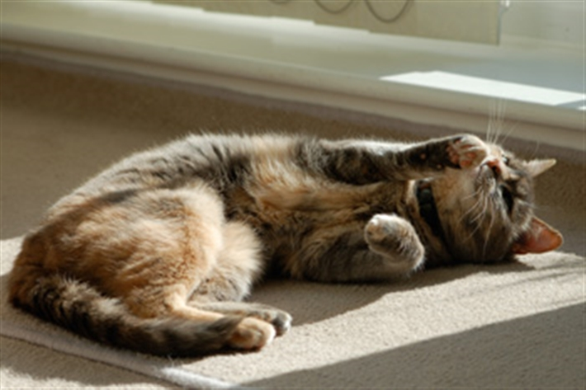
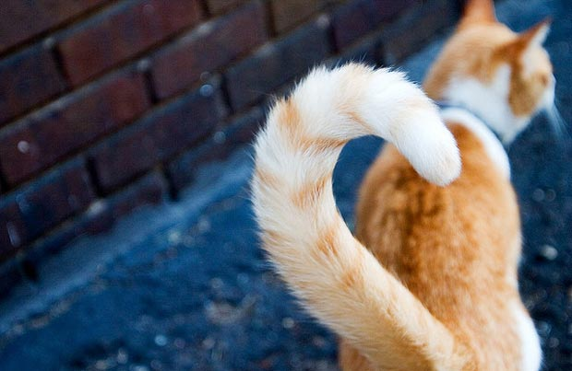
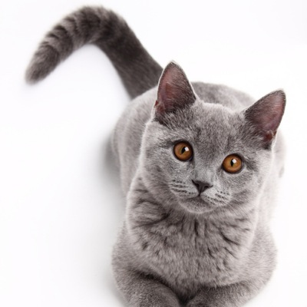
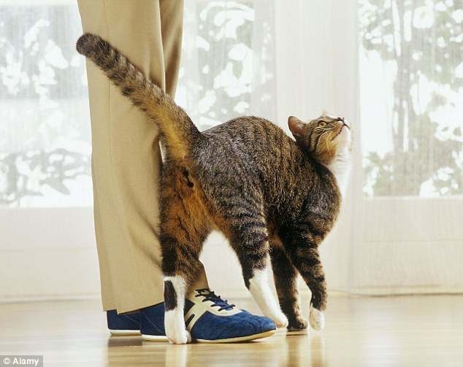
Happy/Relaxed Cat Behavior

Slide 5
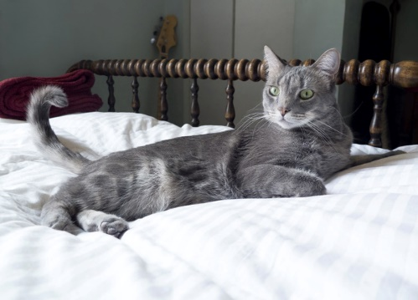
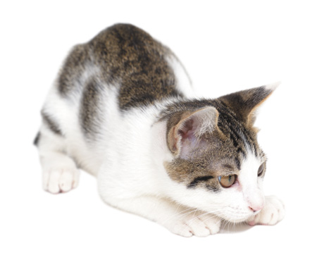
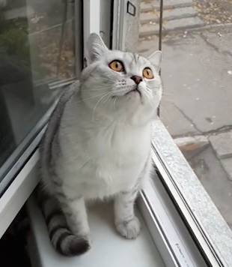
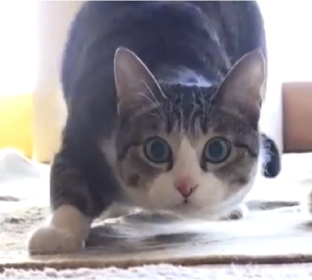
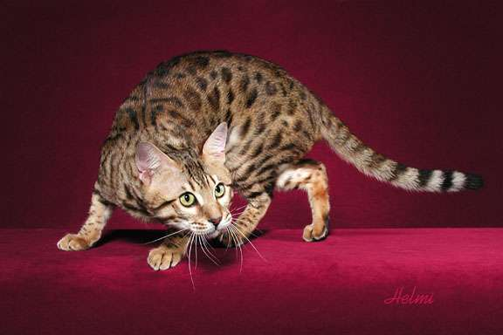
Focused Cat Behavior

Slide 6
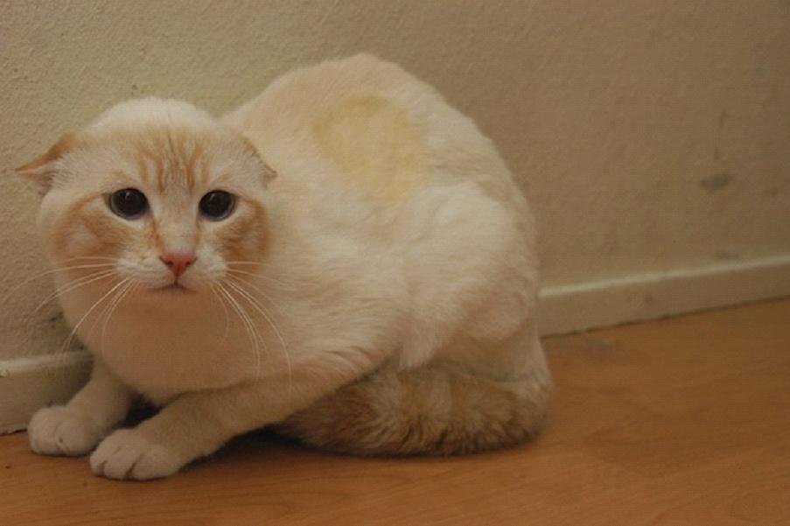
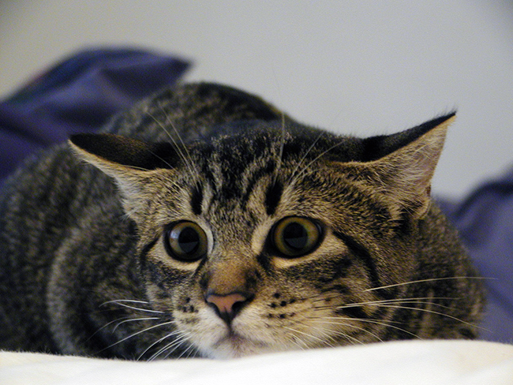
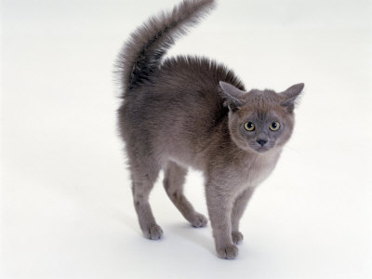
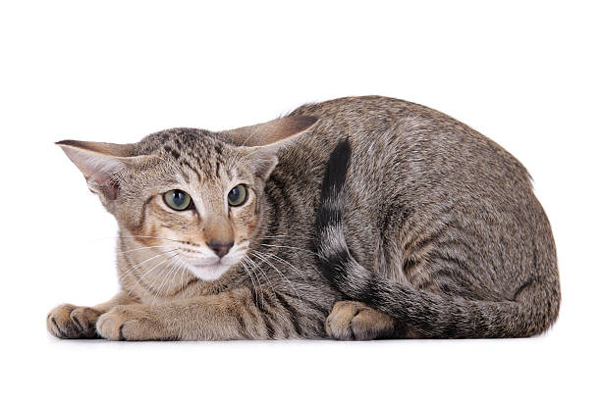
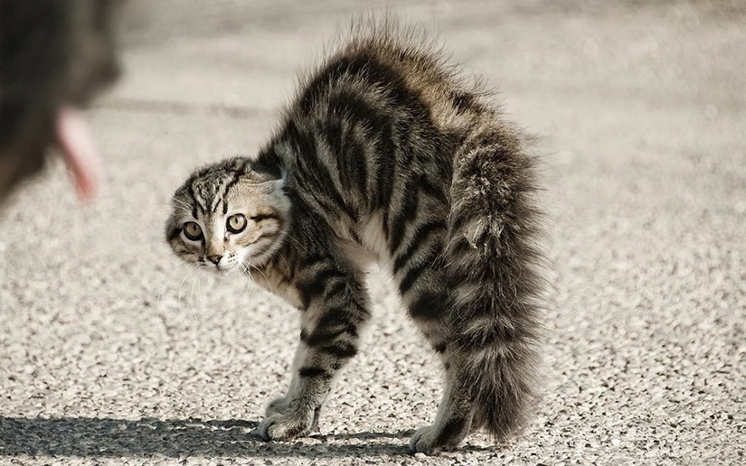
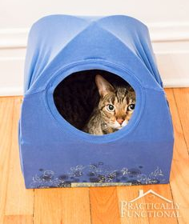
Scared/Nervous Cat Behavior

Slide 7
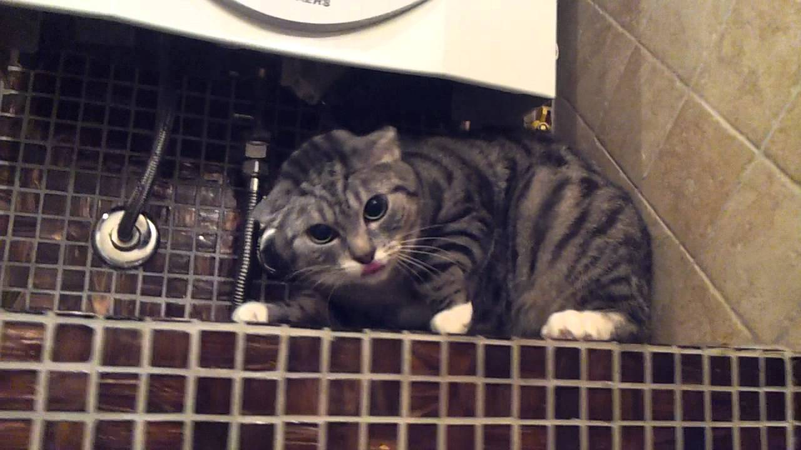
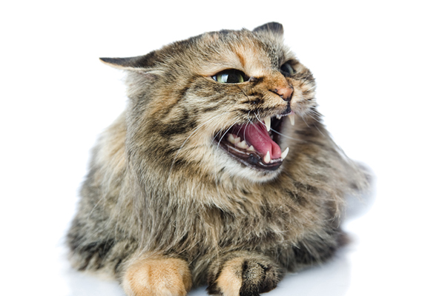
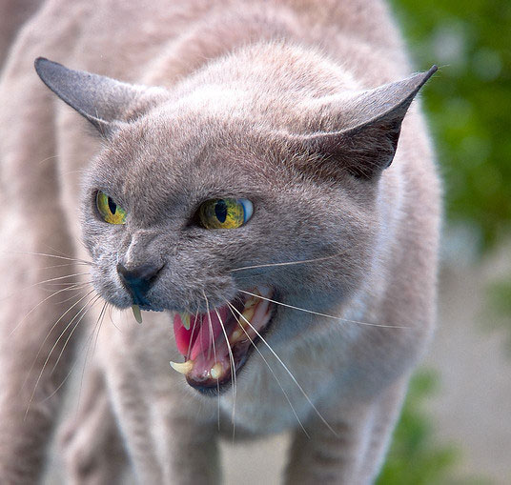
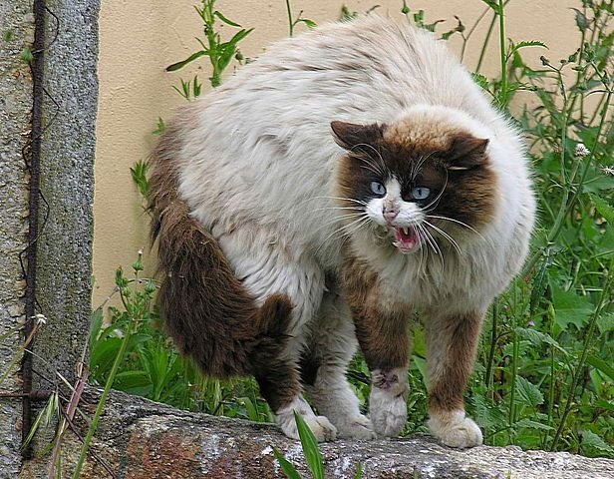
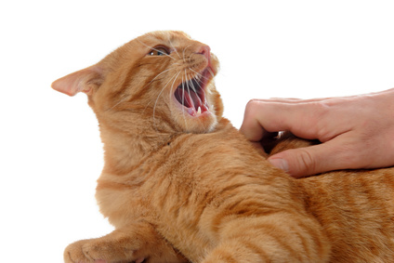

Aggressive Cat Behavior

Slide 8
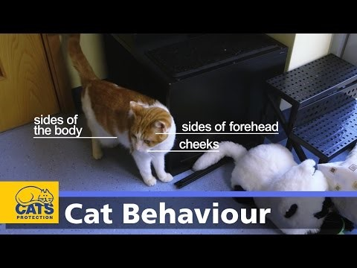
Cat Body Language Video

Slide 9
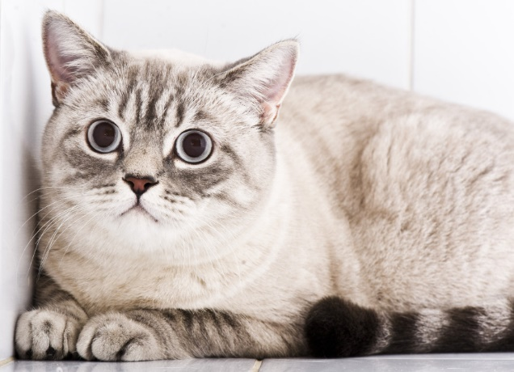
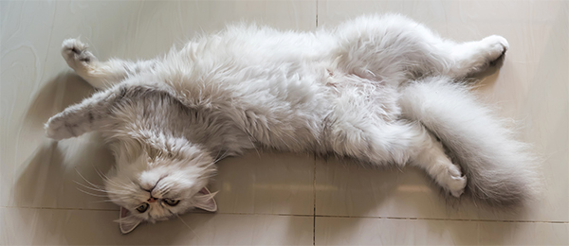
Who’s ready for a visit?

Slide 10
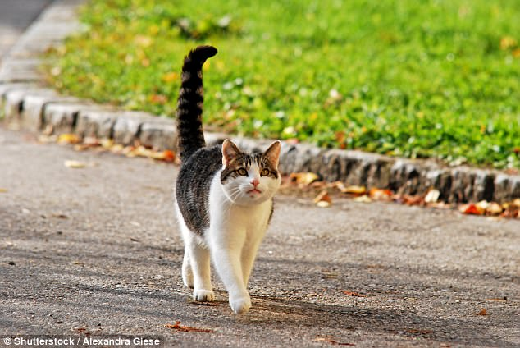
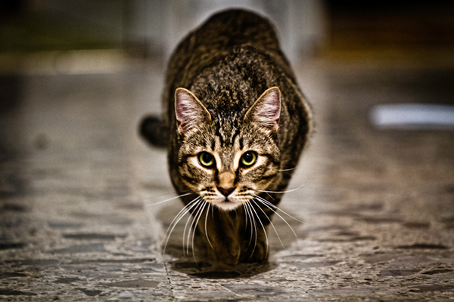
Who’s ready for a visit?

Slide 11
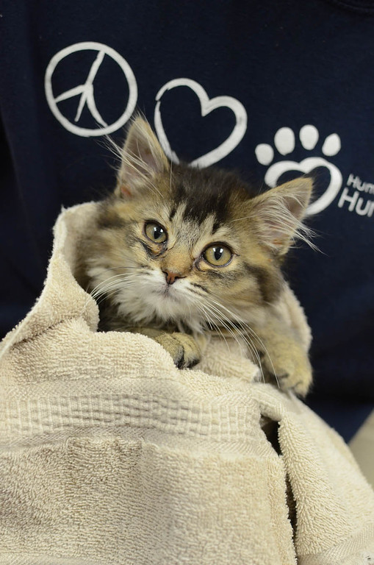
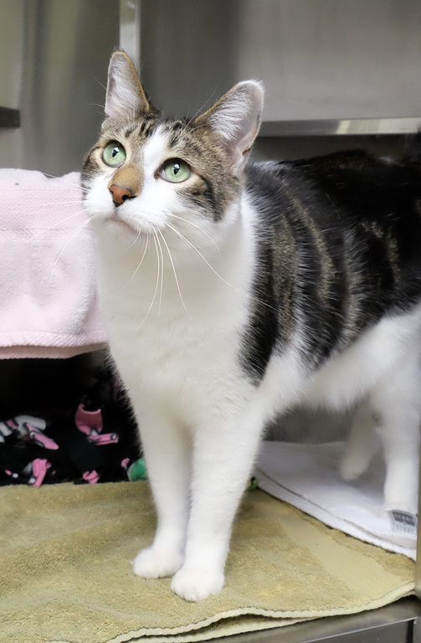
Who can you visit with?
1. Kittens
As long as they don’t have a watch sticker
2. Adult Cats
Must have a JV approved card
Adults in cages (UT/DT)
In lobby or kitten room
In condos or communal rooms

Slide 12





Read the signs!

Slide 13
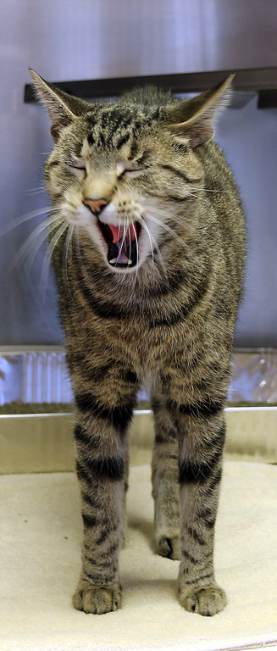
What do you need?
Clean Towel!
Confidence!
That’s it!

Slide 14
Keeping everyone (you + animals) healthy
Towels!
ALWAYS get a new towel in between every animal visit
Hand Sanitizer!
ALWAYS sanitize in between every animal visit (wherever the animal touched)
Clothing!
ALWAYS wear closed toe shoes
Make good choices (pants, hoodie strings, etc.)
Actions
ALWAYS keep the animals calm and happy, no rough play

Slide 15
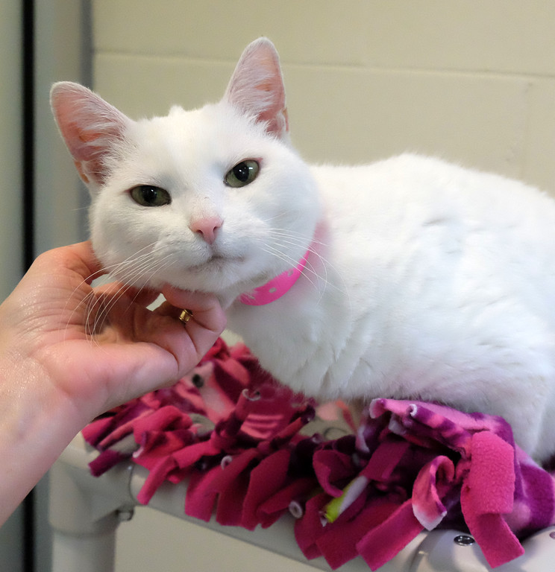
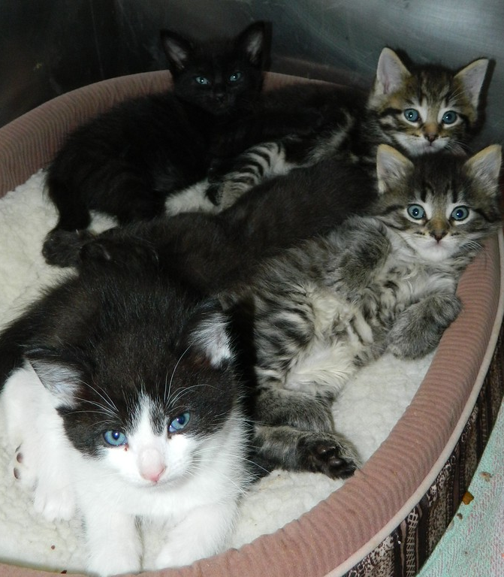
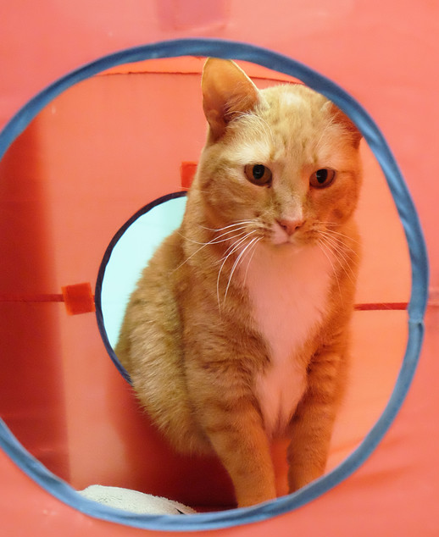
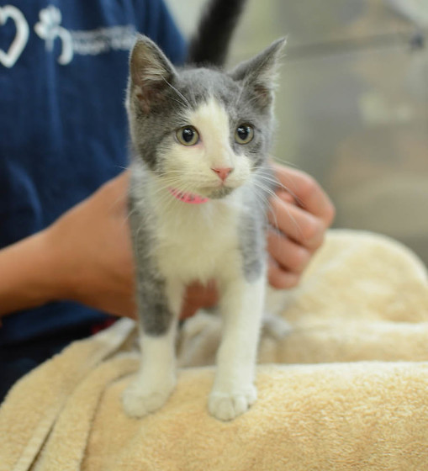
Let’s visit the cats!

Slide 16
Questions?
See you back again for session 2!

