Slide 1
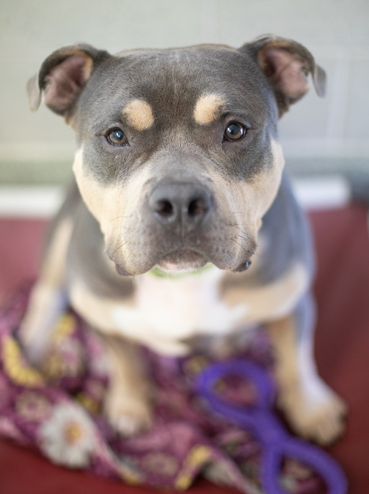
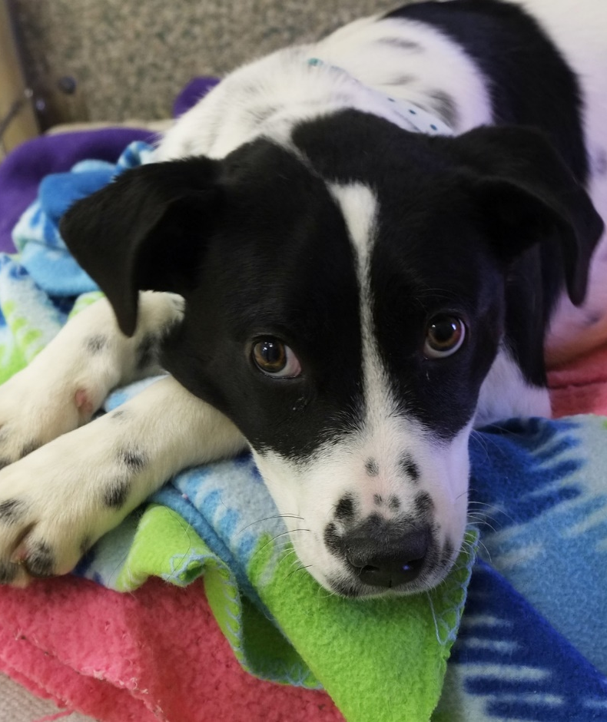
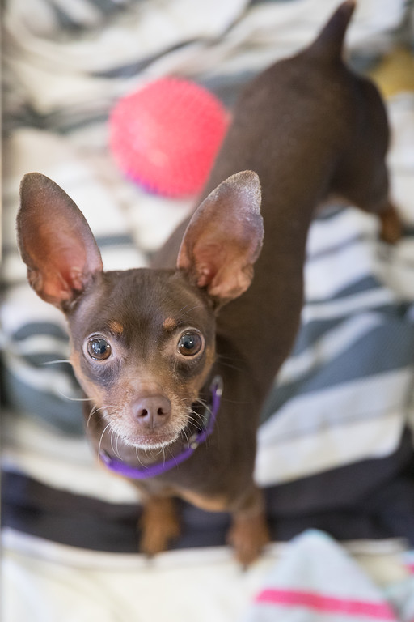
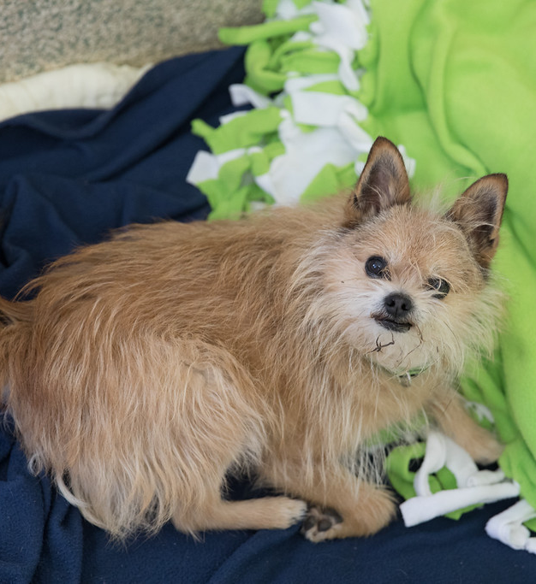
Junior Volunteer
Dog Visitation Training
Day 2

Slide 2
Schedule
Body language review
Common issues
Animal visitation time
Questions
What comes next?

Slide 3
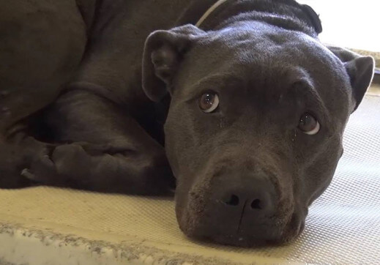
Body Language Review
What is this dog feeling?
How would you respond?

Slide 4
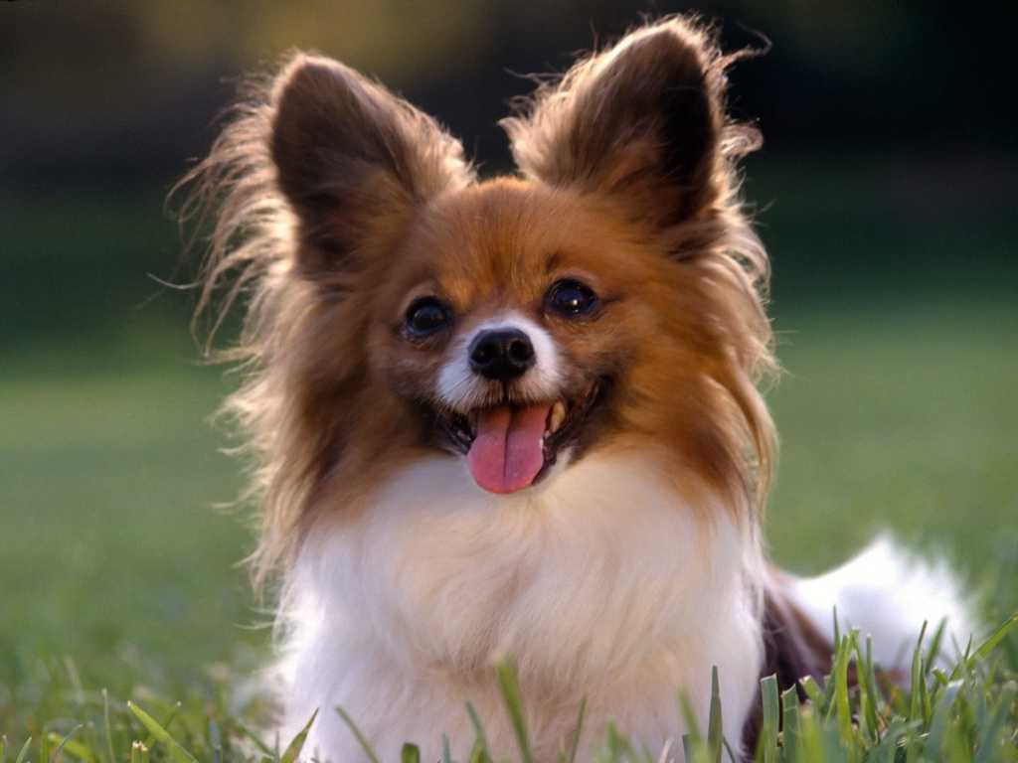
Body Language Review
What is this dog feeling?
How would you respond?

Slide 5
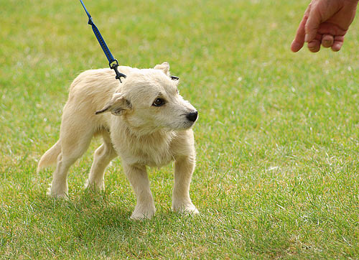
Body Language Review
What is this dog feeling?
How would you respond?

Slide 6
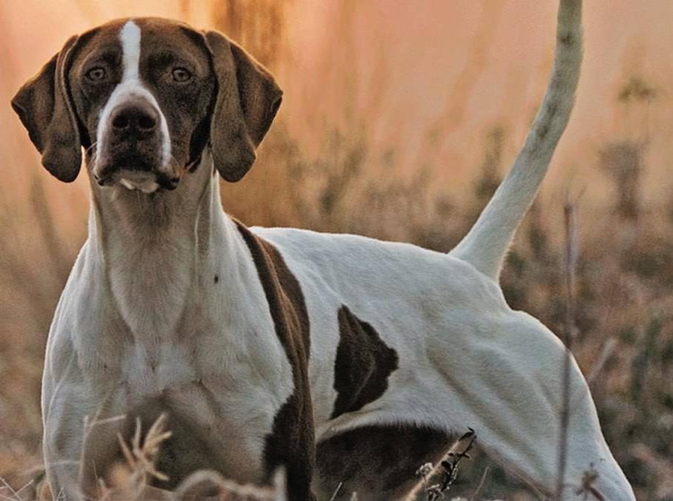
Body Language Review
What is this dog feeling?
How would you respond?

Slide 7
Common Issues
Being mouthy
Reaction to other dogs or people
Trying to escape or getting loose

Slide 8
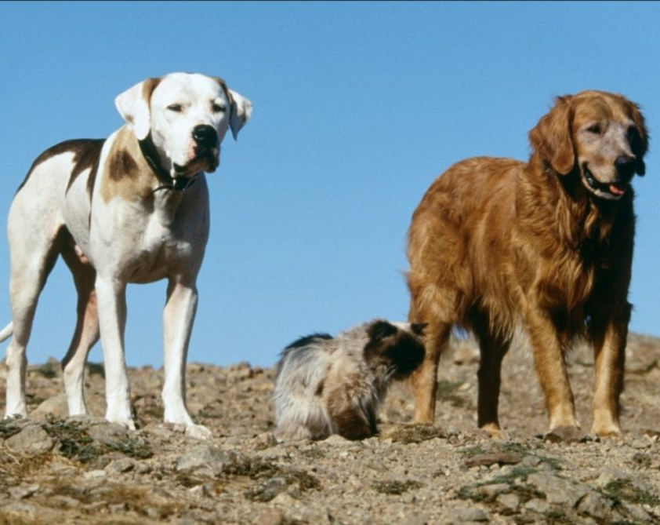
Loose Animals
Prevention is key!
Do NOT try to catch the animal or get them back in their cage
Yell “loose dog!”
Try to watch where the animal goes (without chasing them)

Slide 9
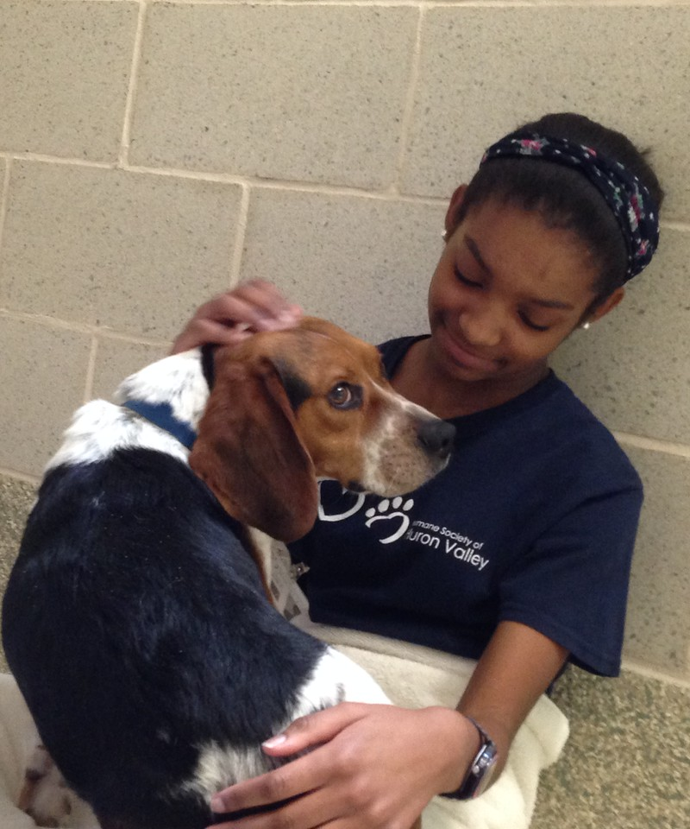
Entering and Exiting Cages & Rooms
Use your body as a barrier
Use food or toys as a distraction
Don’t be afraid to ask for help!
Training opportunity!

Slide 10
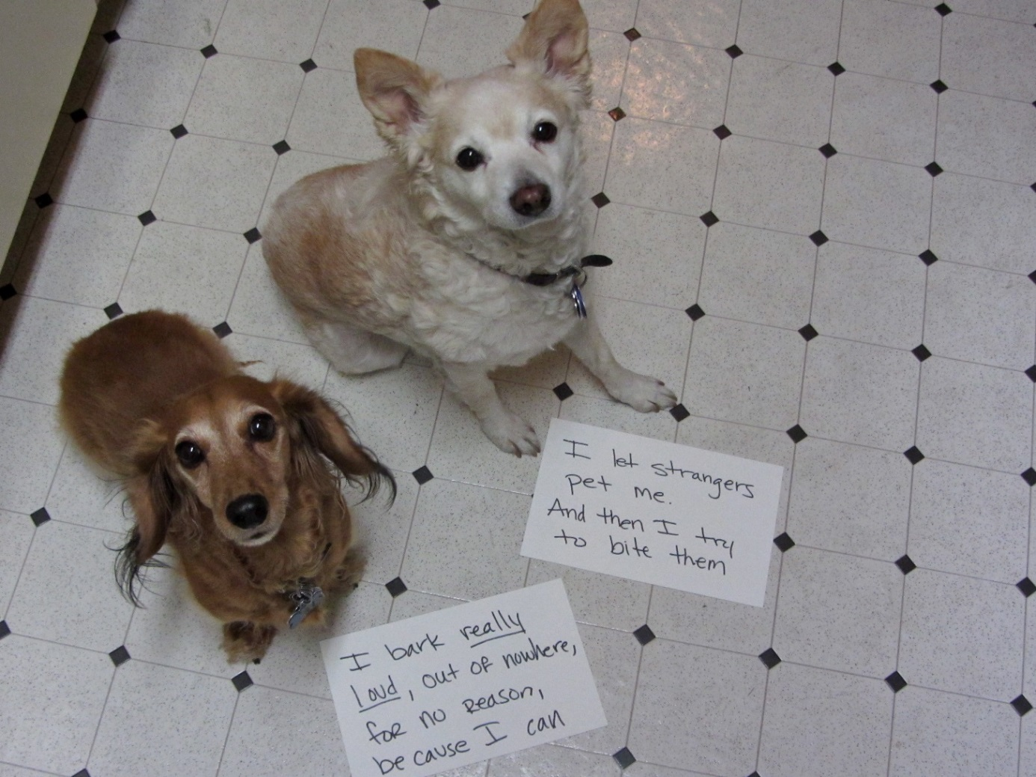
Awareness helps with many challenges
Read the binder to gain information about a dog before visiting
Add a note after every visit
Use clear handwriting
Be descriptive!

Slide 11

Which is helpful?
  That dog was crazy!!!
  Cosmo was very excited when I entered the kennel and had trouble settling down. He kept jumping and was very mouthy but when I gave him a toy he settled down.

Slide 12
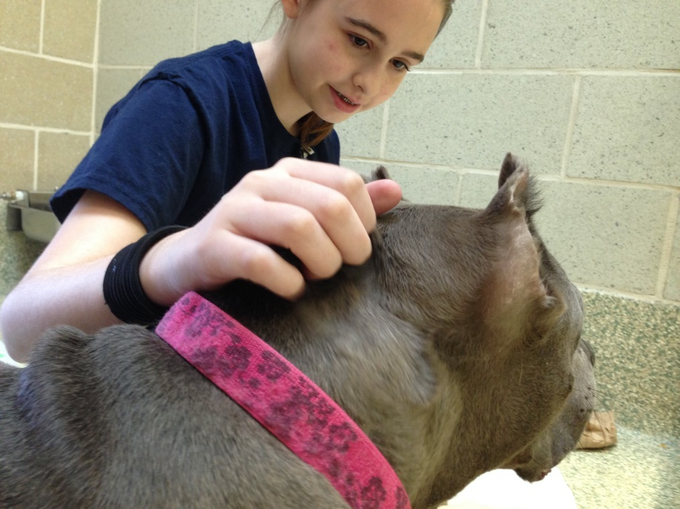
Help our dogs be the best!
Our goal is to help them stay calm and relaxed
Discourage rough play
Use calm, gentle petting
Respond to their cues and body language

Slide 13
Reminders
Puppies in puppy room with “JV Approved” card
Puppies first, then adult dogs
No “I have a cold” card, no “I just had surgery or sedation” cards
Adult dogs in Dogtown or puppy room with “JV Approved” card

Slide 14
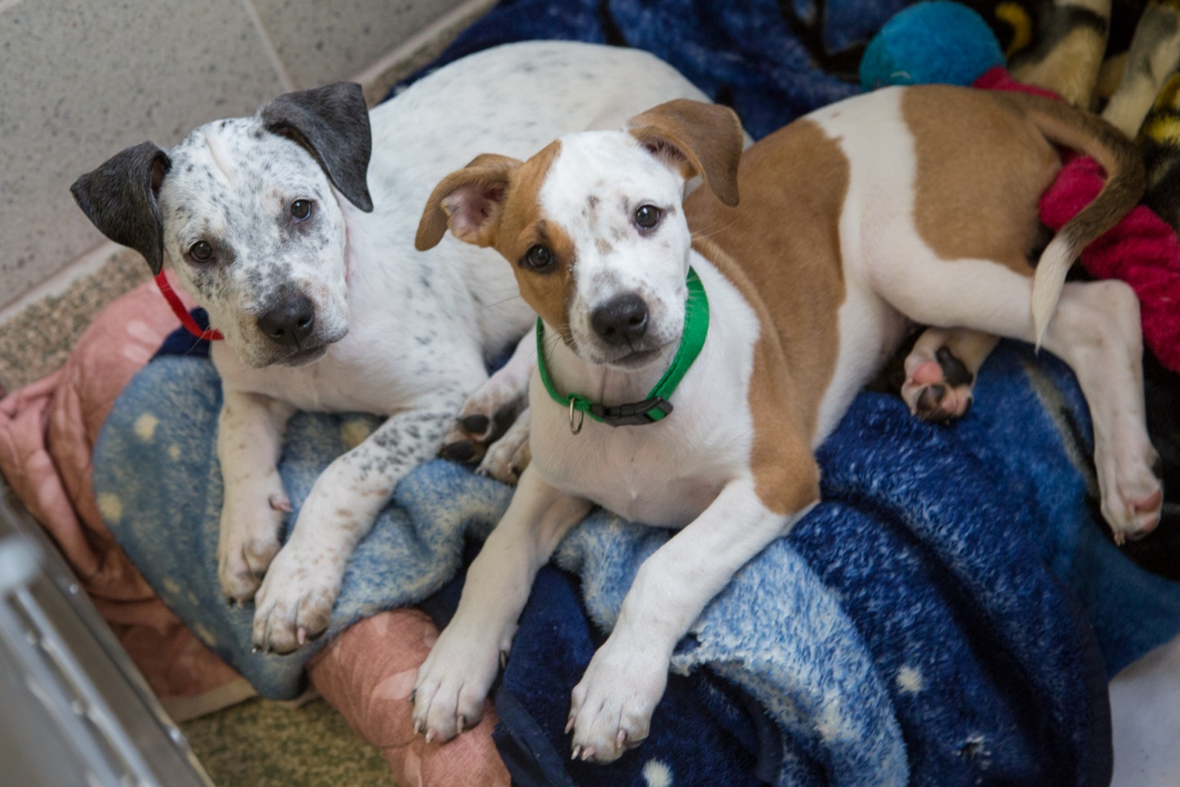
Let’s go visit the dogs!

Slide 15
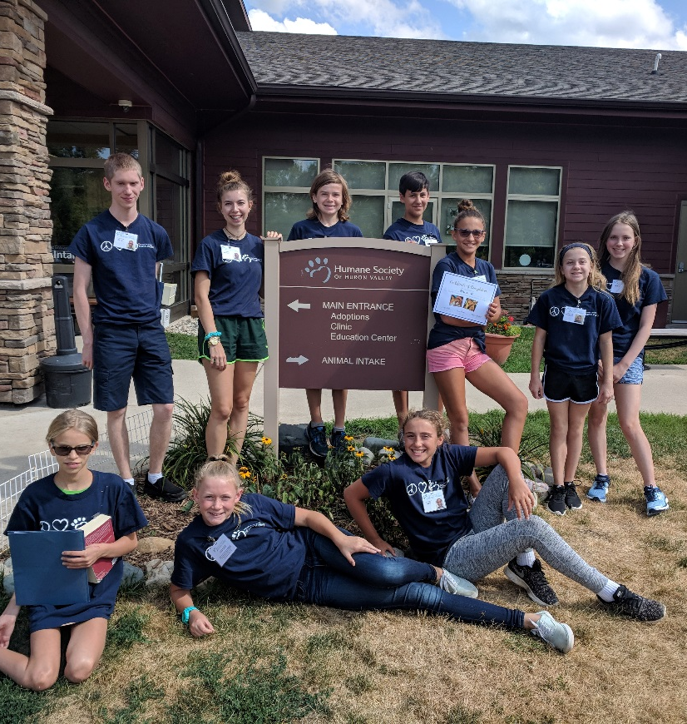
Reminders
You may only volunteer for what you sign up for
You may not bring friends or family members with you when you volunteer
You should only plan on staying for your assigned shift

Slide 16
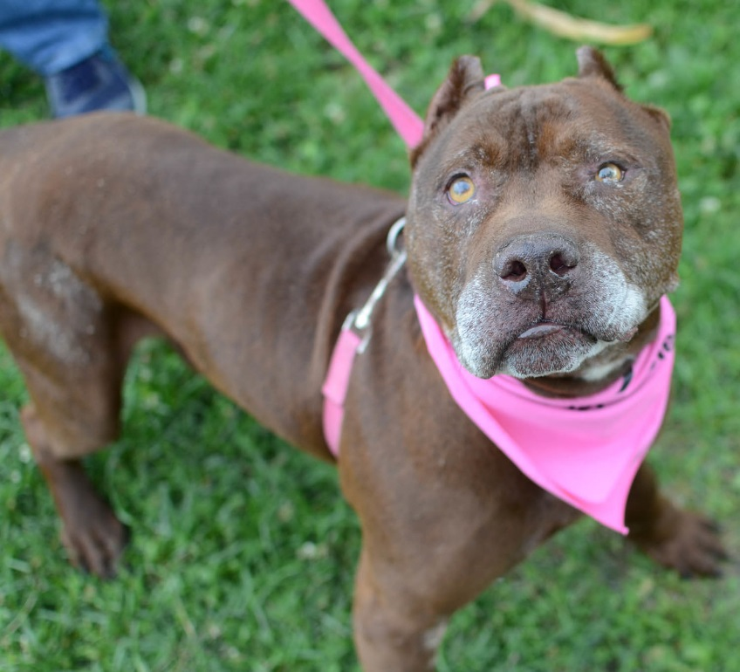
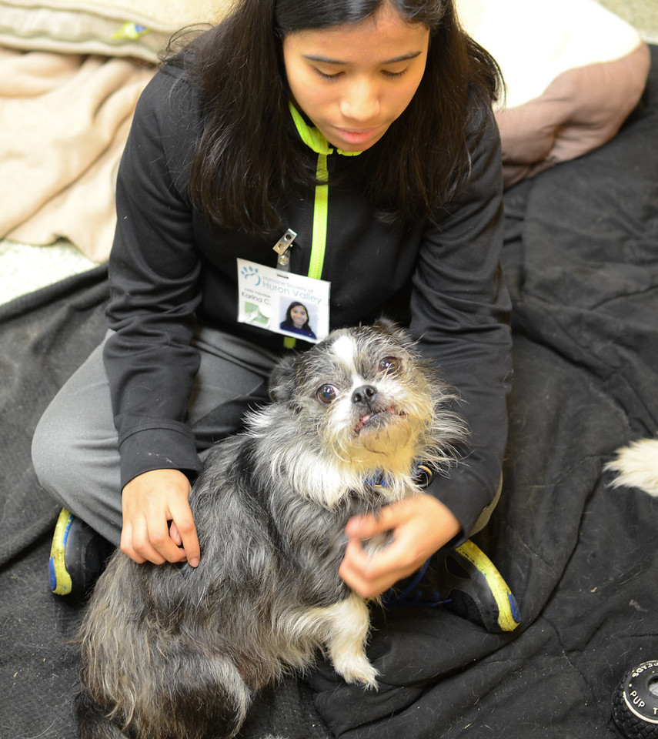
Questions?

