Slide 1
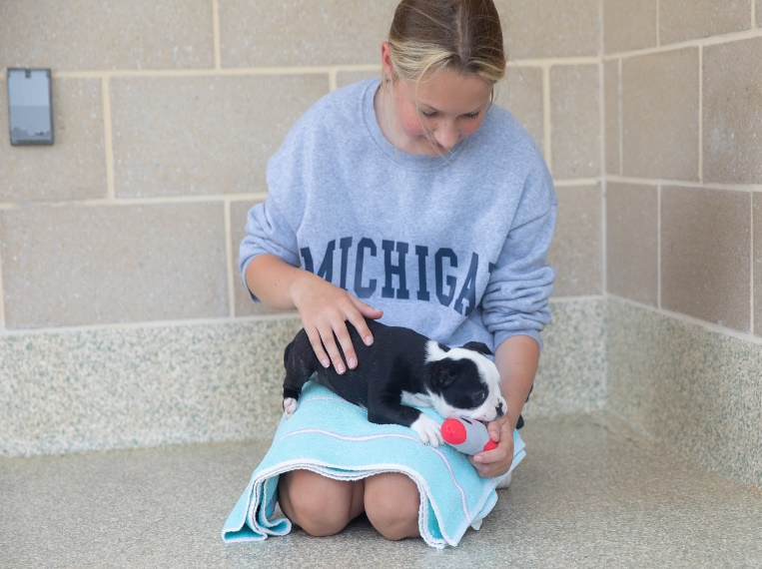
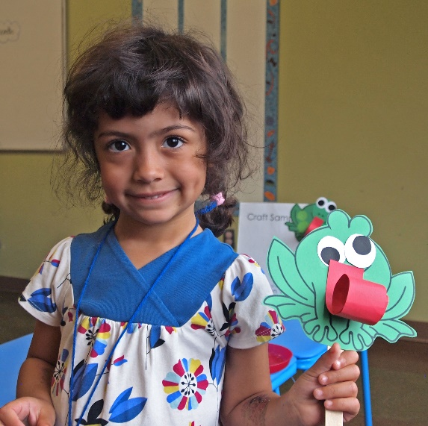
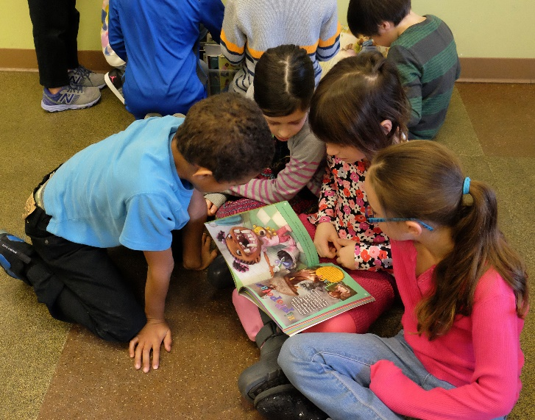
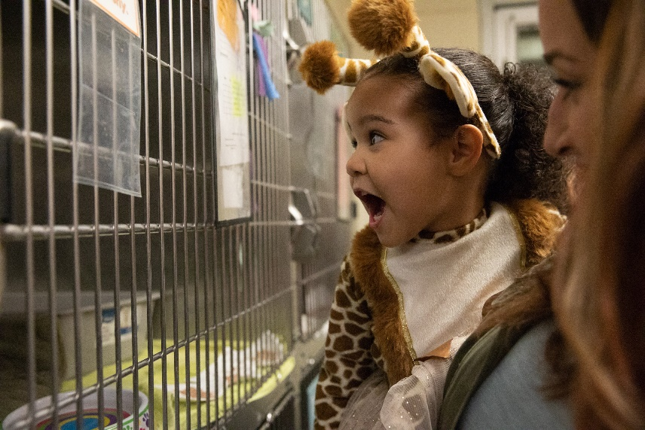

Humane Education Volunteer Training
3100 Cherry Hill Road | Ann Arbor, MI | 48105
(734) 662-5585 | www.hshv.org

Slide 2

What is Humane Education?
  The teaching of
    compassion and respect towards all living beings including humans, animals and the environment.
Humane Society of Huron Valley | (734) 662-5585 | www.hshv.org

Slide 3

The Elements of Humane Education
Providing accurate information
Fostering the “3 Cs”
  Creativity
  Curiosity
  Critical thinking
Instilling the “3 Rs”
  Respect
  Reverence
  Responsibility
Offering positive choices and tools for problem solving
Humane Society of Huron Valley | (734) 662-5585 | www.hshv.org

Slide 4
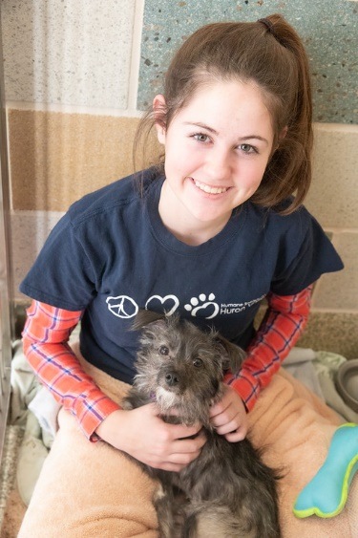
Why do we need Humane Education?
Empathy is a learned skill!
When an owner can no longer care of their pet
Humane Education promotes the following outcomes:
More tolerant and compassionate citizens of the greater community
Cultivates empathy for animals; decreases animal abuse in our society
Helps reduce and prevent violence in school and at home
Motivates students to strive for a more sustainable society
https://teachheart.org/why-humane-education-matters/
When an officer picks up an animal that needs help
An animal that comes from a shelter with less resources than HSHV
Humane Society of Huron Valley | (734) 662-5585 | www.hshv.org

Slide 5
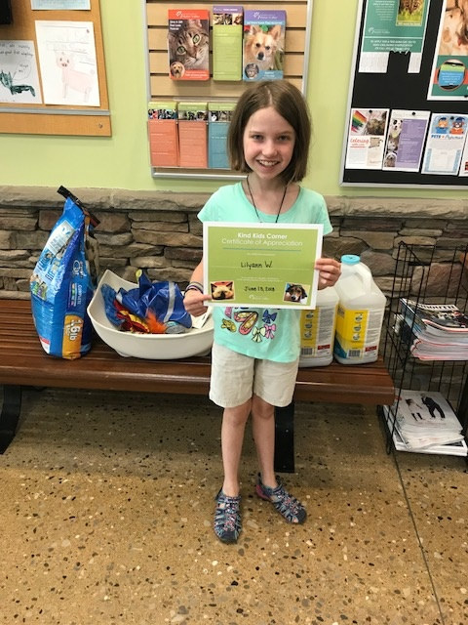
HSHV’s Humane Ed Goals
Provide knowledge of HSHV’s mission
Educate youth on humane treatment of animals and build empathy
Encourage more support for HSHV with donations, volunteers, adoptions
Decrease animal cruelty in our community
Dispel shelter myths
Humane Society of Huron Valley | (734) 662-5585 | www.hshv.org

Slide 6
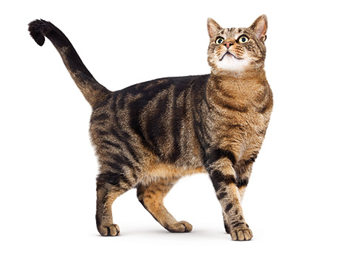

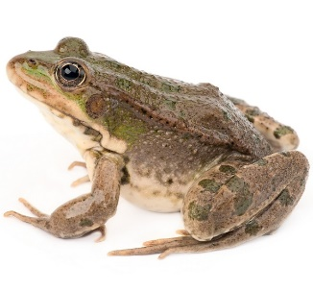
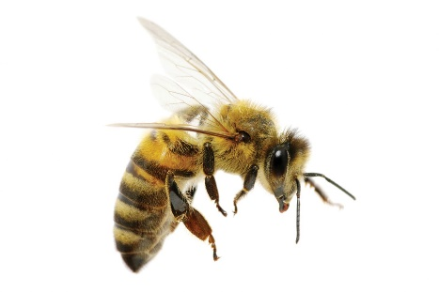
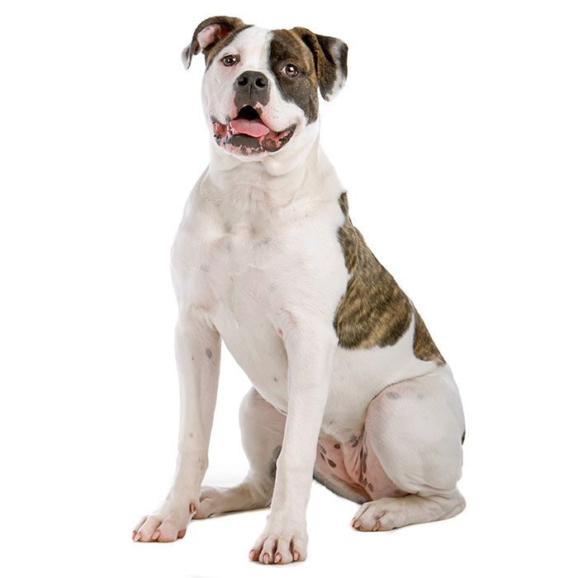
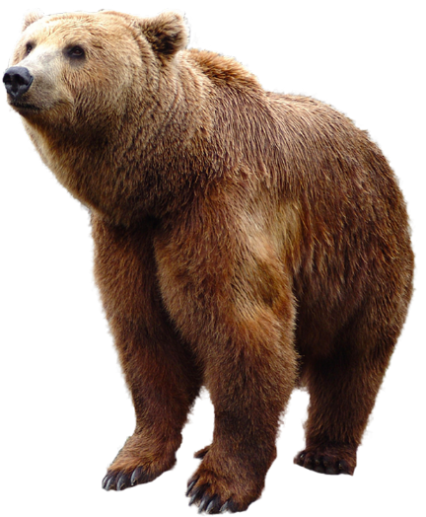
Humane Education Activity
Please rank these animals in order of importance:
Bears
Dogs
Bees
Chickens
Frogs
Cats
Humane Society of Huron Valley | (734) 662-5585 | www.hshv.org

Slide 7
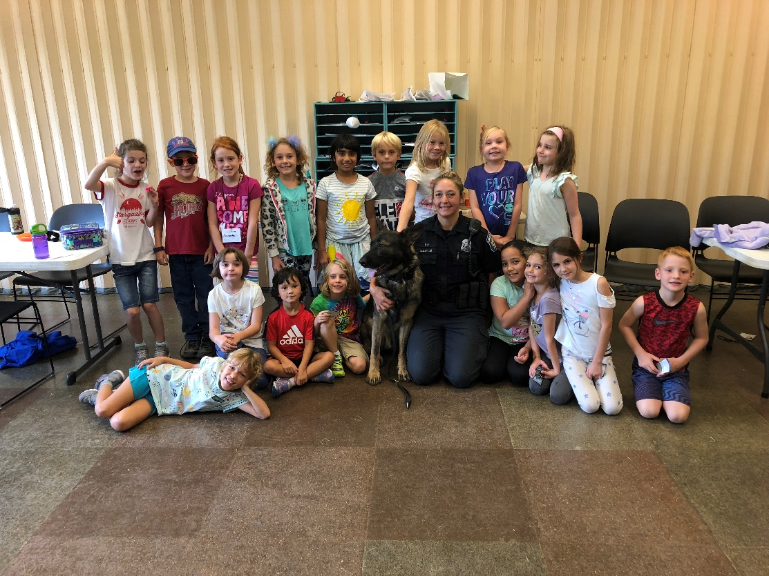
Humane Education Programs at HSHV
Comprehensive Program
Partner with other community organizations
Brings new families to HSHV
Programming for youth with less resources
All Ages
Scholarships available
Shelter Tours
Camp Paws
Scout Programs
Little Paws Story Time
Junior Volunteers
Field Trips
Birthday Parties
Humane Society of Huron Valley | (734) 662-5585 | www.hshv.org

Slide 8
Onsite Programs
Ages 2-5
Little Paws Story Time
Tiny Tales Story Time
Camps Paws Jr.
Ages 6-11
Scout Programs
Camp Paws and Camp Purrs
Field Trips
Birthday Parties and Kitty Pawties
Pets and PJs
Rescue Reading
Ages 12-17
Eagle Scout/Girl Scout Projects
Animal Welfare Residency
Camp Purrs
Field Trips
Junior Volunteer Program
Humane Youth Award
Humane Society of Huron Valley | (734) 662-5585 | www.hshv.org

Slide 9
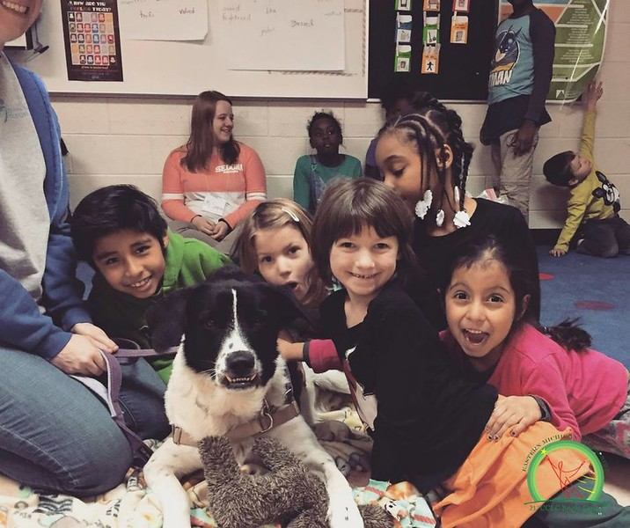
Offsite Programs
ACE (Animal Care Education) Programs
Community Action Network (CAN)
Clubs and trainings at local locations
Humane Society of Huron Valley | (734) 662-5585 | www.hshv.org

Slide 10
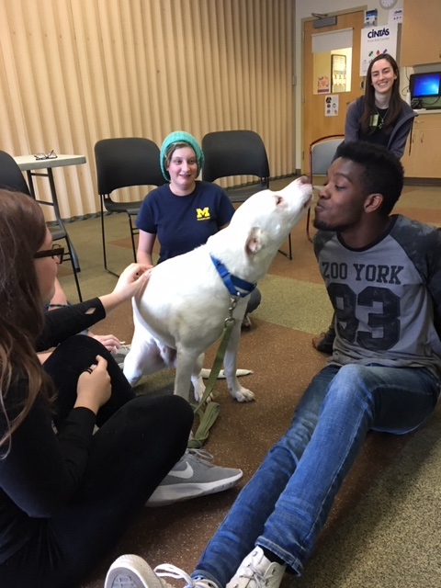
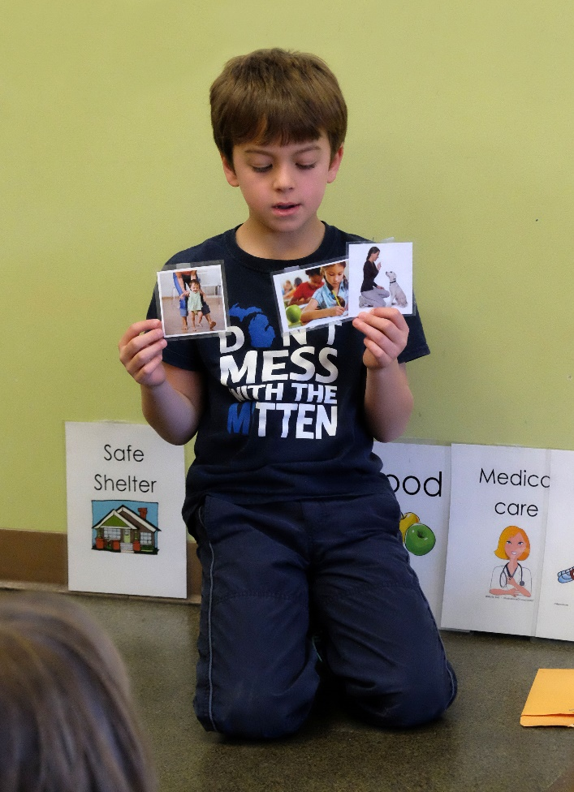
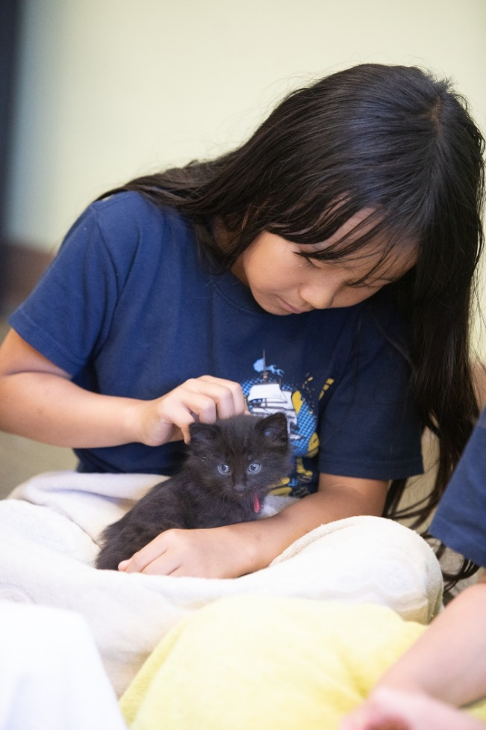
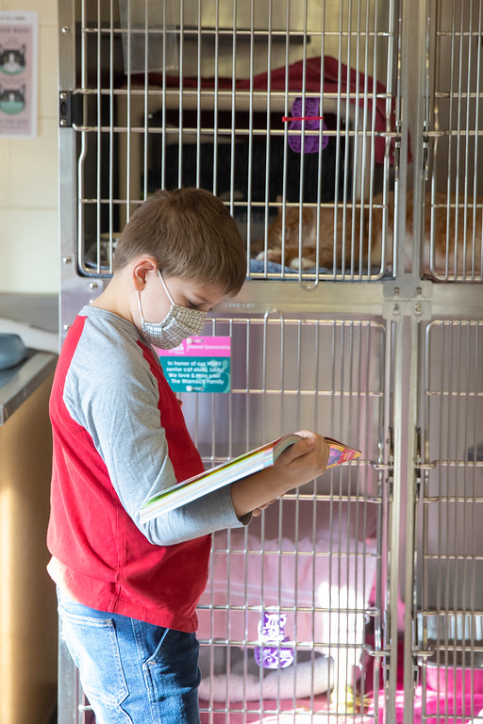
Humane Ed in Action
Humane Society of Huron Valley | (734) 662-5585 | www.hshv.org

Slide 11
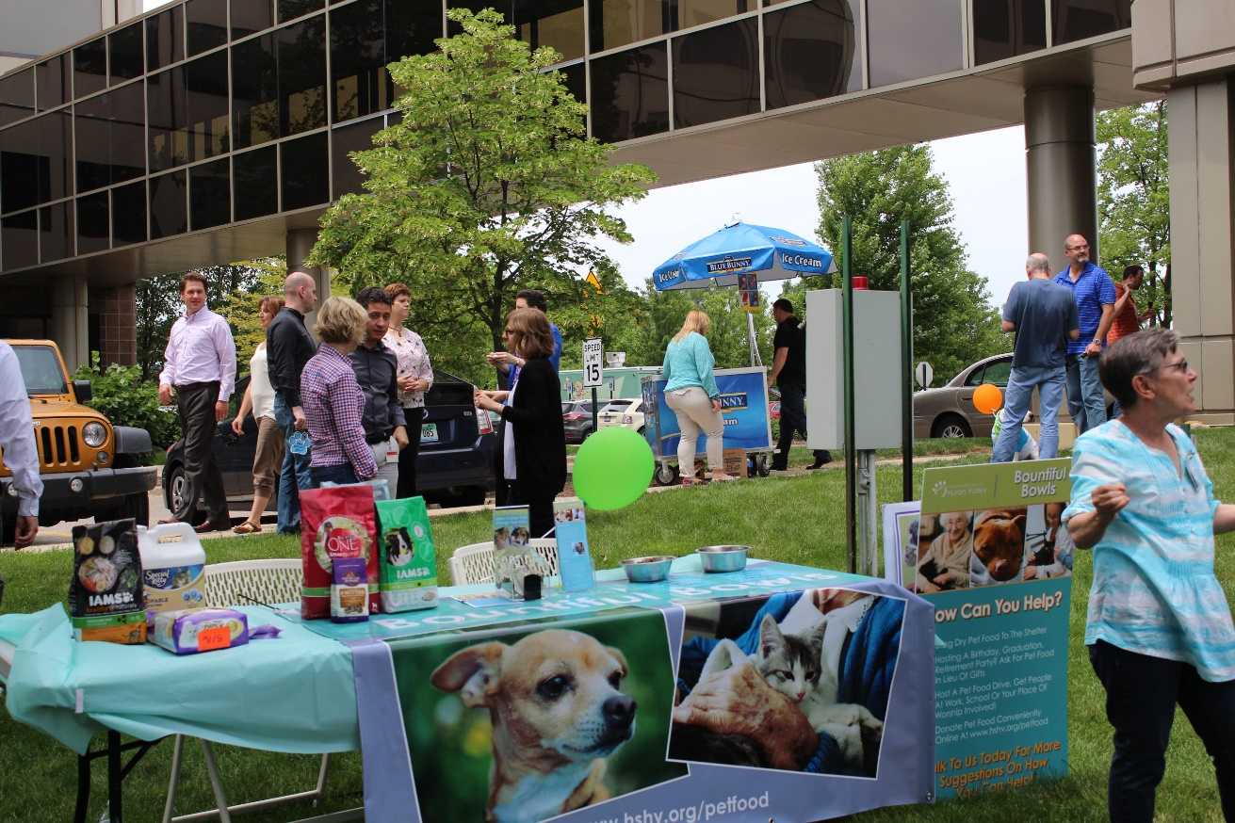
Programing for Adults
Shelter Tours
Group Presentations
Educational Materials
Volunteer Information Sessions
Humane Society of Huron Valley | (734) 662-5585 | www.hshv.org

Slide 12
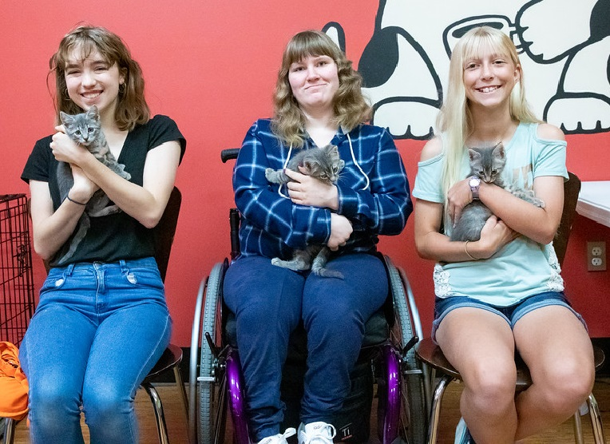
Community Impact
More adoptions
Community Partners
Awareness of animal welfare issues
More respect for animals and the environment
Humane Society of Huron Valley | (734) 662-5585 | www.hshv.org

Slide 13
Testimonials
“This is the first time I have not had to drag my son out the door to participate in a program. He looks forward to spending time at HSHV and it has had an impact on his grades, behavior and social skills. THANK YOU!”
~ JV Parent
Humane Society of Huron Valley | (734) 662-5585 | www.hshv.org

Slide 14
Testimonials
“[Our son] very much enjoyed getting to spend the day with all of the animals and the activities that you had planned for them - although he may not have expressed it to you directly. This camp gave him the opportunity to build so many new and safe memories.
~Camp Paws Parent
Humane Society of Huron Valley | (734) 662-5585 | www.hshv.org

Slide 15
Testimonials
“As a student preparing for college and a career, I know the importance of volunteer experience. Also as a high school student, volunteering didn’t sound like a very appealing experience to me. I was more than a little bit reluctant to donate my time and effort to someone for absolutely no money. However, my sentiments soon reversed when I found myself volunteering my time at the Humane Society of Huron Valley. I joined the Junior Volunteer Club as a way of gaining required volunteer hours, but I ended it with a new understanding of what it means to truly care about something. Being at the Humane Society changed my life and I learned how to give expecting nothing in return except for the gratitude of the recipient.”
~ Megan, age 17, Junior Volunteer
Humane Society of Huron Valley | (734) 662-5585 | www.hshv.org

Slide 16
Testimonials
I love Camp PAWS! I want to be a veterinarian when I get big and I learned a lot about how to care for animals and to make sure I don’t smush bugs outside. I’ll make sure my little brother doesn’t do that either because sometimes he does that.
~ Jackson, age 7
Humane Society of Huron Valley | (734) 662-5585 | www.hshv.org

Slide 17
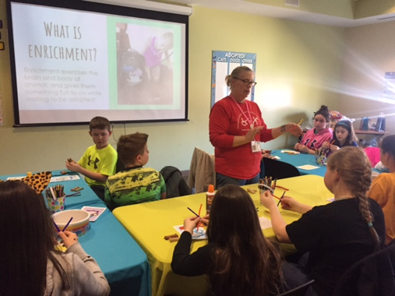
Volunteering with Humane Ed
Common Components
Tours
Enrichment
3 Steps to Meet a Dog
Humane Society of Huron Valley | (734) 662-5585 | www.hshv.org

Slide 18
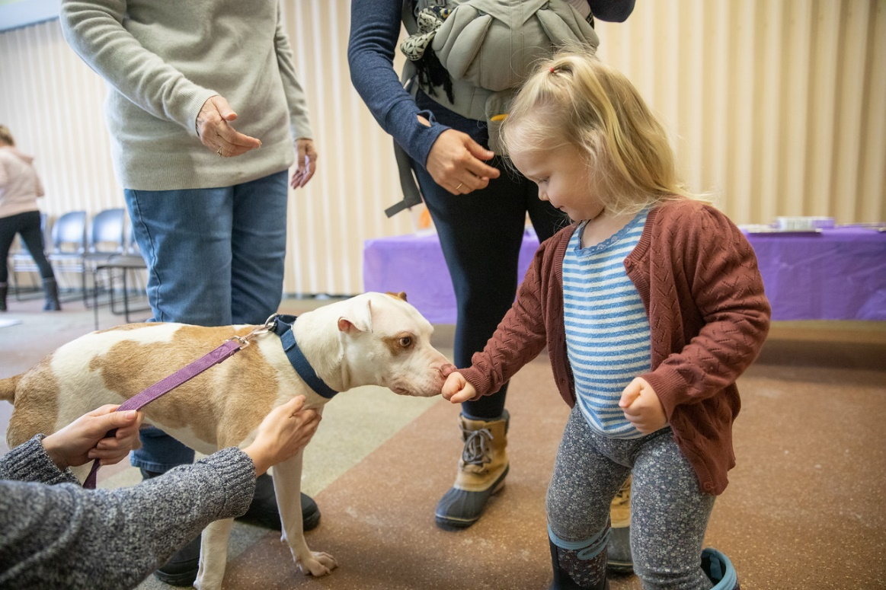
3 Steps to Meet a Dog
Ask permission
Let dog approach and sniff
Pet the dog where they can see you
Humane Society of Huron Valley | (734) 662-5585 | www.hshv.org

Slide 19
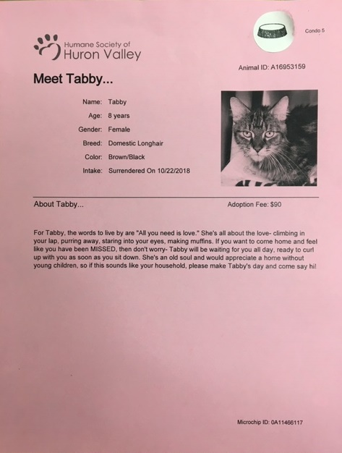
Passing Out Enrichment
Animals with a food bowl sticker on their cage card should not be given treats.
Shelter Tours
Camp Paws
Scout Programs
Little Paws Story Time
Junior Volunteers
Field Trips
Birthday Parties
Humane Society of Huron Valley | (734) 662-5585 | www.hshv.org

Slide 20
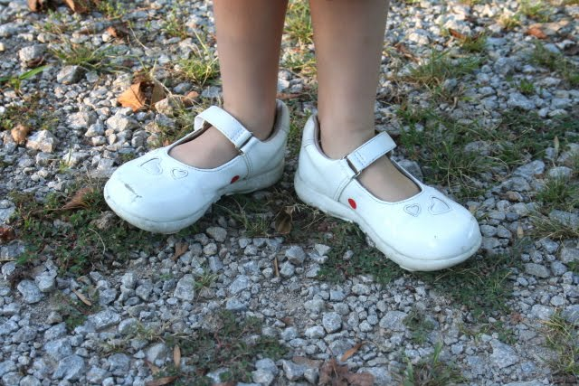

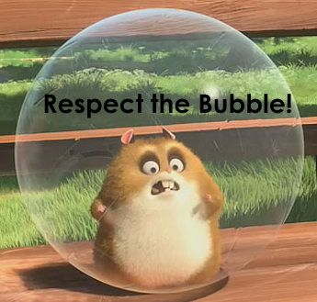

Tour Guidelines
Humane Society of Huron Valley | (734) 662-5585 | www.hshv.org

Slide 21
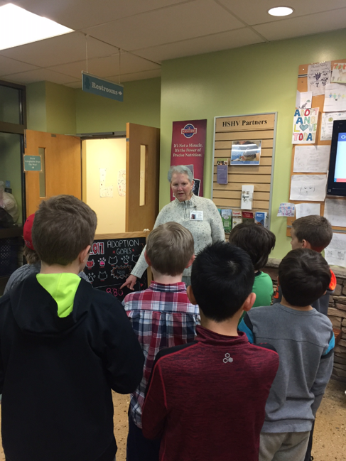
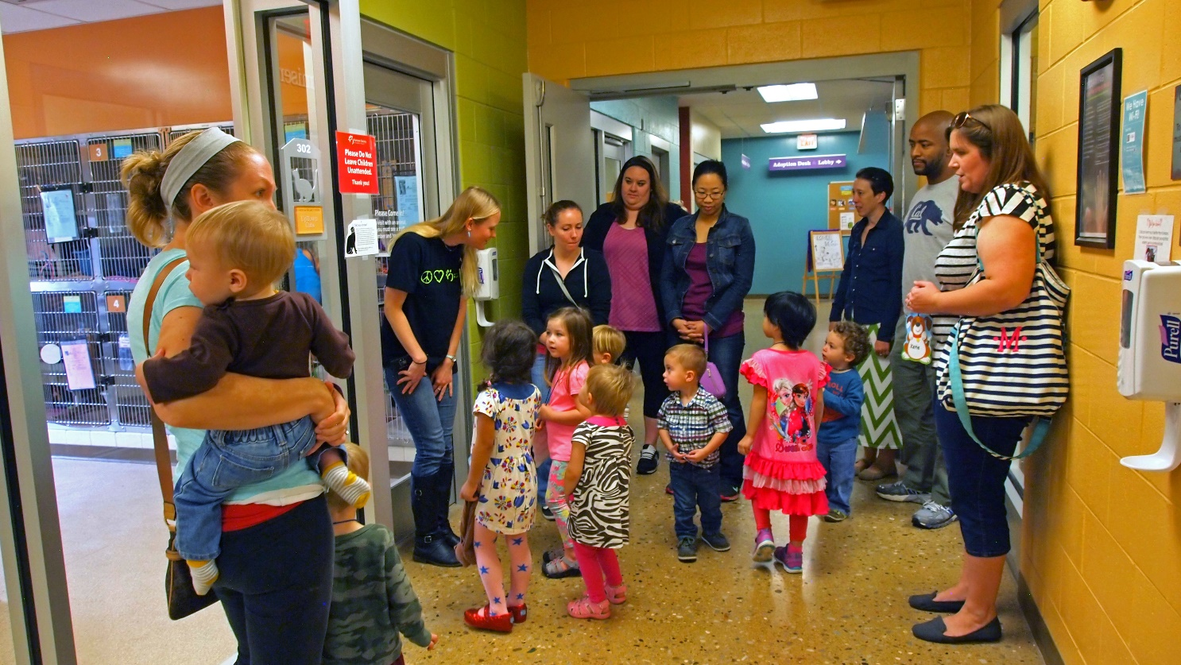
Tour Time!
Humane Society of Huron Valley | (734) 662-5585 | www.hshv.org

Slide 22
Managing Groups
Develop an attention getting signal
We use: “If you can hear my voice…(clap once, touch your nose, etc.)
Don’t start or continue until everyone is ready
Always remain patient and calm
Read the audience
Parents and teachers can help with behavior challenges
Give challenging kids a job to do
Humane Society of Huron Valley | (734) 662-5585 | www.hshv.org

Slide 23
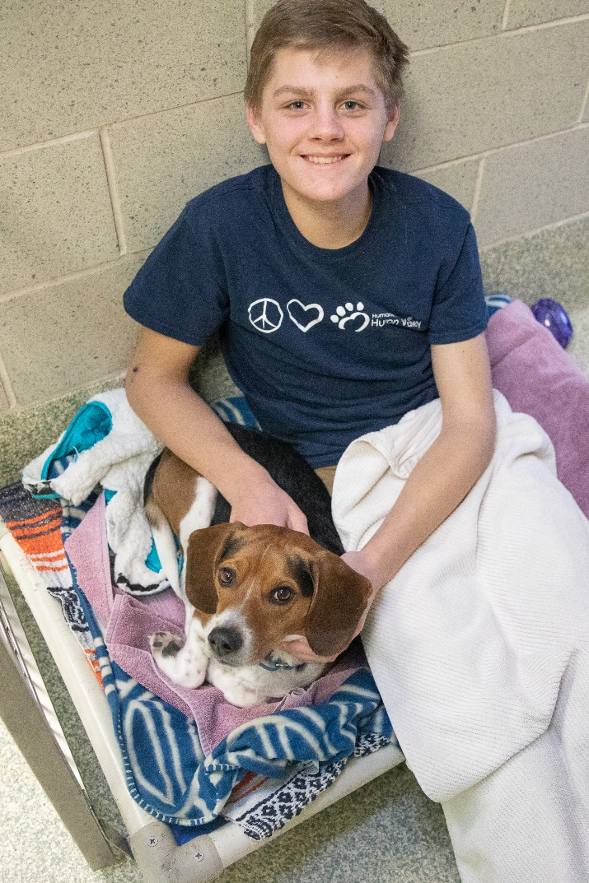
The Language we Use
Non-judgemental
Open and honest
No speciesism
  Refer to animals as he/she not “it”
  Prefer guardian over owner
  Avoid animal stereotypes/clichés (bird brain, bull-headed, etc.)
Avoid using jargon
  Explain words or have children explain them
Humane Society of Huron Valley | (734) 662-5585 | www.hshv.org

Slide 24
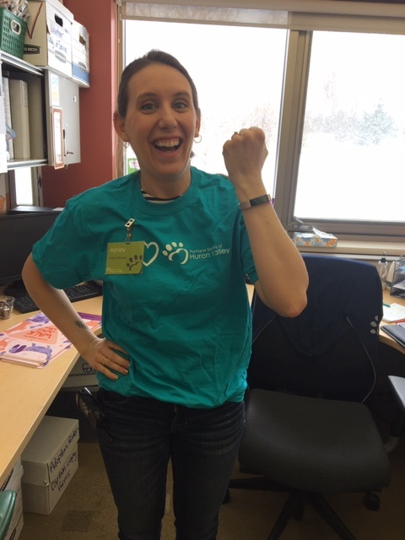
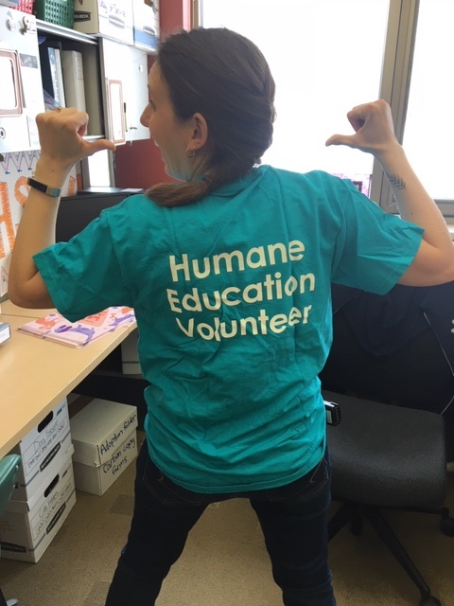
What to Wear
T-Shirt
Name Tag
A Watch
Humane Society of Huron Valley | (734) 662-5585 | www.hshv.org

Slide 25
What’s Next?
HE Program Shadowing allows you to sign up to shadow different programs you may be interested in. You may shadow a program as many times as you like!
If you’re interested in continuing with HE
Fill out background check authorization
Sign up for HE program shadowing
Humane Society of Huron Valley | (734) 662-5585 | www.hshv.org

Slide 26
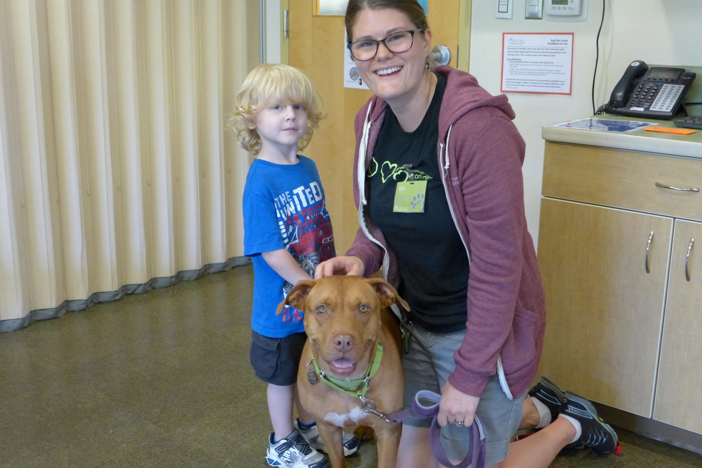
Questions?
Feel free to e-mail me at jessieh@hshv.org
Humane Society of Huron Valley | (734) 662-5585 | www.hshv.org

