Slide 1
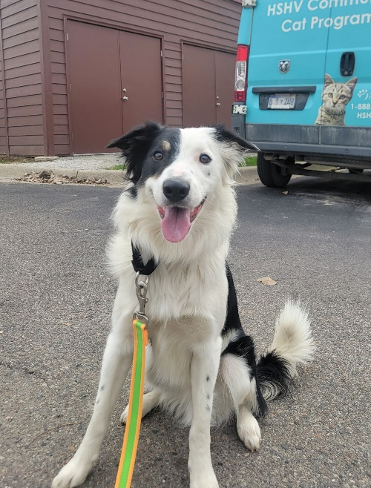
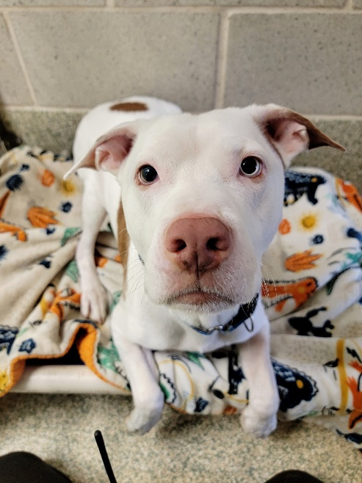
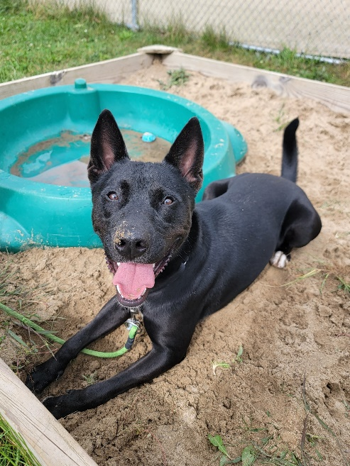
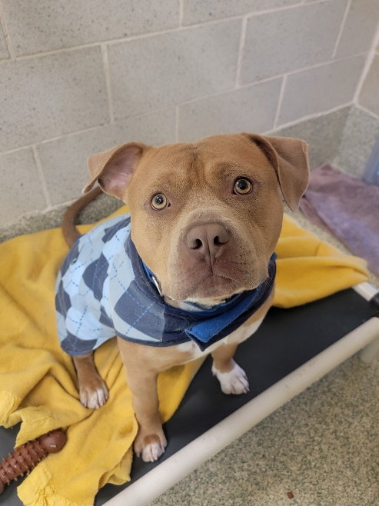
Level 2: Blue dot dog walking

Slide 2
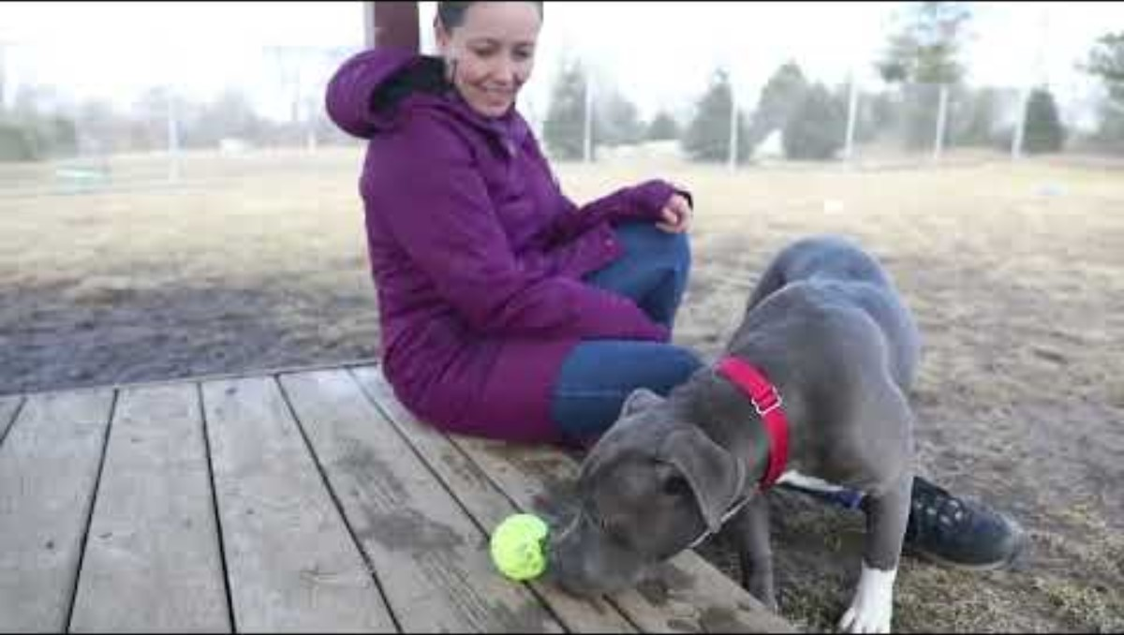
Introduction Video

Slide 3

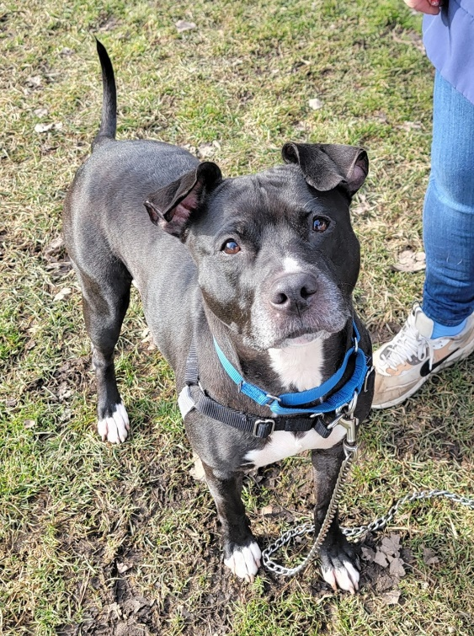
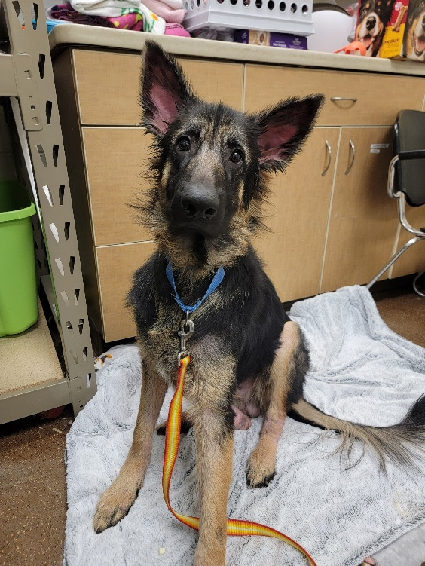
What is a Blue Dot Dog?
Higher arousal levels
Jumpy
Mouthy
Reactive
Difficult to leash
Fearful
Handling sensitive
Leash sensitive
Lacking confidence

Slide 4
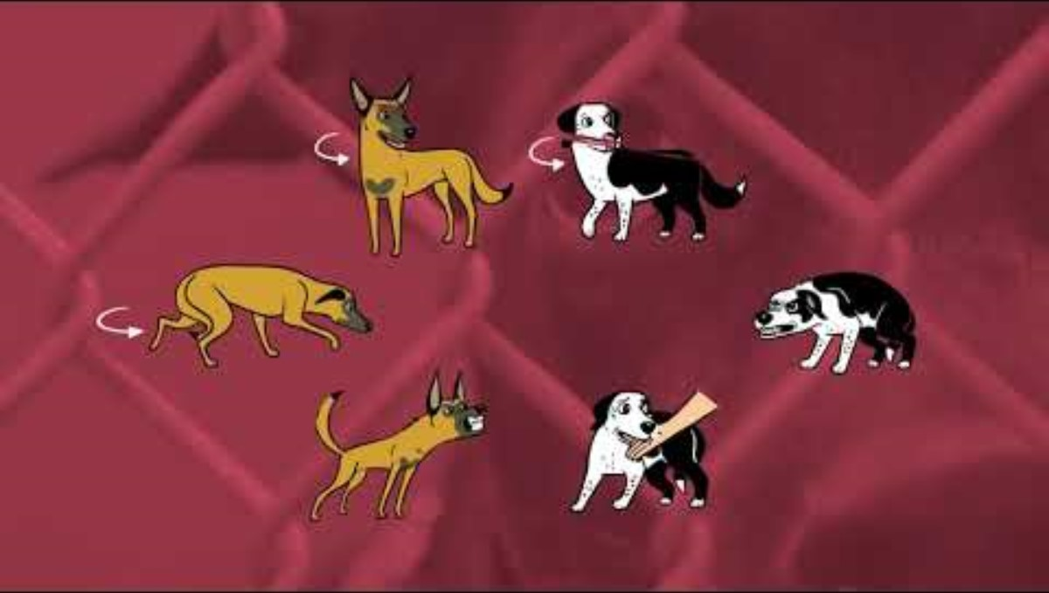
Body Language Overview

Slide 5
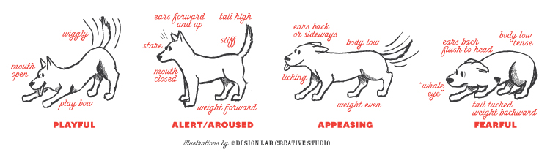
Body Language Overview

Slide 6
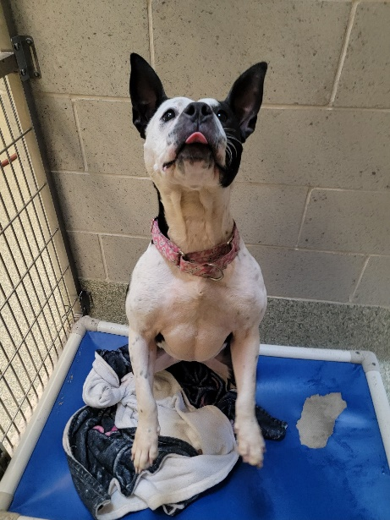
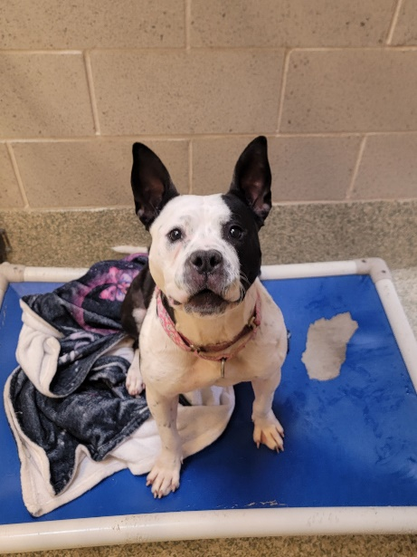
Aroused Body Language
Signs of arousal:
Piloerection (hackles), redness around mouth and eyes, excessive panting, high wagging tail, jumping, mouthing or arousal biting, leash grabbing, pulling, pacing, barking/vocalizing
Reasons for arousal:
Increase in adrenaline
Excessive energy from long hours in their kennel
Walks with volunteers are the highlight of their day

Slide 7
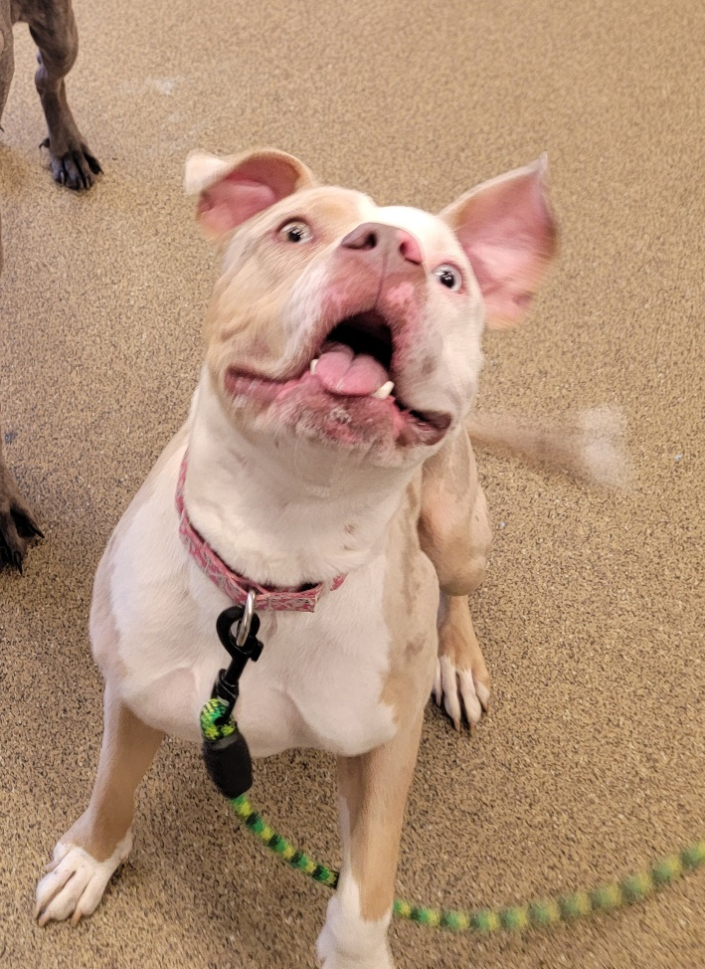
Aroused Body Language
Tips
Control your surroundings:
Remain calm
- Keep distance from other dogs
- Avoid stressful stimuli
Disengage in play when overly aroused
Don’t hesitate to radio for assistance when needed.
Encourage working on basic cues and sniffing out treats to lower arousal levels

Slide 8
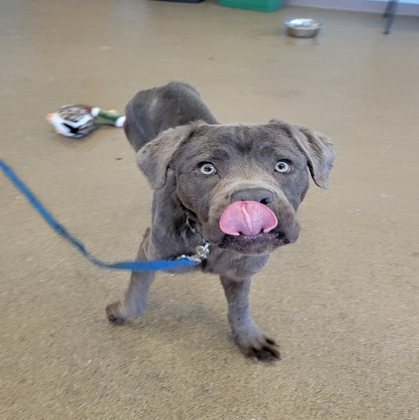
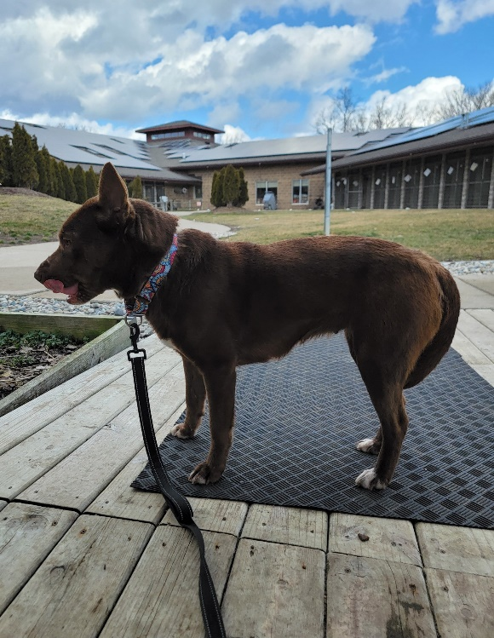
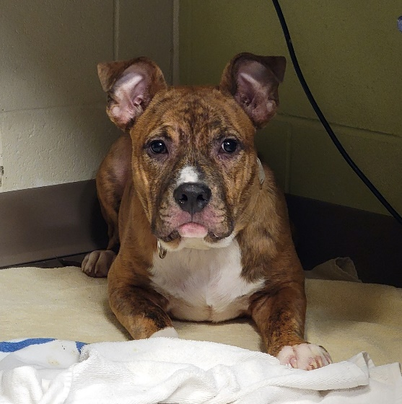
Fearful Body Language
Reasons for fear at the shelter:
New environment, changes, stress, strangers, genetics, past experiences.
Signs of fear:
Averting gaze, whale eyes, lip licking, pinned ears, tucked tail, paw lift, yawning, low head and body, avoidant, may be offering appeasing body language
It is important to recognize low levels of fear and respect the dog’s space, so they do not feel the need to progress to higher levels of fear.
Carefully review the next three slides

Slide 9
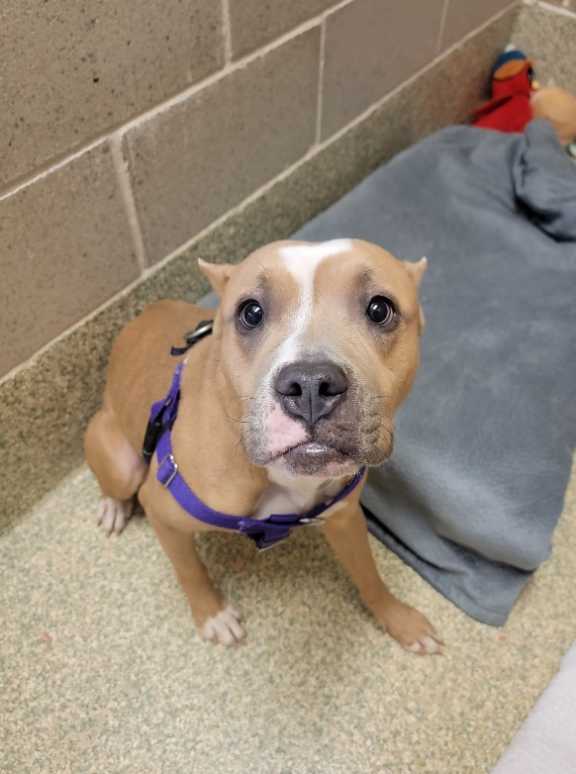
Fearful Body Language
Tips:
Refrain from approaching or reaching towards a fearful dog. Instead, offer space, turn your body sideways, avoid eye contact, and gently toss treats.
Patience and a calm demeaner are key.
Remove items that obscure your face such as sunglasses and hats.
Recognize the subtle signs of fear and refrain from putting the dog over threshold.
If the dog remains fearful and overly stressed, discontinue the interaction and leave a detailed note in the dog walking binder.

Slide 10
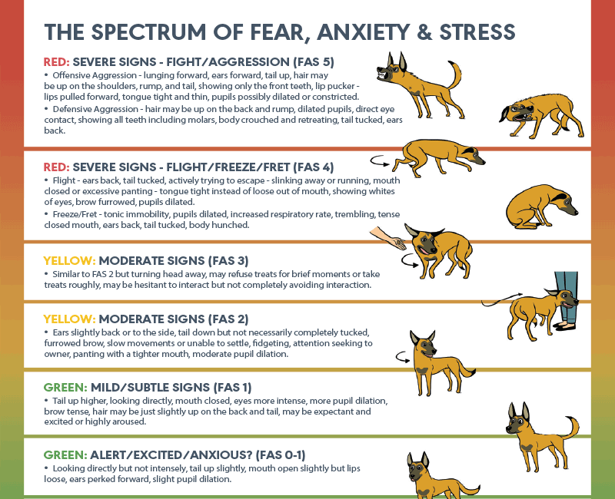
https://fearfreepets.com/

Slide 11
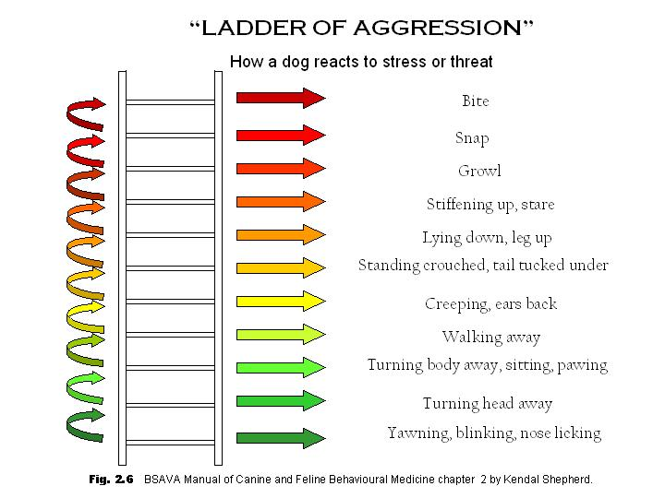

Slide 12
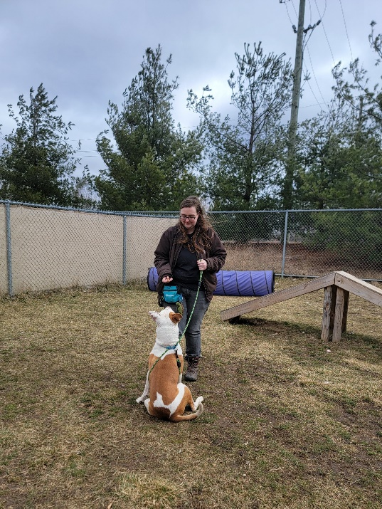
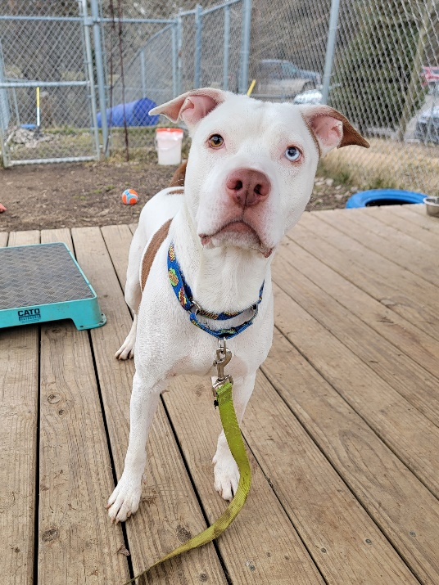
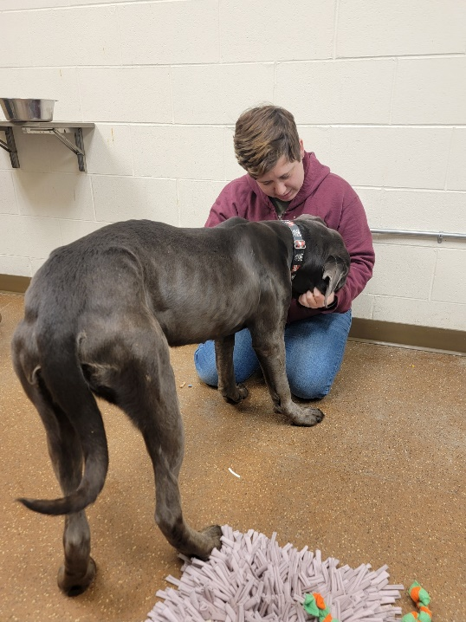
Interacting with Blue Dot Dogs

Slide 13
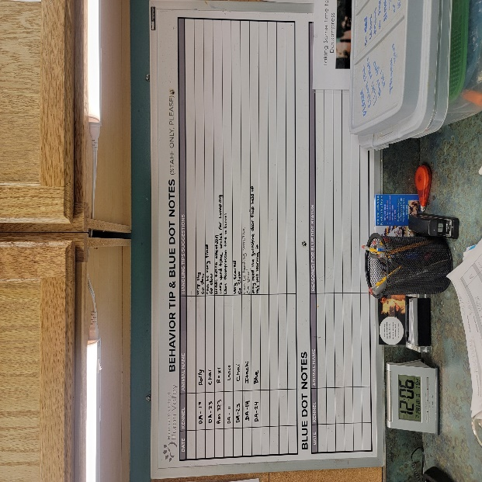
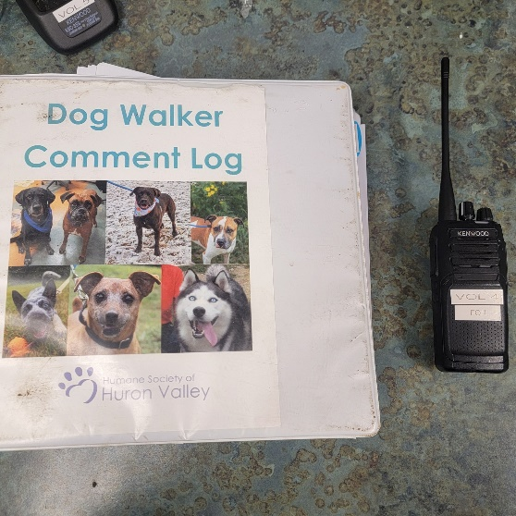
Preparing for a walk
Review prior walker notes in the binder
Check for tips on the blue dot walker board
Check their required tools, prepare any needed items, and follow all signage
Always have a radio and treats

Slide 14
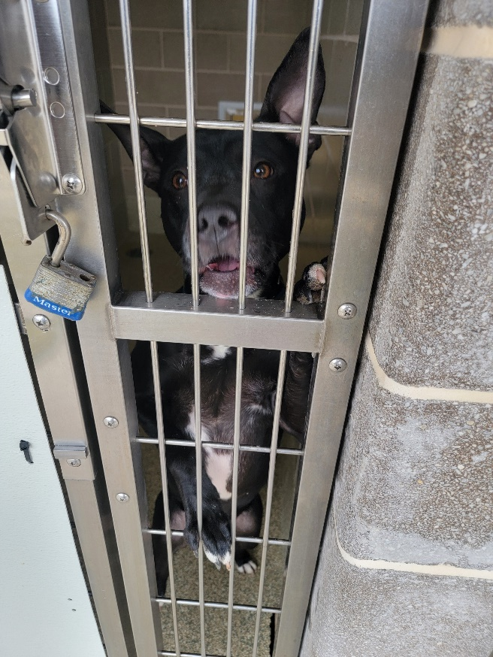
Entering and Exiting the Kennel: Aroused Dog
Toss treats to the back of the kennel before entering
Ask the dog to sit for another treat. Then,
  Offer a licki mat, spray cheese, or stuffed animal if required
  If a harness is required:
    Offer a treat through the harness as the dog approaches
    Clip the harness then treat
    Clip the leash to the harness and collar then treat
  If leash wrapping is required:
    Clip the leash to the collar and then treat
    Wrap the leash and then offer a treat again
  Before exiting:
    Check your surroundings
    Encourage four paws on the floor
    Walk quickly through the Red zone

Slide 15
Entering and Exiting the Kennel: Aroused Dog
Toss treats to the back of the kennel before entering
1
Use any required tools for leashing
2
Treat frequently during leashing and harnessing
3
Ensure four paws on the floor before exiting
4
Walk quickly through the Red Zone
5

Slide 16
During the walk: Aroused Dog
Walking through the Redzone:
Follow bowl game if required or toss treats forward
If the dog is focused on the kennels or other dogs, call their name and give a “yes” and treat when they respond by looking back at you. Continue walking out of the Redzone.
Jumping and mouthing during the walk:
Shorten leash, hold it high and out.
Refrain from looking directly at the dog and from petting
Refocus the dog with basic cues or treat scatter/nose work
Encourage forward progress with periodic treat tossing
Remain calm and radio if you need assistance
Reactivity during the walk:
Increase distance from other dogs
Redirect the dog by calling their name and giving a treat when they respond
Finish with a calm decompression lap and nose work/treat search before returning to the kennel

Slide 17
After the walk: Aroused Dog
Ask the dog to sit for a treat while you unleash
If they become overly aroused and jumpy:
Calmly work on sitting for treats
Toss more treats to the back of the kennel and exit
Optional but encouraged:
Dogs can be more aroused after a fun an engaging walk, causing them to be stressed when returned to their kennel.
Volunteers are encouraged to make dogs an enrichment item in the dog kitchen or toss them a new toy after interactions!

Slide 18
Entering and Exiting the Kennel: Fearful Dog
Toss treats to the back of the kennel and enter.
Remain near the door and kneel down, staying sideways to the dog. Avoid eye contact and wait for the dog to choose to approach you.
Be patient, keep tossing treats, and speak with a soft, friendly voice.
When the dog approaches:
Continue tossing treats down and only offer food from your hand if the dog is comfortable
Before attempting petting, offer your hand low and let them sniff. Engage in consent checks – briefly stop petting every 3-5 seconds to see if they solicit more with social body language or if they give stress signals and need space.
Show the leash then offer a treat before attempting to clip it.
If the dog is avoidant, turns away, lifts paw, etc. refrain from continuing
Once leashed, stand up slowly and check your surroundings before exiting

Slide 19
During the walk: Fearful Dog
Red Zone
Walk quickly through the Redzone but avoid pulling the dog or having tension on the leash.
Encouragement
Use treats to encourage the dog to continue through the walk
Rewarding
Use treats to reward the dog for being brave
If they’re hesitant when other dogs are nearby, keep your distance and say “yes” and give a treat when they look at the dog.
Frequently rewarding will help them gain confidence
Confidence Building
Practice teaching their name and give treats when they respond by looking at you.
Radio
If they are showing high levels of fear during the walk or if they lay down and refuse to continue, radio for assistance.

Slide 20
After the walk: Fearful Dog
After returning to their kennel, kneel sideways by the door, averting eye contact and remain in a non-threatening position.
Slowly offer a treat and light petting (if interested) then slowly unclip the leash and treat again. Toss treats to the back of the kennel and exit.
If they are showing fear, anxiety, or stress:
Be patient and refrain from reaching towards them.
Toss treats nearby and offer soft, encouraging words.
Practice reaching towards them and treating a few times before attempting to unclip.
If they are still showing high levels of FAS: leave the leash attached, toss treats, and exit the kennel. Then, note it on the behavior alert board and in the walker notes binder.
Optional but encouraged:
Dogs can have an increase in cortisol after returning to their kennel, causing additional stress.
Volunteers are encouraged to make dogs an enrichment item in the dog kitchen or toss them a new toy after interactions!

Slide 21

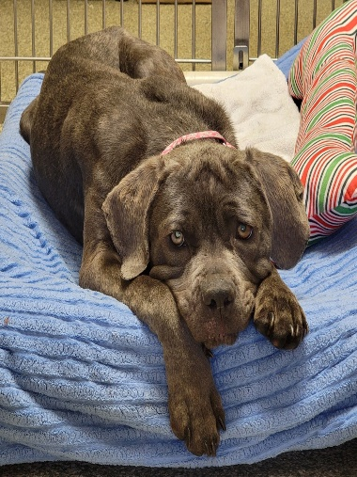
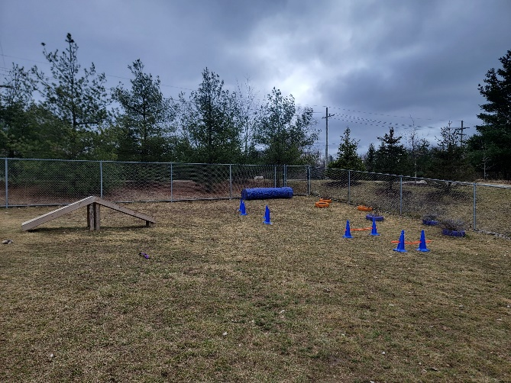
Activities to consider
Play yard
Watch for overarousal and encourage decompression breaks to practice basic cues and search for treats.
Toss a treat scatter around the yard after play
Calm decompression lap on the trail before returning to kennel
Always give a new toy or enrichment item after play yard time
Front trail walk
Beneficial for reactive dogs
Helps get out excessive energy and gives them different scent trails and scenery
Decompression time
Good for fearful and aroused dogs
Sit in the gazebo, play yard, on a bench, or in their kennel
Give calm attention and light petting
Opportunity to give treats for looking at stimuli like other dogs and not being reactive
Can also be done in the temp test room or ed center when available

Slide 22
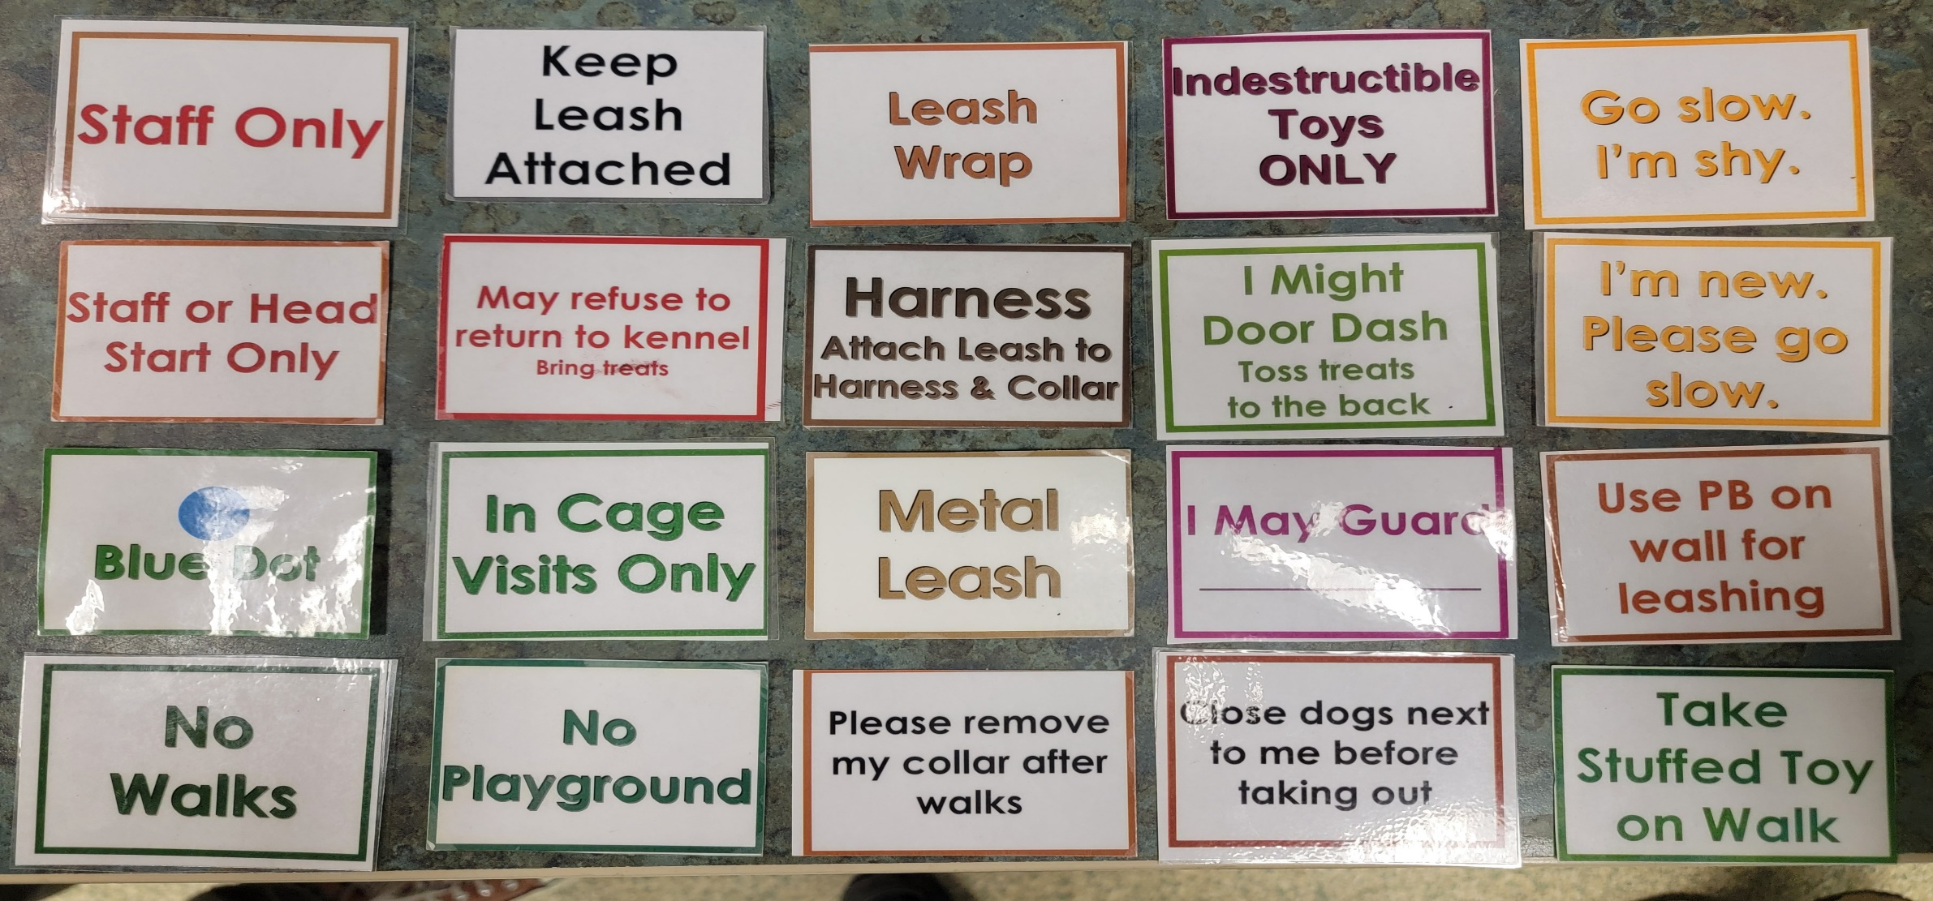
Reminder: Follow All Kennel Signs

Slide 23
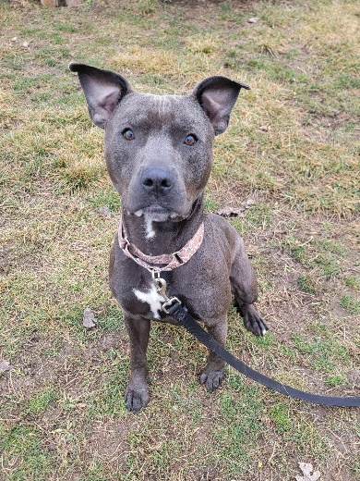
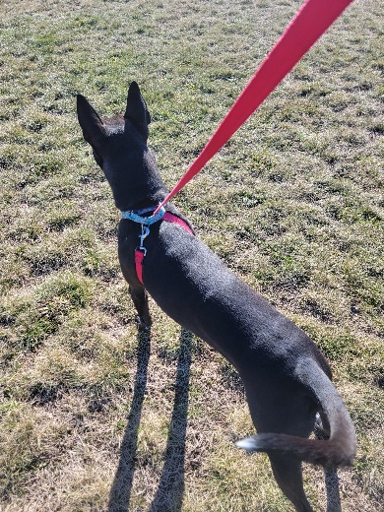

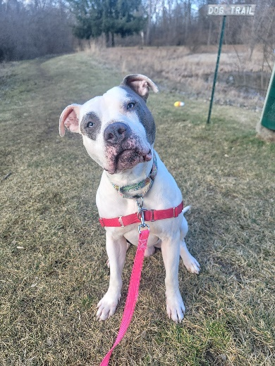
Walking Tools
Standard leash
Always clips to the martingale
Leash wrap
Clip to the martingale, wraps behind their front legs, loops through the martingale
Metal leash
Required for leash grabbers/biters
Easy walk harness
Required for dogs that pull or have concerns with leash pressure on their neck
Clip leash to the harness and martingale unless otherwise noted on the kennel sign

Slide 24
Notes and Alerts
Binder for walking notes
Notes are highly important for monitoring progress
Be as thorough as possible and refrain from subjective language
Read prior walker notes before taking a dog out
Blue dot dog notes board
Additional notes that are specific to certain dogs
Always check this board before walking
Behavior alert board
Checked daily by the behavior team
Important for noting concerning and/or sudden changes in behavior
Not for medical alerts. If you think a behavior may be the result of a medical concern, report on both the behavior alert board and the medical alert clipboard

Slide 25
Subjective vs. Objective Language
Objective language uses concise facts and detailed information
Subjective language uses our perspectives, feelings, or opinions
Using objective language helps us more accurately understand body language and interactions and is vital when recording notes
Example:
  Subjective: Aries was pretty good today. He was only aroused at first, but he calmed down quickly and was very sweet.
  Objective: Aries pulled hard through the Redzone, whining and panting with full piloerection. Once past the gazebo, he began loose leash walking and taking treats. He frequently looked back at me and solicited attention with a neutral wagging tail and loose wiggly body.

Slide 26
Reminders
Always stay within your comfort level.
Confidence and skill comes with practice and repetition.
If you’re tired after a difficult walk, take a break with some decompression time or walk a lower level dog.
If you have a question about an animal, staff and the behavior team are always available.
The behavior office is located directly across from the laundry room and is staffed 7 days a week.
Never be afraid to radio for assistance or ask for advice.

Slide 27
Thank you for being a Blue dot walker!

