Slide 1
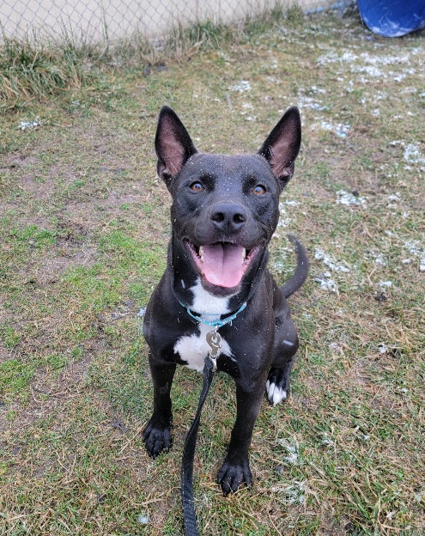
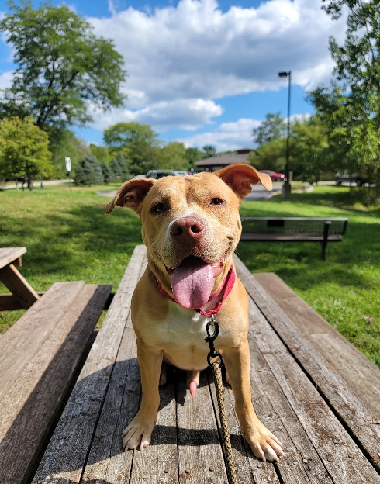
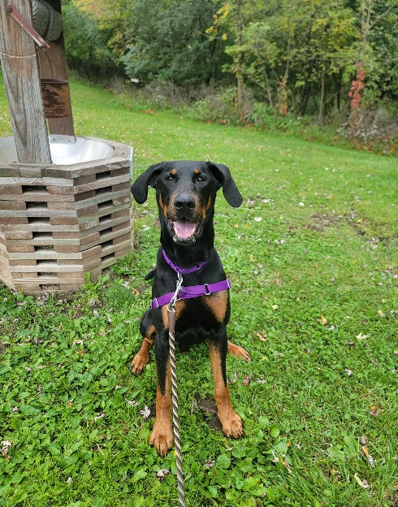
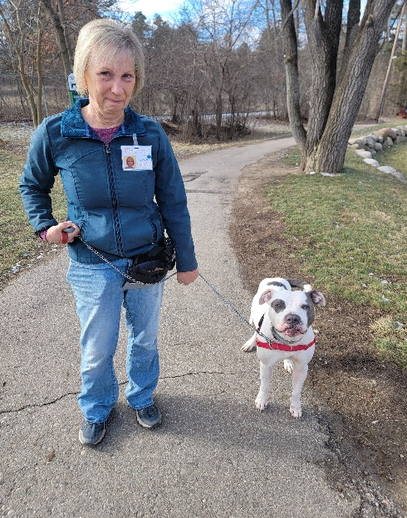
Head Start Dog Walking Training

Slide 2
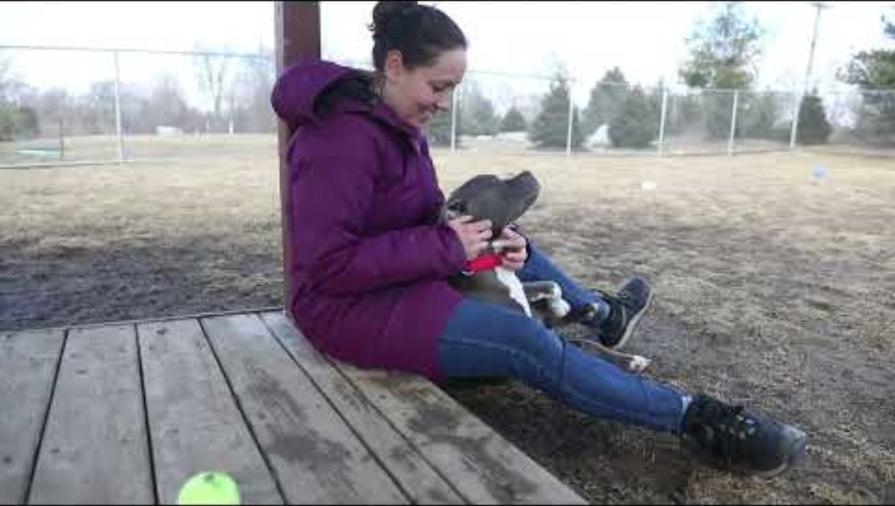
Introduction Video

Slide 3
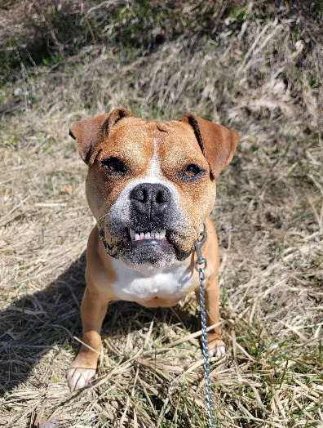
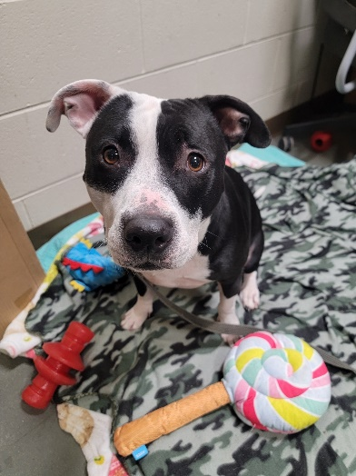
What is a Head Start Dog?
High arousal levels - May include some or all of the following:
  Jumpy and hyperactive
  Mouthy/arousal bites
  May be reactive to dogs, people, and/or other external stimuli
  Difficult to leash and may require multiple walking tools
  Unsettled in the shelter and in need of extra one-on-one attention
  In need of intervention through training and management
Fearfulness – May include some or all of the following:
  Body handing and leash sensitivity
  Shows FAS (fear, anxiety, stress) around dogs, people, the shelter setting, and/or other external stimuli
  Lacking confidence and may be in fear shutdown
  In need of intervention through training and management

Slide 4
Head Start Dogs vs. Head Start Walker Level
Head Start Dogs:
These Dogs are on the Headstart training team roster and are assigned a number 1-8, with number 1 being the dog with highest priority/training needs.
They may not be at the Headstart walker level. Some Blue dot dogs are in high need of training too!
Head Start Walker Level:
These Dogs are often new or have a higher level of difficulty and/or fear during walks
They will usually follow one of two paths:
Become a Blue dot or Level 1 walker, once we have a better understanding of the dog and they become more adjusted to the shelter setting
Remain a Headstart walker level and eventually join the HeadStart training roster.

Slide 5
Back of House (BOH) Head Start Dogs
New to the shelter:
These dogs have just recently arrived at the shelter.
Dogs that benefit from residing in holding:
Have a high level of need and benefit from extra attention and enrichment.
The staff are still getting to know their needs and personalities.
HS volunteers help us get to know these dogs and make them more comfortable at the shelter.
Always read body language carefully and go slow with new dogs
Any dogs displaying high levels of FAS or aggression will always be “Staff Only”
They often have been unsuccessful in the adoptable dog area or are not ready to move there because of high levels of fear, anxiety and/or reactivity towards the higher volume of people and dogs.

Slide 6
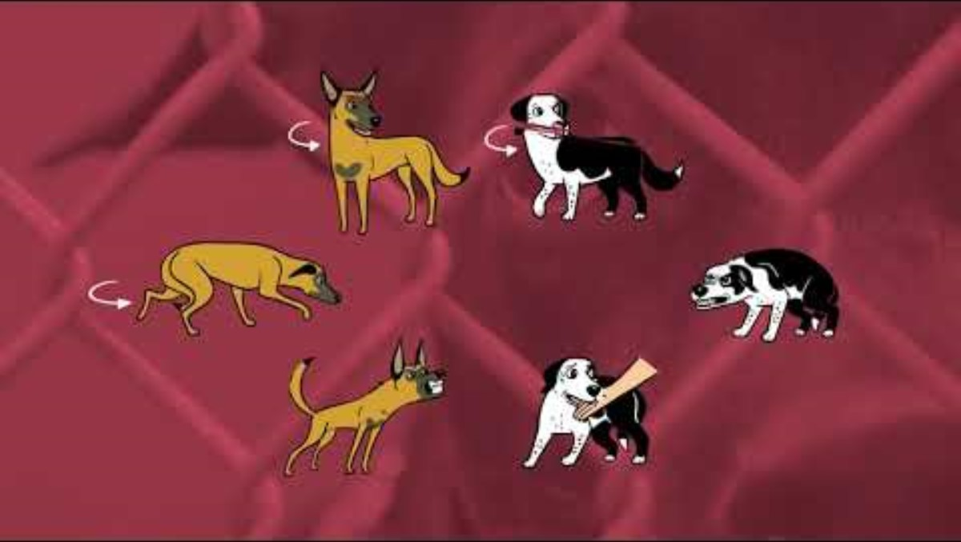
Body Language Overview

Slide 7
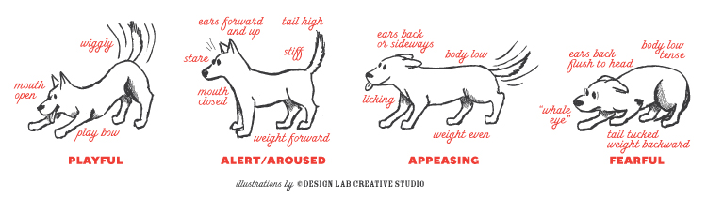
Body Language Overview

Slide 8
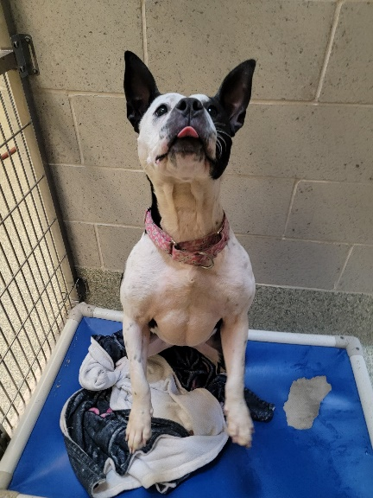
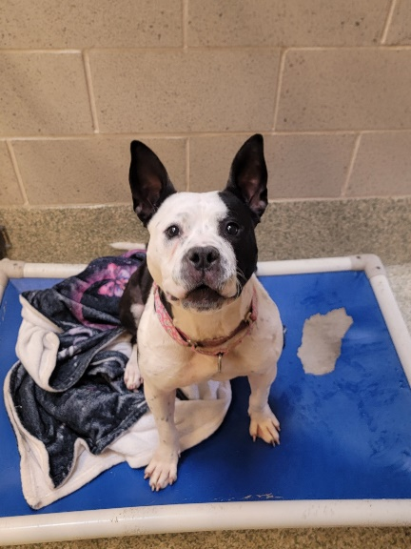
Aroused Body Language
Reasons for arousal:
Increase in adrenaline
Excessive energy from long hours in their kennel
Engaging with volunteers is the highlight of their day
Signs of arousal:
Piloerection, redness around mouth and eyes, excessive panting, high wagging tail, jumping, mouthing or arousal biting, leash grabbing, pulling, pacing, barking/vocalizing
Tips:
Control surroundings (distance from other dogs, avoid stressful stimuli)
Remain calm, always revert to decompression activities when arousal increases. Frequently practice basic cues and sniffing out treats to lower arousal levels. Always disengage in play when overly aroused

Slide 9
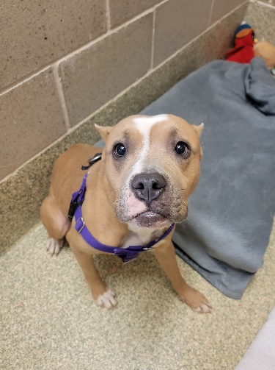
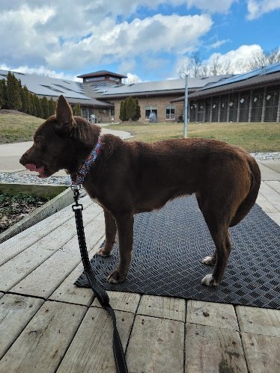
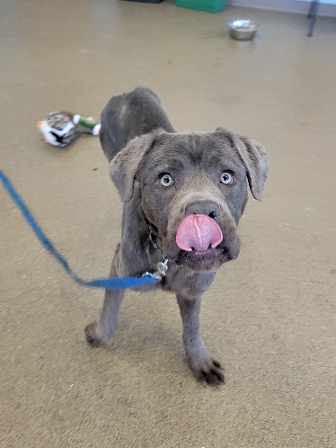
Fearful Body Language
Reasons for fear at the shelter:
New environment, changes, stress, strangers, genetics, past experiences.
Some signs of fear:
Averting gaze, whale eyes, lip licking, pinned ears, tucked tail, paw lift, yawning, low head and body, avoidant, may be offering appeasing body language
It is important to recognize low levels of fear and respect the dog’s space, so they do not feel the need to progress to higher levels of fear.
The next two slides provide important body language refresher information.
Tips:
Refrain from approaching or reaching towards a fearful dog. Instead, offer space, turn your body sideways, avoid eye contact, and toss treats.
Patience and a calm demeaner are key.
Remove items that obscure your face such as sunglasses and hats.
Recognize the subtle signs of fear and refrain from putting the dog over threshold.
If the dog remains fearful and overly stressed, discontinue the interaction.

Slide 10
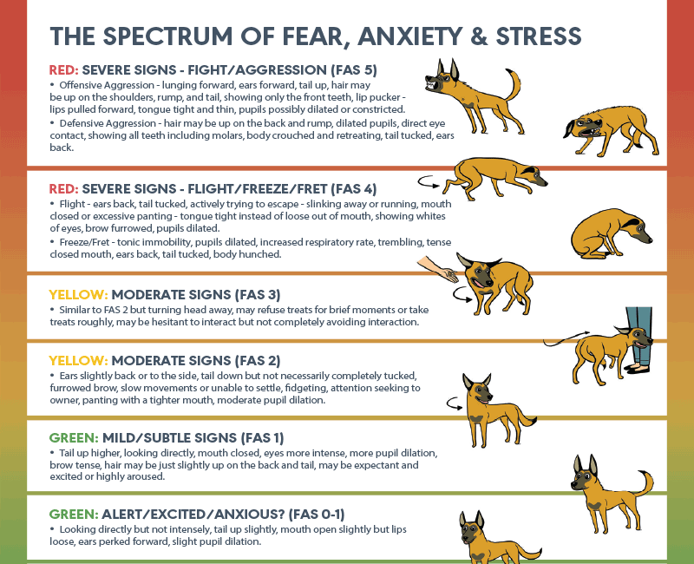
https://fearfreepets.com/

Slide 11
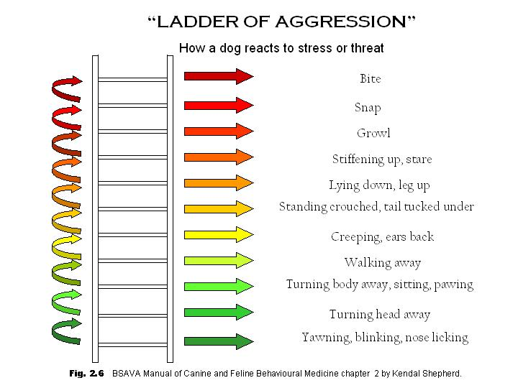

Slide 12
Objective vs. Subjective Language Reminder
Objective language uses concise facts and detailed information
Subjective language uses our perspectives, feelings, or opinions.
Using objective language helps us more accurately understand body language and interactions and is vital when recording notes.
Example:
  Subjective: Aries was amazing today. He listened well and was only aroused at first and reactive towards one dog on the trail during our training session, but we created more distance and that helped him calm down.
  Objective: Aries pulled hard through the Redzone, whining and panting with full piloerection. Once past the gazebo, he began loose leash walking and taking treats, so we started engage/disengage. We worked on looking at dogs from about 40 feet away. He had a relaxed body and responded by looking back at me for a treat each time, but once we rounded a corner and saw a dog 20 feet away, he began barking and pulling towards the dog. His body learned forward, his face was tense, and tail was high and sniff. We practiced an emergency U-turn to create distance from the dog and his barking and pulling stopped when we were over 40 feet away.

Slide 13


Overview of the Hormone Cortisol
Cortisol
  A Stress hormone produced by the adrenal gland
  Studies show that dogs residing in shelters often have higher levels of cortisol
  Going over-threshold with a trigger can cause a surge of cortisol and adrenaline. When this happens, the dog is unable to focus and train. This is why we remain under threshold during training.
  Placing a dog back in their kennel after an interaction can cause an increase in cortisol and result in an increase of FAS
    We can alleviate this stress by offering an enrichment item and a new toy after returning to their kennel.
    Offering enrichment provides the chance to engage in species specific behaviors like shredding, licking, and chewing. This can help lowers stress

Slide 14


Overview of Neurotransmitters
Studies show that dogs can have an increase in serotonin and dopamine during exercise, play, and positive interactions with humans.
Serotonin:
  A neurotransmitter that relays messages between neurons and affects mood, sleep, appetite, and concentration
Dopamine:
  The brain’s primary reward center
  Increases when dogs experience a reward/treat during training
  Engaging in the predation cycle also increases dopamine. Enriching activities like the flirt-pole and shredding enrichment offer the chance to mimic parts of the predation cycle

Slide 15
ABC’s of Dog Training
Antecedent
What is happening before the behavior occurs?
What is going on in the environment?
Is there a nearby trigger?
This is where we can try to set up the environment for successful training
Asking a dog to perform a cue is an example of an antecedent
Behavior
Observable action that occurs in response to the antecedent
Consequence
What occurred in response to the behavior?
Marking and rewarding for a behavior is an example of a consequence

Slide 16
Positive Reinforcement Training
What is positive reinforcement?
The addition of a reinforcer delivered contingent on a behavior that increases the likelihood of that behavior occurring in the future.
Providing a primary reinforcer, such as food, when a dog does something that we like or want them to continue doing.
Why do we use it?
Teaching a “marker” such as a “click” and “yes” enables us to effectively communicate which behaviors we want to see.
Positive reinforcement enables us to build a healthy relationship and gain trust from the dogs we’re working with
Why don’t we use aversive training techniques?
Harmful and aversive training techniques can worsen behavior concerns, create additional behavior issues and fear, strain our relationship and break trust with the dog, and can cause unwanted behaviors to be suppressed rather than addressed which can cause aggressive responses to triggers

Slide 17
Positive Reinforcement Training
For positive reinforcement training, we use a mark and reward system
Always mark first and then reward for a desired behavior
Common markers:
Clicker
Verbal marker:
Use a high pitched and friendly “Yes!” or “Yip!”
Common rewards:
High value food (always the default and to be used first)
Toy
Praise

Slide 18


Clicker Training Overview
Involves taking a neutral stimuli (the sound of a clicker) and pairing it with a positive reinforcer (food) to create a positive conditioned emotional response
Pairing can be established quickly, in as little as one training session
Staff and HS volunteers use the clicker to effectively communicate desired actions while working with shelter dogs.

Slide 19
Clicker Training Overview: Reminder
A click always equals a reward. If we accidentally click, still reward.
It is important to first mark the behavior and then follow it with a reward within a few seconds. This timing is the most effective delivery for positive reinforcement training
Watch your treat count. Be sure to have enough for returning to the kennel, especially when walking through the Red zone with a reactive dog or a dog that may refuse to return

Slide 20
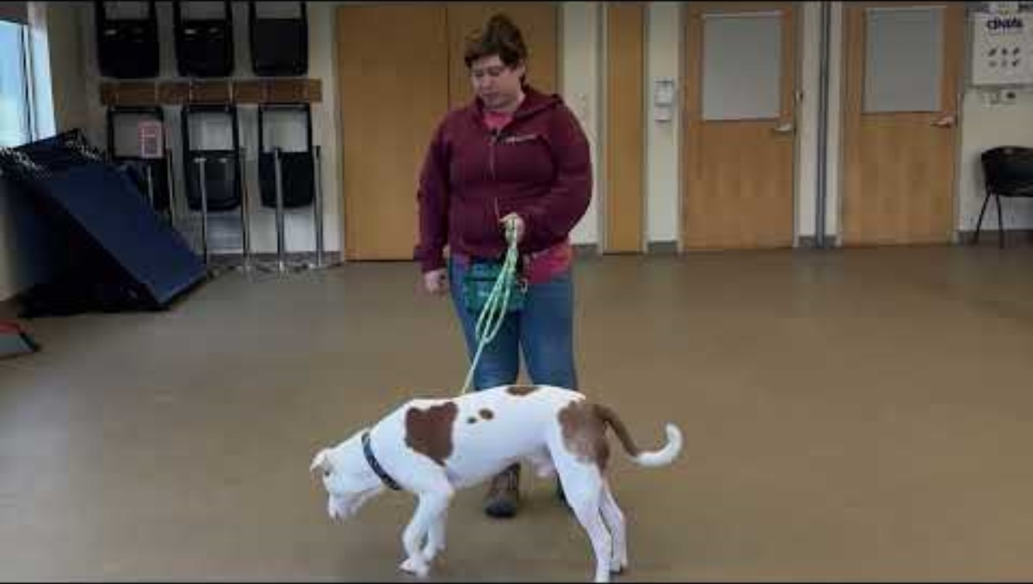
Clicker Training Video Examples

Slide 21
Head Start Resource Manual
An overview of how dogs learn, clicker mechanics, and training exercises
Provides detailed instructions for training exercises from the Karen Pryor Clicker Training Academy
Can be found in the VIC resource library and in the front of the Head Start binder

Slide 22
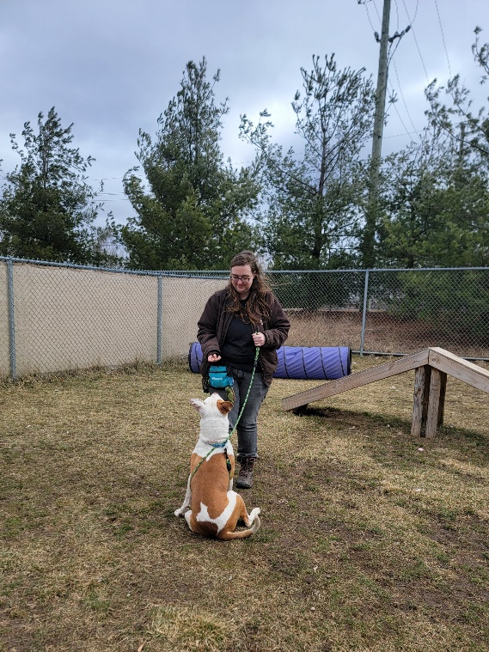
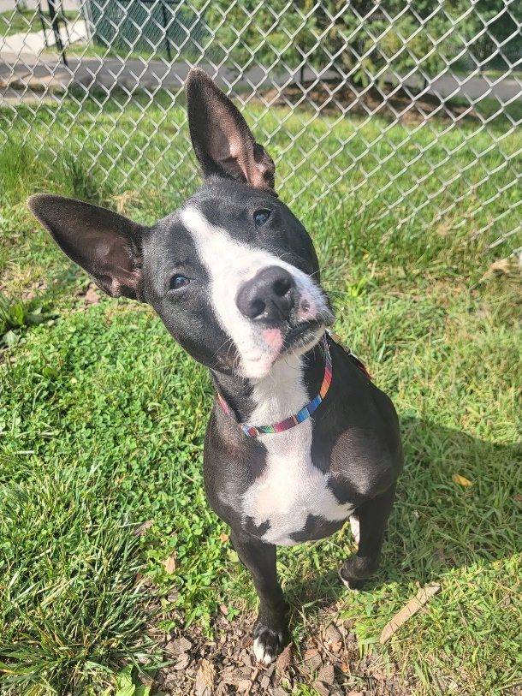
Common Training Exercises:
Basic cues
Sit, down, stay, come, shake, drop it
Name game
Click to Calm
1-2-3 Game
Hand target
Loose leash walking

Slide 23
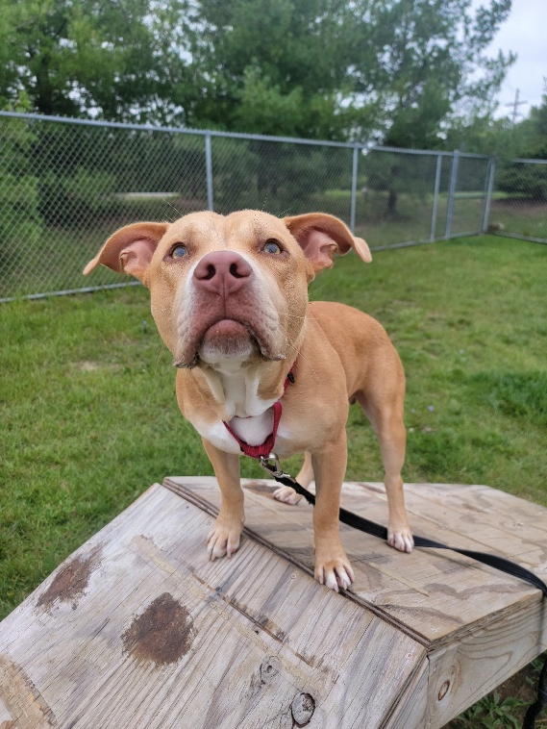
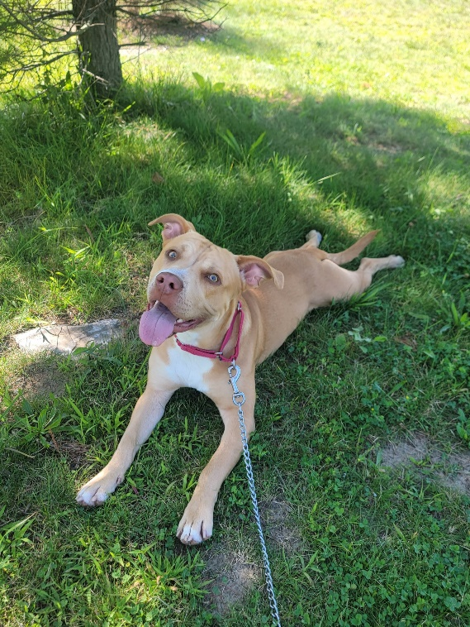
Common Training Exercises:
Desensitizing and counter conditioning
Engage/Disengage
Treat/Retreat
Consent for leashing
Nose work and “Find-it”
Go to mat/ Stationing
“Let’s go” and emergency U-turns

Slide 24
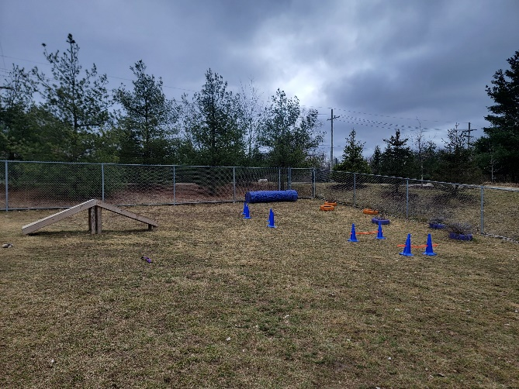
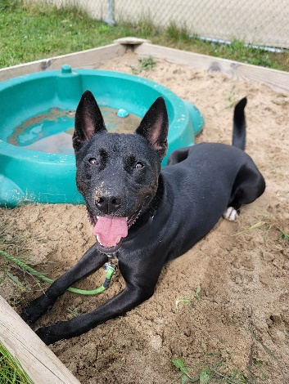
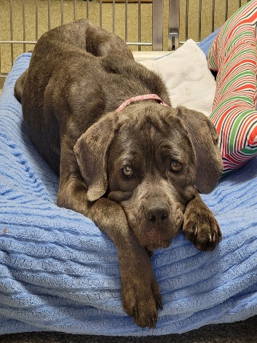
Additional Activities:
Play yard
Watch for overarousal and take frequent decompression and training breaks
Toss a treat scatter around the yard after play for calming nose work
Calm decompression lap on the trail before returning to kennel
Always give a new toy or enrichment item after play time in the yard.
Longer front trail walk
Beneficial for reactive dogs that need a break from LAT training
Helps get out excessive energy and gives them different scent trails and scenery
Decompression time
Good for fearful and aroused dogs
Sit in the gazebo, play yard, on a bench, or in their kennel
Give calm attention and light petting
Opportunity to give treats for looking at stimuli like other dogs and not being reactive
Can also be done in the temp test room or ed center when available

Slide 25
Troubleshooting Problem Behaviors: Arousal Jumping/Biting
  Remain calm and have a sturdy stance with your knees slightly bent
  Toss a handful of treats away from you to re-direct the dog
  Immediately ask the dog to “sit” or try the 1-2-3 game to encourage alternative behaviors
  If that doesn’t work:
    Hold the end of the leash in one hand at your core and take the slack with your other hand, holding the leash and dog directly away from your body
    Offer something else for the dog to bite like a toy or stick, if available
    Wrap the leash around a tree, pole, gazebo, or through a fence to prevent the dog from accessing you. This is called a back-tie
    Radio for assistance

Slide 26
Troubleshooting Problem Behaviors: Reactivity
Attempt to control the antecedent arrangements by remaining under a dog's threshold distance to a trigger.
If this fails, we can try to immediately create distance by:
The “Find-it” cue and tossing treats away from the trigger
An emergency U-turn: See training manual for detailed instructions
Rapid succession treating while creating distance
Using “Kong hand”: Hold a handful of treats in front of their nose and lure them away as they gradually lick/eat the treats
Attempt to walk the dog behind a visual barrier
Attempt to pull the dog away and create distance, only if all else fails
Call for help if needed

Slide 27
Asking for Help
Never be afraid to ask for help! There is at least one staff member from the volunteer and the behavior department at the shelter 7 days a week.
Talk to the behavior team for:
  Tips and advice about working with a certain dog
  Concerns about a dog’s progress at the shelter
  New and/or concerning behavior that you’ve seen (also record this on the behavior alert board)
Do not hesitate to use your radio when:
  A dog that struggles with arousal is not calming down
  A dog is showing high levels of FAS, frustration, or aggression
  A fearful dog has pancaked or is refusing to return to their kennel
  You’re struggling or need any type of assistance with a dog

Slide 28
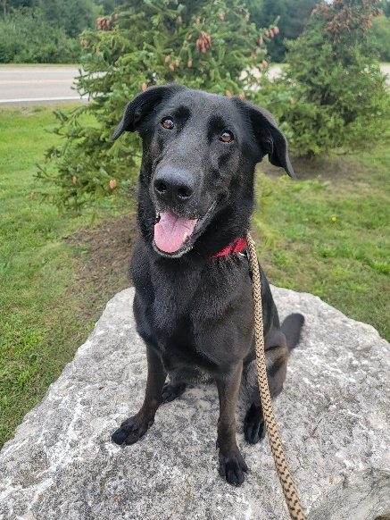
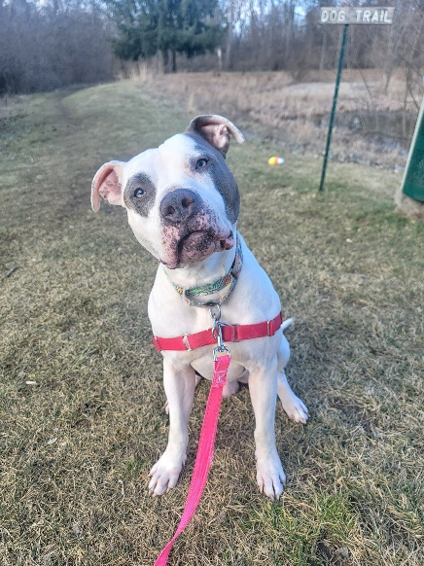
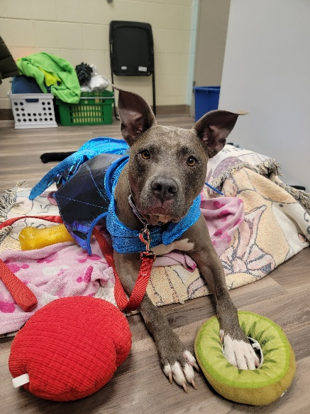
Conclusion
Head Start volunteers play a huge role at our shelter!
You help increase the adoptability of our dogs by:
Working on basic manners
Training unwanted behaviors
Building confidence
Getting their energy out
Keeping them happy, comfortable, and enriched

Slide 29
Thank you for being a Head Start Volunteer!

