Slide 1
Basic Body Language
Understanding adult cat and kitten body cues and behavior

Slide 2
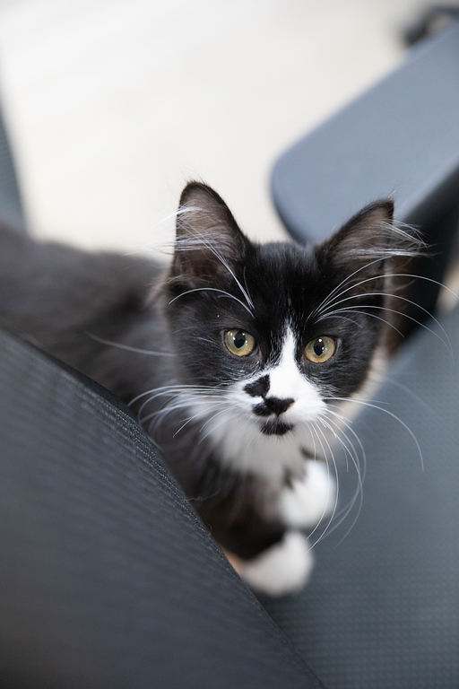
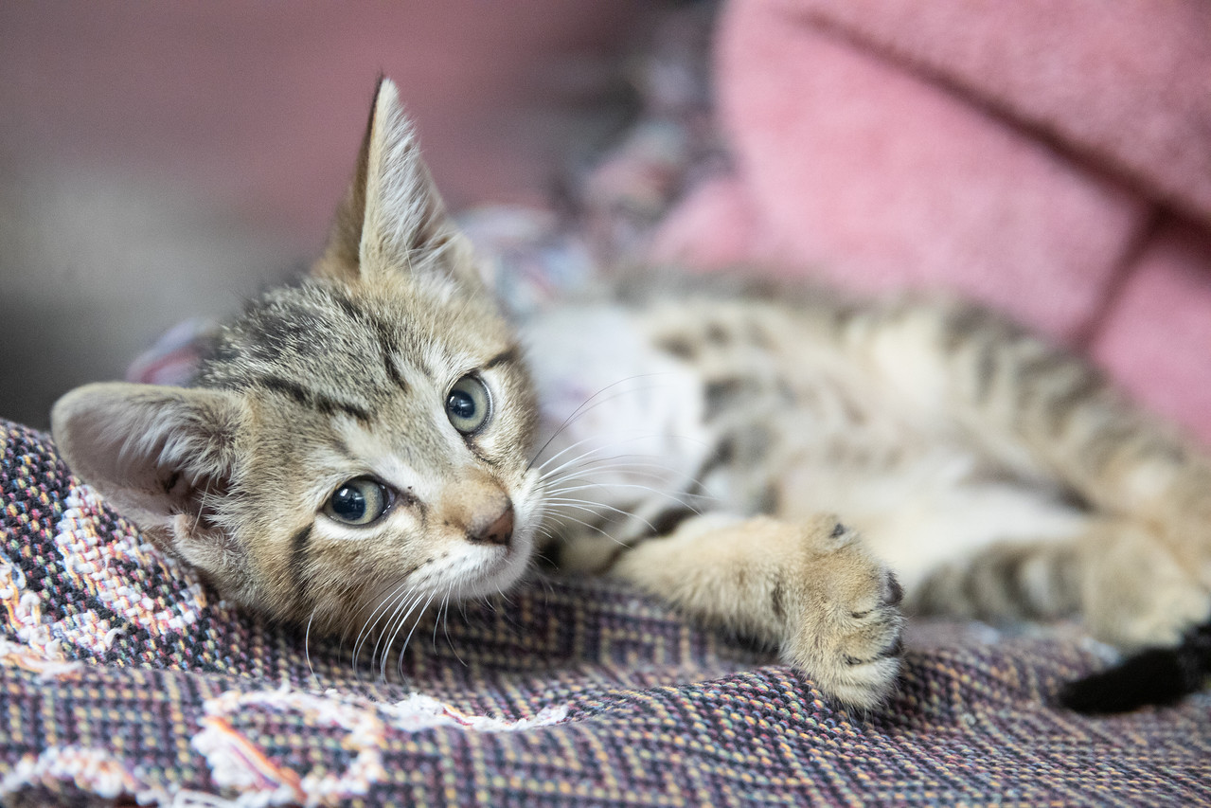
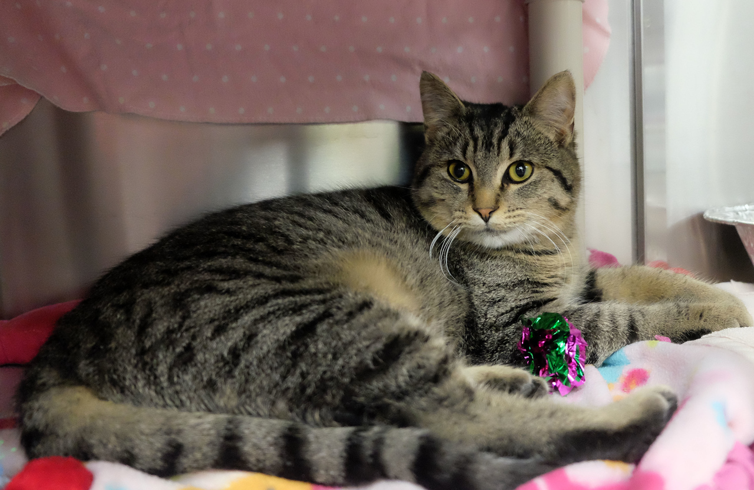
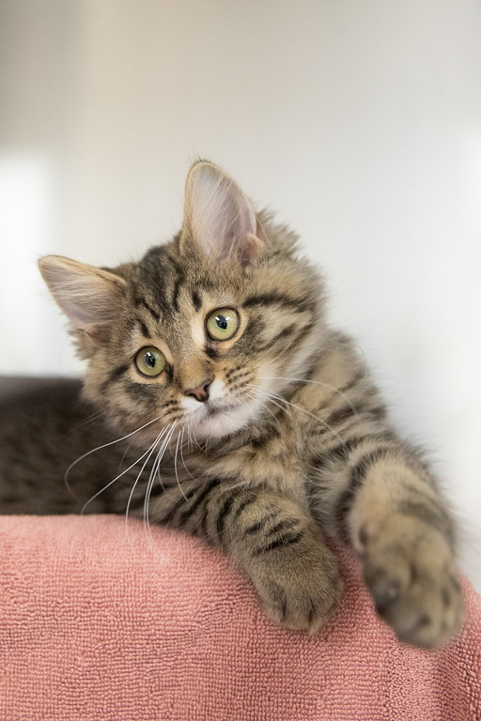
Relaxed, comfortable and at ease
Loose, soft body
Blinky eyes, oval pupils
Approach without hesitation
Napping comfortably in the open
Choosing to interact with the environment
Eating well
Not hiding

Slide 3
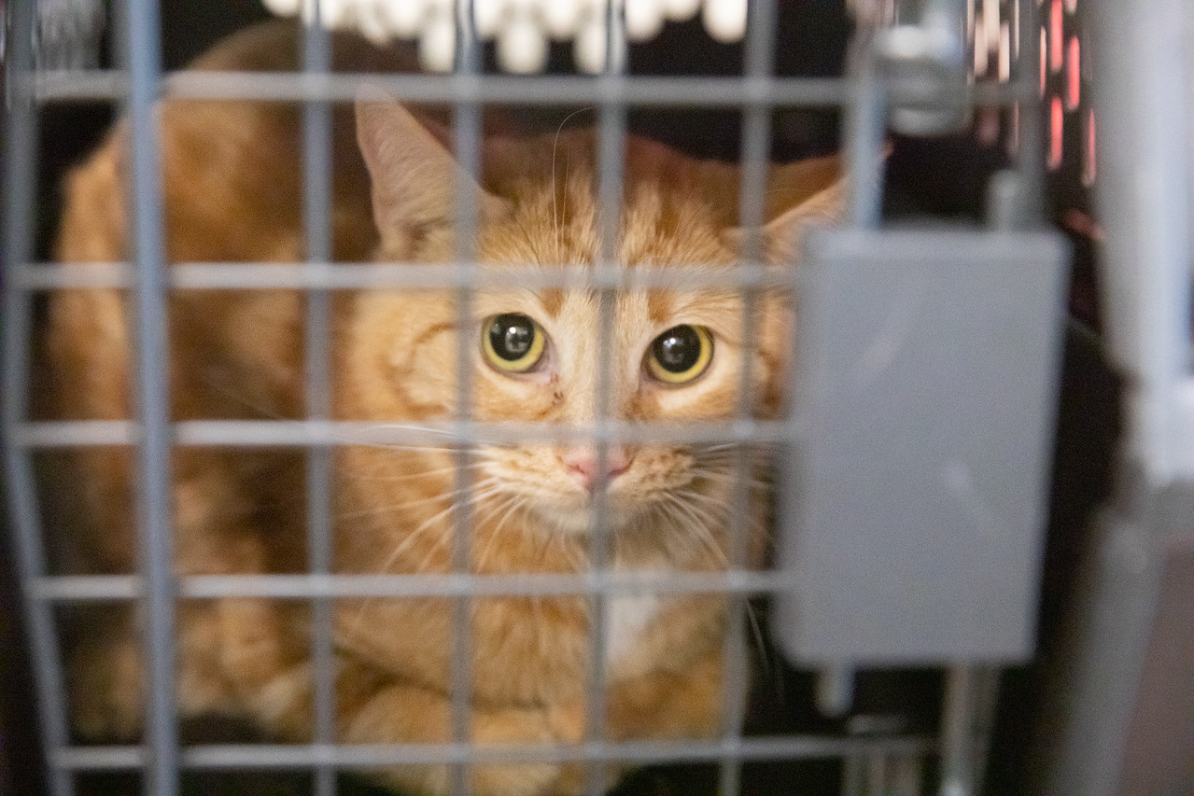
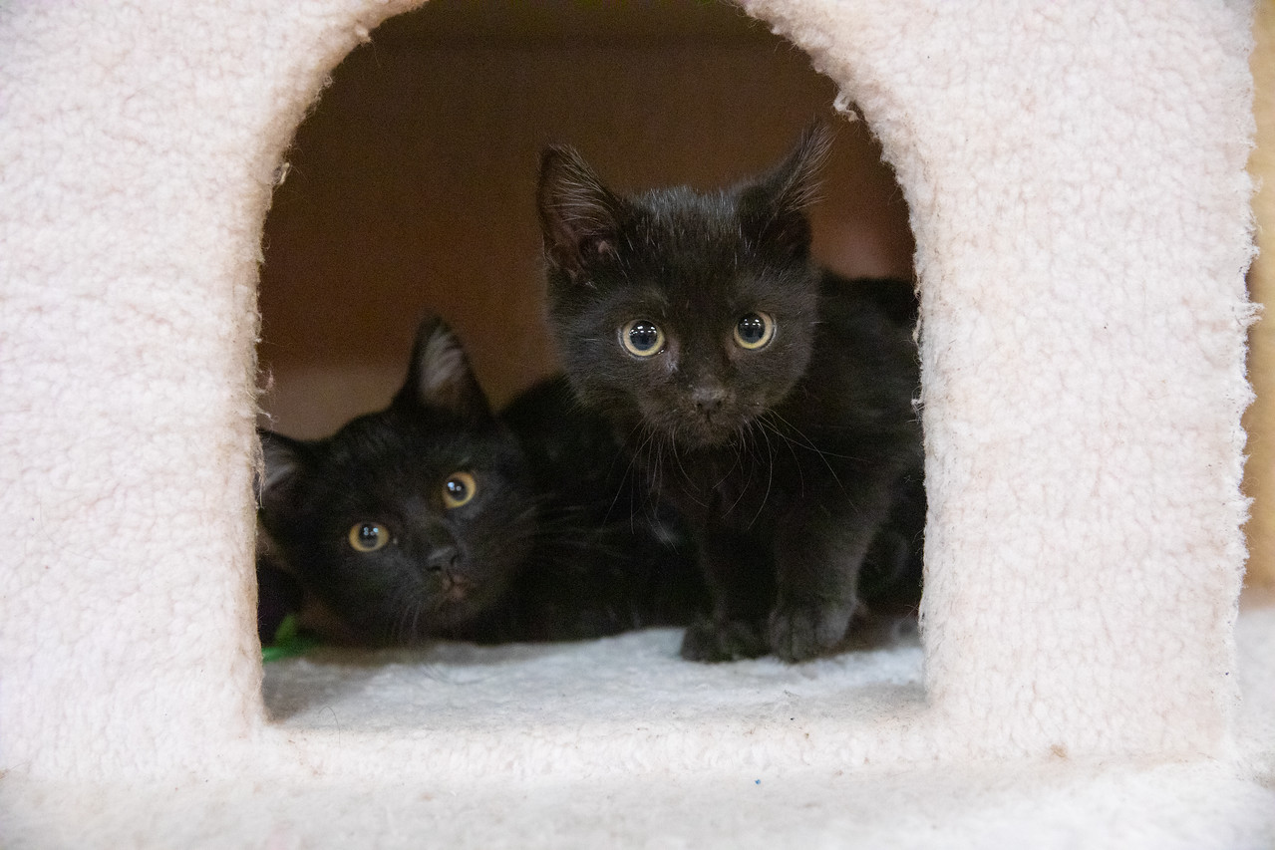
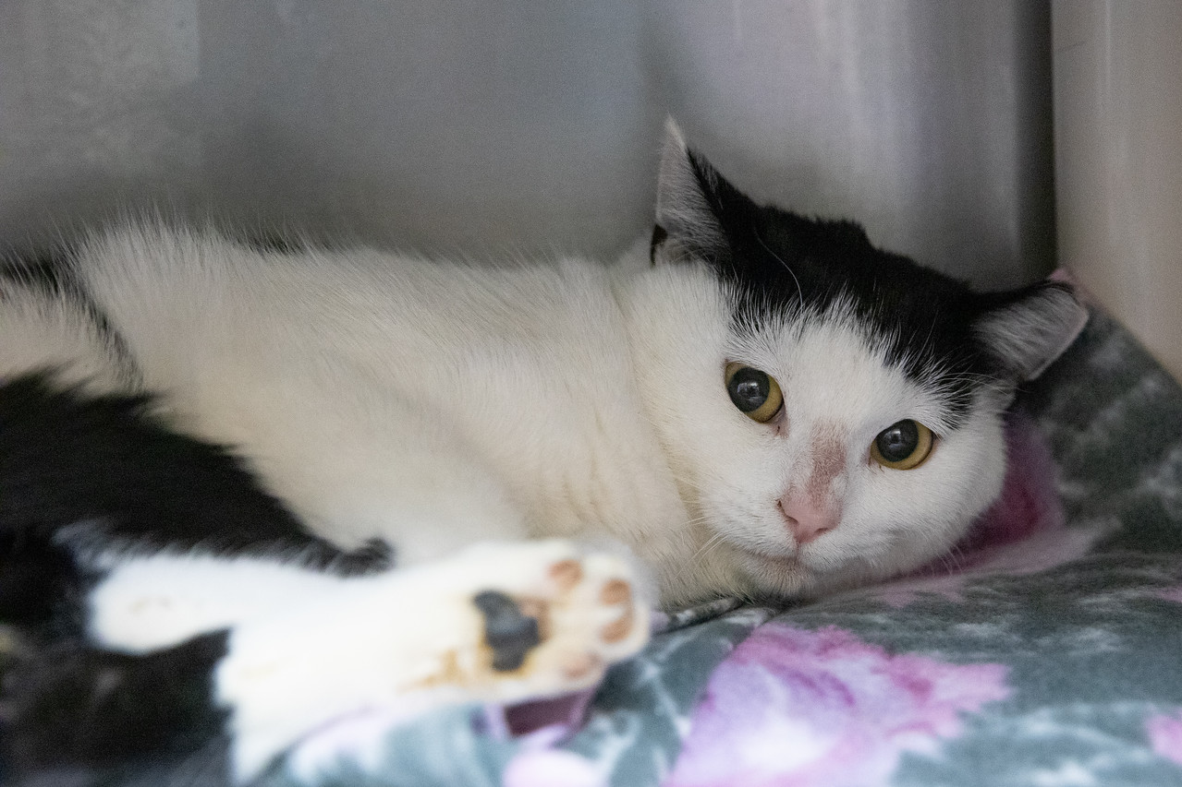
Fearful and unsure
Tense, clenched
Tail and legs pulled into body
Ears down
Pupils dilated
Stress signals
  Lip licking
  Overgrooming
Hiding
Not eating well
Not engaging with environment

Slide 4
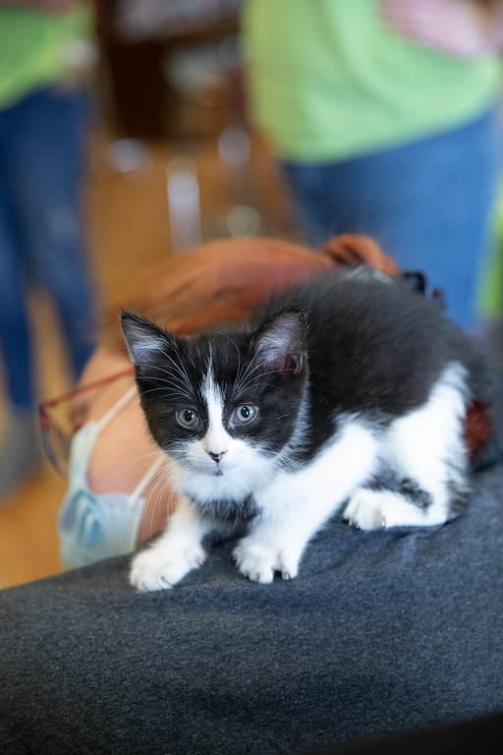
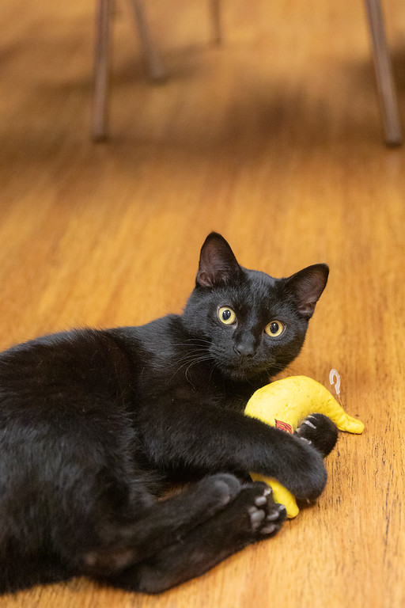
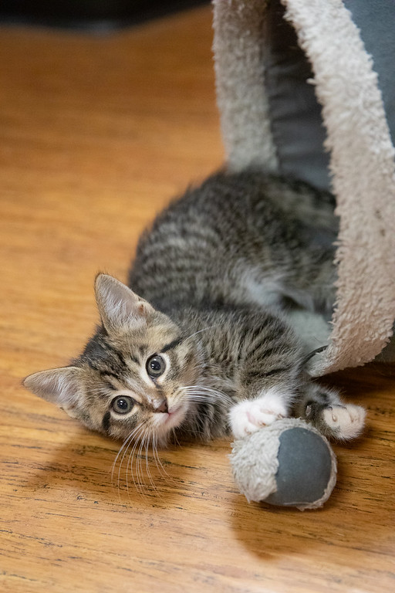
Over arousal
Coat rippling
Tail twitching
Pupils constrict
Can move from low energy to high quickly
Rough play/ nipping during touch
Use paws to direct touch or play, often with claws out
“Annoying” other cats
Can’t move from play to relaxed easily

Slide 5
How to respond to offered body language
What should we do when we see these things?

Slide 6
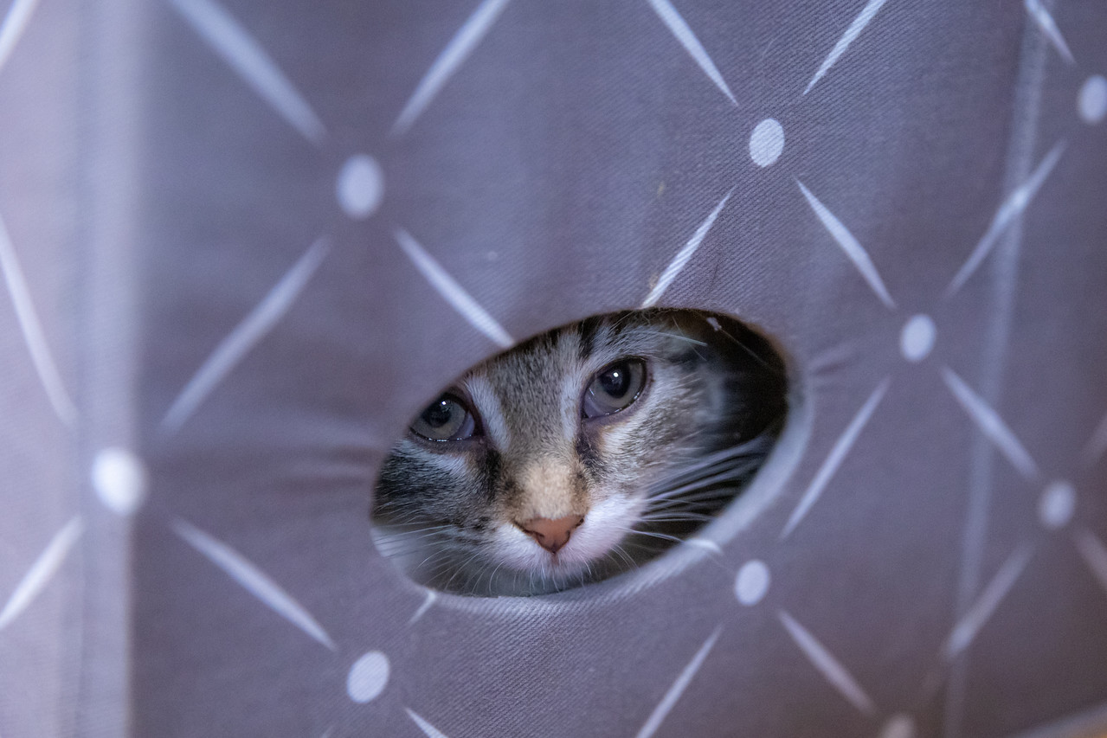
Fearful cats and kittens
Must have a safe place to hide
Use food motivators to gain trust
  Churu
  Smelly wet food
Do not force interaction
Allow them to choose
  Only touch when they offer the opportunity
  Let them hide
Consistent hiding- should likely return to HSHV for care and treatment

Slide 7
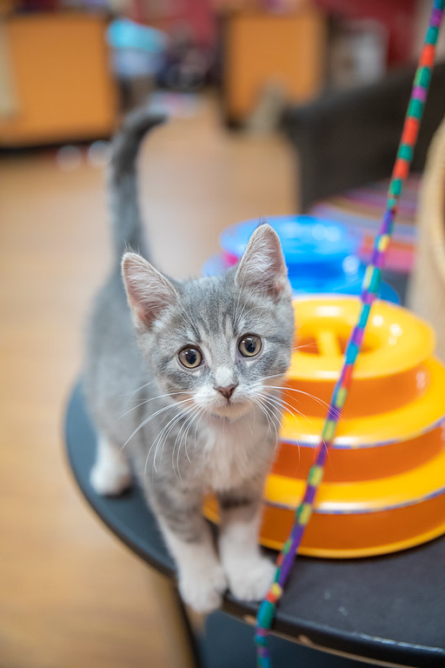
High energy, high arousal cats and kittens
Need a variety of play opportunities
Never pet while in a high arousal state
Redirect with toys
Reward with treats
Give them a game to play
  Battery operated toys can be perfect!
Only pet when calm, and only pet face and cheeks

Slide 8
Are they fighting or playing?
How to know if you’re seeing normal behavior, or reactive aggression

Slide 9
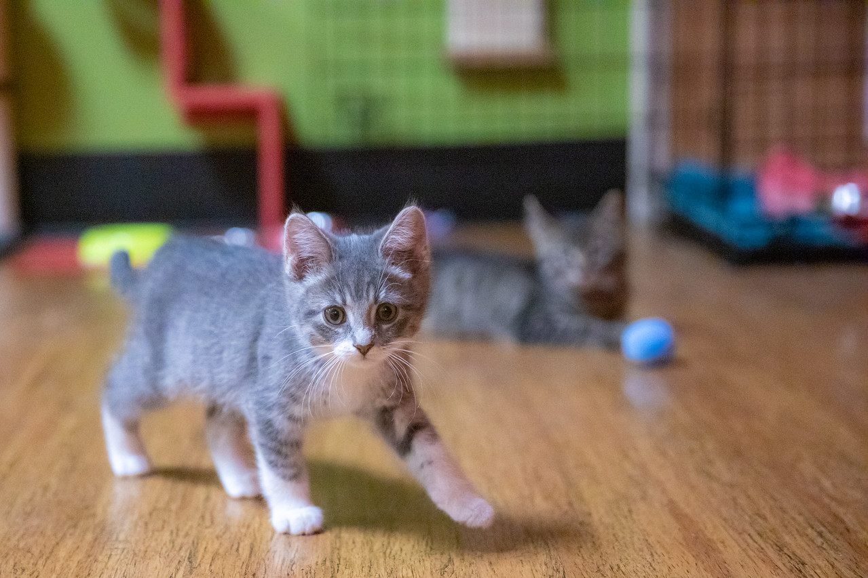
Play vs reactivity/ discomfort
Play:
  Reciprocal- both cats engaged
  One or both cats are allowed to take a break and may reengage
  If one cat leaves, the other allows them to leave
  Hissing, growling and physical play are ok if it’s reciprocal!
Reactivity/ discomfort
  Hissing, growling, with chase and one or both cats engaging with claws/ teeth
  One cat hissing or growling when another cat comes near without loosening
  On guard, alert to the other cat’s movement, may affect sleeping and/or eating for that cat

Slide 10
Helping our guests
How to help guests interact safely and respectfully with our cats and kittens

Slide 11
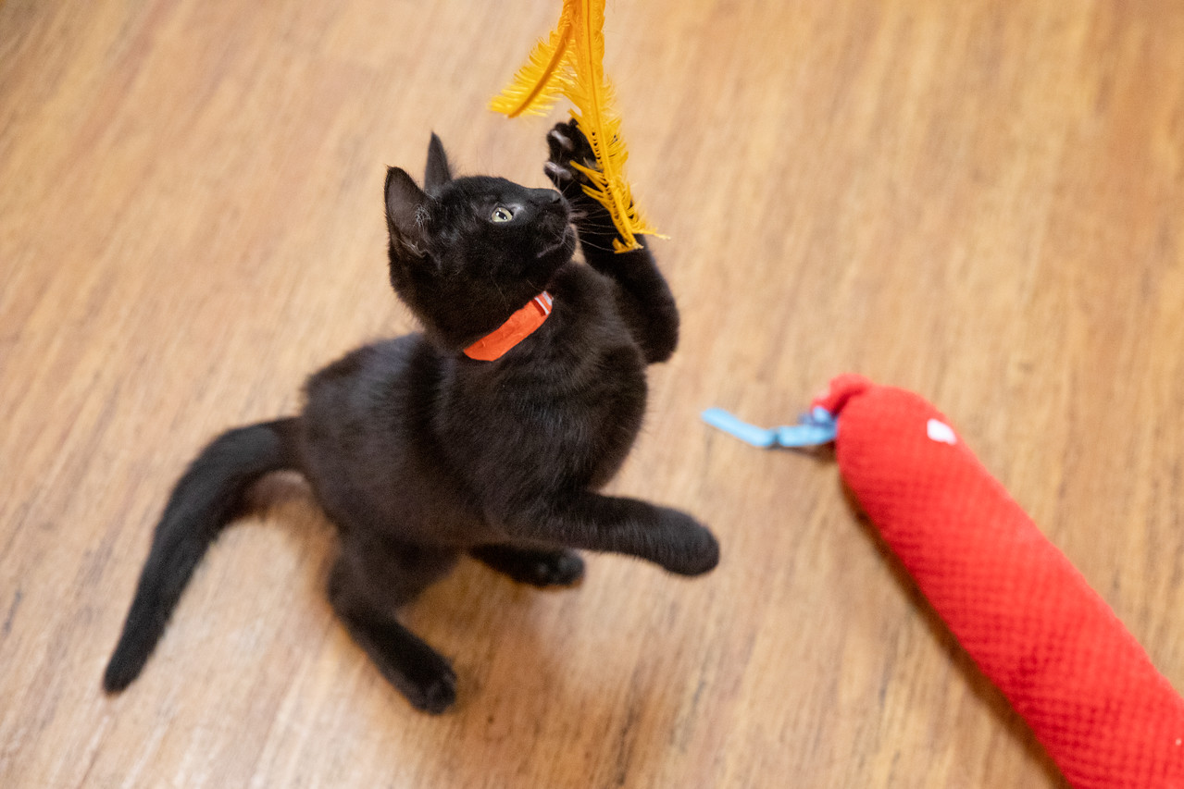
Helping our guests engage safely with our cats
Keep a close eye on body language
Always have an alternative
  Picking up/ carrying cats or kittens can be scary for them!
    Have toys and treats handy!
    Direct them to another cat who may be more comfortable with an interaction
Having toys available and ready for your customers will enhance their interactions and the safety of your cats!

Slide 12
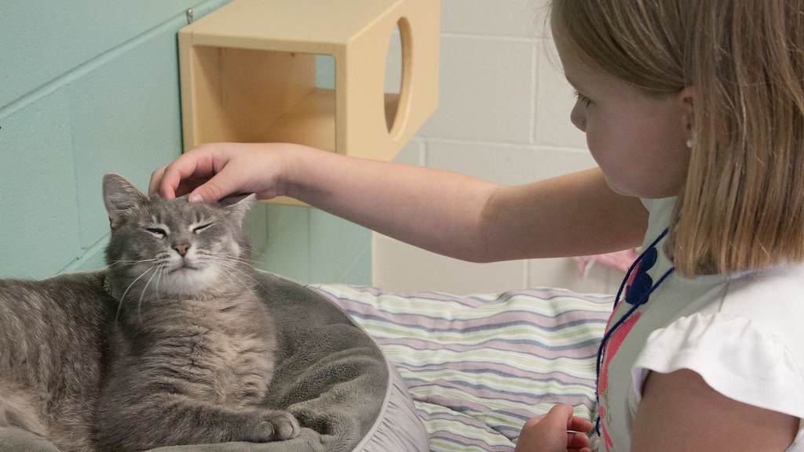

Working with Families

Slide 13
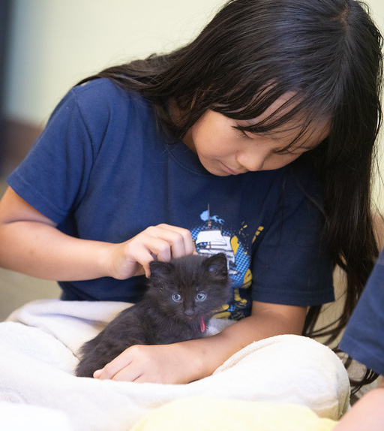

Kids at Tiny Lions
  Participants in Humane Ed programs
    Supervised by Humane Ed staff and parents/guardians
  The general public
    Go over guidelines together with children and adults upon entrance

Slide 14
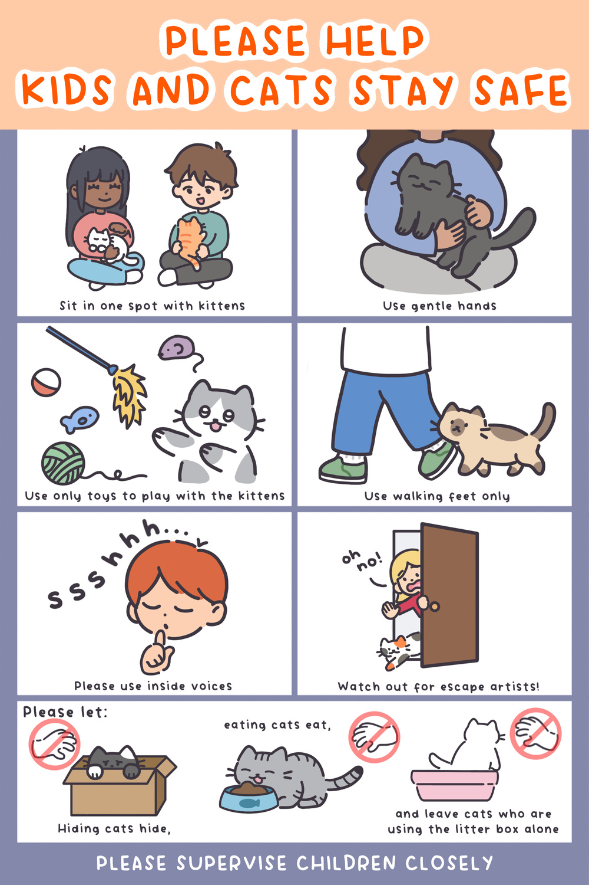
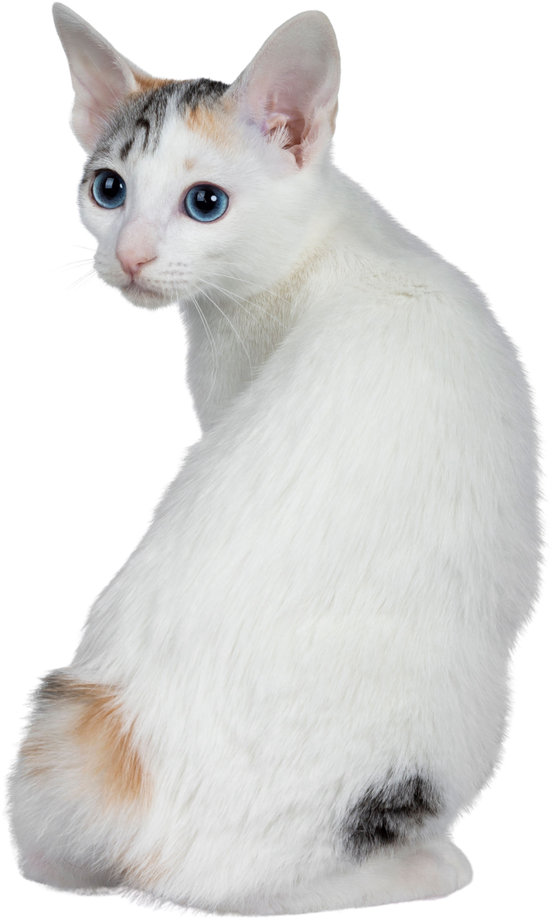


Slide 15
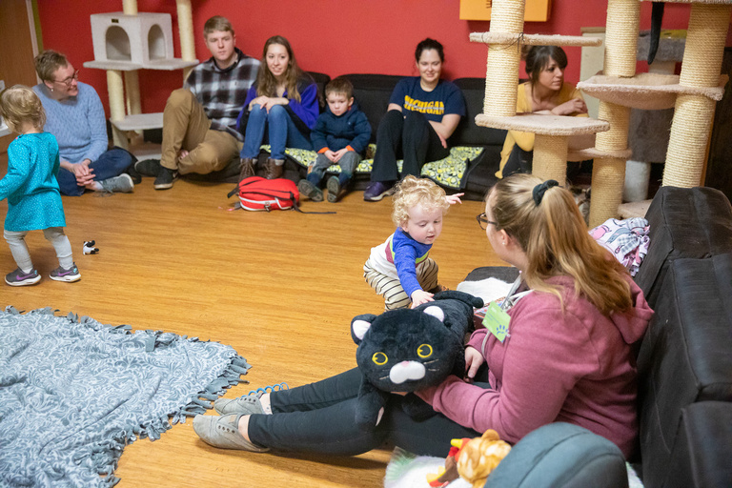
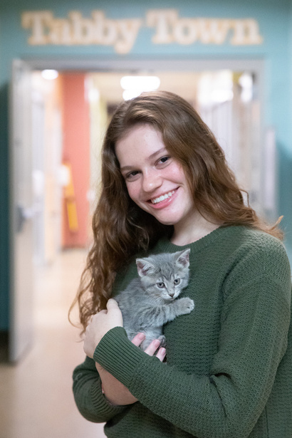
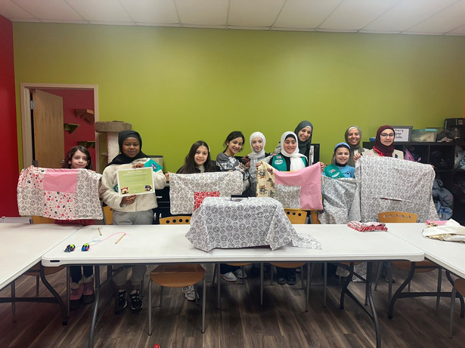
The Value of Kids & Cats Together
Learning
Cultivates empathy
Encourages support
Visiting Tiny Lions gives children the chance to learn how to appropriately interact with cats.
Caring for animals helps children recognize emotions in others. Children can draw connections between themselves and animals.
Children and families often provide financial support or donations for Tiny Lions and HSHV.

Slide 16
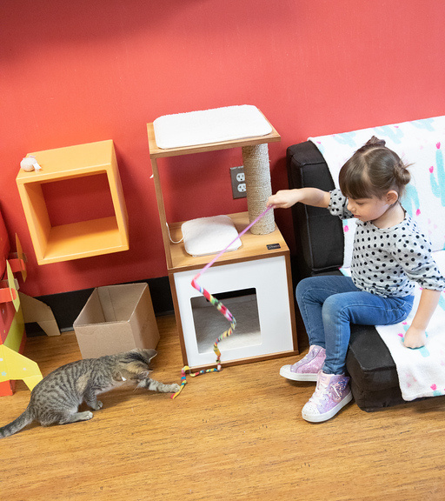
The young people we work with
  Are of varying ages and developmental levels
  Have varying experiences and understanding of appropriate animal interaction
  Have varying abilities, empathy levels and executive functioning skills
  May have disabilities

Slide 17

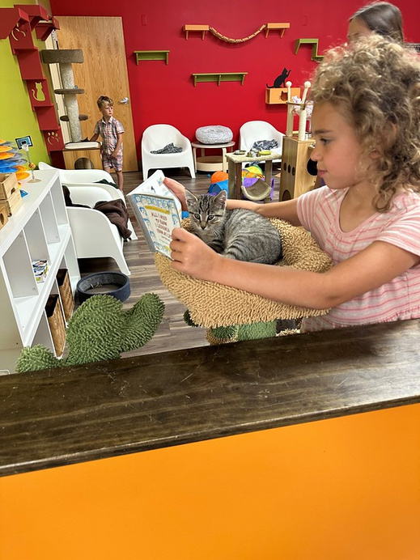
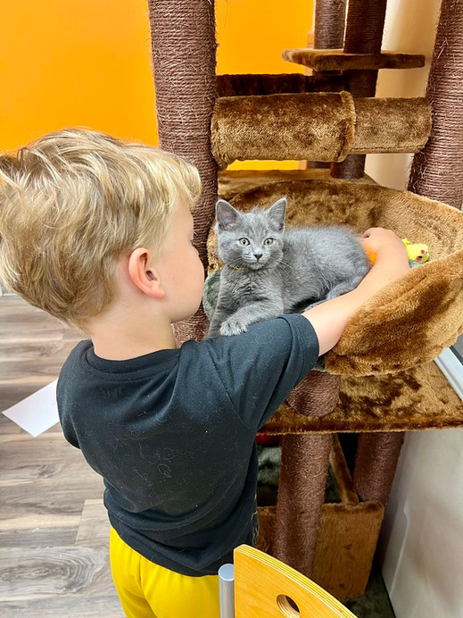
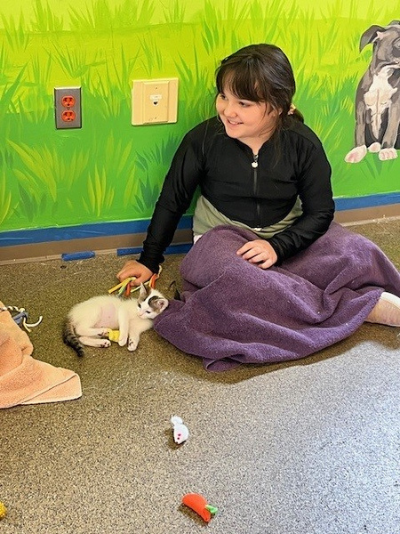
Common Challenges
Voice Level
Animal Handling
Activity Level
Youth may exhibit voice levels that may be uncomfortable for others or animals.
Handling concerns may arise with young people that require immediate staff intervention.
A young person’s activity level may exceed what is safe.

Slide 18
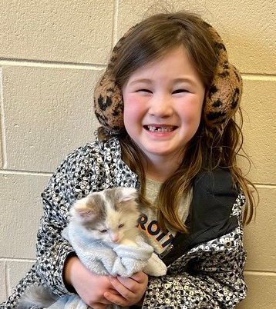
When to Intervene
    When a person or animal’s safety and well being is at risk.
    When the comfort level of others may be impacted, including the animals.
Staff should primarily handle these types of situations, not volunteers.

Slide 19
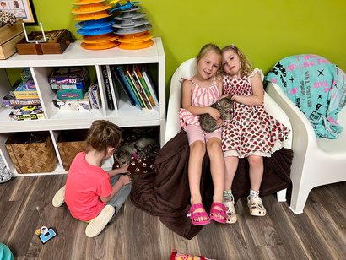
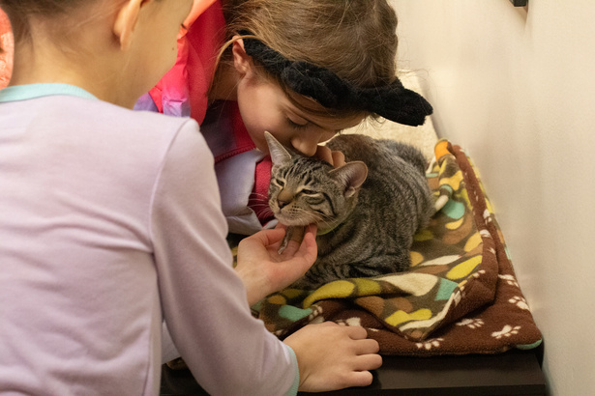
Approaching Young People
Connection before Correction
Smile and use a friendly, gentle voice
Assume Good Intentions
Approach at Eye Level
Children want to do well and though they make mistakes, they are likely not intentional.
Talking with children at eye level can help children to feel comfortable, especially with someone unknown.
Connect with a child before correcting a behavior.
Maintain eye contact and ensure the child knows you are there to help.

Slide 20

Communicating with Young Children
Be clear and concise
Build confidence and keep it positive
Loop things back to animal care
Praise children often!
Young children are not always able to read between the lines so be clear in what you are asking.
Compliment children who are showing desired behaviors. Include compliments for those you may have talked with.
Keep the focus on what they should do and not what they shouldn’t do.
Share why you are asking them to do something.

Slide 21
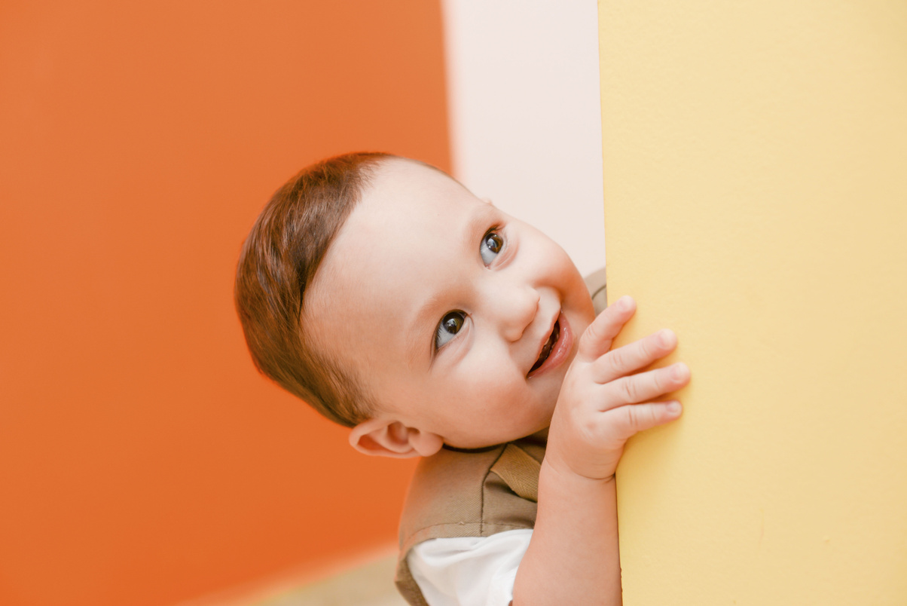

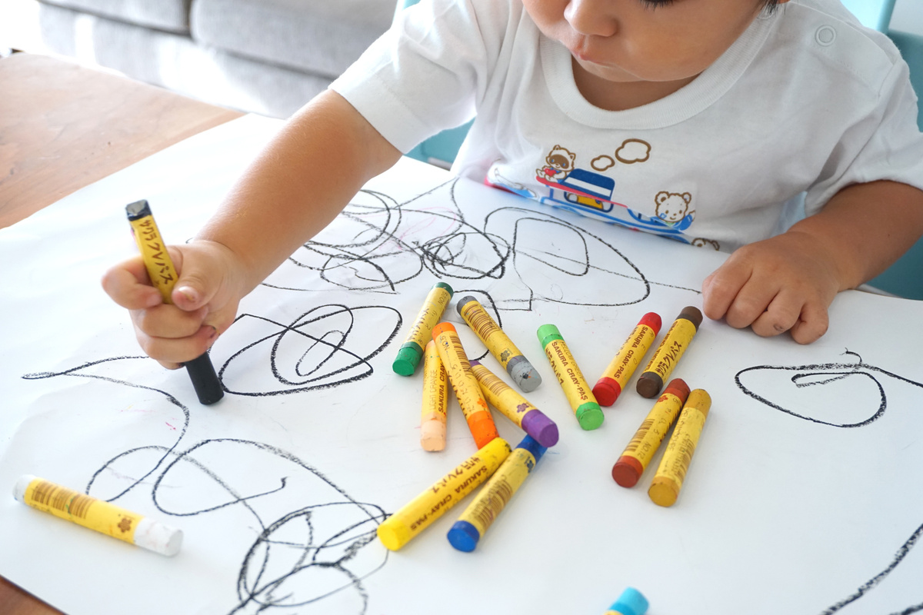
Strategies to Intervene
Redirect Children
Give a Child a Job
Offer Activities
Find a different kitten for them to play with, a different area for them to move over to or something else to engage them.
Have a child help you find a kitten, put toys back or feed a cat to help engage them in a positive behavior.
When attention spans are short, provide lots of other activities such as coloring books, games, making toys for the kittens, puzzles, etc.

Slide 22
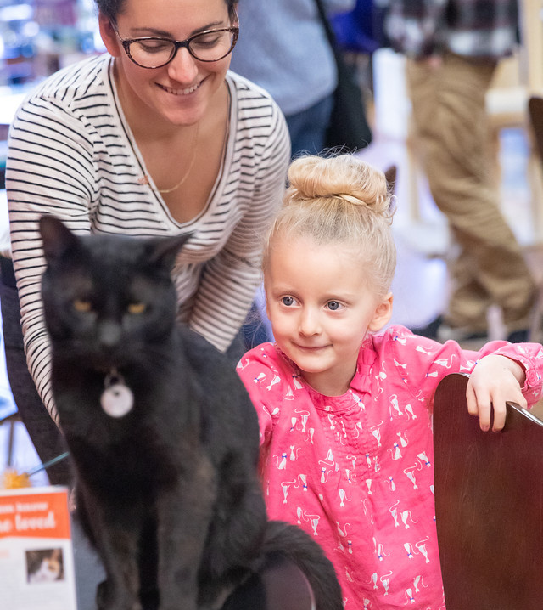
Involving Families
  Adult Caregiver
    Share expectations and resources when they enter the cafe.
    Include them in conversations you are having with their children - they may need to learn, too!
    Ask them for assistance, as needed.

Slide 23

Let’s Practice!

Slide 24
Scenario 1
A customer enters the cafe with four small children under the age of 5. What might you review with them as they check in?

Slide 25
Scenario 2
A six year old boy is constantly running through the cafe and has almost stepped on a kitten a few times. The parents are on their phones and not intervening.

Slide 26
Scenario 3
A young child is trying hard to get a kitten that is hiding underneath a chair. You can tell that kitten is nervous and does not want to be handled.

Slide 27
Scenario 4
A kitten is being carried with their back legs fully extended. The parent is working to help the child carry the kitten safely.

Slide 28
Scenario 5
A young person is shouting loudly every time they get excited while playing with a kitten.

Slide 29
Scenario 7
A child comes in and is scattering the toys all over the cafe. The parents are not stepping in to assist.

Slide 30
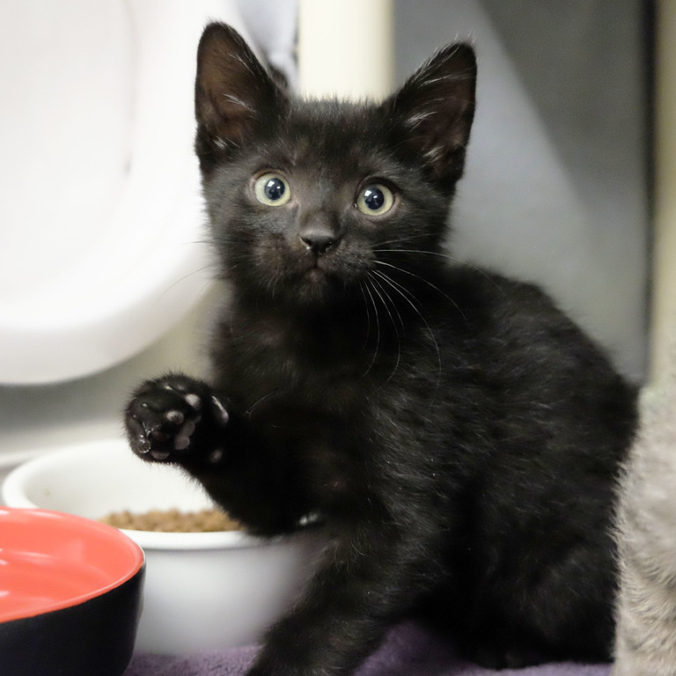
Questions?

Slide 31
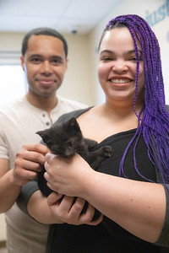
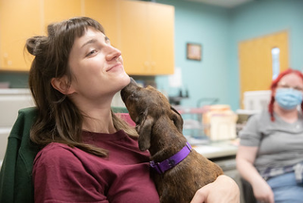
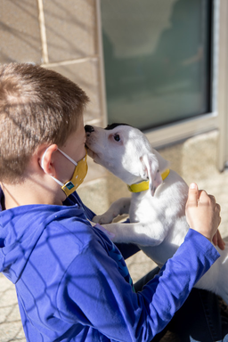
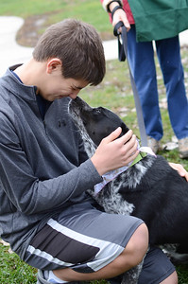

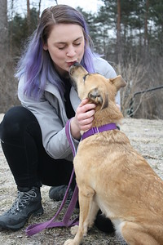
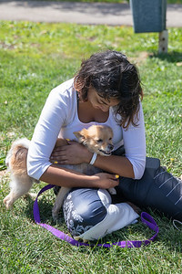
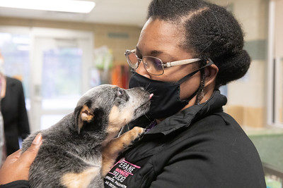
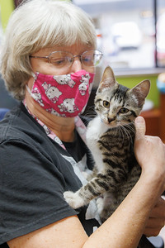
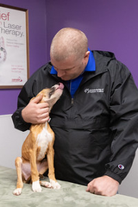
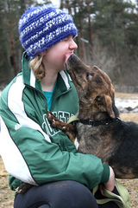


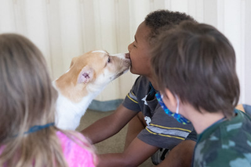
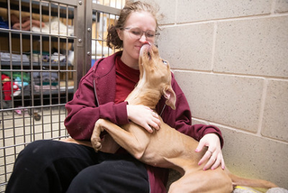
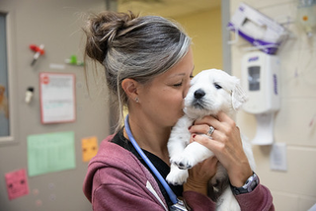

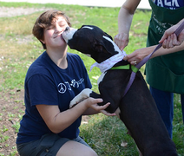
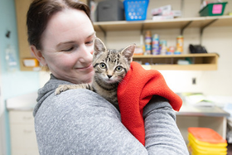


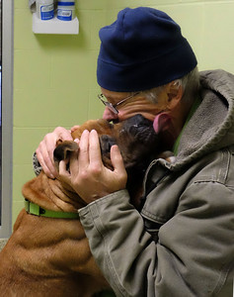
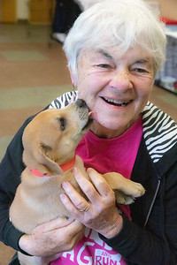
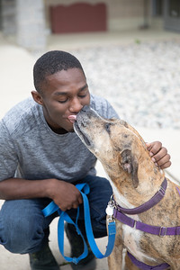






Thank You!

