Slide 1
Beyond the walk – A closer look at our enrichment programs
Continuing Education Session 3

Slide 2
Topics for Today
What is enrichment?
Why is enrichment beneficial?
What are our enrichment programs?
What are the benefits of each enrichment program?
What are other ways we can enrich our dogs?

Slide 3
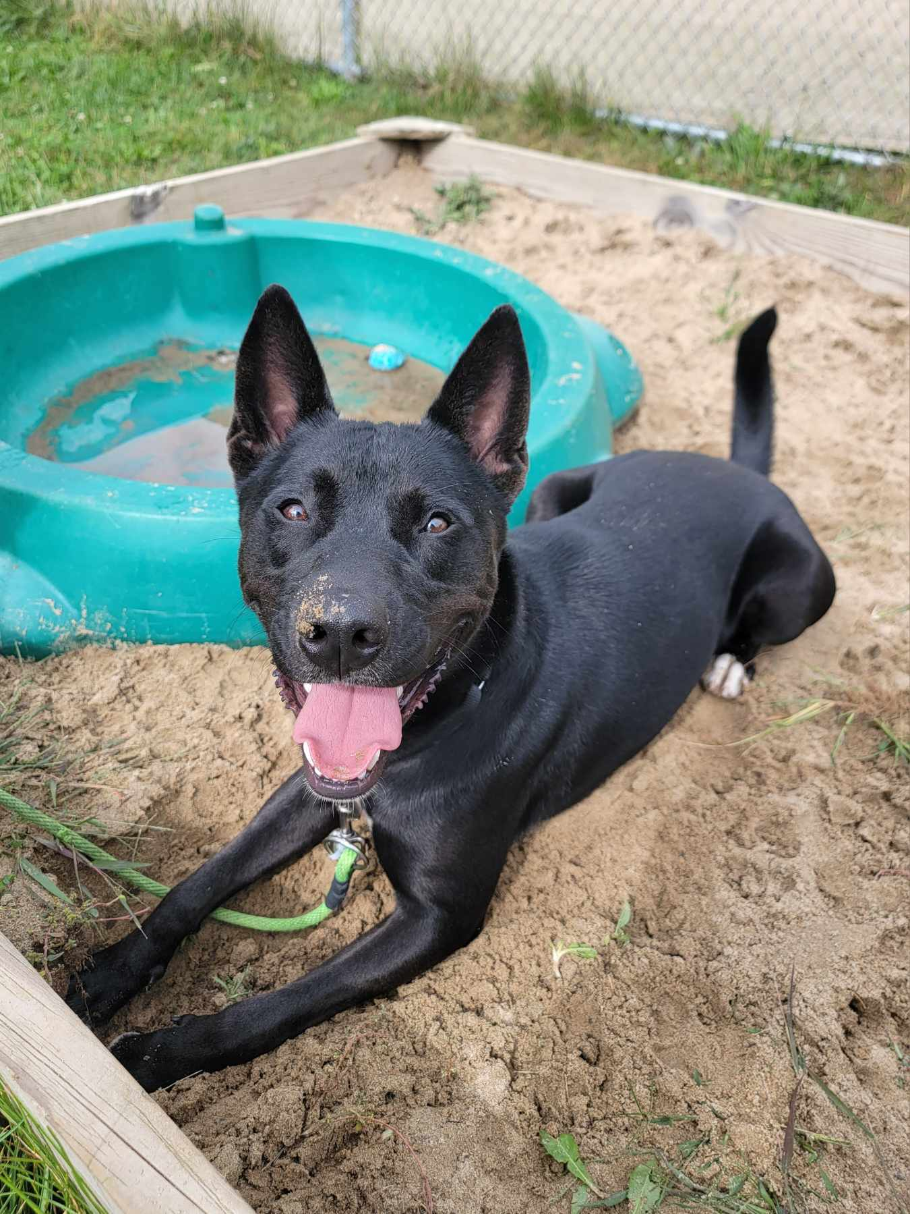
What is enrichment?
What is enrichment?
Enrichment is the practice of providing opportunities for mental and physical engagement with natural behaviors
Includes a wide variety of activities
Think about the natural history and typical environment of the dog

Slide 4
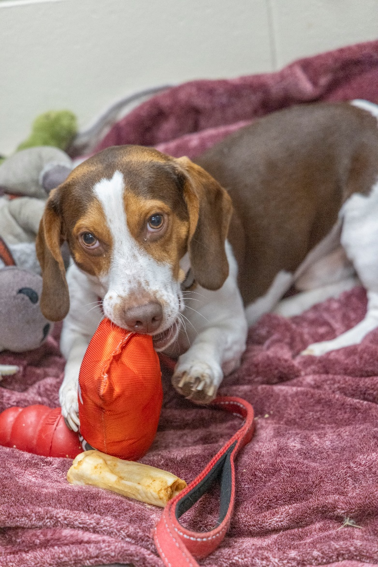
What is enrichment?
What activities are “Enrichment?”
Food based activities - kongs, snuffle mats, puzzle toys
Sensory activities – sniffy walks, new textures or scents
Mental engagement – Training new behaviors, novel problem solving
Social opportunities – with dogs or people
Physical engagement – Opportunities to run, chase, or tug

Slide 5
Why is enrichment beneficial?
Why is enrichment beneficial?
Animals in the shelter experience higher levels of stress than animals in homes
Fewer opportunities to express a variety of natural behaviors
Reduced opportunities for choice
Shelter environment is busy and full of potential triggers

Slide 6
Why is enrichment beneficial?
Why is enrichment beneficial?
Choice and control over the environment helps with stress reduction
Natural soothing behaviors (chewing, sniffing, licking) all release serotonin and help dogs emotionally regulate
Increasing the opportunity to engage in a variety of behaviors increases quality of life

Slide 7
What are our Enrichment Programs?
Pack Hikes
Read to Calm
K9 Running Club
Click to Calm
Headstart Team
Shelter Breaks

Slide 8
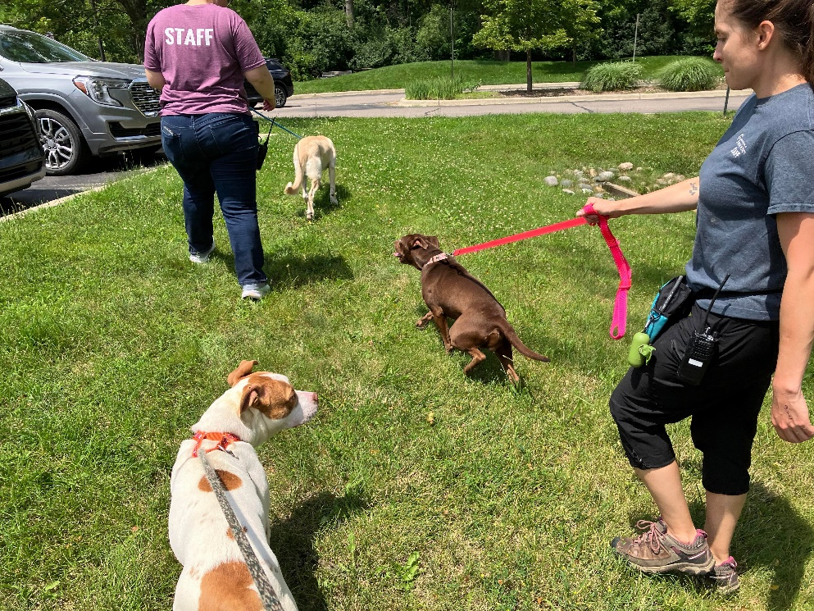
Pack Hikes
What are Pack Hikes?
Walks in a neutral setting with other dogs and people
Small group of volunteers, happens every Sunday morning
Dogs are picked form a pre-approved list

Slide 9
Pack Hikes
What are the benefits?
Allows dogs to spend extra time out of their kennels
Gives dogs practice being around other dogs in a neutral setting where there is no expectation of play or interaction
Extra exercise

Slide 10
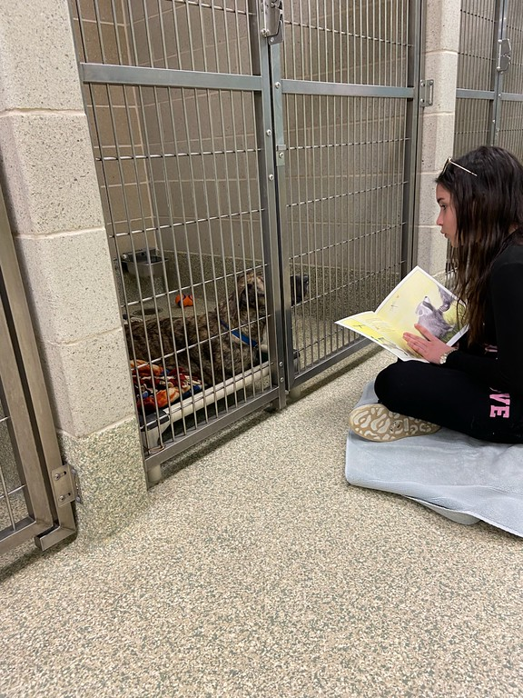
Read to Calm
What is Read to Calm?
Volunteers spend time reading to the dogs outside their kennel
Goal is to create a calm interaction between the person and the dog
Done by JVs as well as adult volunteers

Slide 11
Read to Calm
What are the benefits?
Can be used for both fearful and excitable dogs
Low pressure interaction is great for building confidence, allows fearful dog to explore and engage at their speed
Excitable dogs benefit from the calm interaction and learn that hyperactive behavior does not get them more attention

Slide 12
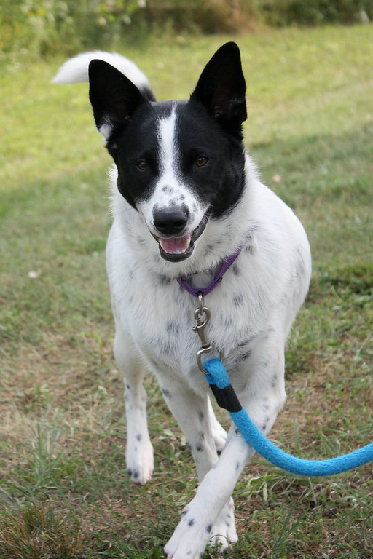
K9 Running Club
What is K9 Running Club?
Opportunity for volunteers to take dogs off site for an extra long run
Dogs are chosen from a pre-approved list

Slide 13
K9 Running Club
What are the benefits?
Extra physical exercise
Most beneficial for high-energy and “working breed” dogs who struggle to get their exercise needs met in shelter

Slide 14
Click to Calm
What is click to calm?
Simple clicker training activity that teaches animals that calm behavior in their kennel leads to interaction or treats
Widely used in shelters across the country
JV assignment, but also utilized by staff and dog walkers

Slide 15
Click to Calm
What are the benefits?
Creates calmer kennel presence, helping dogs relax
Increases likelihood adopters will choose to interact with the dog

Slide 16
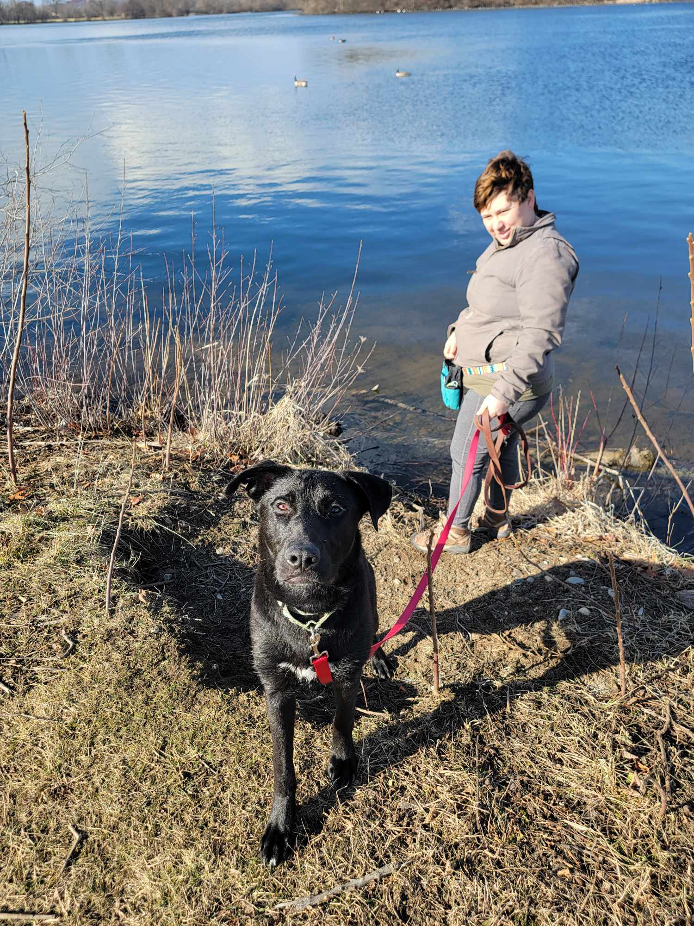
Shelter Breaks
What is a shelter break?
Shelter breaks allow our dogs to get time out of the shelter with a volunteer or staff member
Must submit an application for approval

Slide 17
Shelter Breaks
What are the benefits?
Allows the dog to get time away from the kennel to decompress
Can give us more information on how the dog behaves in a home

Slide 18
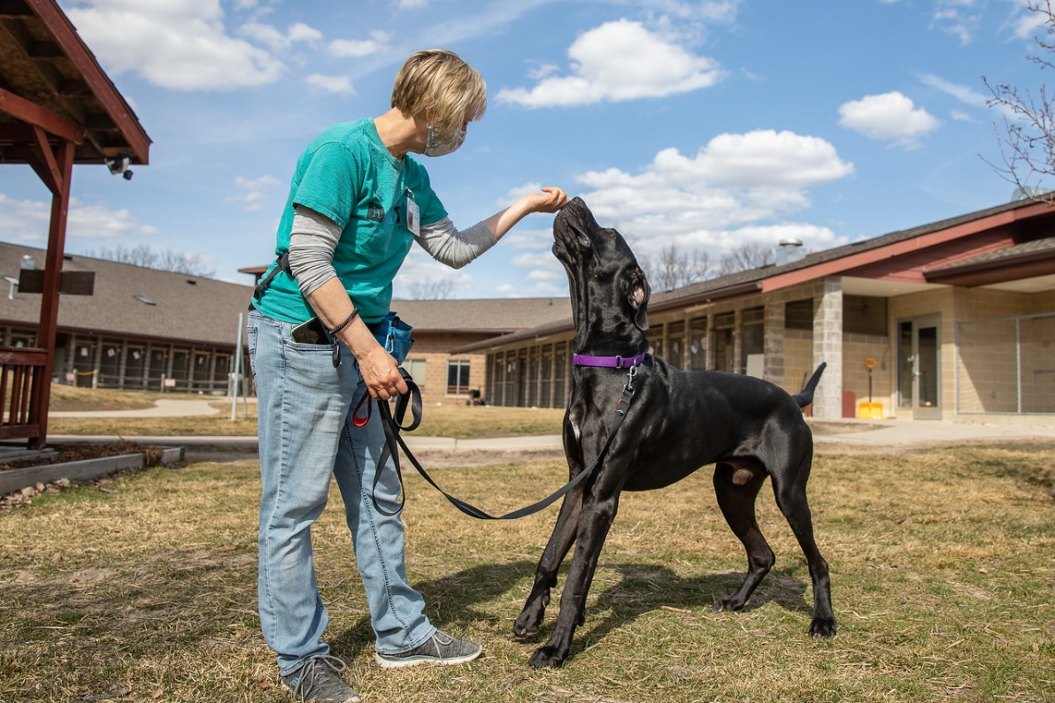
Headstart Team
What is the Headstart Team?
Highest level dog walking volunteers
Have the option to join a team work assist in training for the dogs who are struggling hardest in the shelter setting

Slide 19
Headstart Team
What are the benefits?
Gives dogs extra long one one time out of the kennel
Mental enrichment from training
Learning new skills helps with adoptability

Slide 20
What enrichment can you do as a walker?
Food Enrichment
Play Yard
Bench/Gazebo time
Sniffing Time on Walks

Slide 21
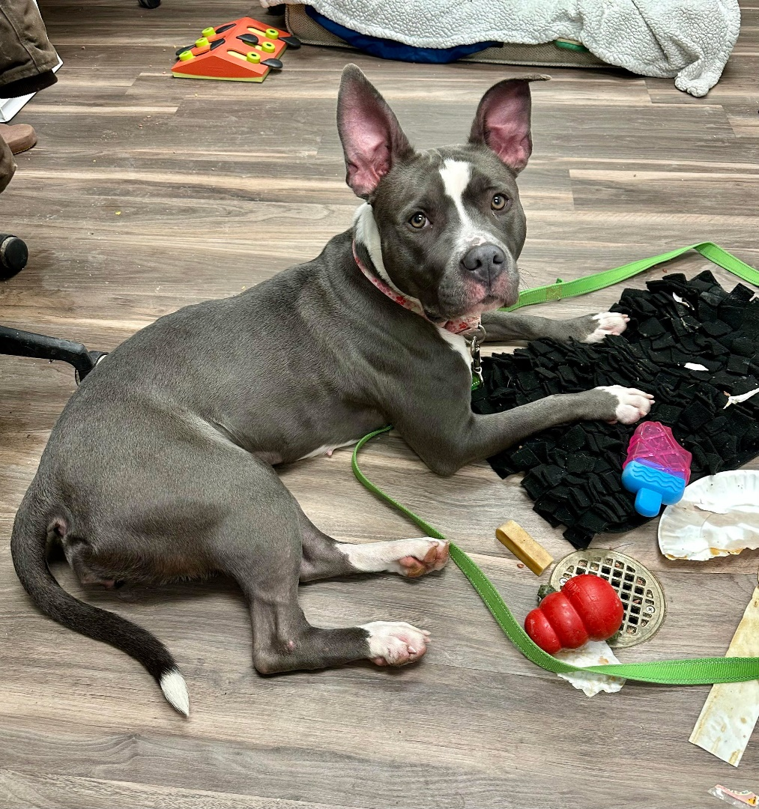
Food enrichment
Frozen kongs/slow feeders
Coated nylon chews
Snuffle mats or Treat Scatters
Enrichment bags or boxes

Slide 22
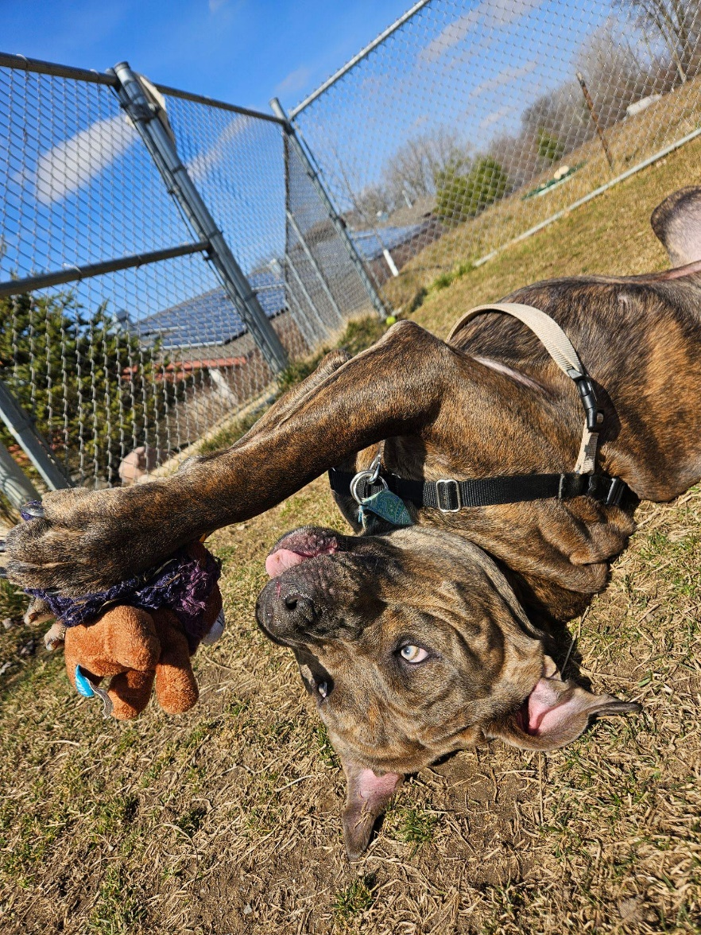
Play Yard
Play with novel toys
Practice known cues
Fetch or Flirt Pole time
Pool time
Work with A-frames, tunnels, or jumps

Slide 23
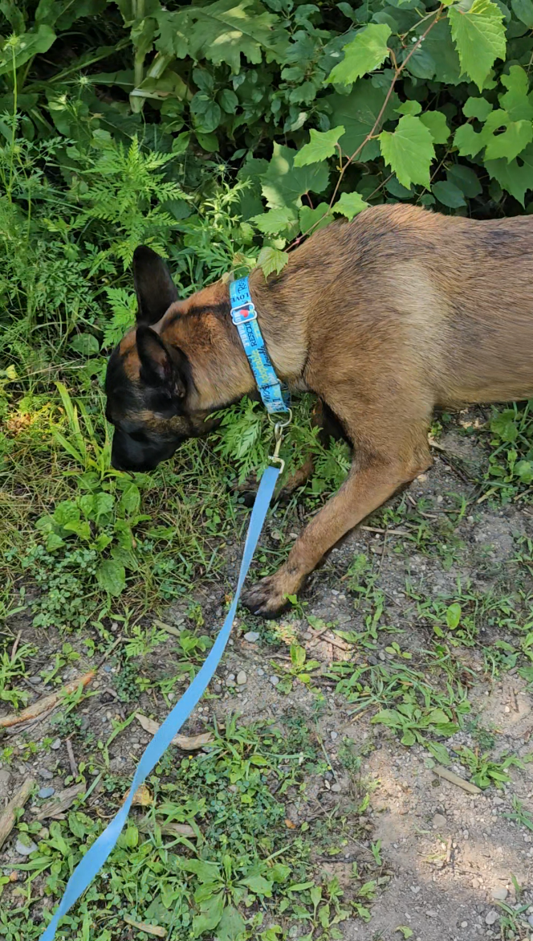
Sniffing time on walks
Walk in new or different locations
Let them sniff!
Offer treat scatters

Slide 24
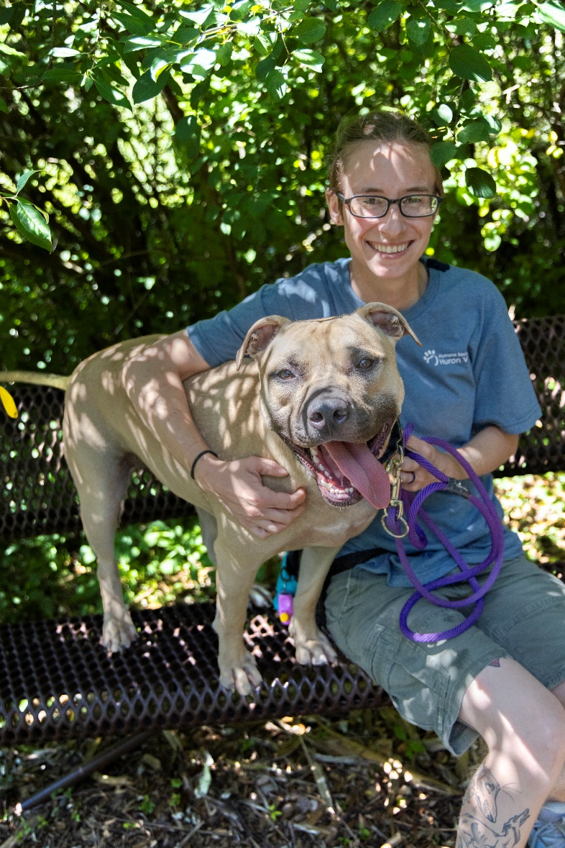
Bench and Gazebo Time
Sit and offer calm pets and interactions
Practice rewarding known cues and calm behavior

Slide 25
Questions?

Slide 26
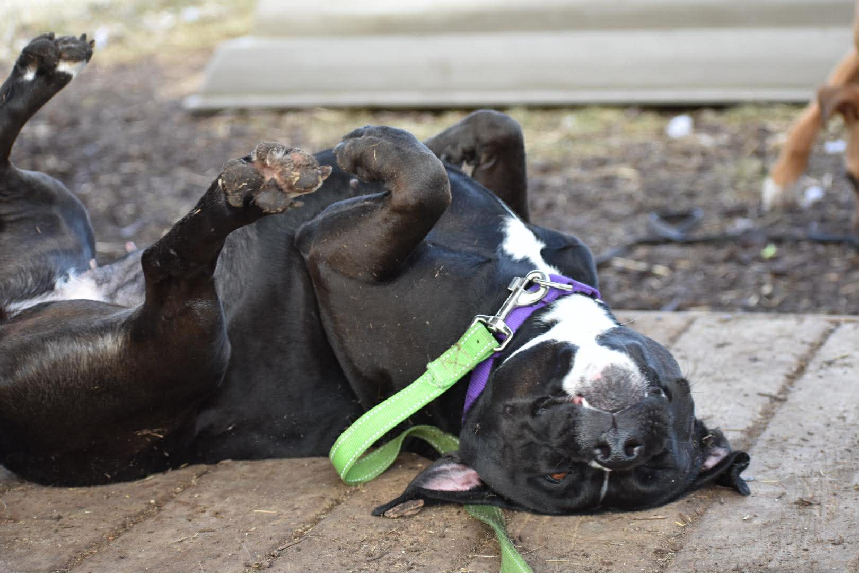
Thanks for helping our dogs!

