Slide 1
Customer Care Training

Slide 2
Training Overview
Assignment Overview
Basic Body Language of Cats
Common Challenges & Working With Families
How to Respond to Body Language
Helping Our Guests Interact Safely
What’s Next?

Slide 3
What is Customer Care?

Slide 4
Assignment Overview
Welcome guests to the café. Review “cat house rules”. Help visitors who may be looking for a particular cat, especially if they are interested in adopting.
Help answer questions about the café, point out activities if needed (books, games, card making station)
Watch interactions with cats and intervene when/if appropriate
Alert staff to any concerns when out in the café
Assist staff with adoptions if needed

Slide 5
Welcoming Guests to the Café
Be the welcoming face to visitors at the café

Slide 6
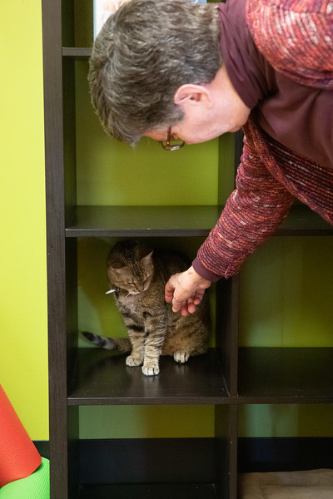
Greeting Customers
Welcome guests to the café
  Have they been here before? Do they have a reservation?
  Have them check in at the front desk
Do they have young children with them?
    Ask parents to keep close to children & help with rules

Slide 7



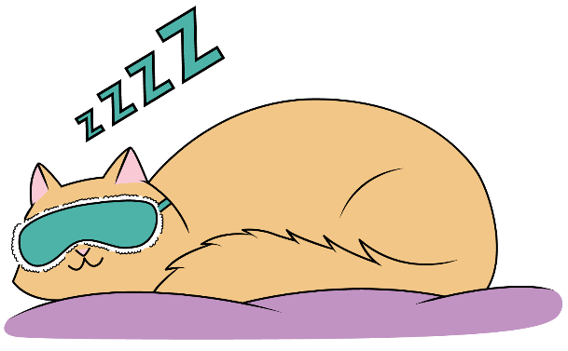

Greeting Customers-Cat House “Rules”
Hands are not cat toys
Don’t fall for my belly rub invitation
No flash photography
Avoid picking me up
Shhh…let sleeping cats sleep and hiding cats hide.

Slide 8
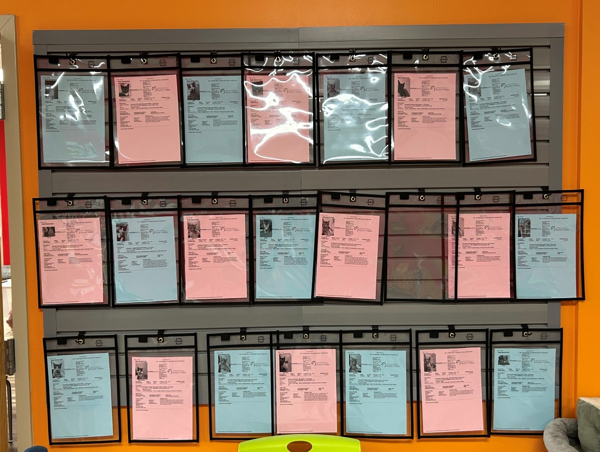
Greeting Customers-Café Basics
Café Set-Up Overview
    Restroom location (keep door closed)
  Snack & Drink Bar ($1.00 suggested donation)
  Games
  Cat toys & wands (use toys, not hands to interact/play)
About the Cats/Kittens
  Names on collars
  Point out the slat board
    Who is available to adopt
    Those with “pending adoptions” will have a hold tag on them

Slide 9
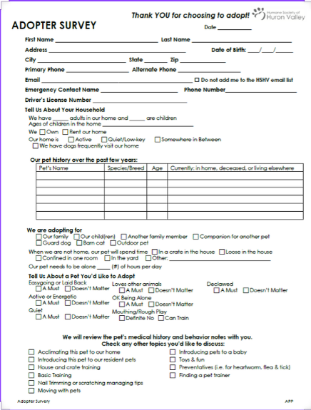
Assisting with Adoptions
When checking in for a reservation, staff will know if someone is interested in adopting
Staff may ask for assistance in locating a particular cat
If a visitor is interested in adopting, ask if they have filled out a survey
  If yes, have them go to the front desk
  If no, you can have them fill out an adoption survey (located at front desk)
  Once the survey is completed, have them go to the front desk
  STAFF will schedule the adoption & process the application, not volunteers

Slide 10
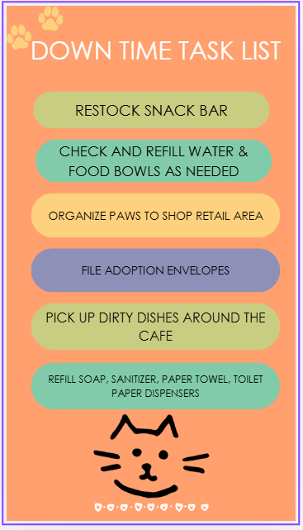
How to Help When There is “Down Time”
You can help staff by assisting with the following tasks on the “Task List”
This list is available behind the front desk
We ask that side conversations are kept to a minimum, especially with staff focused on their own tasks
If the café is slow during your shift, you are welcome to check with a staff member if you wish to go home early
Thank you for all you do to help the café, even when not assisting visitors ☺

Slide 11
Basic Body Language
Understanding adult cat and kitten body cues and behavior

Slide 12
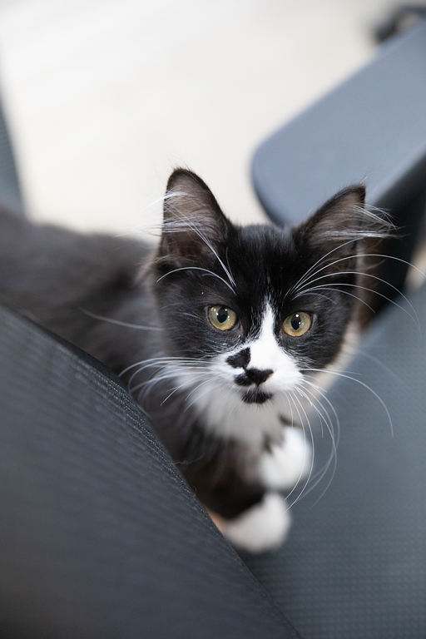
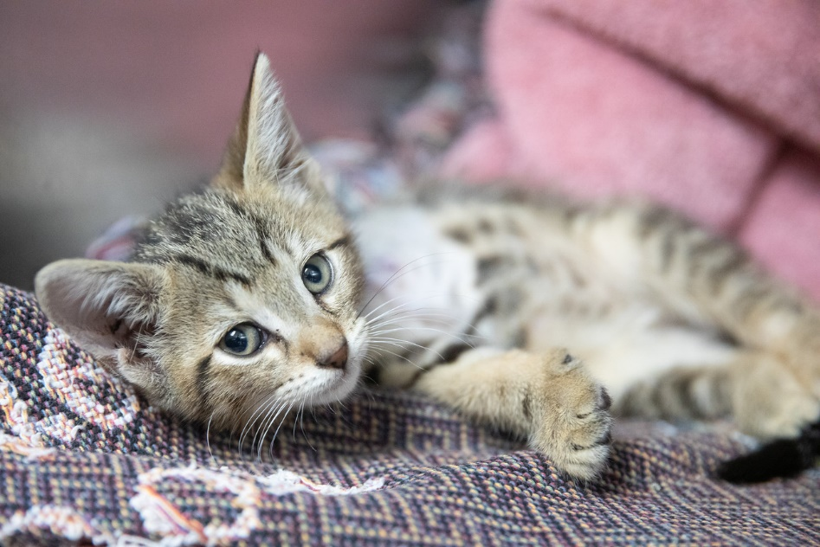
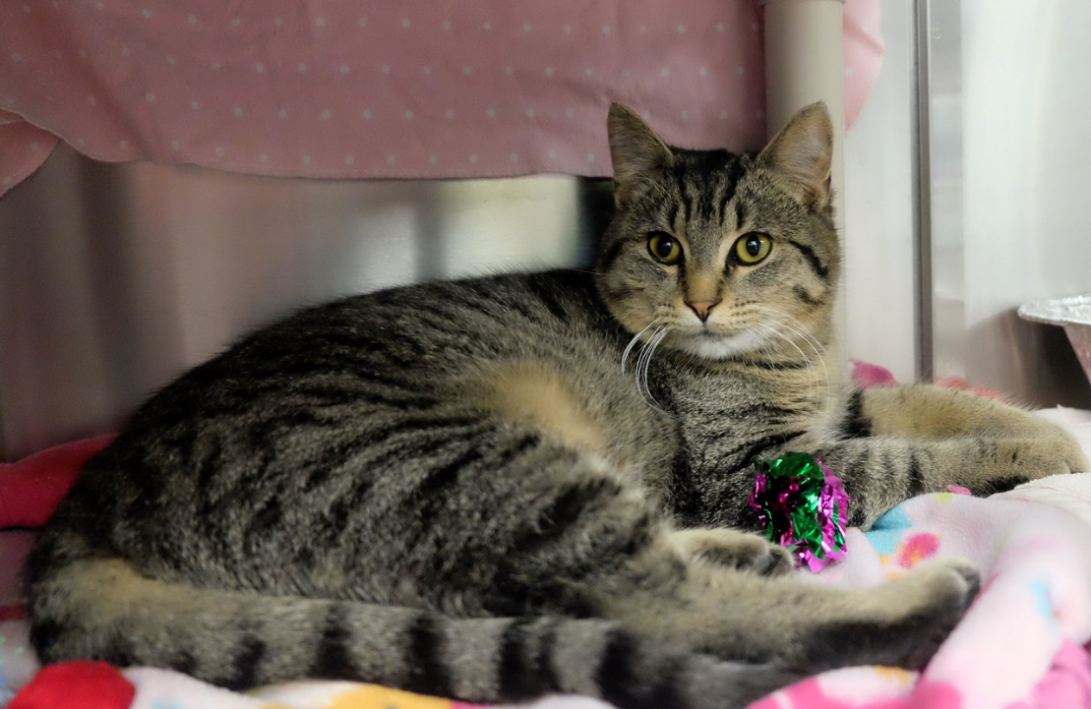
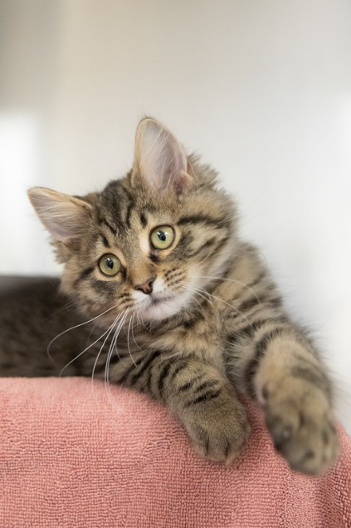
Relaxed, Comfortable and at Ease
Loose, soft body
Blinky eyes, oval pupils
Approach without hesitation
Napping comfortably in the open
Choosing to interact with the environment
Eating well
Not hiding

Slide 13
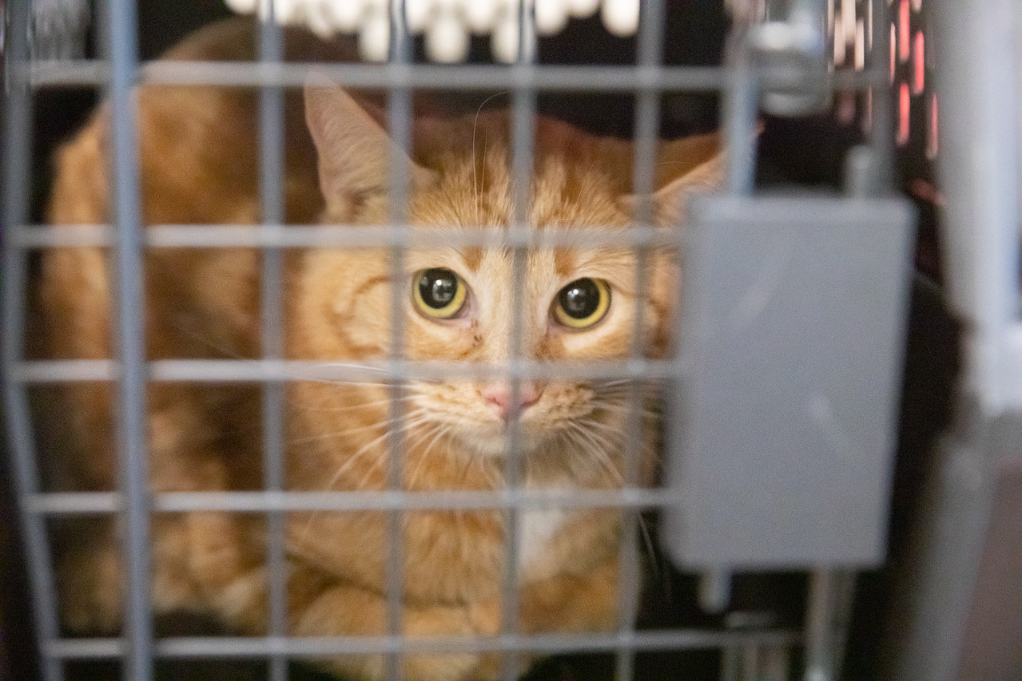
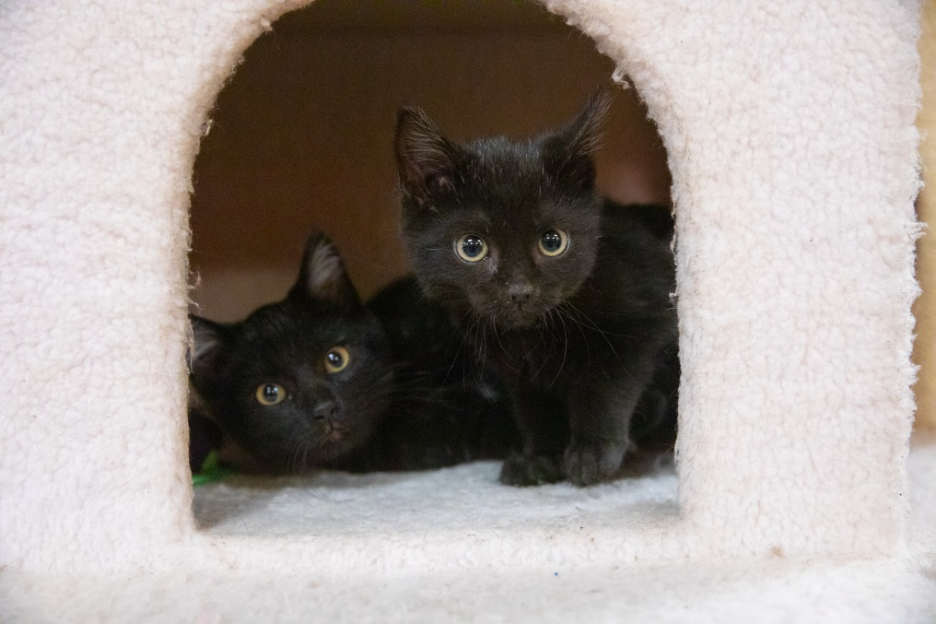
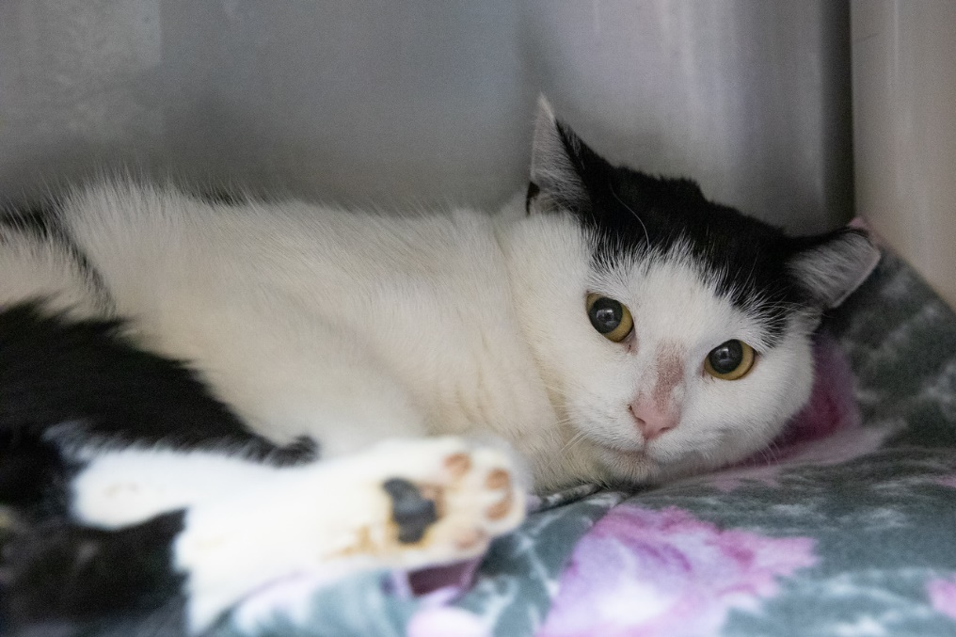
Fearful and Unsure
Tense, clenched
Tail and legs pulled into body
Ears down
Pupils dilated
Stress signals
  Lip licking
  Overgrooming
Hiding
Not eating well
Not engaging with environment

Slide 14
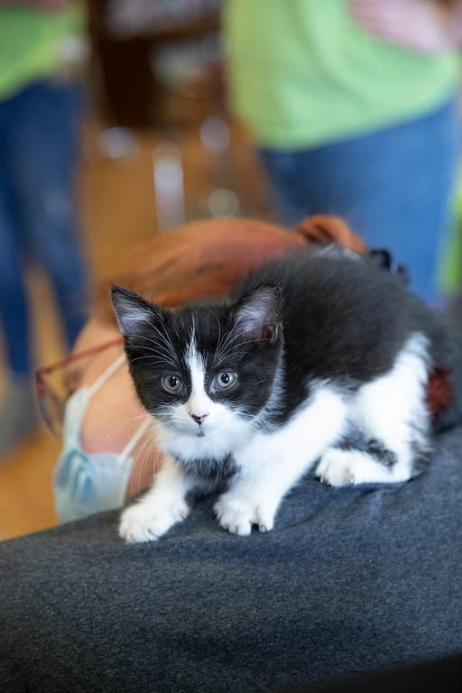
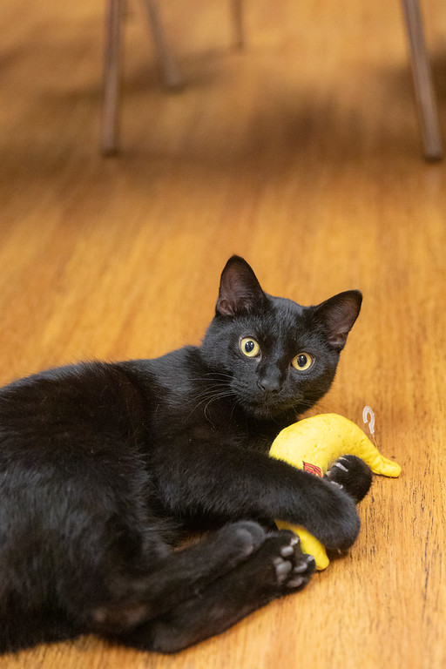
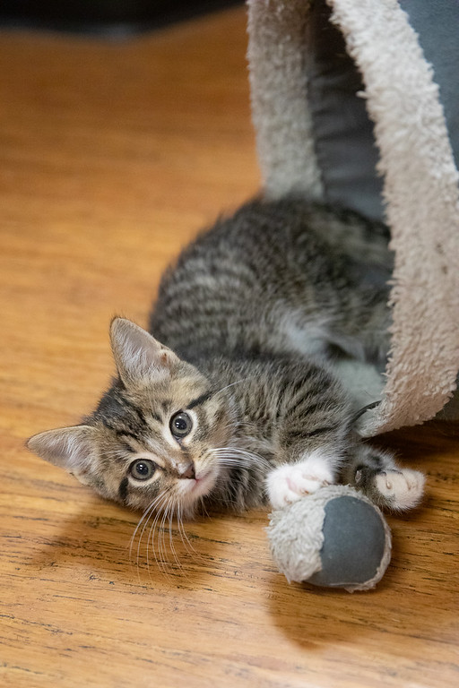
Over arousal
Coat rippling
Tail twitching
Pupils constrict
Can move from low energy to high quickly
Rough play/ nipping during touch
Use paws to direct touch or play, often with claws out
“Annoying” other cats
Can’t move from play to relaxed easily

Slide 15
How to Respond to Offered Body Language
What should we do when we see these things?

Slide 16
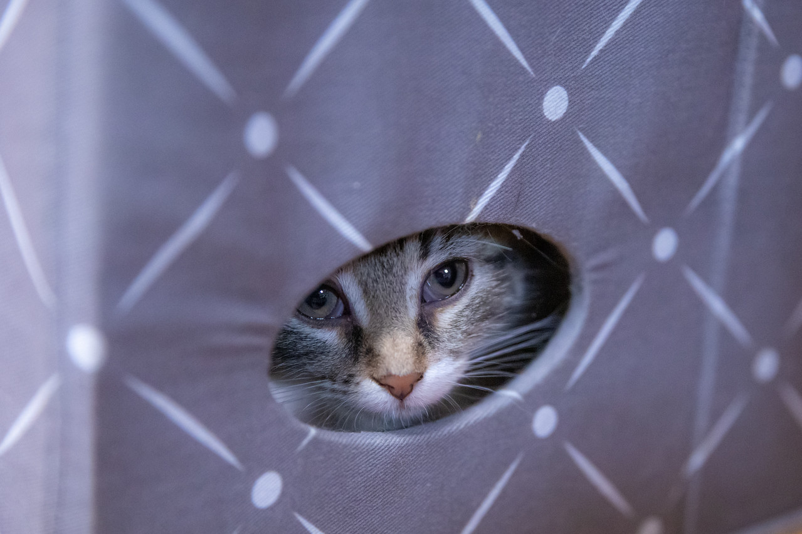
Fearful cats and kittens
Must have a safe place to hide
Use food motivators to gain trust
  Churu
  Smelly wet food
Do not force interaction
Allow them to choose
  Only touch when they offer the opportunity
  Let them hide
Consistent hiding- should likely return to HSHV for care and treatment

Slide 17
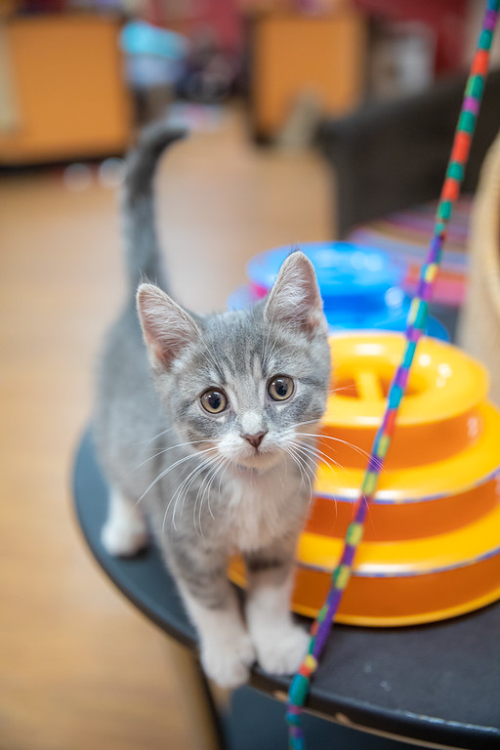
High energy, high arousal cats and kittens
Need a variety of play opportunities
Never pet while in a high arousal state
Redirect with toys
Reward with treats
Give them a game to play
  Battery operated toys can be perfect!
Only pet when calm, and only pet face and cheeks

Slide 18
Are They Fighting or Playing?
How to know if you’re seeing normal behavior, or reactive aggression

Slide 19
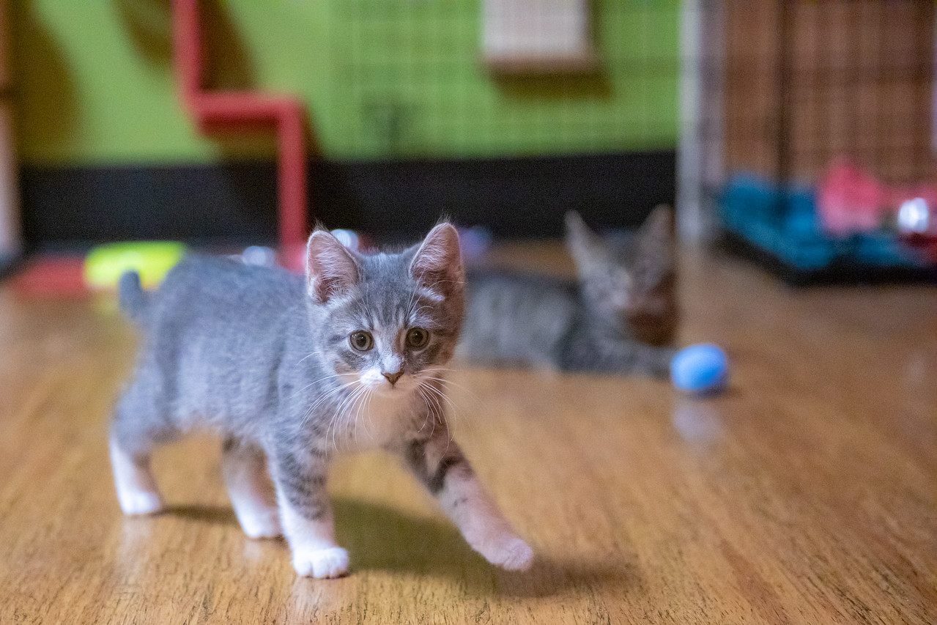
Play vs. Reactivity/Discomfort
Play:
  Reciprocal- both cats engaged
  One or both cats are allowed to take a break and may reengage
  If one cat leaves, the other allows them to leave
  Hissing, growling and physical play are ok if it’s reciprocal!
Reactivity/ discomfort
  Hissing, growling, with chase and one or both cats engaging with claws/ teeth
  One cat hissing or growling when another cat comes near without loosening
  On guard, alert to the other cat’s movement, may affect sleeping and/or eating for that cat

Slide 20
Helping Our Guests
How to help guests interact safely and respectfully with our cats and kittens

Slide 21
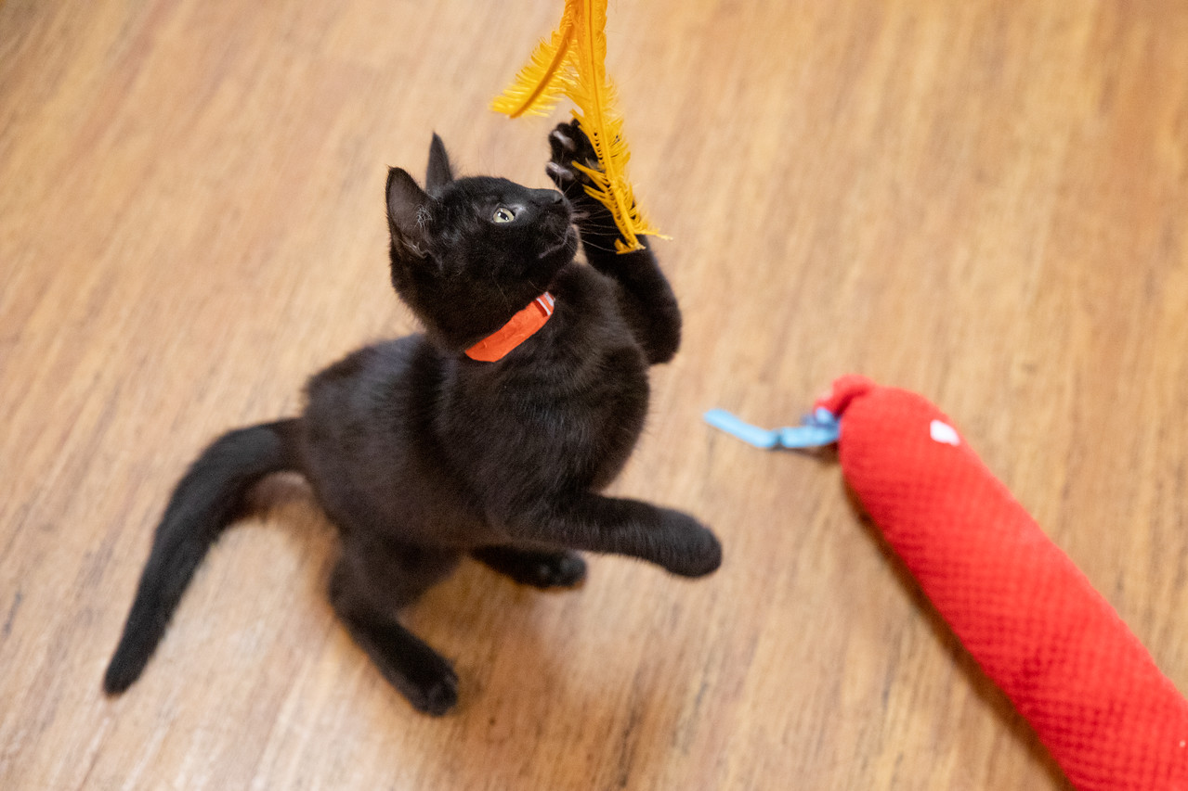
Helping our guests engage safely with our cats
Keep a close eye on body language
Always have an alternative
  Picking up/ carrying cats or kittens can be scary for them!
    Have toys and treats handy!
    Direct them to another cat who may be more comfortable with an interaction
Having toys available and ready for your customers will enhance their interactions and the safety of your cats!
Make sure they are aware of the card making station, especially if there are less cats at the café, they are sleeping, or not engaging at the moment

Slide 22
Common Challenges-Working With Families

Slide 23
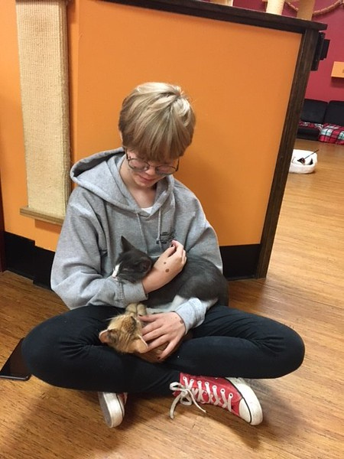
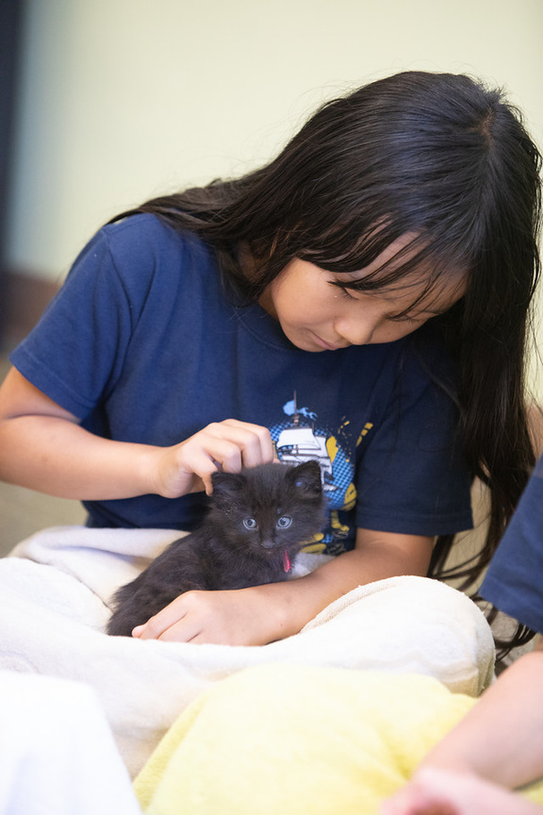
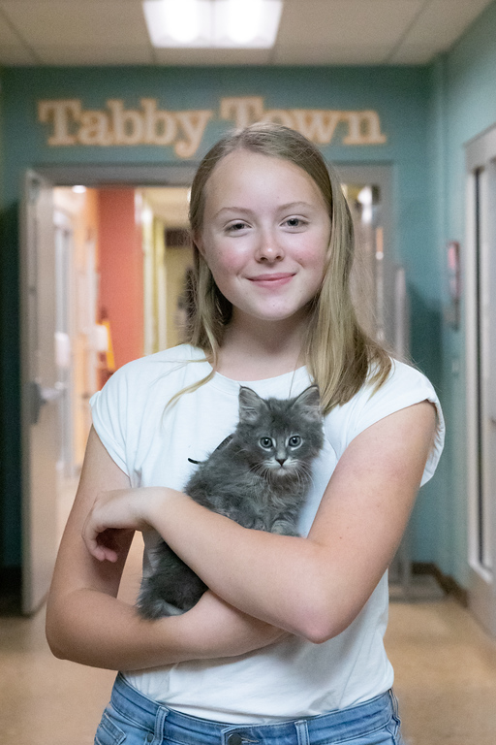

Common Challenges
Voice Level
Animal Handling
Activity Level
Youth may exhibit voice levels that may be uncomfortable for others or animals.
Handling concerns may arise with young people that require immediate staff intervention.
A young person’s activity level may exceed what is safe.

Slide 24
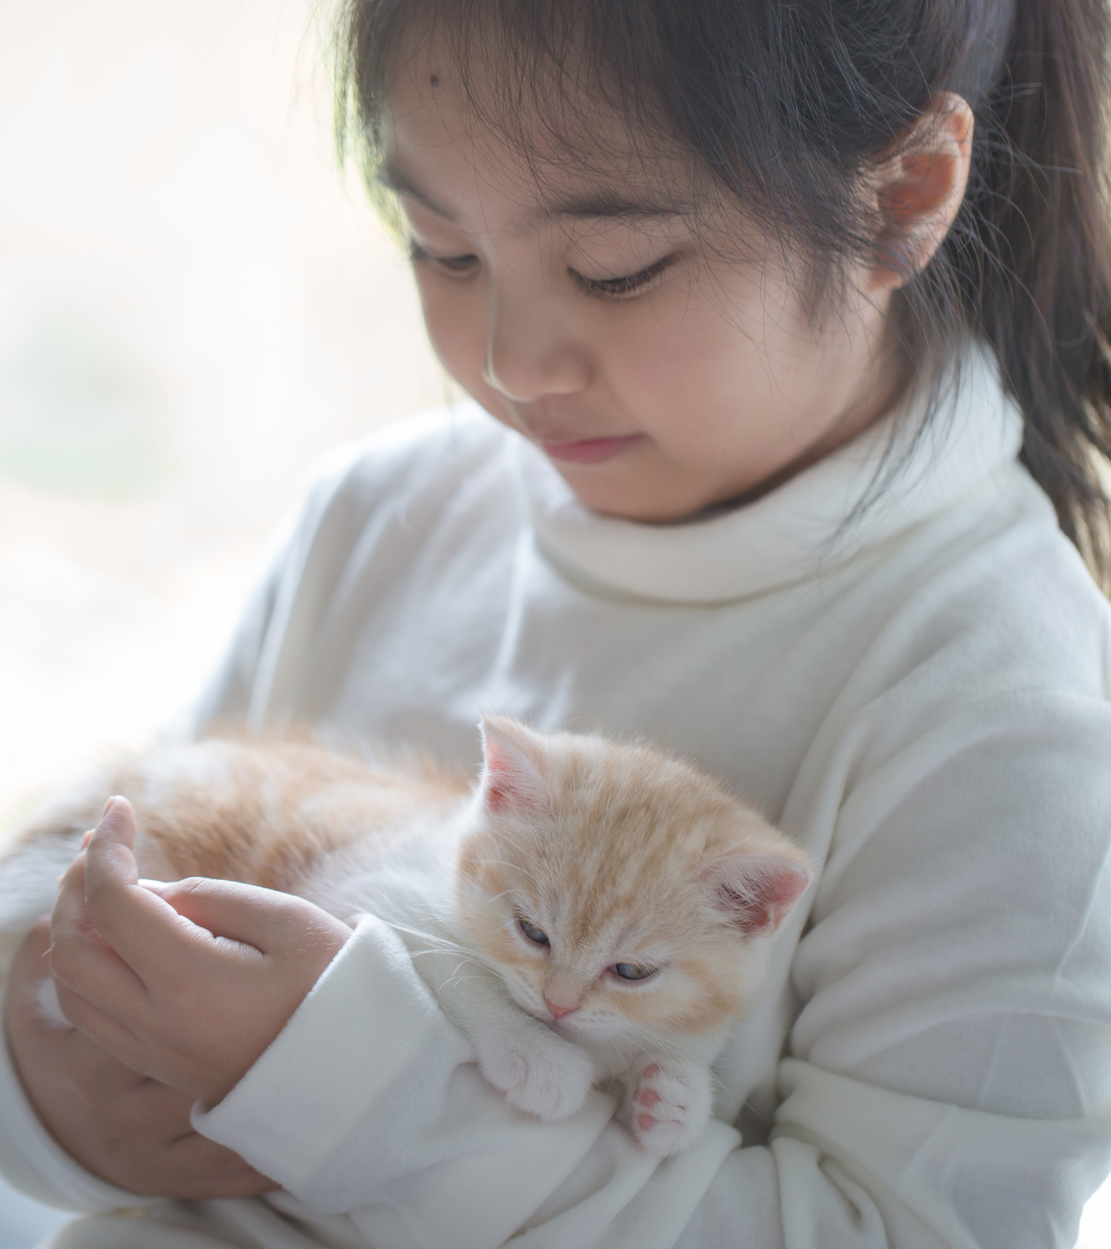
When to Intervene
    Staff should intervene immediately when a person or animal’s safety and well being is at risk.
    When the comfort level of others may be impacted, including the animals.
Some strategies discussed will need to be bypassed in a situation that involves safety. Good customer service should always be a part of every interaction.
Staff should primarily handle these types of situations, not volunteers.

Slide 25
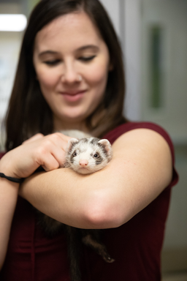
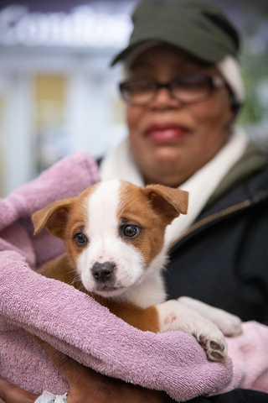
Approaching Young People
Connection before Correction
Smile and use a friendly, gentle voice
Assume Good Intentions
Approach at Eye Level
Children want to do well and though they make mistakes, they are likely not intentional.
Talking with children at eye level can help children to feel comfortable, especially with someone unknown.
Connect with a child before correcting a behavior.
Maintain eye contact and ensure the child knows you are there to help.

Slide 26

Communicating with Young Children
Be clear and concise
Build confidence and keep it positive
Loop things back to animal care
Praise children often!
Young children are not always able to read between the lines so be clear in what you are asking.
Compliment children who are showing desired behaviors. Include compliments for those you may have talked with.
Add statements that help to build their confidence! Keep the focus on what they should do and not what they shouldn’t do.
Share why you are asking them to do something.

Slide 27
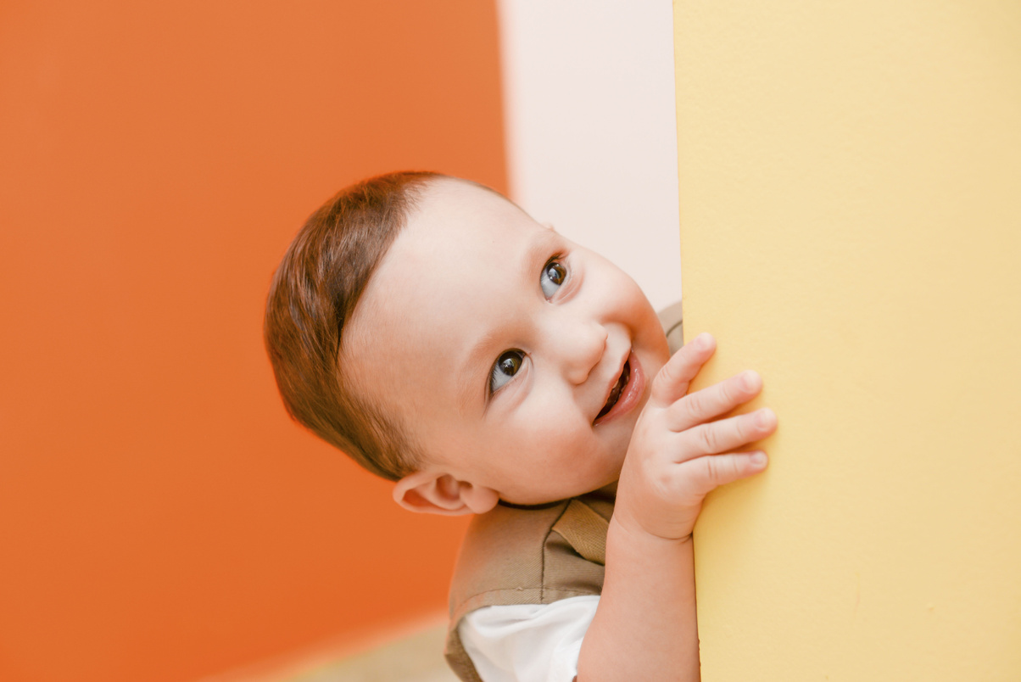


Strategies to Intervene
Redirect Children
Give a Child a Job
Offer Activities
Find a different kitten for them to play with, a different area for them to move over to or something else to engage them.
Have a child help you find a kitten, put toys back or feed a cat to help engage them in a positive behavior.
When attention spans are short, provide lots of other activities such as coloring books, games, making toys for the kittens, puzzles, etc.

Slide 28
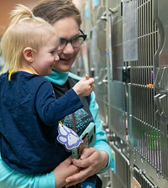
Involving Families
  Adult Caregiver
    Share expectations and resources when they enter the cafe.
    Include them in conversations you are having with their children - they may need to learn, too!
    Ask them for assistance, as needed.

Slide 29

Let’s Practice!

Slide 30
Scenario 1
A customer enters the cafe with four small children under the age of 5. What might you review with them as they check in?

Slide 31
Scenario 2
A six year old boy is constantly running through the cafe and has almost stepped on a kitten a few times. The parents are on their phones and not intervening.

Slide 32
What’s Next?

Slide 33
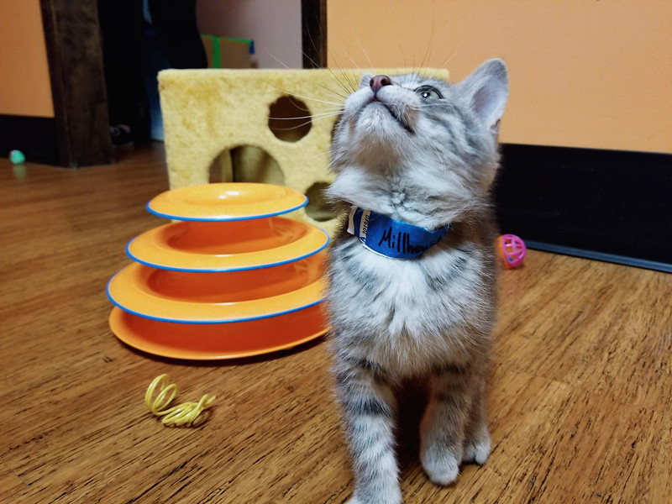
After Training Today…
Your account in VIC will be updated
Check the schedule and sign up for shifts
Remember staff are there to help, so ask questions when needed
Have Fun!
Thank you for helping to make sure our visitors have a great time at the café

