Slide 1
Managing Challenging Behaviors
Continuing Education Session 2

Slide 2
Topics for Today
What behaviors might you see?
How do we change behavior?
What is “management” and what is it’s roll at the shelter?
Why do we see these behaviors?
What can we do to help?

Slide 3
What challenging behaviors do we see at the shelter?
Reactivity to dogs or people
High arousal/overstimulated behaviors
“Balking” or refusal to walk

Slide 4
How do you we change the behavior of an animal?
Identify the motivation or emotional driver
Create a management plan to reduce rehearsal of behavior
Teach the dog a replacement behavior
If fear based, pair trigger with reinforcement

Slide 5
How do we train a new behavior?
What is Positive Reinforcement? (R+)
The addition of a reinforcer contingent on a behavior that increases the likelihood of that behavior occurring in the future.
Providing a primary reinforcer, such as food, when a dog does something that we like or want them to continue doing
Reinforcers can also include toys, play or praise

Slide 6
How do we train a new behavior?
Why do we use R+?
Broadly considered the most ethical way to teach an animal
Positive reinforcement enables us to build a healthy relationship and gain trust from the dogs we’re working with
Creates clear communication to the animal to tell them what behaviors we like to see, often through a mark and reward system
Increases an animal’s behavioral repertoire so they can communicate with use in ways that are safe and functional

Slide 7
How do we train a new behavior?
What is an aversive?
An aversive is any stimulus that a dog finds unpleasant or uncomfortable
In training, this can range from a loud noise, to tools like a shock or prong collar
The intention is to teach the dog that a behavior they are doing is unwanted and to reduce the likelihood of the dog doing that behavior
The learner decides what is aversive

Slide 8
How do we train a new behavior?
Why don’t we use aversives?
Aversive training can create conflict in the relationship we have with an animal
Dogs can learn through the application of an aversive stimulus, but there are ethical concerns about intentional discomfort caused in training
Risks include suppressing warning signs for aggressive behaviors, increasing chance “unpredictable” aggression
Applying an aversive does not address the underlying motivation of the behavior

Slide 9
Positive Reinforcement Training
For positive reinforcement training, we use a mark and reward system
Always mark first and then reward for a desired behavior
Common markers:
Clicker
Verbal marker:
Use a high pitched and friendly “Yes!” or “Yip!”
Common rewards:
High value food (always the default and to be used first)
Toy
Praise

Slide 10
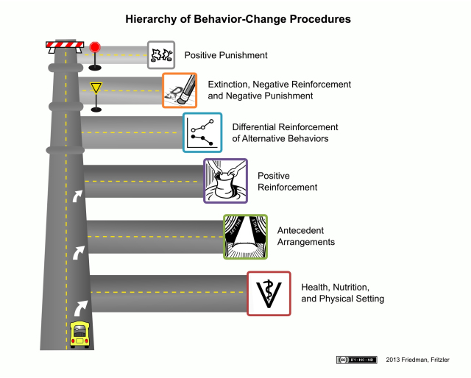
What are the considerations for changing behavior?

Slide 11
What is “management”?
A plan to prevent the rehearsal of unwanted behavior
Can include choices of housing location, walker signage and assigned tools
Active management on walks includes choice of when and where to walk and games like “find it” or treat scatters

Slide 12
Why do we see problematic behaviors at the shelter?
Shelter environment is high stress
High concentration of potential triggers
Reduced opportunities for choice
Less one on one interaction

Slide 13
What is “balking”?
Refusal to continue walking
Often called “pancaking” or “return refusal”
Usually fear or anxiety based - often of the kennel

Slide 14
How can we help dogs who don’t want to walk?
Go slow, give encouragement
Be sure to reward when the dog chooses to move
Do not pull or force the dog
Offer enrichment/something positive upon return
Radio for assistance if needed

Slide 15
Can we train “balking” in the shelter?
Difficult to change in shelter – solution requires changing feelings around the kennel
Sometimes reduced with kennel location change
Ultimate goal is to get to foster/adopted

Slide 16
What is “reactivity”?
Out of proportion emotional response to a “trigger”
Often barking, lunging, pulling
Body language and behavior can give hints to the motivation
Can be motivated by a variety of emotions

Slide 17
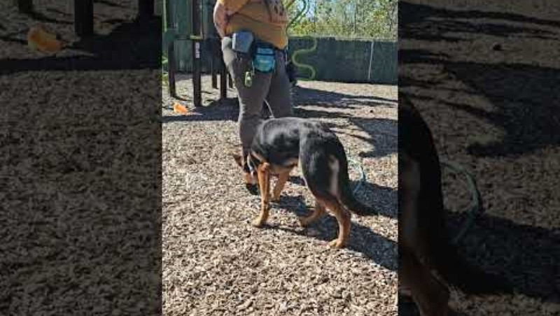
How do we change reactivity?

Slide 18
How can we help a dog manage their reactivity?
Be conscious of triggers
Try to determine distance threshold
Consider time of day, location of walk
If an appropriate walker level, can work on reactivity training games

Slide 19
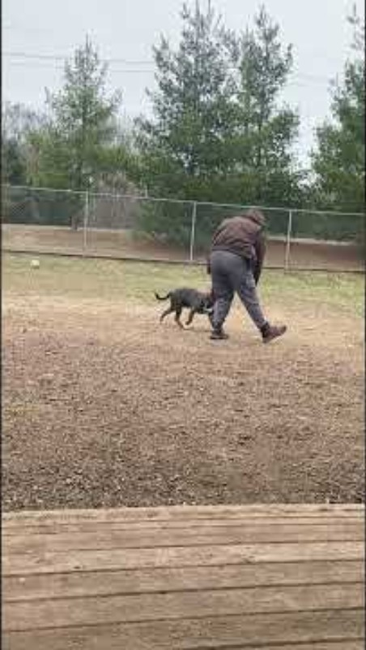
Tips for active management: “Find it”

Slide 20
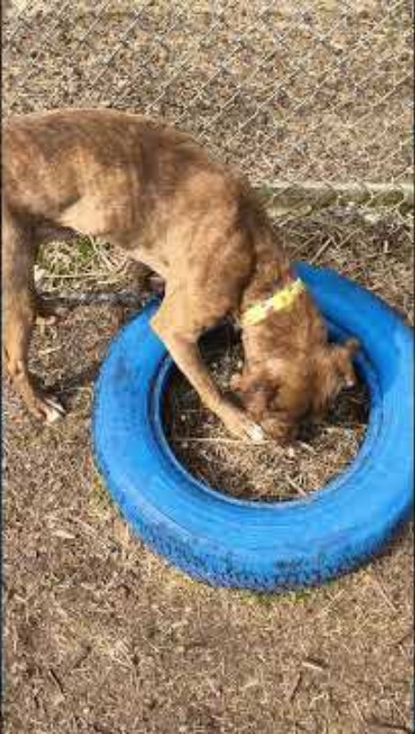
Tips for active management: Treat Scatters

Slide 21
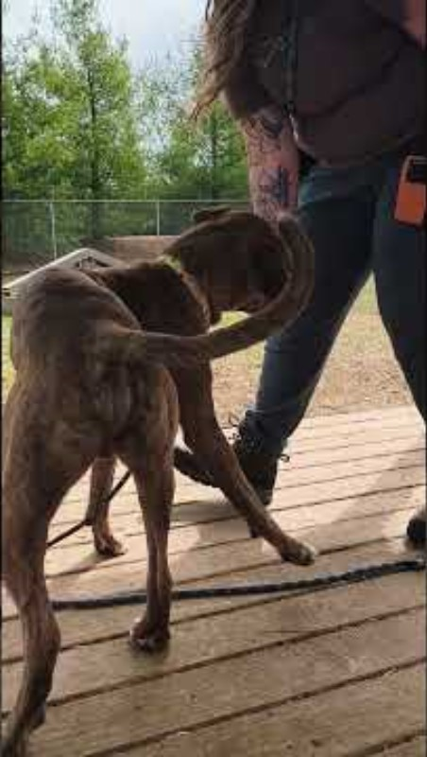
Tips for active management: Lure & “Kong Hand”

Slide 22
What are “high arousal behaviors”?
Often seen the most in kennel or in “red zone”
Jumping, mouthing, leash biting, humping
Often motivated by excitement or anxiety

Slide 23
How to we teach dogs to manage high arousal behaviors?

Slide 24
How can we help dogs who experience high arousal?
Offer calming and decompressing activities
Avoid extended exciting activities, take breaks during play
Ensure consistency with handling
Often benefit from impulse control training games with trained volunteers

Slide 25
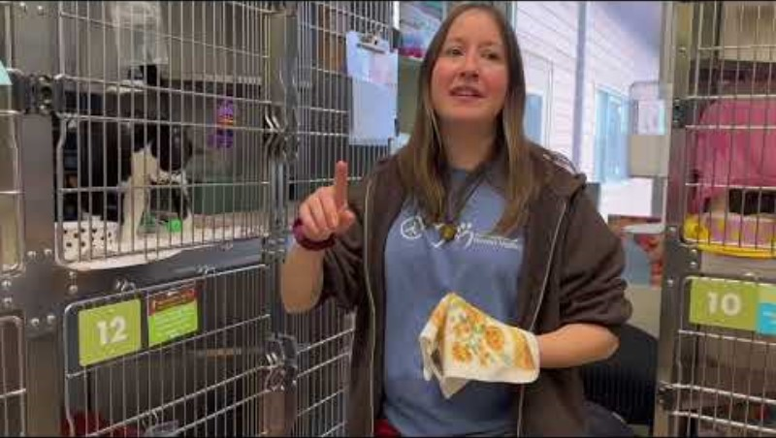
Tips for active management: “Click to Calm”

Slide 26
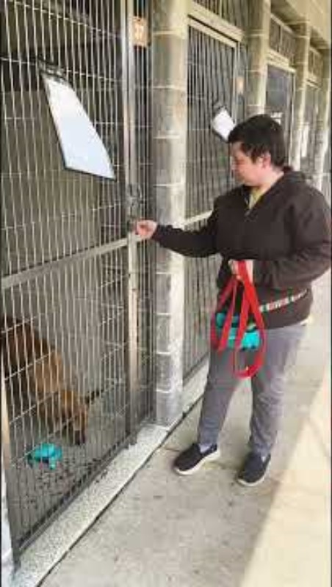
Tips for active management: Calm leashing

Slide 27
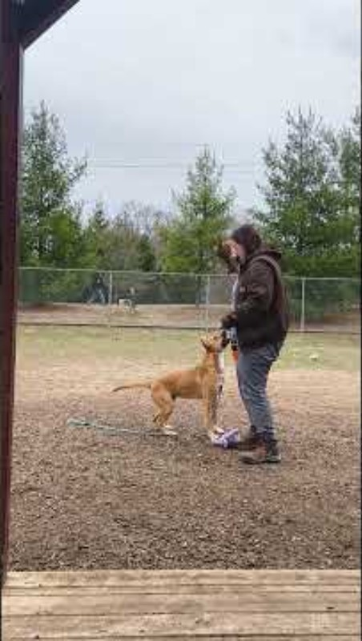
Tips for active management: Pairing play with decompression

Slide 28
Questions?

Slide 29
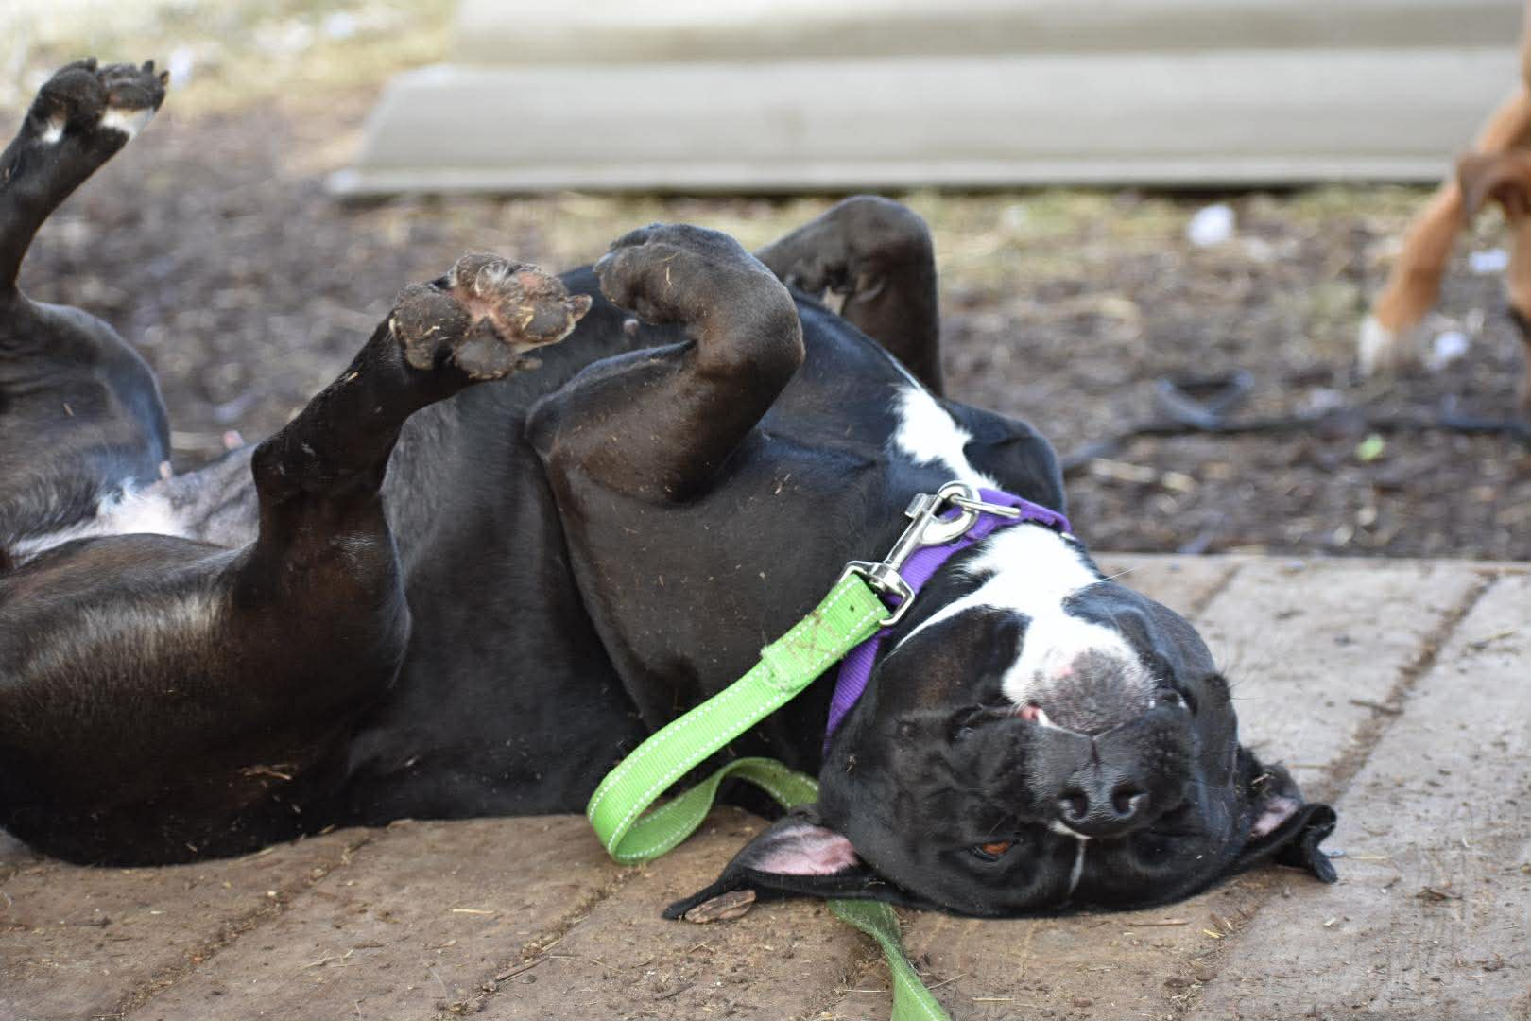
Thanks for helping our dogs!

