Slide 1

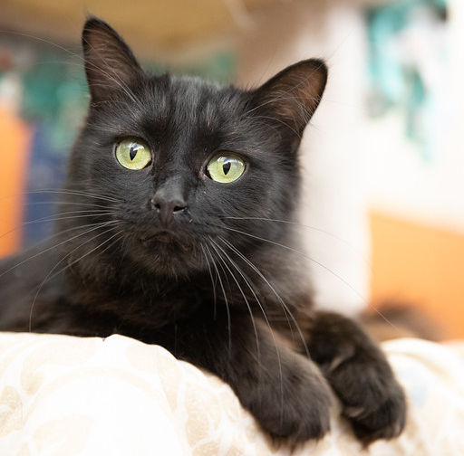
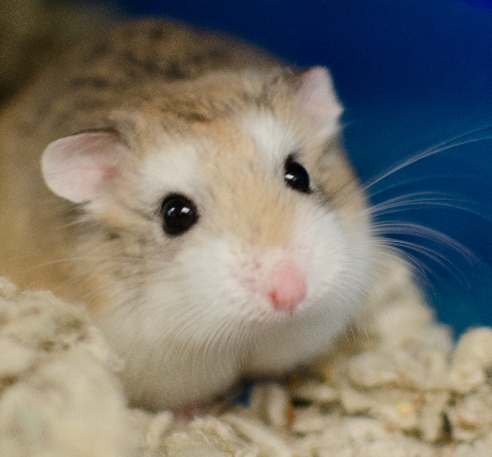
Welcome!
New Volunteer Orientation
3100 Cherry Hill Road | Ann Arbor, MI | 48105
(734) 662-5585 | www.hshv.org

Slide 2
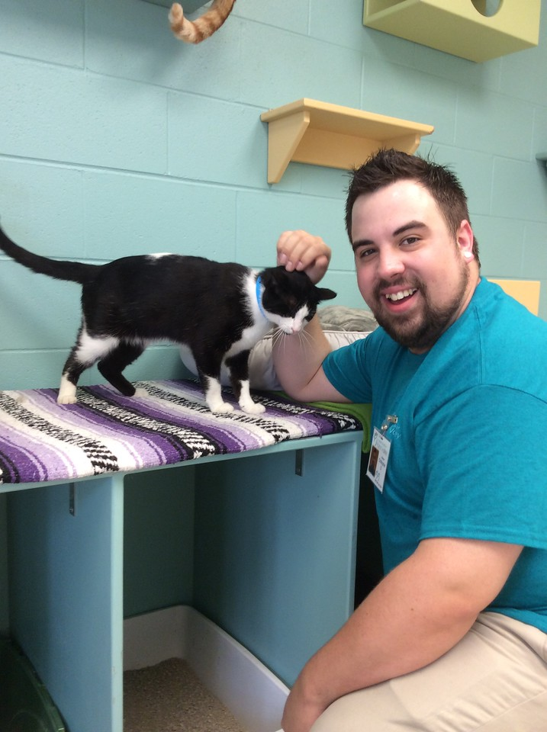
Schedule & Agenda
Welcome & Presentation
  Meet the Volunteer Department
  An Overview of HSHV
  Volunteering at HSHV
Small Groups
  Shelter Tour
  Laundry & Shelter Cleaning
VIC & Getting Started
  Using VIC & Scheduling
  Your first day volunteering
  What’s Next!
Questions?

Slide 3
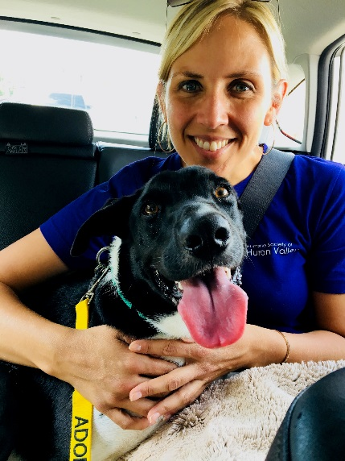
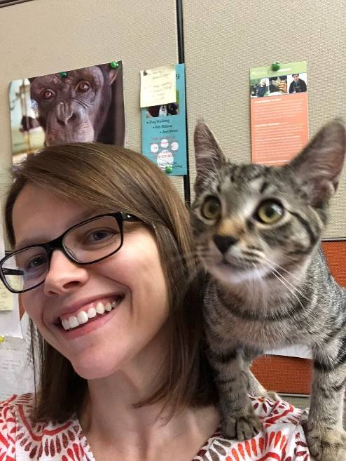
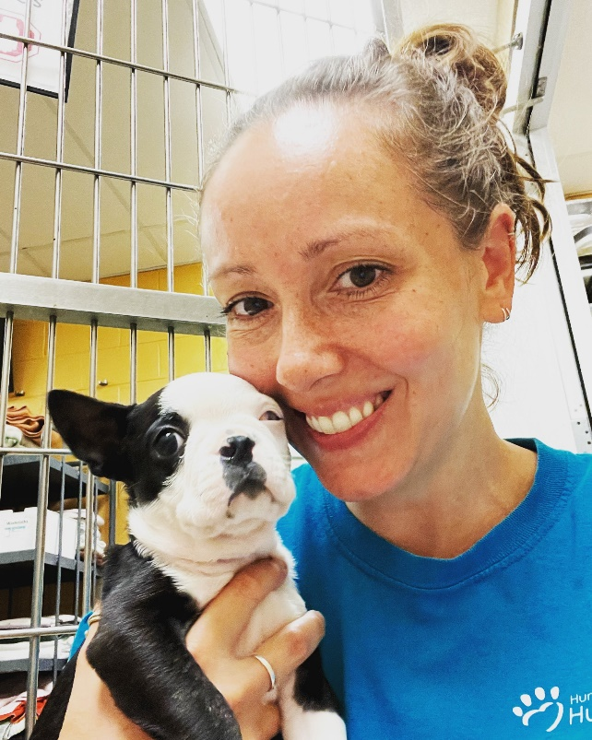
Meet the Volunteer Department
Karen Patterson, Vice President of Humane Education and Volunteers
Tawn Hinze, Director of Volunteers
Jaime Campbell, Volunteer Coordinator

Slide 4
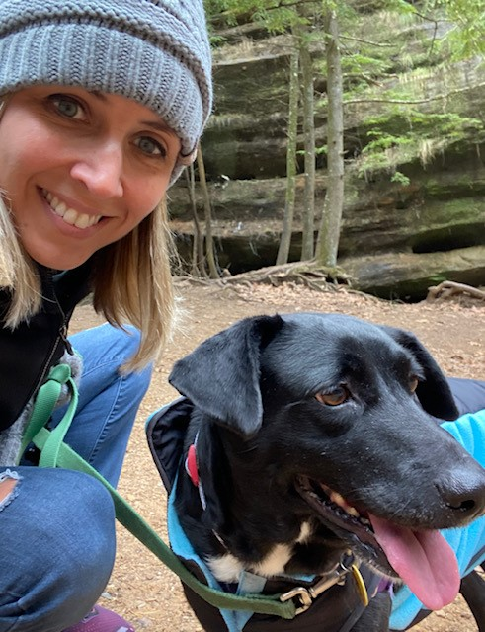
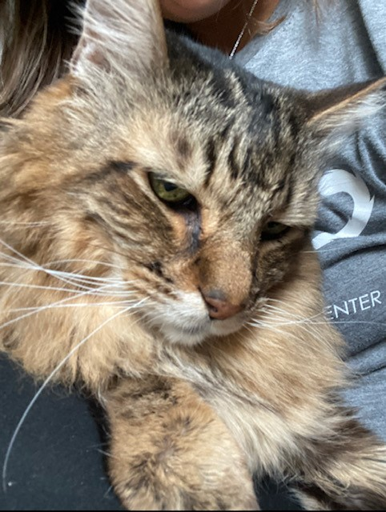
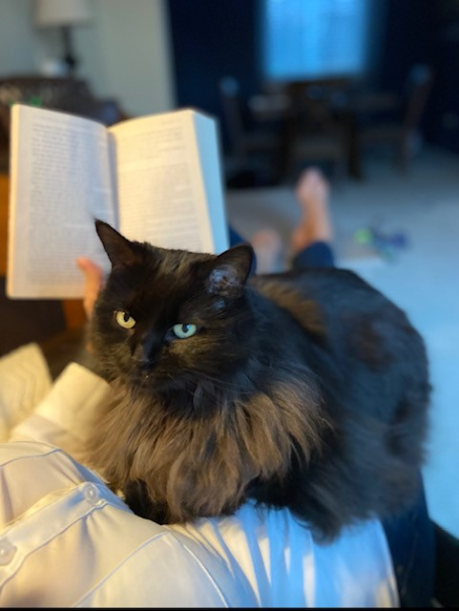
Karen
Vice President of Volunteers and Humane Education
Began as a volunteer and became staff in 2011.
Enjoy time with my family, two cats and dog.
In my spare time I like hiking, paddle boarding, vegetarian food, reading and listening podcasts
I love working with our wonderful volunteers who give so much to HSHV!
Willow
(HSHV Alum)
Milo
Moo-moo (HSHV Alum)

Slide 5
Tawn
Director of Volunteers
I started with HSHV in 2009 as a volunteer.
I want to make sure each of you have a wonderful experience as you get started volunteering.
I enjoy yoga, tennis, coffee, and spending time with family and friends.
I enjoy being around all of our animals…we are their family until they find a forever home.

Slide 6
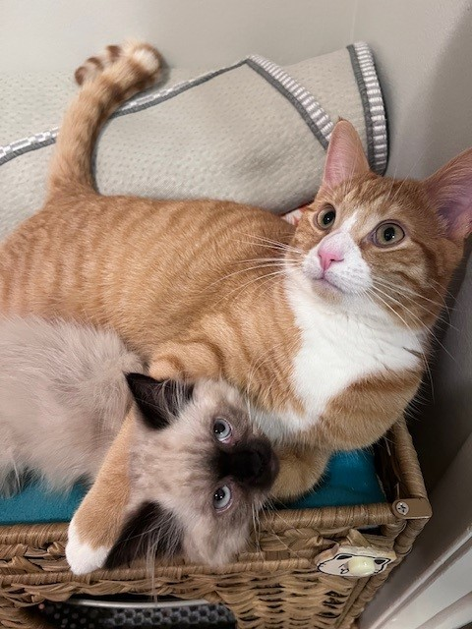
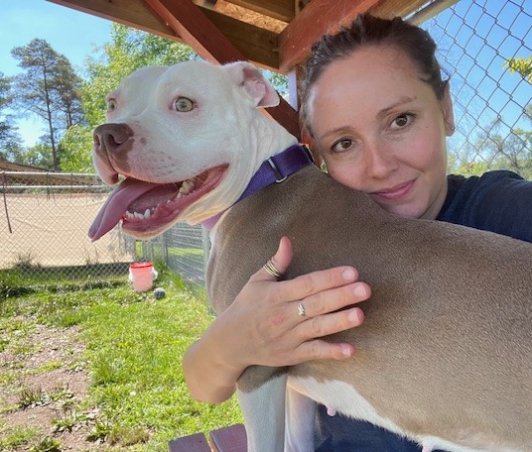
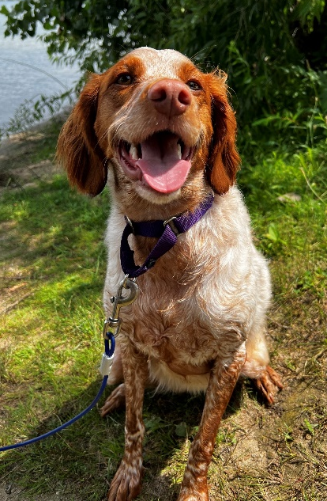
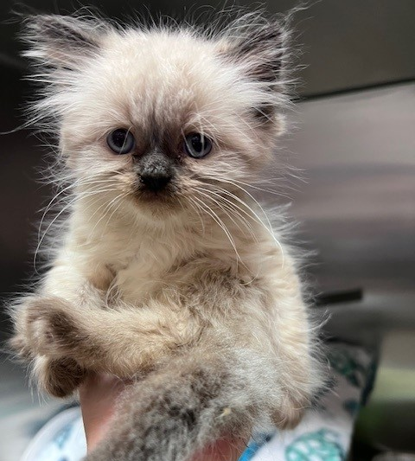
Jaime
Volunteer Coordinator
Started at HSHV in back of house animal care in January 2022.
I have lots of critters at home and love to foster kittens!
I love working here because of all the amazing people I meet, and the relationships I get to form with the animals!

Slide 7
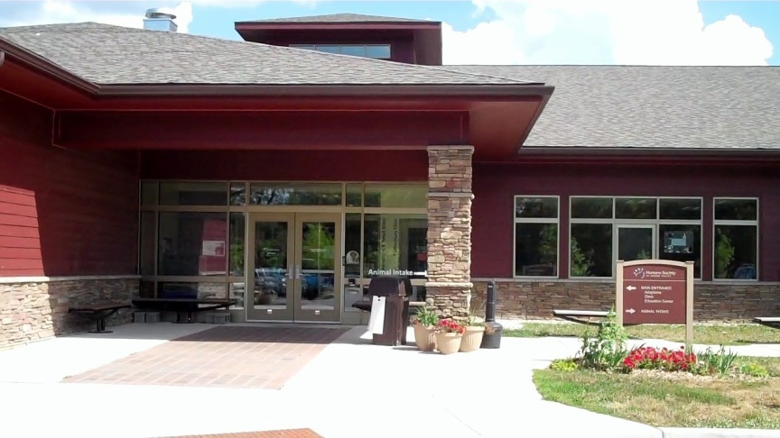
An Overview of HSHV

Slide 8
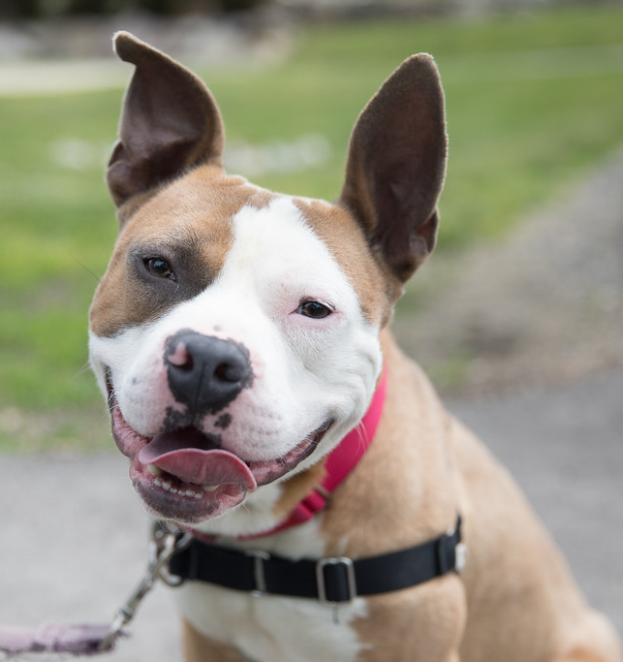
Our Mission
  To encourage loving, responsible care of all animals in our community, to prevent suffering, and to save as many lives as possible.

Slide 9
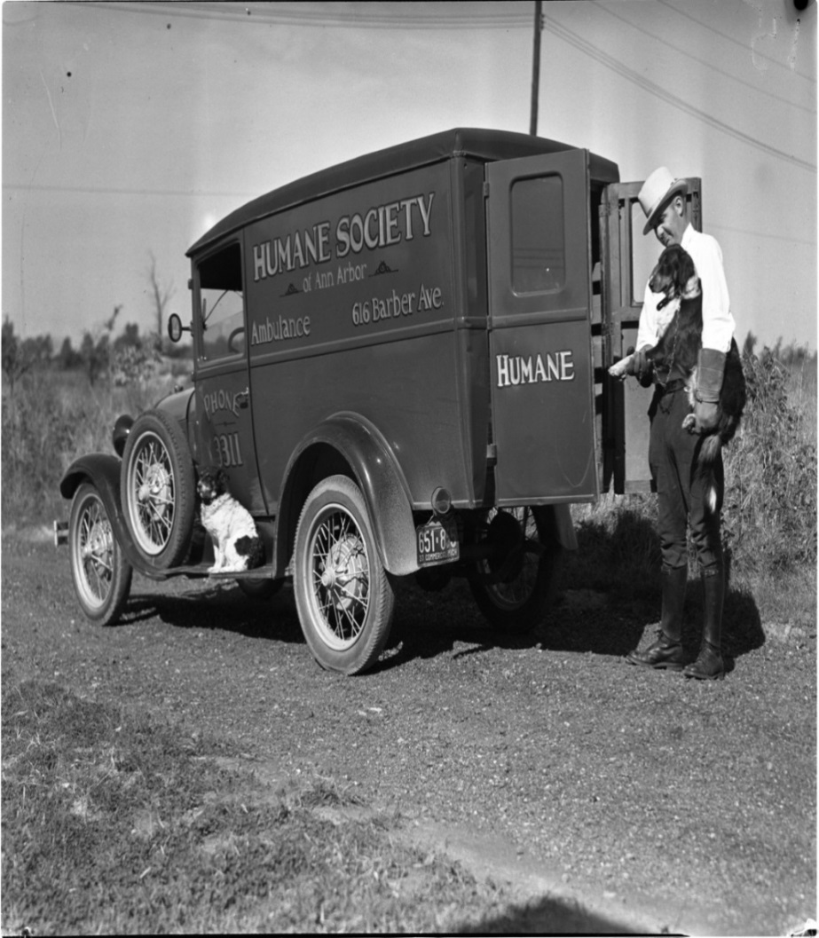
A Little History…
Founded in 1896
Have provided wildlife services for 50+ years
New shelter completed in 2009
501(c)(3) charitable organization
  A private, independent nonprofit agency
Notes:
We are not affiliated with any other Humane Society, we have our own separate operating budget.

Slide 10
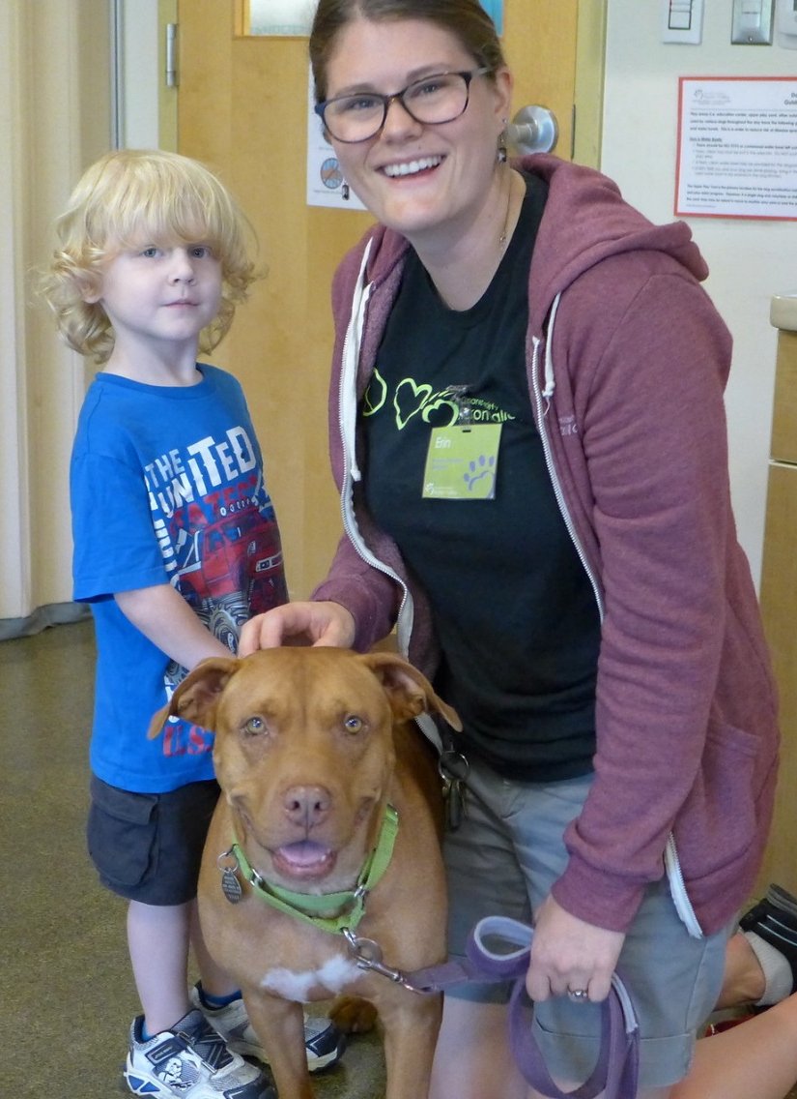
Just Some of What We Do
Cruelty & Rescue
Veterinary Care
Behavior Management
Bountiful Bowls
Safe Harbor
Community Cats
Humane Education
Notes:
Plus many more:
Fundraising events such as Walk & Wag and Compassionate Feast
Bountiful Bows is our food assistance program
Safe Harbor-can house an animal for up to 2 weeks in the event of disaster or other type of emergency situation (i.e. domestic violence).

Slide 11
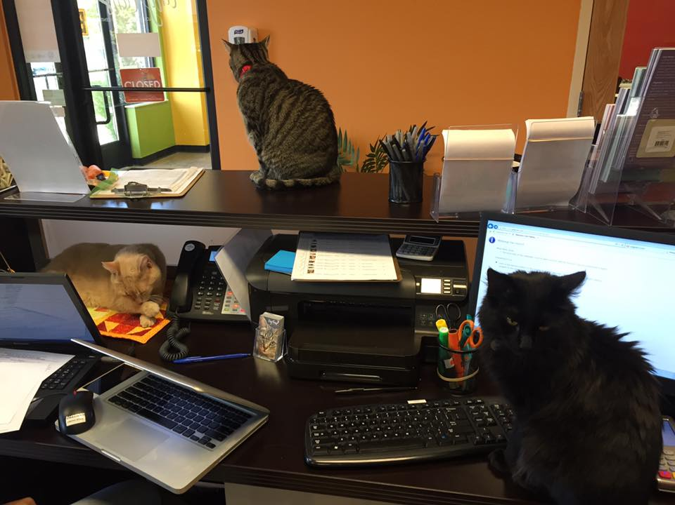

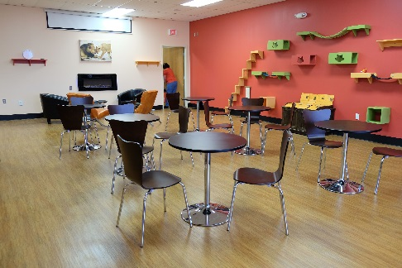
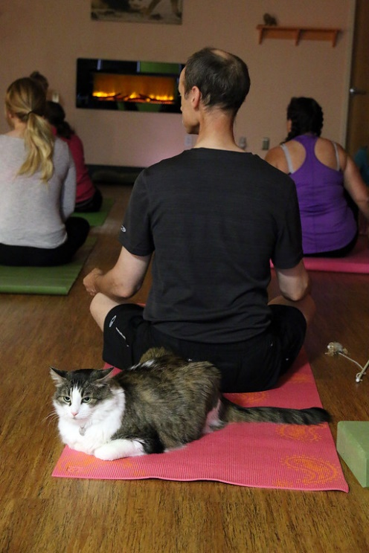
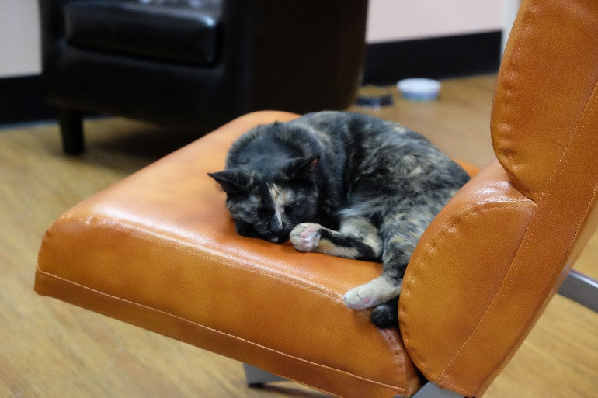
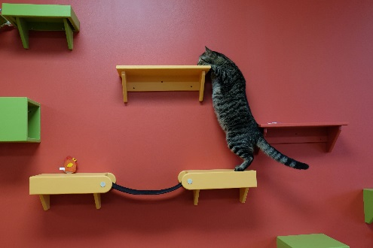
Opened in May 2016
Notes:
Just one of 3 in the state of Michigan!

Slide 12
Friends For Life
Started in March of 2023 through grant from Buhr Family.
Protects the Animal-Human bond by keeping animals in the homes of those with housing insecurities or in need of support for their animals.
Can help provide services such as:
  Essential Supplies (food, litter, etc)
  Vet assistance
  Short-term housing help
  Behavior Advice
  Animal Visitation/Adoption

Slide 13
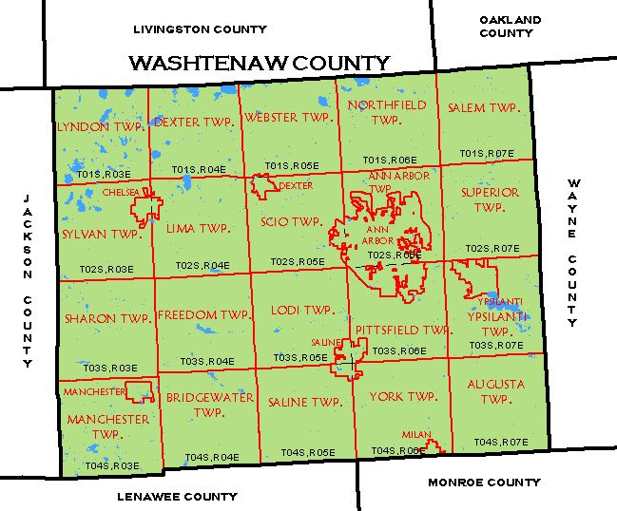
Our Service Area
Washtenaw County & Plymouth
  All our programs and services
Southeast Michigan
  Community Outreach
  Humane Education
  Intake (Space Limited)
  Vet Services
Nation Wide
  Adoptions

Slide 14
HSHV is an Open Admission Shelter
What Does This Mean?
We accept animals even when shelter is full.
We accept animals who are sick or injured.
We fit the definition of “no kill” set by Maddie’s Fund.
We rarely use this term due to confusion.
Euthanasia does happen as a humane course of action.
No “time limit” for adoptions.
Notes:
HSHV is an Open Admission Shelter.
We accept strays and owner surrenders even when the shelter is full.
Since HSHV is an ‘open admission’ shelter, euthanasia is a part of our operation
While HSHV fits the definition of “no-kill” (as defined by Maddie’s fund) we don’t use the term very often because there is so much confusion and politics around the term.
Circumstances when euthanasia is the humane course of action:
unmanageable pain that cannot be controlled through reasonable medication and/or medical treatment
severely injured
chronic medical issues
deemed unsafe
cage neurosis that is not treatable with fostering

Slide 15
How Do Animals Arrive at HSHV?
Surrendered
Stray
Seized
Transferred

Slide 16
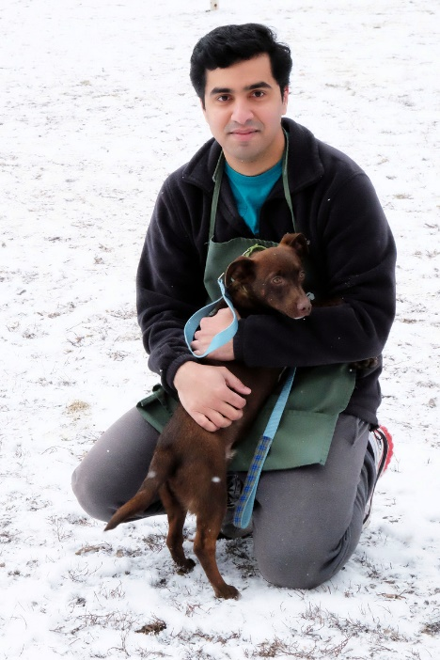
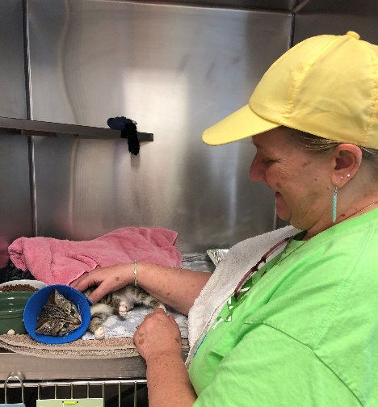
Fun Facts
How many adoptions does HSHV do each year?
How many animals does HSHV care for each year?
What is HSHV’s animal save rate?
5000+
20,000+
97.5% (2025)

Slide 17
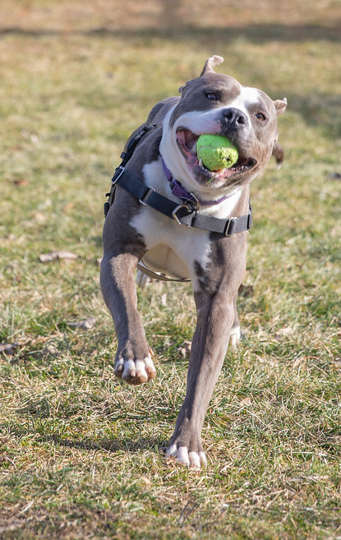
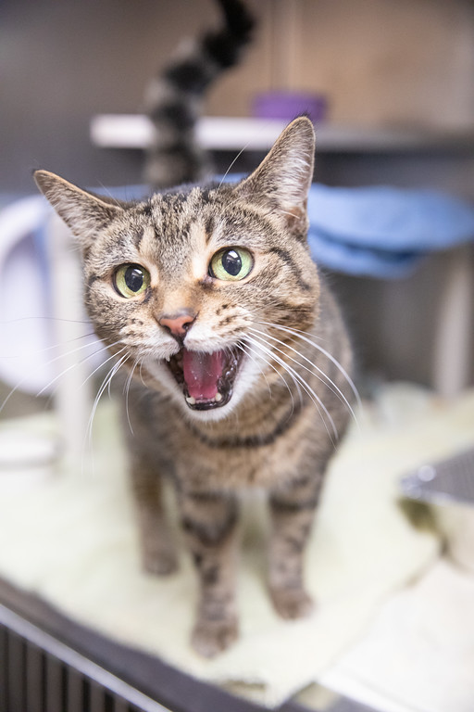
We Don’t Mean to Brag….
No, no...go on…I mean HSHV is better than tennis balls!
HSHV is truly the cat’s meow...I get wet food twice a day!

Slide 18


We won,
We won,
WE WON, Thanks to YOU!
Ann Arbor Family Favorites 2024:
Best Place to Volunteer
2nd Place-Best Kid’s Camp (new category in 2024)
Best of Washtenaw Readers Choice Awards 2024:
Best Animal Non-Profit
Best Veterinarian
Best Trivia Night @ Tiny Lions Cafe

Slide 19
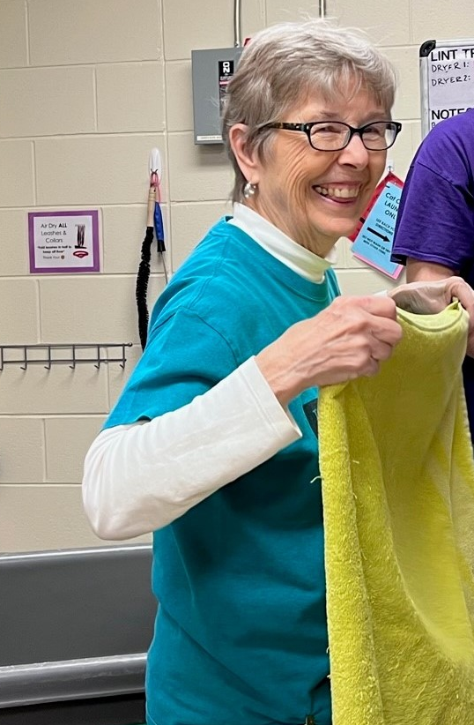
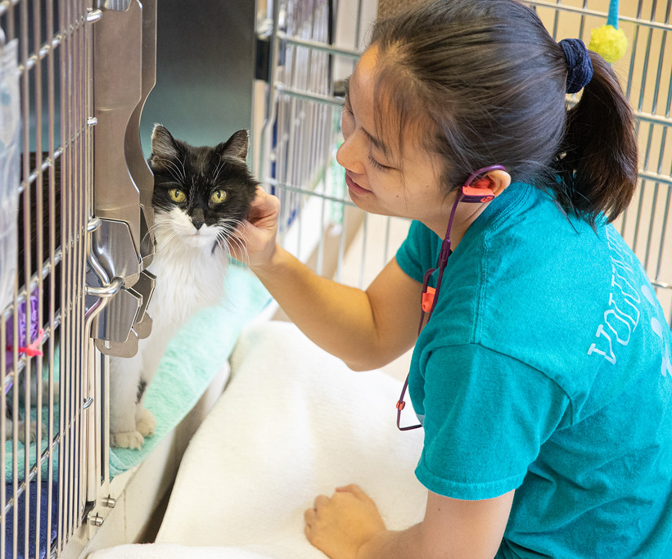
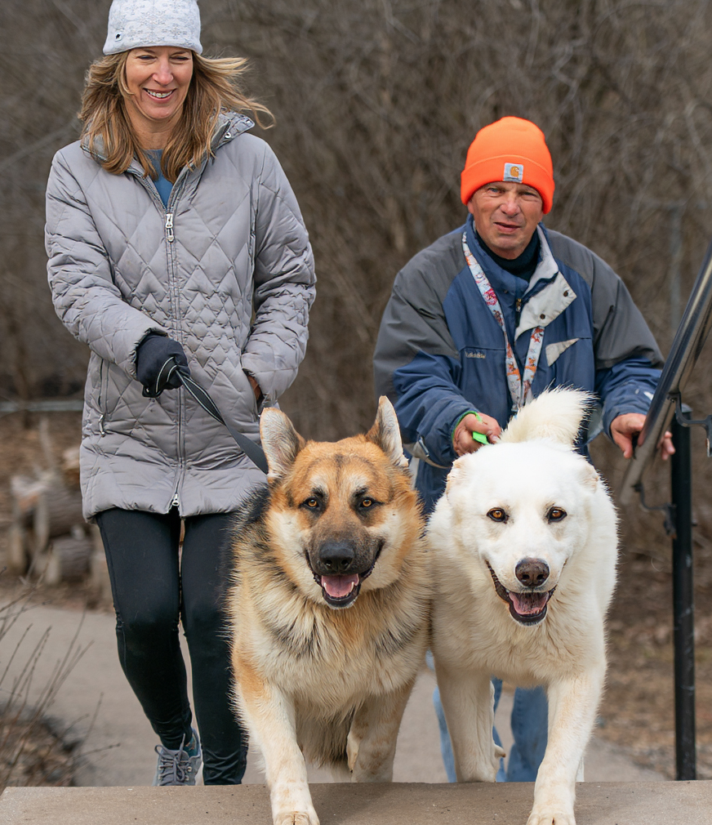
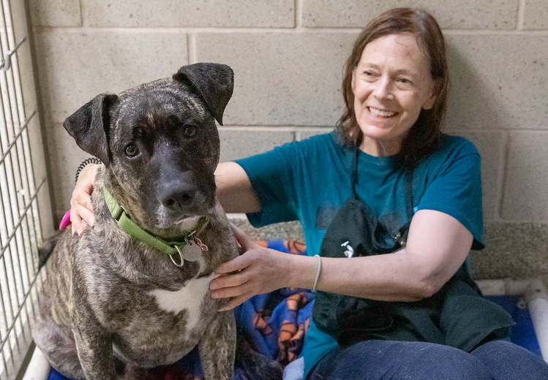
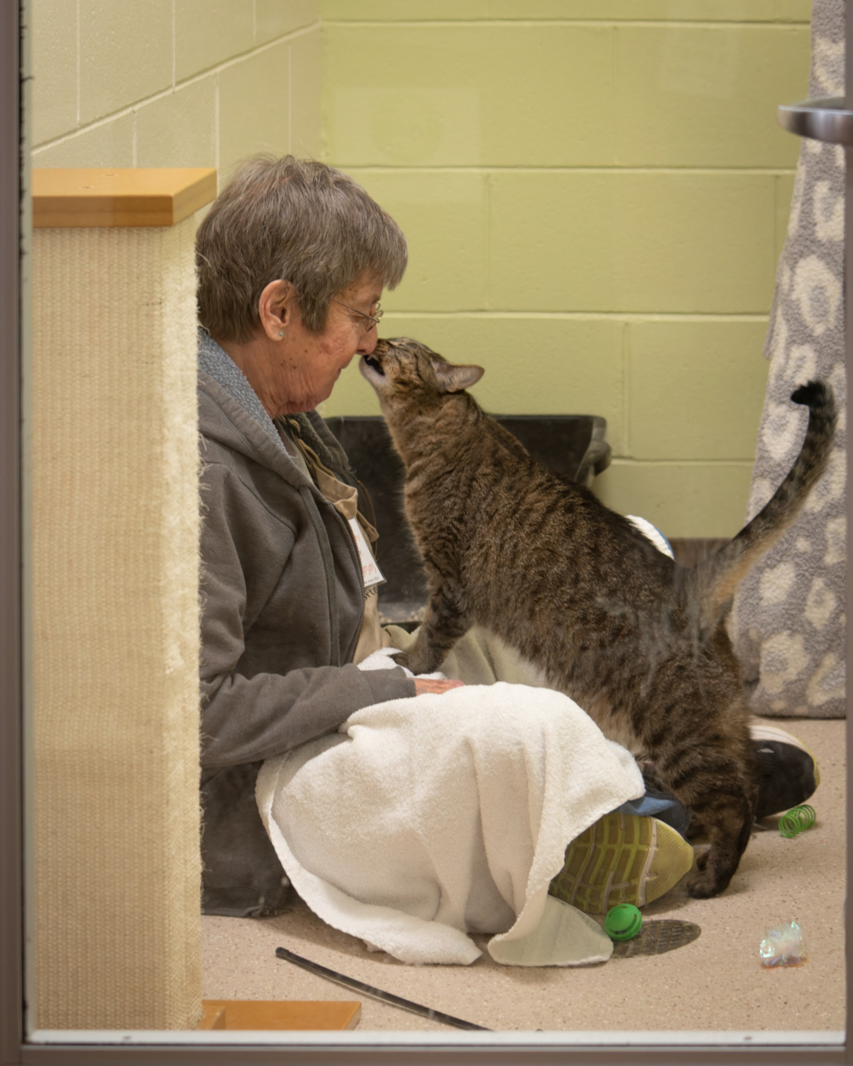
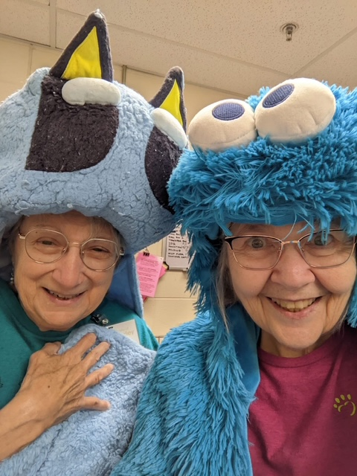
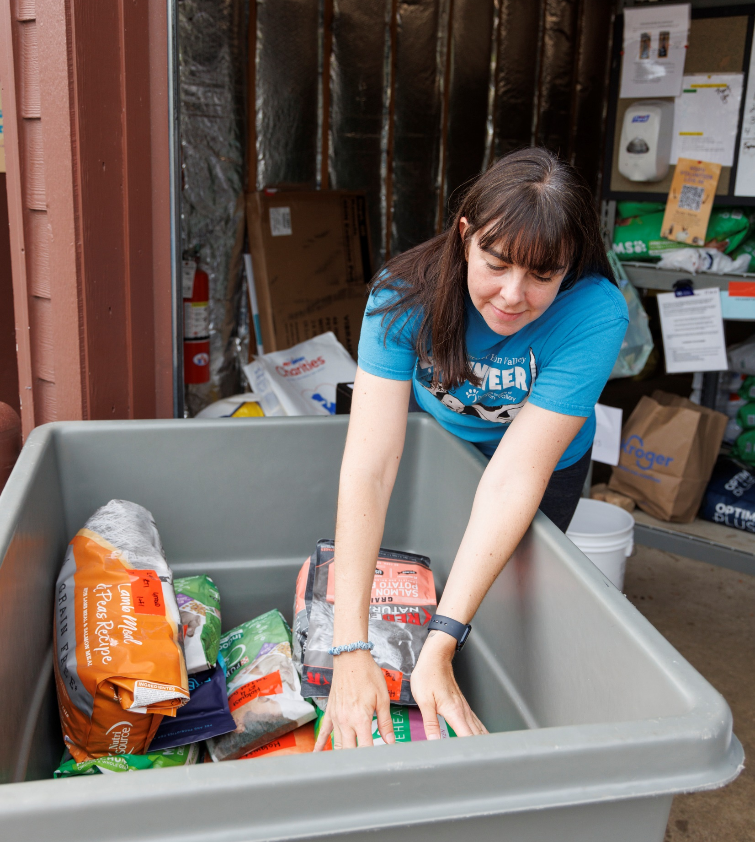
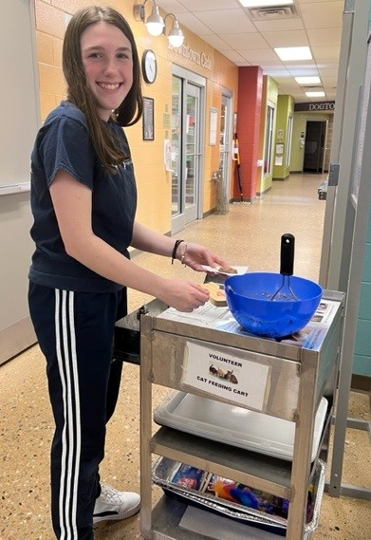
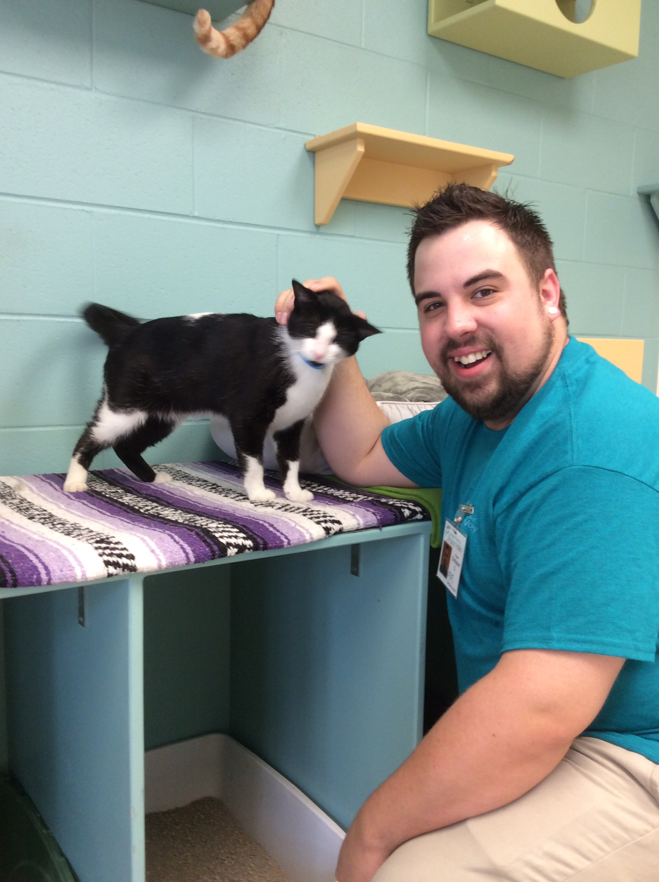
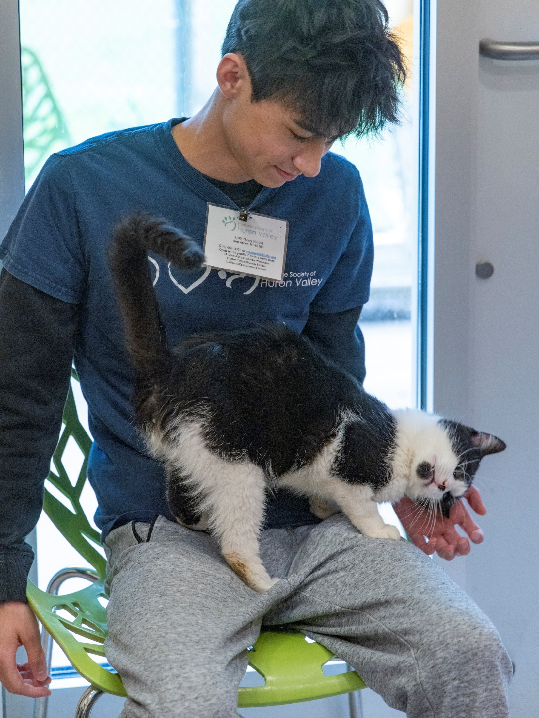
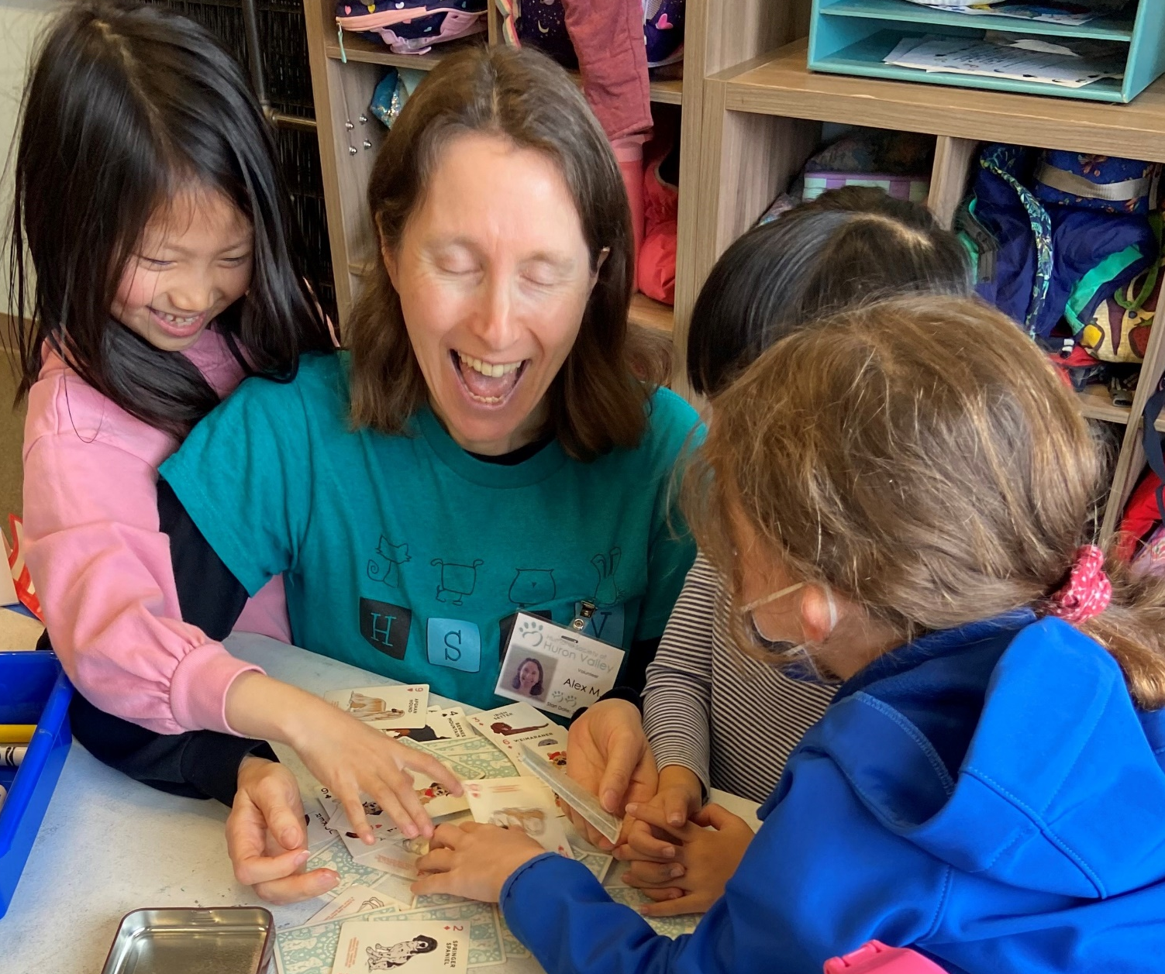
Volunteers Make
HSHV Great!

Slide 20

We got our
16th consecutive
4-star Charity Navigator putting HSHV in top 1% of charities ranked nationwide
+ we're a "great nonprofit,"
thanks to you, too!

Slide 21

We are Fear Free Certified!
Looking at not only physical health but emotional health of our animals
Reducing stress by observing the environment and how the animal sees his/her world
  Example: sounds…loud sounds can be stressful, so we avoid wheeling carts into our cat rooms.
From enrichment, to read to calm, to cat feeding, volunteers play a crucial role in supporting an animal’s overall well-being

Slide 22
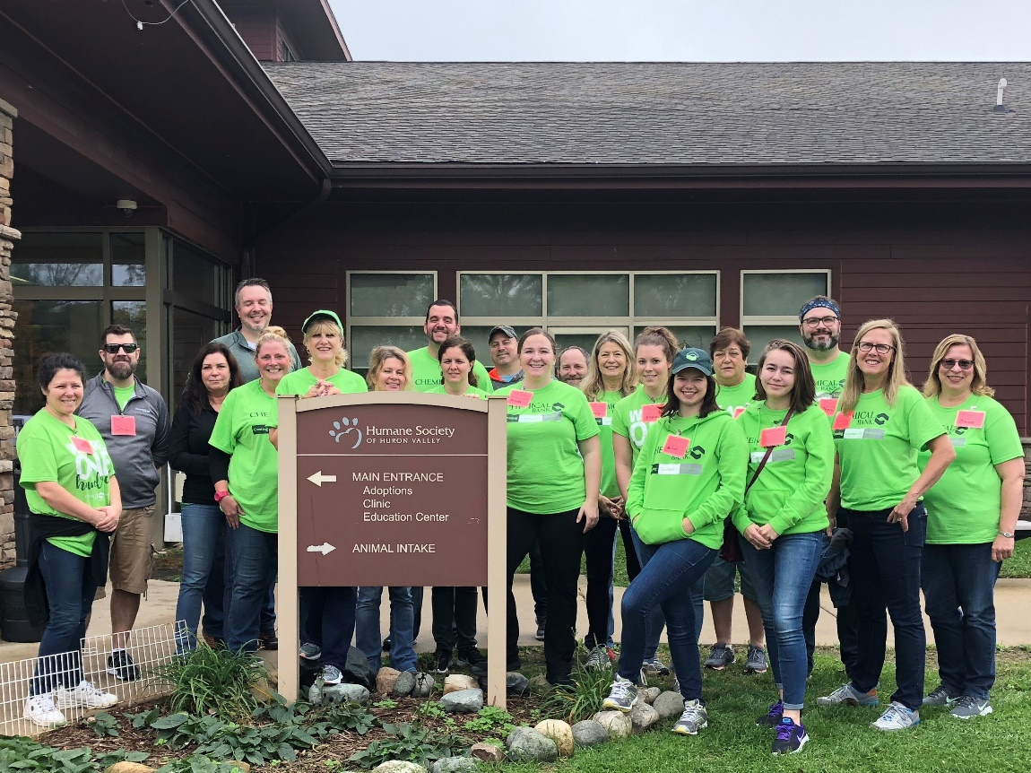
Volunteering at HSHV

Slide 23
Who Volunteers with HSHV?
Adults (ages 18+)
Junior Volunteers (ages 12-17)
Community Service Volunteers (18+)
Fosters
Day of Service
Tiny Lions

Slide 24
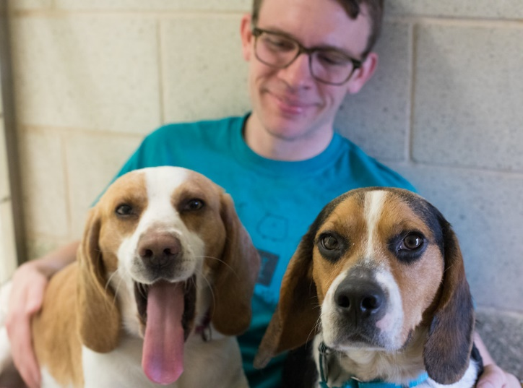
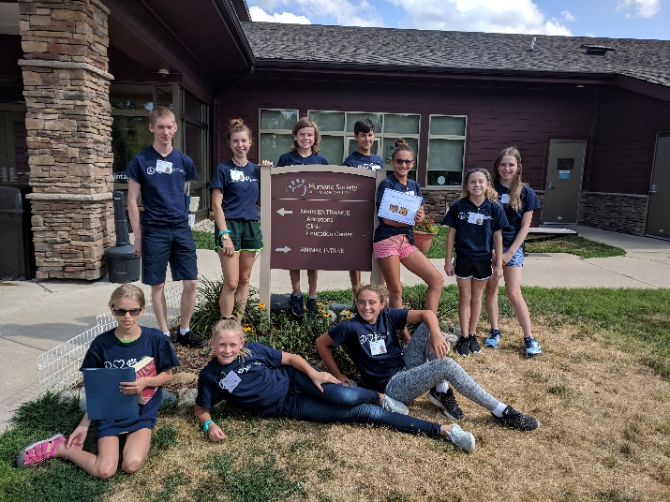
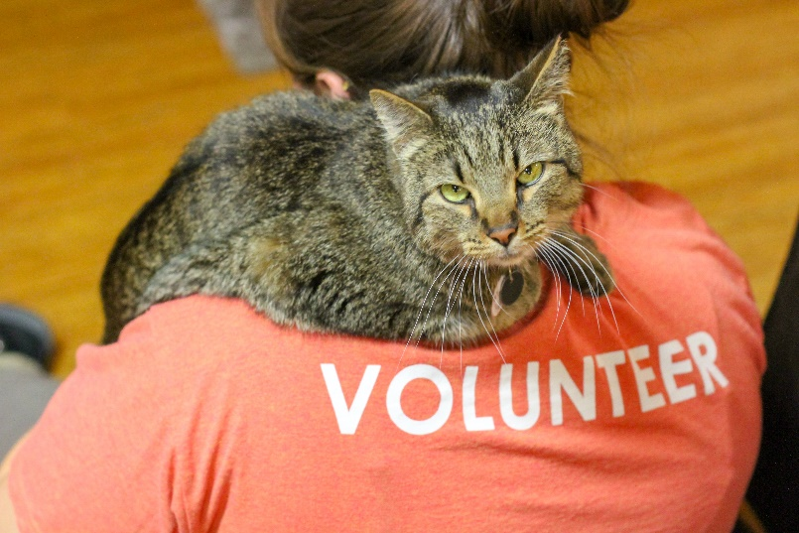
2025 Volunteer Statistics
Total number of adult volunteer: 1,061
Total number of youth volunteers: 438
Total number of volunteer hours: 162,106
Hours donated by volunteers is equal to about 77 full-time paid staff!!
Notes:
Highlighted 6 top areas:
Dog walking: 21,419
Cat Comforting: 6,944
Fostering: 43,367
Shelter Support: 9,046
Clinic Support: 1,602
Humane Education: 10,041

Slide 25
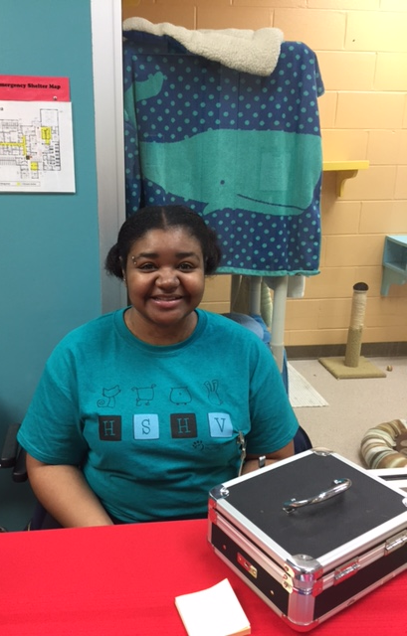
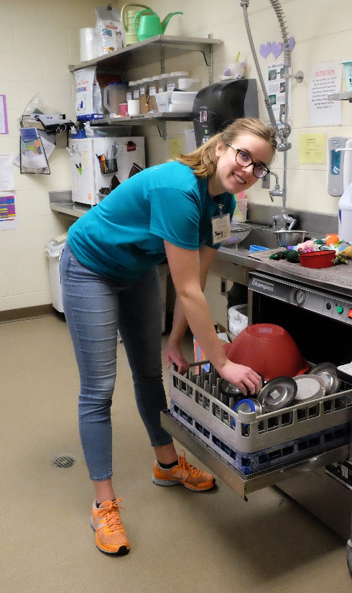
Paw I Volunteering
All volunteers start at the Paw I level
Primarily help with:
Laundry
Shelter Support
Administrative Support
Cat Feeding
Community Events
Love Train
No contact with animals (that’s Paw II)
Notes:
Community Service volunteers- stay at Paw I until completion of their required hours.

Slide 26
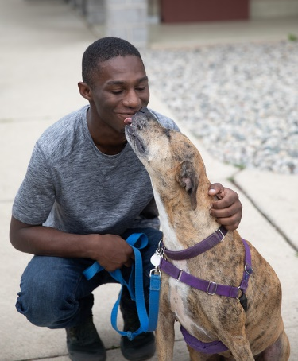
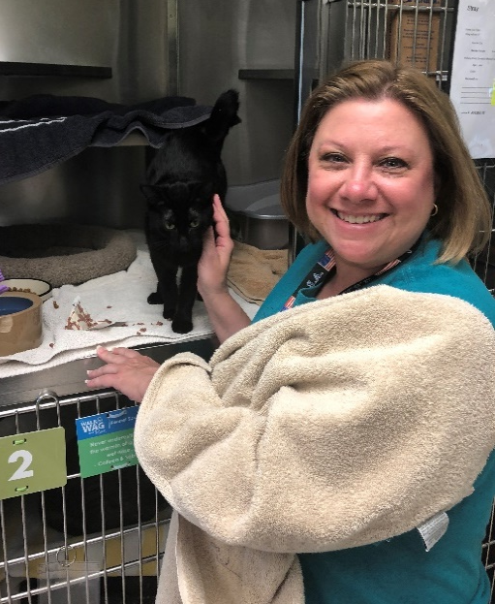
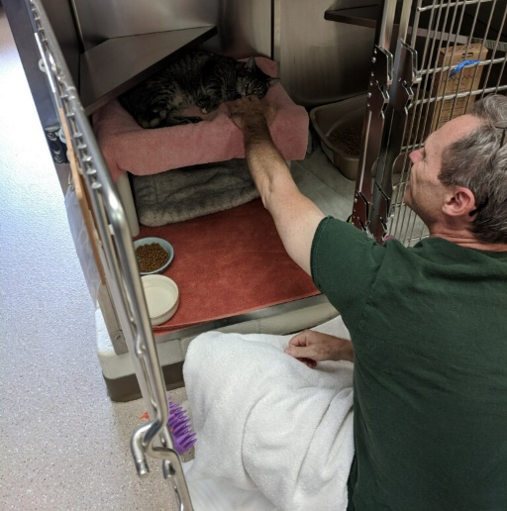
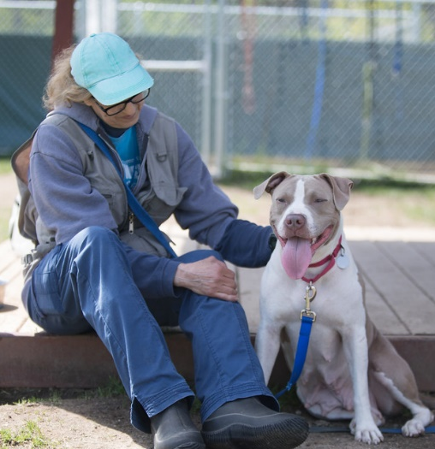
Paw II Volunteering
Volunteer at least 10 hours
(community service volunteers move to Paw II upon completion of hours)
Receive email notification
Sign up for dog walking, cat comforting, or small mammal training
10% DISCOUNT!

Slide 27
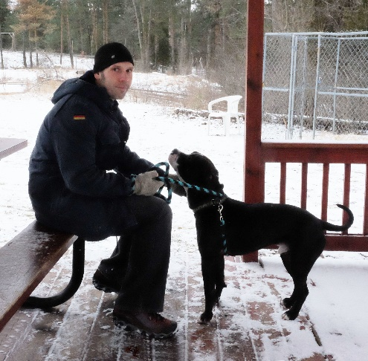
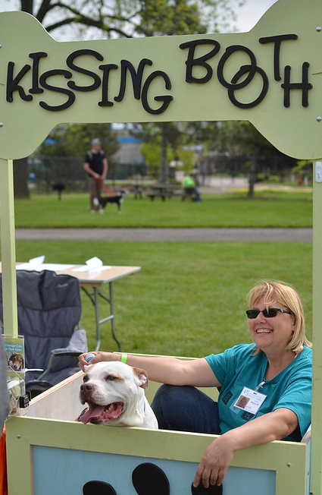


Beyond Paw II Volunteering
100 Hours of Volunteering
Recognition sticker for name tag; “Thank You” vinyl sticker!
250 Hours of Volunteering
Paw III - New name tag
500 Hours of Volunteering
Paw IV- New name tag & certificate

Slide 28
Things to Know
What to Wear
Volunteer shirt (optional)
Cell Phones
Should not be out
Name tag
Close toed shoes
Sign out if you need to make a call
Other Policies
Smoke-free facility
Weapons/Alcohol-free facility
No open food or drink in work areas
No family or friends come to volunteer with you (unless they too are volunteers)
Notes:
I

Slide 29
Our Volunteer Culture
Balance
Don’t over schedule yourself
Communication
Let us know how we can help
Respect
Follow Policy and Procedures
Have fun
Find what you enjoy doing
Notes:
Balance. We understand that you have a life outside of volunteering.
Don’t overschedule yourself as this could potentially lead to burn-out/compassion fatigue. Ideally no more than 4 hours on a given day.
Communication. Starts with the volunteer department.
Feel free to email volunteers@hshv.org or follow up with Karen, Tawn, or Ashley directly. We are here to help!
Have Fun. Each year we have end of year and summer appreciation events. We also celebrate Volunteer Appreciation Week with fun giveaways and special classes. We want you to enjoy your time volunteering!
Respect. We ask that policies and procedures are followed to ensure the safety of you, those around you, and the animals trusted in our care.

Slide 30
Volunteering at HSHV
Be Respectful
We create a welcoming environment by respecting our differences.
Ask for Help if You Need It
If you need help better understanding a difference, ask a staff member/volunteer department for help.
Keep an Open Mind
Try to understand where others are coming from rather than get frustrated from a difference in understanding.
Leave bias, stereotypes, and prejudice at the door. Let’s not have our differences get in the way of our mission for caring for the animals and finding them loving homes.

Slide 31
Communicating Effectively
Volunteer Department
Communication starts here! We are available to discuss any concerns that you may have.
Confidentiality Agreement
Social Media
Using social media to voice concerns or issues is not effective. See volunteer department staff instead.
No sharing of confidential information. Volunteers can be dismissed if violated.
Notes:
Confidential information about HSHV employees, volunteers, customers or adopters and confidential animal information should not be discussed without the written consent of HSHV.
Violating the confidentiality agreement (which you received when filling out your application) is grounds for being dismissed as a volunteer.
If you have a concern or question about anything that is happening at HSHV, communication begins with the volunteer department.
Using facebook or twitter as a means to voice your concerns is not an effective way to begin communication. Remember, Karen is available for you to talk with, so feel free to visit with her, or email at karenp@hshv.org.

Slide 32




HSHV on Social Media
HSHV.animals and Tiny Lions Catfe
humanesocietyofhuronvalley and
tinylionscatcafe
Humane Society of Huron Valley and
Tiny Lions Lounge and Adoption Center
tiktok.com/@humanesocietyhuronvalley
Humane Society of Huron Valley | (734) 662-5585 | www.hshv.org

Slide 33
Advocacy Text Alerts
Text 734-662-5585 -get help or join our advocacy group and get text alerts
Texting these words to the above number link you with intake and our lost/found services and provide updates
Lost cat
Lost dog
Found cat
Found dog
Text Defender – get added to the text notifications about advocacy alerts

Slide 34


Animal Advocacy
Sign up as an Animal Defender to protect animals, speak up for those who do not have a voice, and support compassionate policies in our community and beyond.
HSHV works with local, state and federal legislators and partner organizations to help better protect animals.
Learn about animal welfare issues and how to take action on their behalf.
Community Gatherings
hshv.org/advocacy

Slide 35

Volunteer Facebook Group
Closed group
A place for updates, stories, pictures, or
volunteers needed requests.
No posts about death, euthanasia, or killing/injury to animals.
Posts should not include solicitations of goods/money.
Questions? Ask us!
Notes:
Closed group, must be a volunteer to join

Slide 36

Facebook Posts
Posts are removed that do not fit the social media policies
Notification sent
2 or more posts removed = removal from FB group
Notes:
Posts that do not fit within the social media policies will be removed.
If a post needs to be removed, the volunteer will be notified by Karen or Tawn explaining “why”.
Volunteers may be removed from the facebook group after 2 posts.
Tone of the group remains positive.
Respecting that not everyone wants to know or read about certain topics
If you ever have questions, please just ask. We are here and want to help ☺.

Slide 37


Time for Small Groups!
Shelter Tour
Laundry & Shelter Cleaning

Slide 38
When Out in the Shelter
Please Stay Together as a Group
  The animals are super cute, but we have limited time today
Keep Hands and Fingers Out of Kennels
Avoid Side Conversations
  Let’s make sure everyone can hear what is being said
Cell Phones are Kept Away

Slide 39



Welcome to Laundry
Laundry is one of our biggest needs at the shelter in terms of volunteer support. It is where a lot of new volunteers start volunteering at HSHV.
https://youtu.be/e1uDsJTpd9M
Notes:
vimeo.com/davidmbrown/hshvlaundrytraining

Slide 40
Laundry Room Supplies
Everyday Supplies
Cleaning Products
Gloves, garbage bag liners, paper towels, Accel products are all available on the cart.
If supplies are low, see a Shelter Supervisor or the Volunteer Team
Washing machines are programed to dispense the right amount of soap and bleach into each machine.
Please do not bring any outside cleaning products into the shelter - we only use safe and environmentally wise products around the animals and in the shelter.

Slide 41
Laundry Room Machines
Washing Machines
Dryers
Machines cycles can vary depending on load.
To run washers press “1 start”
Run best when full, leave enough space for a football to fit at the top
Any combination of items can go into either washer
Soap and bleach are automatically dispensed.
Put clean laundry from either washer into either dryer.
Press the green “start” button
Clean lint traps every two hours (located below each dryer) and mark the time cleaned on the whiteboard.
If an item doesn’t dry completely, put it back in the dryer.
**Reminder: If any item that has been washed falls on the floor it is considered dirty and need to be re-washed.

Slide 42

Handling Dirty Laundry
Please shake out all laundry before putting it into one of the large bins inside the laundry room
General Laundry Cyle: Press 1 start
Both washers and dryers are identical in programming and size, so no need to sort the dirty laundry (just remember to remove any debris).
We do not put Hard plastic/rubber toys into the washer/dryer. Instead, they go…
  Cat kitchen-Cat hard plastic/rubber
  Dog kitchen-Dog hard plastic/rubber
Items that we do not put in the dryer
  Collars/Leashes/Harnesses- hang on hook on back wall to dry.

Slide 43


Folding & Storing Laundry
Most clean, folded laundry will go to the storage shelves in the cat storage area (before Dog Adoptables). Only put items on the correct shelf.
Some items (flat sheets only (no fitted sheets), dog beds, and cat beds) do not go on these shelves, but instead are stored in Dogtown Storage or Uptown Cats. (See map on next page)
If you don’t know where an item goes, check the signs above the washers, or just leave it on the counter in the laundry room.

Slide 44
Special Laundry Loads
Special laundry is done for several departments. This laundry will have its own washing instructions found on the back of the laminated cards that will be attached to the laundry bags.
The special laundry often requires a different wash cycle. Please follow instructions carefully. Do not mix special laundry with “normal” laundry.
Red = Clinic Laundry –Cycle 2 (press 2, start-that’s it!!)
Yellow = Community Cats- Cycle 3 (press 3, start)
Green = Humane Education –Cycle 2 (press 2, start)
Pink=Cat/Kitten Nursery- Cycle 1 (press 1, start)
Please note any “extra” rinse cycles are already programmed into the special cycle.
Red bag clinic laundry takes top priority – it should go in the to washer as soon as possible.

Slide 45
Waiting For a Load to Finish?
Check the lint traps every 2 hours
Sweep/Mop the Floor As Needed
Check Trash in the Laundry Room-Take out to Dumpster

Slide 46
Important Laundry Reminders
Always sign up before coming in
Laundry is the last assignment you do at the shelter!
Questions? Need supplies? Just ask!
Read signs! They have important reminders
Notes:
Laundry is last assignment for the day…we humans are the largest carriers of fomites and we don’t want to carry germs.

Slide 47
Volunteering in a Shelter Setting
Exposure to Germs/Diseases.
  Zoonotic-animal to human (i.e. Ringworm).
  Other diseases animal-animal (i.e. Parvo, URI’s).
Humans are the largest carriers of germs.
  Always sanitize hands.
  Laundry is the last thing you do at the shelter.
After Volunteering
  Clothing-
    wash in hot water/color-safe bleach. Dry in the dryer on highest setting.
  Shoes-
    wipe down and/or have a separate pair just for volunteering.

Slide 48


The Laundry Room
Let’s go check out the laundry room!
After
Volunteers
Before
Volunteers

Slide 49

Getting Started – Signing Up
VIC =
Volunteer Information Center

Slide 50

Let’s Take a Look at VIC!
Logging In
Homepage Overview
Email Settings
Calendar
  Signing Up
  Canceling
Job Descriptions
Resource Library

Slide 51
Need to Cancel?
More than 36 Hours to your assignment
Log into VIC
Click the “remove me” button
Less than 36 Hours to your assignment
You will no longer see the “remove me” button in VIC
Email volunteers@hshv.org to let us know you aren’t coming in
No notification? You will marked “absent”. 3 or more absences could result in dismissal from the volunteer program.

Slide 52

Your First Day of Volunteering
Park in the back of the parking lot
Leave valuables in the car
Door code: 8318#
Sign in and out at the station
(your main phone number WITHOUT the area code)
Wear a temporary name tag
Notes:
Personal Items can be hung up back in the admin area or there is a place to hang jackets/keys in the laundry room.
When entering into the building first thing in the morning, be sure to not let anyone from the public come in behind you as the main doors close.

Slide 53
Staying Active as a Volunteer
90 days with no activity on your volunteer account
We will email you, you will have 3 weeks to log hours
Your account becomes inactive if you don’t come in
Contact us if you will be gone for an extended period!
Notes:
A monthly inactive report is completed
Looks at which volunteers have not logged any time in the past 90 days.
You will receive email notification that you are on the inactive list
If you do not complete a shift prior to the date given in the email, your account will be archived.
Need to take time off (a month or more)? Email volunteers@hshv.org so we can update your account to vacation mode.
Absences without Notification
Will be marked in your account
3 absences without notification=possible dismissal from volunteering

Slide 54



Welcome to Volunteering!
A “Welcome to Volunteering” email will be sent to your email. Once you receive this, your volunteer account will be “active” in VIC!

Slide 55
VIC Reference Guide

Slide 56

VIC Net Login: Visit our website, www.hshv.org, on the homepage you can click on “Volunteer”, then “Volunteer Login” to access VIC on your computer.
Logging Into Your Account
Login: Your login name will be your email address and your password from the application. Click “go”.
Don’t worry, if you forgot your password, there is a “Forgot your password?” button.

Slide 57

Welcome Screen: This is the main page you will see every time you log into VIC. Check here for the most important and up to date information about upcoming trainings, happenings at the shelter, or events you can participate.
Getting Started-VIC Homepage Morning door code – 8318#
As a volunteer, you are responsible for knowing the morning door code! Write it down but don’t share it!
Please be mindful, especially before we open to not let someone from the public come in behind you as you go through the main doors into the shelter.

Slide 58

Communication through VIC
Communication through email in VIC is how we send information on trainings, shelter news, schedule changes, and help needed.
Please check your message preferences in VIC under the
“account” tab

Slide 59

OR you can select the assignment you would like to perform from the drop down menu. This will filter out all other assignments except the assignment chosen and show you on the calendar next available.
Signing Up for Assignments
Registering for Assignments:
You can select an assignment based on the calendar date you are available. Just click the “Help Wanted” bubble to see your options.

Slide 60


Job Description: Learn more about the specific tasks associated with that volunteer assignment. If that assignment is something you would like to schedule yourself for, click on the green “Schedule Me” button
Job Descriptions

Slide 61

Removing Yourself:
Things do come up and there may be times that you need to change your schedule. That is okay.
You may remove yourself from any scheduled assignment up to 36 hours before you are to perform that assignment. Just click “Remove Me”
If the green REMOVE ME option is NOT available, please email volunteers@hshv.org to cancel.
Canceling Assignments
Reminder: 3 unexplained absence means you could be dismissed from volunteering at HSHV. Communication is the key. Just let us know if you cannot make an assignment so we can plan.

Slide 62

Online Resource Library
Look for the “earth” icon on home page.
The resource library has all of our volunteer training presentations and informational meetings.
Trainings are organized into categories and you are welcome to print off or review trainings whenever you would like.

