Slide 1
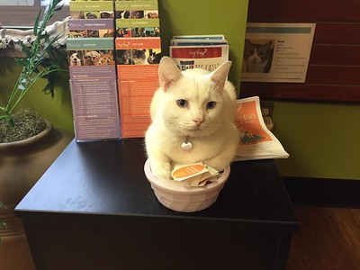
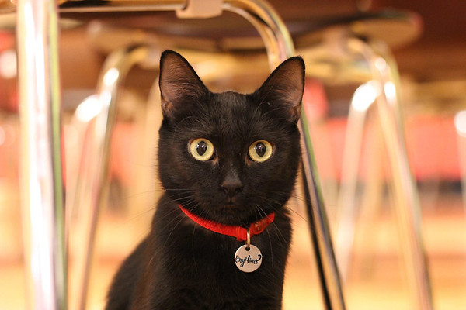
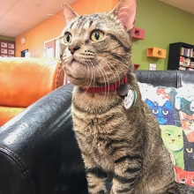
Welcome!
New Volunteer Orientation
3100 Cherry Hill Road | Ann Arbor, MI | 48105
(734) 662-5585 | www.hshv.org

Slide 2
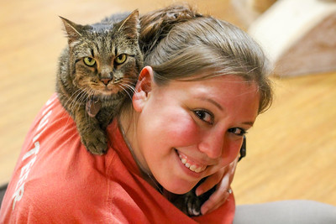
Schedule & Agenda
Welcome & Presentation
  Meet the Staff
  An Overview of HSHV & Tiny Lions
  Volunteering at HSHV
Tour of the Café
  Interacting with cats at Tiny Lions
  Get your picture taken
VIC
  Using VIC & Scheduling
  Your first day volunteering
  What’s Next!
Questions?

Slide 3
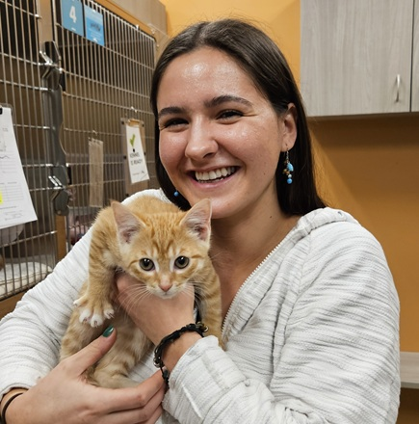
Meet the Staff
Carmen Grove
Tiny Lions Cafe Manage
Tara Simon
Tiny Lions Cat Coordinator

Slide 4
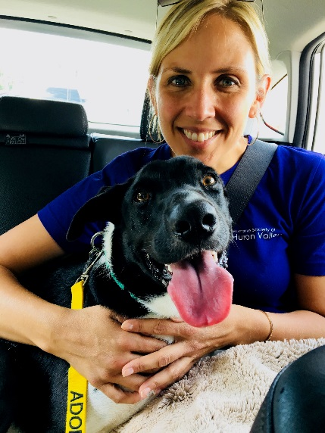
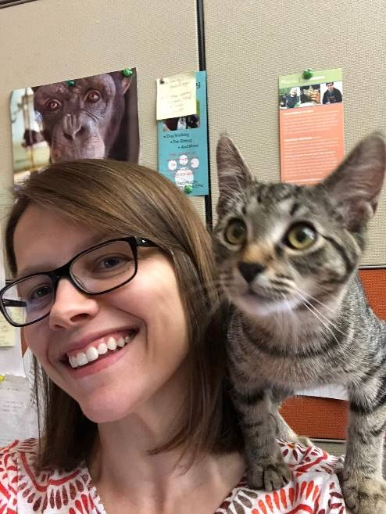
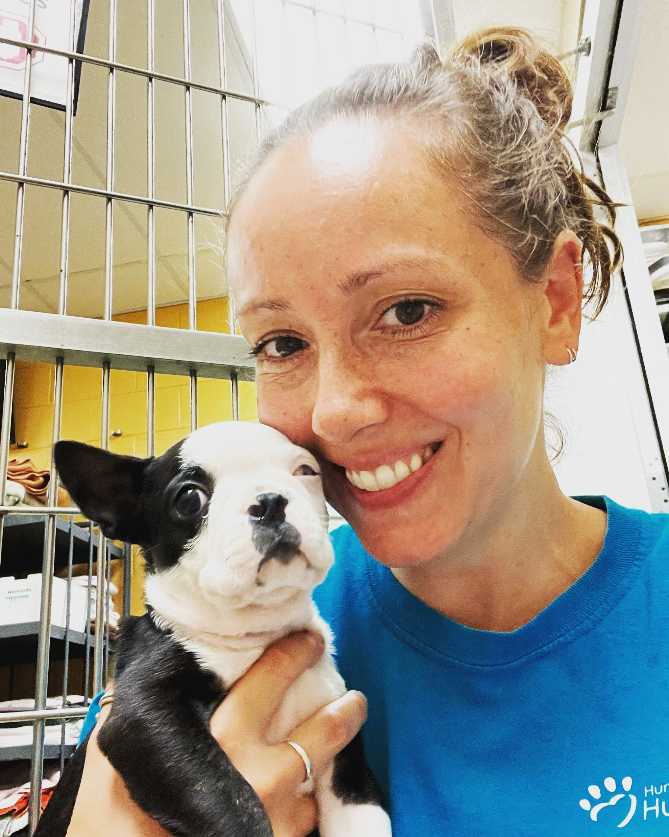
Meet the Volunteer Department
Karen Patterson, Vice President of Humane Education and Volunteers
Tawn Hinze, Volunteer Manager
Jaime Campbell, Volunteer Coordinator

Slide 5
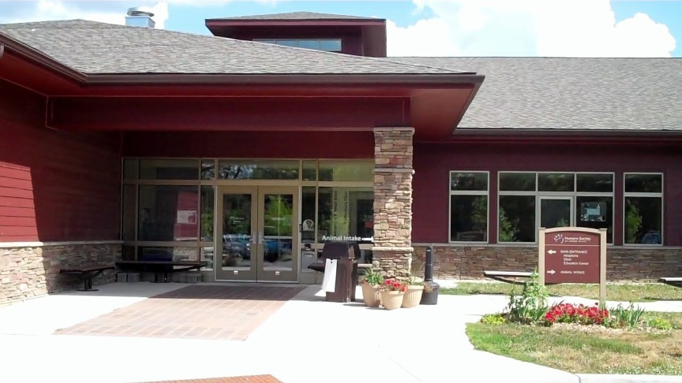
An Overview of HSHV

Slide 6
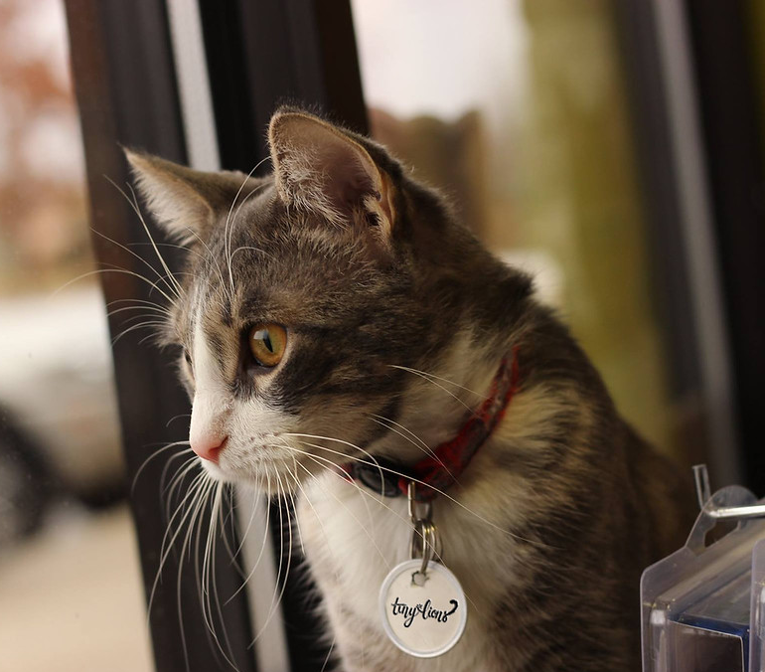
Our Mission
  To encourage loving, responsible care of all animals in our community, to prevent suffering, and to save as many lives as possible.

Slide 7
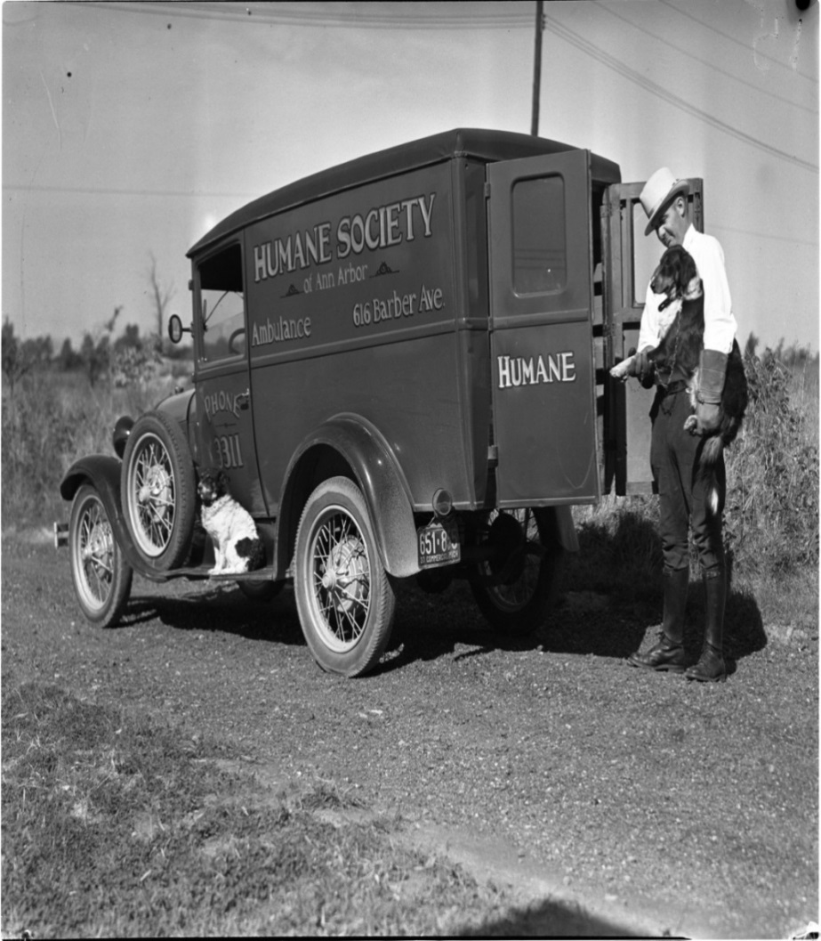
A Little History…
Founded in 1896
New shelter completed in 2009
501(c)(3) charitable organization
  A private, independent nonprofit agency
Notes:
We are not affiliated with any other Humane Society, we have our own separate operating budget.

Slide 8
HSHV is an Open Admission Shelter
What Does This Mean?
We accept animals even when shelter is full.
We accept animals who are sick or injured.
We fit the definition of “no kill” set by Maddie’s Fund.
We rarely use this term due to confusion.
Euthanasia does happen as a humane course of action.
No “time limit” for adoptions.
Notes:
HSHV is an Open Admission Shelter.
We accept strays and owner surrenders even when the shelter is full.
Since HSHV is an ‘open admission’ shelter, euthanasia is a part of our operation
While HSHV fits the definition of “no-kill” (as defined by Maddie’s fund) we don’t use the term very often because there is so much confusion and politics around the term.
Circumstances when euthanasia is the humane course of action:
unmanageable pain that cannot be controlled through reasonable medication and/or medical treatment
severely injured
chronic medical issues
deemed unsafe
cage neurosis that is not treatable with fostering

Slide 9
Our Save Rate
HSHV Named Best Animal Shelter for the highest animal “save rate.” ~Michigan Petfund Alliance
97.5%

Slide 10
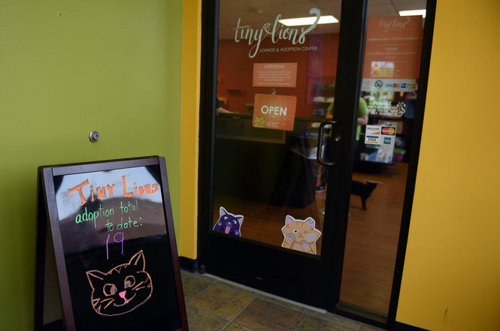
Welcome to Tiny Lions

Slide 11
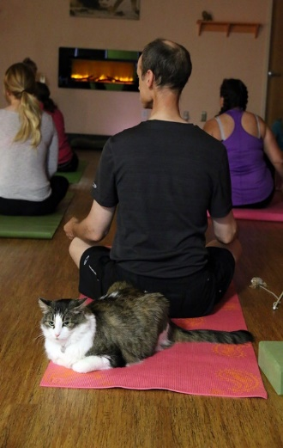
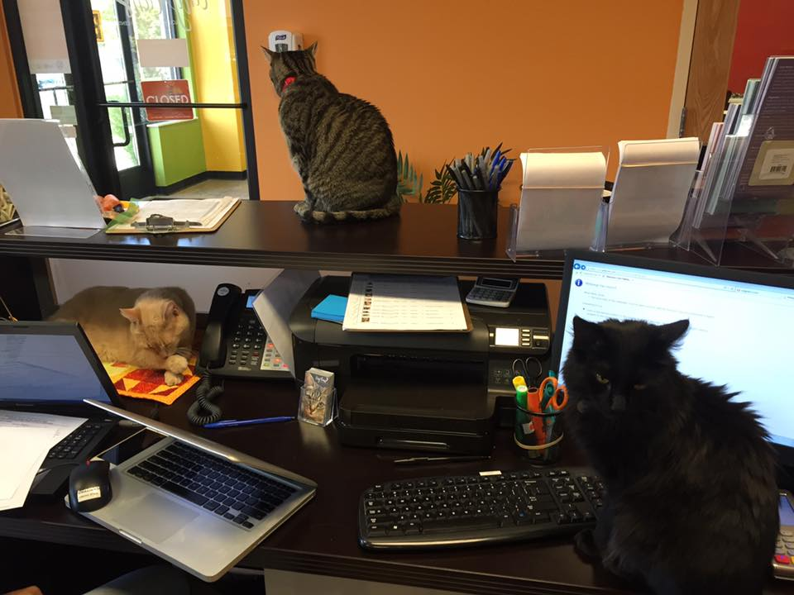
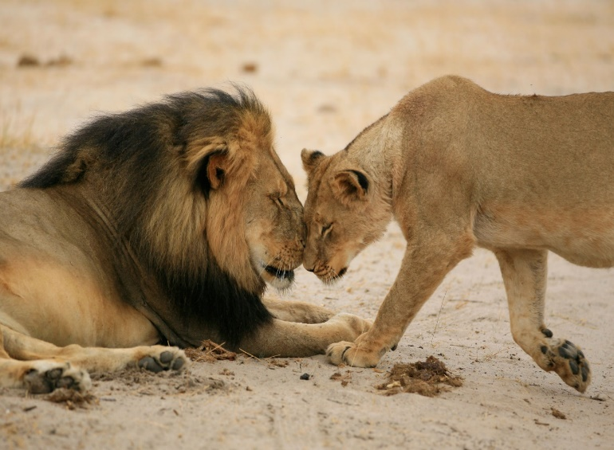
A Little History…
Opened in May of 2016
Named after Cecil the Lion
Do you know where the first known cat café in the world was?
Cat Flower Garden" (貓花園), opened in Taipei, Taiwan, in 1998

Slide 12
A Brief Overview
Cats are chosen by TLC Staff. Come from main shelter. Kitten coming up through Kitten Love Train (typically winter months)
There is an admission fee. Open to all groups and ages
We offer fun programming each month!

Slide 13
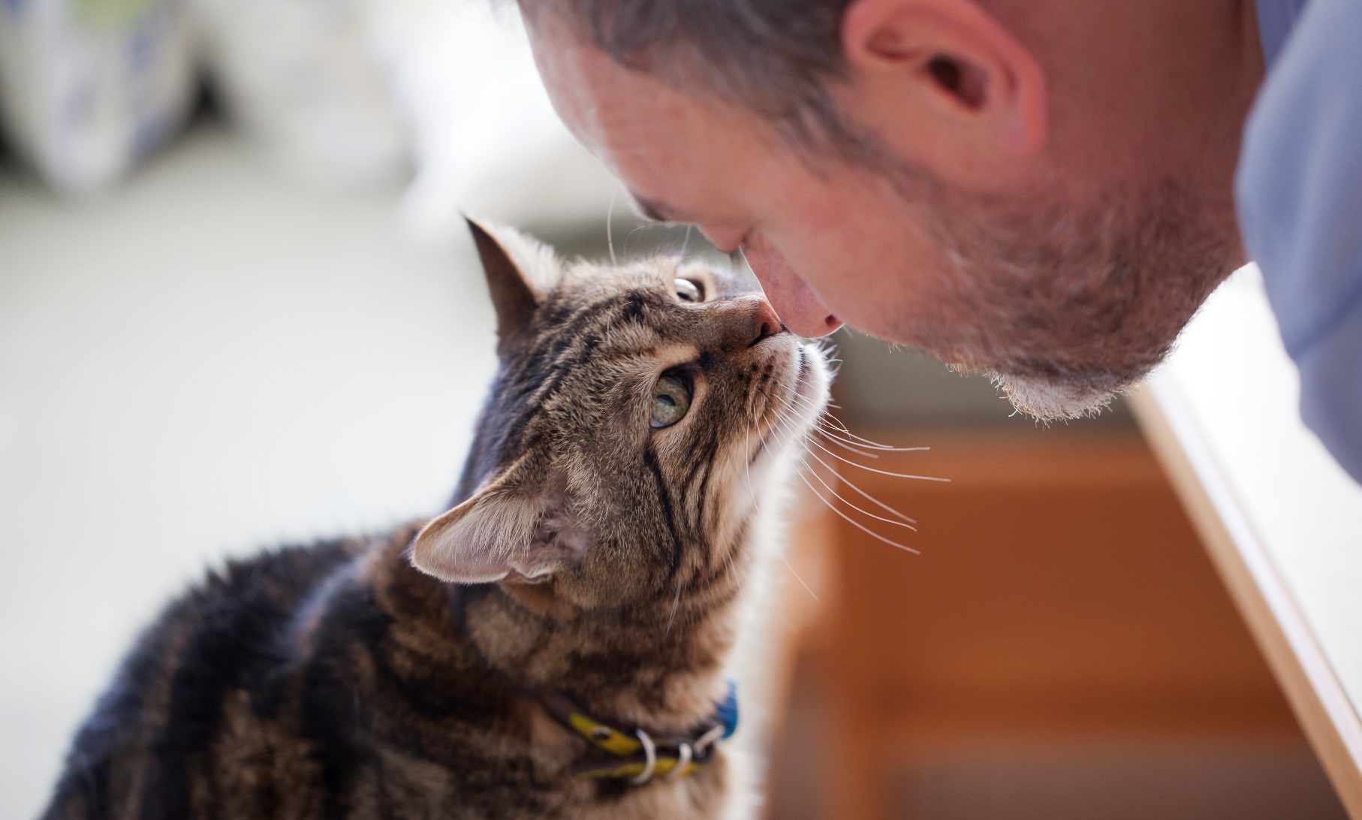
Interacting with Tiny Lions Cats

Slide 14
Collar Coding

Slide 15





Working with Cats
Hands are not cat toys
Don’t fall for my belly rub invitation
No flash photography
Avoid picking me up
Shhh…let sleeping cats sleep and hiding cats hide.

Slide 16
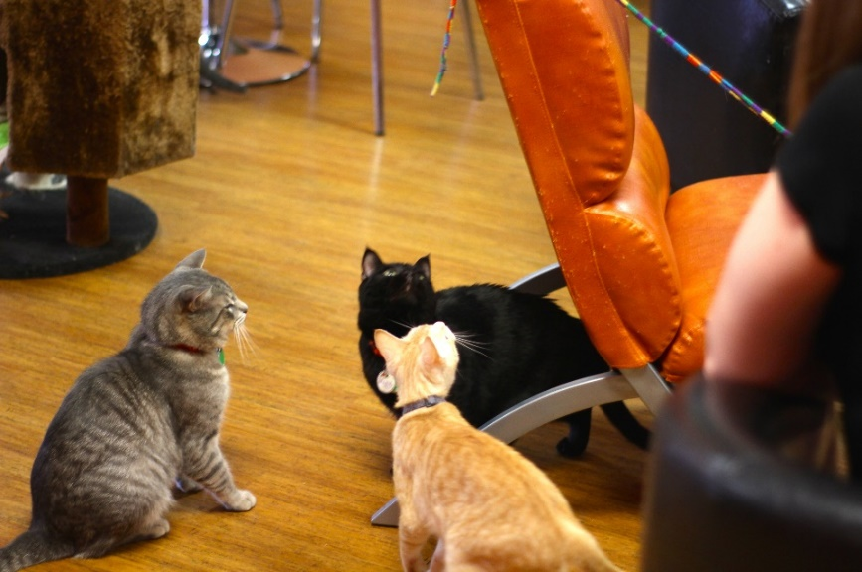
If a Cat Gets Loose
Remain Calm
Call for staff assistance immediately
Avoid chasing the cat
Watch to see where/he she goes
Keep the area safe (alert cars, etc.)

Slide 17
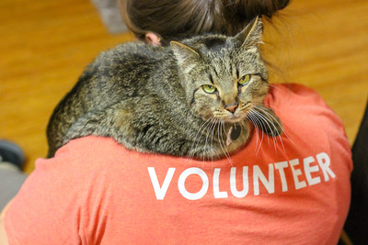
Volunteering at Tiny Lions

Slide 18
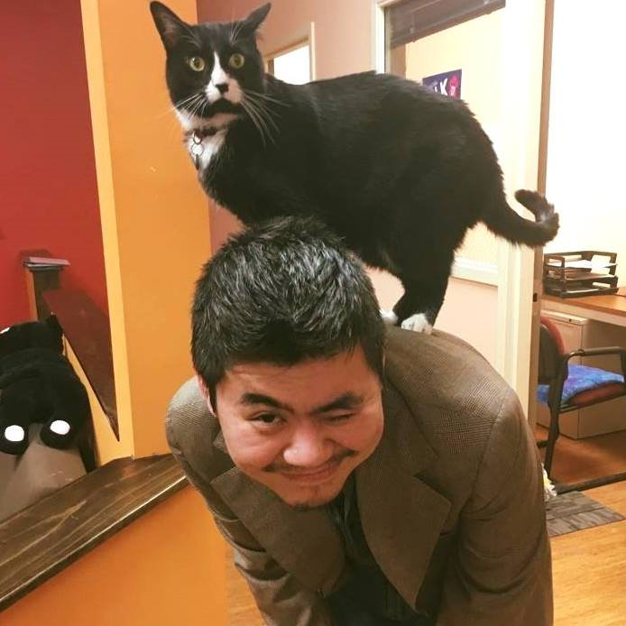

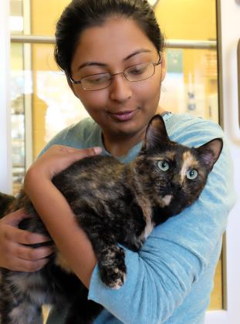
2025 Volunteer Statistics
Total number of Tiny Lions Volunteers: 251
Total number of volunteer hours: 2,781
Hours donated by volunteers is equal to an extra full-time paid staff!!
Notes:
Highlighted 6 top areas:
Dog walking: 21,419
Cat Comforting: 6,944
Fostering: 43,367
Shelter Support: 9,046
Clinic Support: 1,602
Humane Education: 10,041

Slide 19
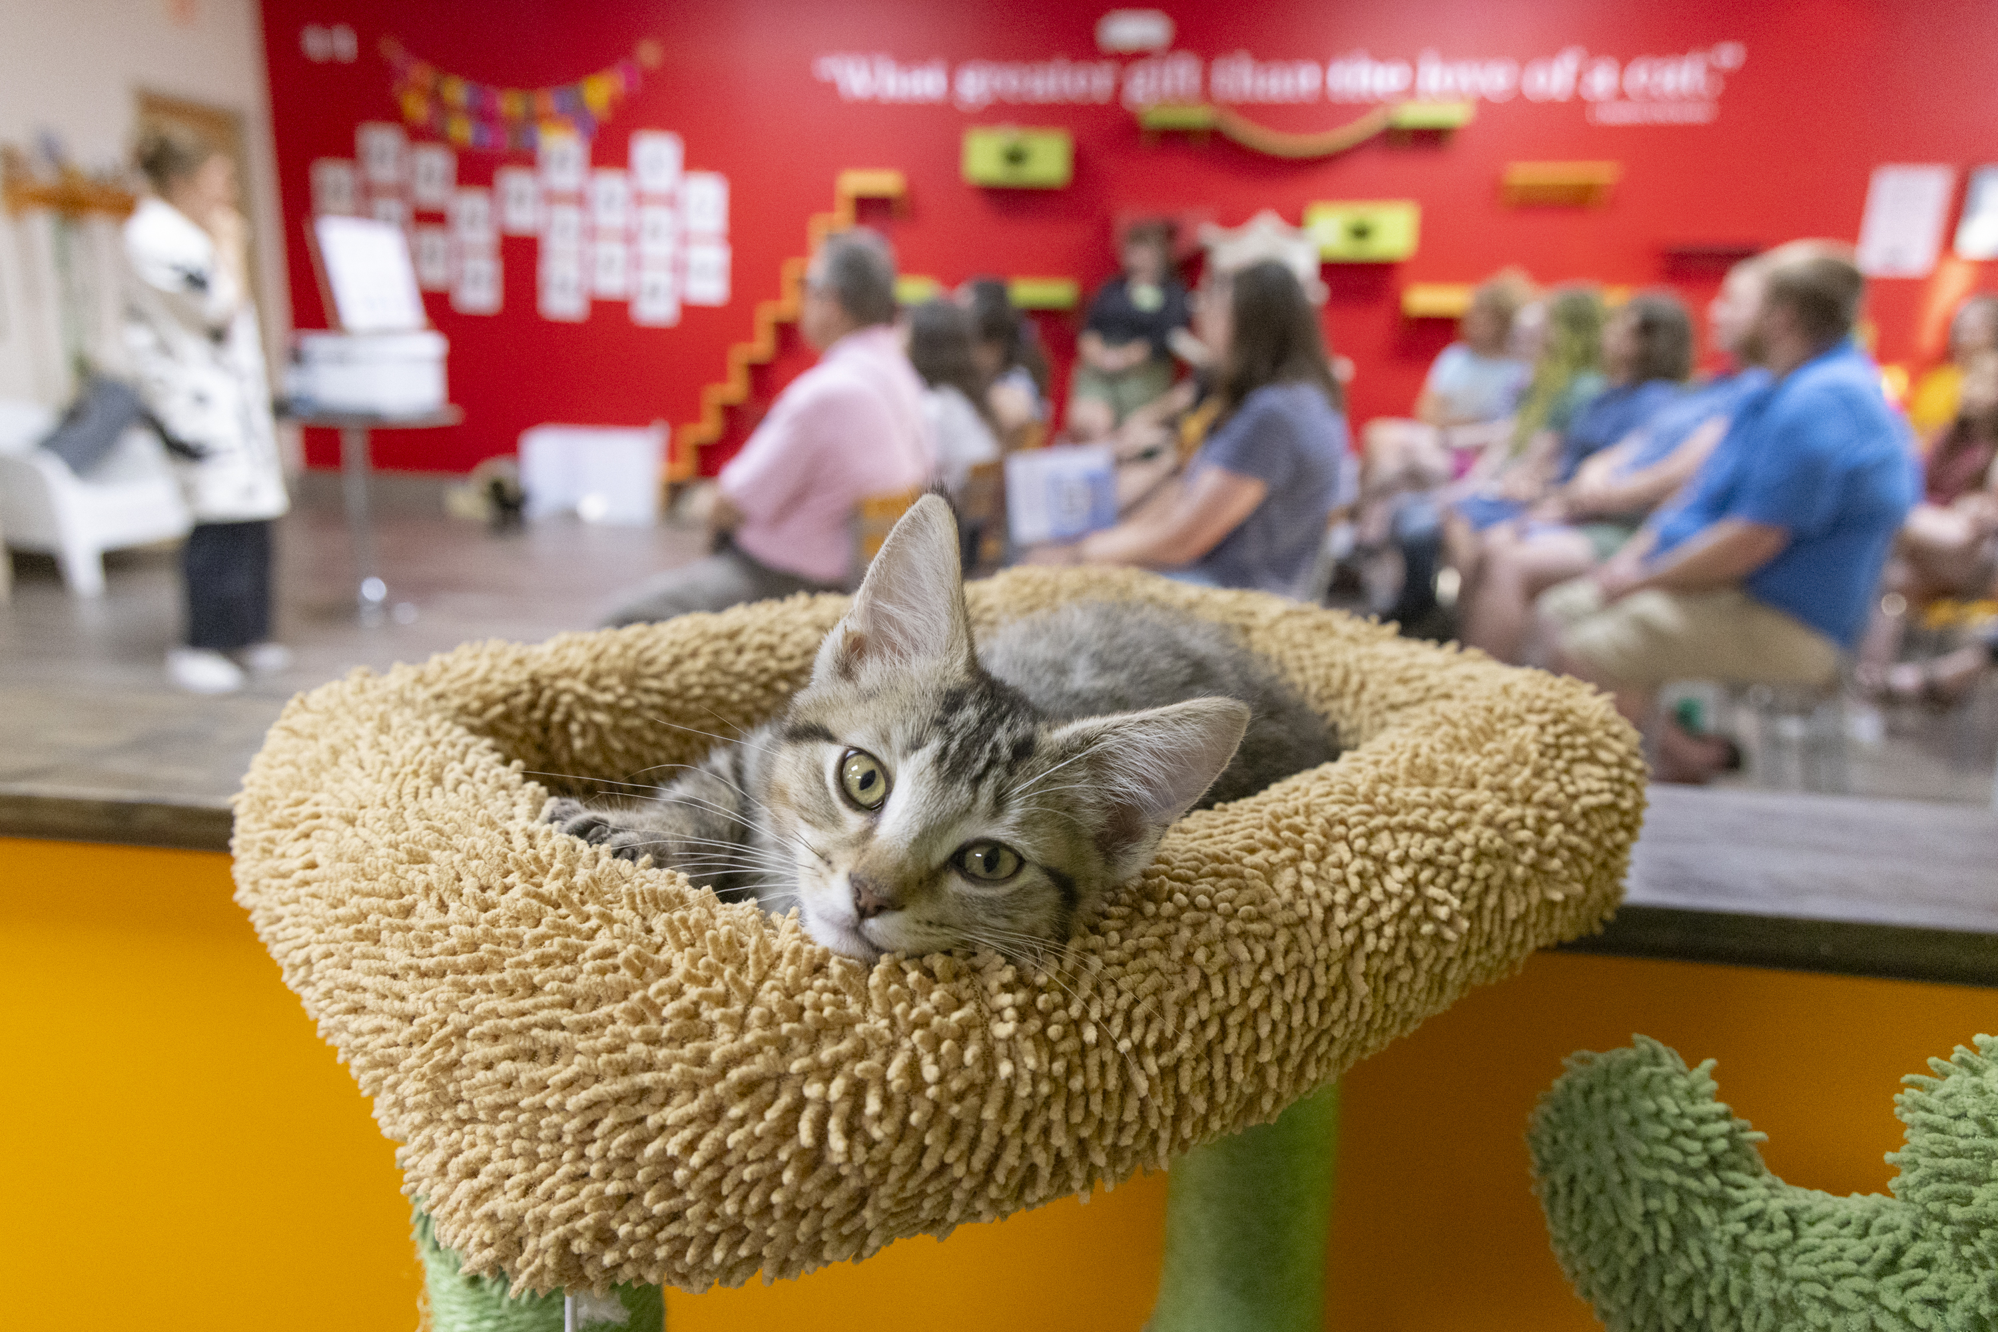
2025 Cafe Stats
668 adoptions in 2025
15,501 visitors to the café through programming, events, and café visits

Slide 20
Tail System for Volunteering
Cat Café Care, Admin & Retail Support
Tail 2 - 10 hours
Customer Care Assistant, AM Cat Care Assistant, New Nametag!
Tail 3 - 100 hours
Community Outreach, Leadership Team, Sticker for your nametag
Tail 4-250+ Hours
Tail 1- 0-10 hours
Certificate of appreciation, “Thank You” vinyl sticker, new nametag

Slide 21
Perks for Volunteering
(Just in case hanging around adorable cats and great people isn’t enough)
Tail 2-10 Hours
Tail 3- 100 Hours
Tail 4- 250+ Hours
Personalized Name Tag
One, 5 hour punch card
10% off Retail Sales, HSHV Vet Clinic, HE Programs & TLC entrance fees
Adoption discounts
Sticker for your Name Tag
Two, 5 hour punch cards to use
10% off Retail Sales, HSHV Vet Clinic, HE Programs & TLC entrance fees
Adoption discounts
New nametag
Certificate of Appreication
“Thank You” vinyl sticker
10% off Retail Sales, HSHV Vet Clinic, HE Programs & TLC entrance fees
Adoption discounts

Slide 22

Things to Know
What to Wear
Volunteer shirt (optional)
Cell Phones
Should not be out
Name tag
Close toed shoes
Sign out if you need to make a call
Other Policies
Smoke-free facility
Weapons/Alcohol-free facility
Park closest to furniture store when possible
Notes:
I

Slide 23
Volunteering around Animals
Exposure to Germs/Diseases.
  Zoonotic-animal to human (i.e. Ringworm).
  Other diseases animal-animal (i.e. URI’s).
Humans are the largest carriers of germs.
  Always sanitize hands.
After Volunteering, we recommend…
  Clothing-
    wash in hot water/color-safe bleach. Dry in the dryer on highest setting.
  Shoes-
    wipe down and/or have a separate pair just for volunteering.

Slide 24
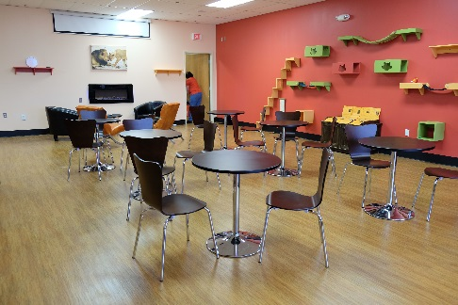
Overview of the Cafe!

Slide 25
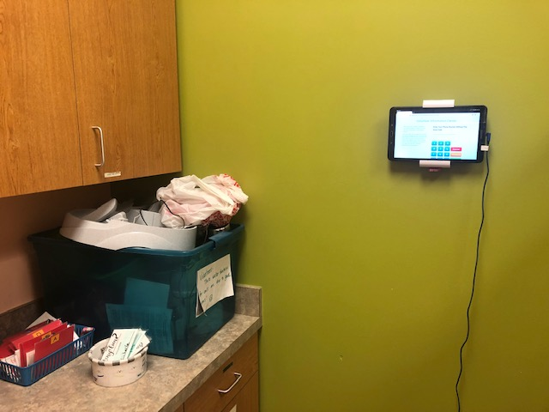
Kitchen
Main Location for VIC sign-in
  Use phone number (minus area code
Nametags are on the counter
  Permanent nametags at Tail 2 (10 hours)

Slide 26
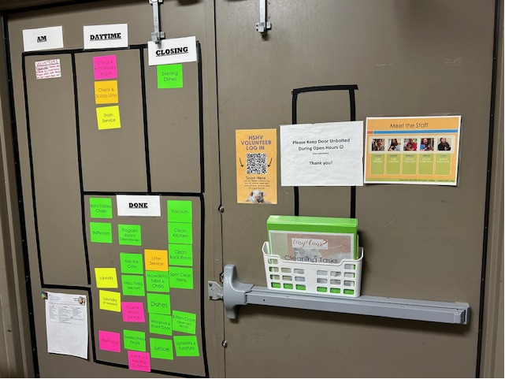
Back Room
Where you will find shelter cleaning assignments
Laundry goes here
Where feeding and cleaning supplies are located

Slide 27

Program Room
Can be rented for parties/events
HE programming takes place here (look for the doors to be closed…do not just “enter”)
Storage cubbies for events like yoga

Slide 28
Our Volunteer Culture
Balance
Don’t over schedule yourself
Communication
Let us know how we can help
Respect
Follow Policy and Procedures
Have fun
Find what you enjoy doing
Notes:
Balance. We understand that you have a life outside of volunteering.
Don’t overschedule yourself as this could potentially lead to burn-out/compassion fatigue. Ideally no more than 4 hours on a given day.
Communication. Starts with the volunteer department.
Feel free to email volunteers@hshv.org or follow up with Karen, Tawn, or Ashley directly. We are here to help!
Have Fun. Each year we have end of year and summer appreciation events. We also celebrate Volunteer Appreciation Week with fun giveaways and special classes. We want you to enjoy your time volunteering!
Respect. We ask that policies and procedures are followed to ensure the safety of you, those around you, and the animals trusted in our care.

Slide 29
Volunteering at HSHV
Be Respectful
We create a welcoming environment by respecting our differences.
Ask for Help if You Need It
If you need help better understanding a difference, ask a staff member/volunteer department for help.
Keep an Open Mind
Try to understand where others are coming from rather than get frustrated from a difference in understanding.
Leave bias, stereotypes, and prejudice at the door. Let’s not have our differences get in the way of our mission for caring for the animals and finding them loving homes.

Slide 30




HSHV on Social Media
HSHV.animals and Tiny Lions Catfe
humanesocietyofhuronvalley and
tinylionscatcafe
Humane Society of Huron Valley and
Tiny Lions Lounge and Adoption Center
tiktok.com/@humanesocietyhuronvalley

Slide 31

Volunteer Facebook Group
Closed group
A place for updates, stories, pictures, or
volunteers needed requests.
No posts about death, euthanasia, or killing/injury to animals.
Posts should not include solicitations of goods/money.
Questions? Ask us!
Notes:
Closed group, must be a volunteer to join

Slide 32
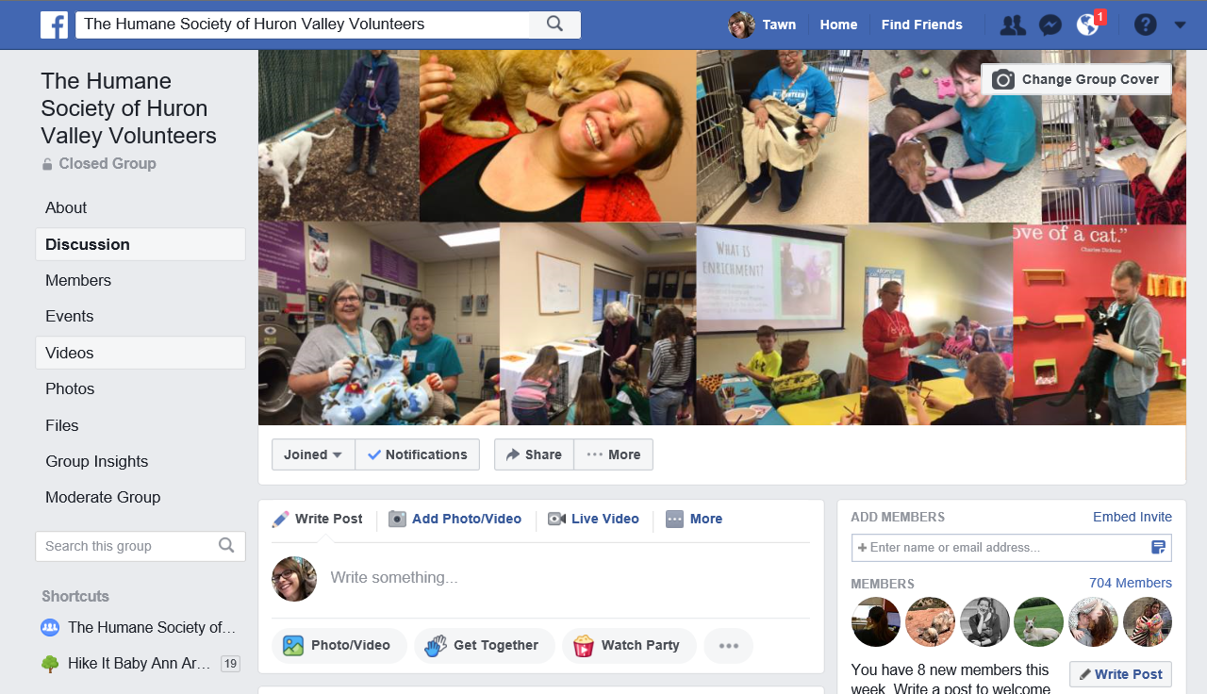
Facebook Posts
Posts are removed that do not fit the social media policies
Notification sent
2 or more posts removed = removal from FB group
Notes:
Posts that do not fit within the social media policies will be removed.
If a post needs to be removed, the volunteer will be notified by Karen or Tawn explaining “why”.
Volunteers may be removed from the facebook group after 2 posts.
Tone of the group remains positive.
Respecting that not everyone wants to know or read about certain topics
If you ever have questions, please just ask. We are here and want to help ☺.

Slide 33
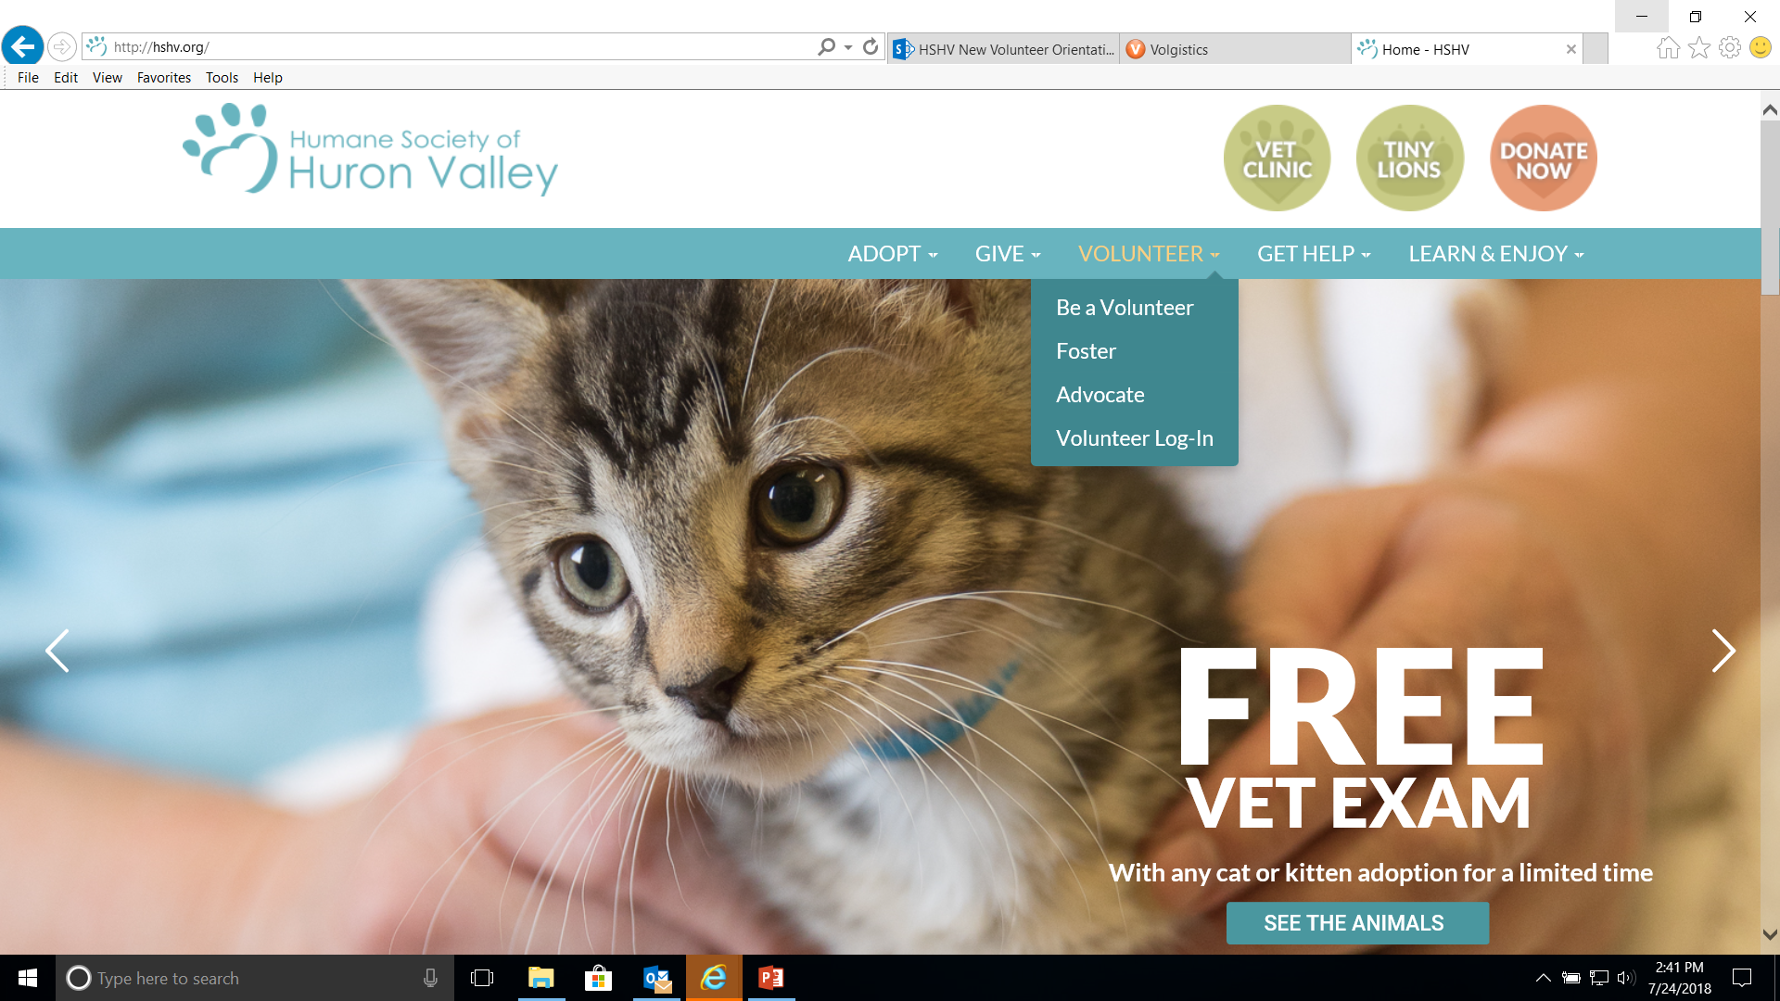
Getting Started – Signing Up
VIC =
Volunteer Information Center

Slide 34

Let’s Take a Look at VIC!
Logging In
Homepage Overview
Email Settings
Calendar
  Signing Up
  Canceling
Job Descriptions
Resource Library

Slide 35
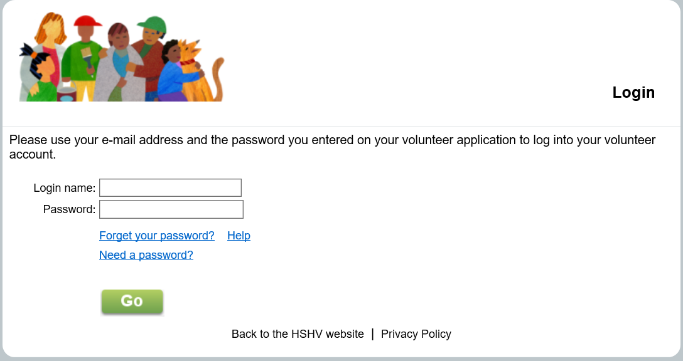
VIC Net Login: Visit our website, www.hshv.org, on the homepage you can click on “Volunteer”, then “Volunteer Login” to access VIC on your computer.
Logging In
VIC = Volunteer Information Center
Login: Your login name will be your email address and your password from the application. Click “go”
Don’t worry, if you forgot your password, there is a “Forgot your password?” button

Slide 36
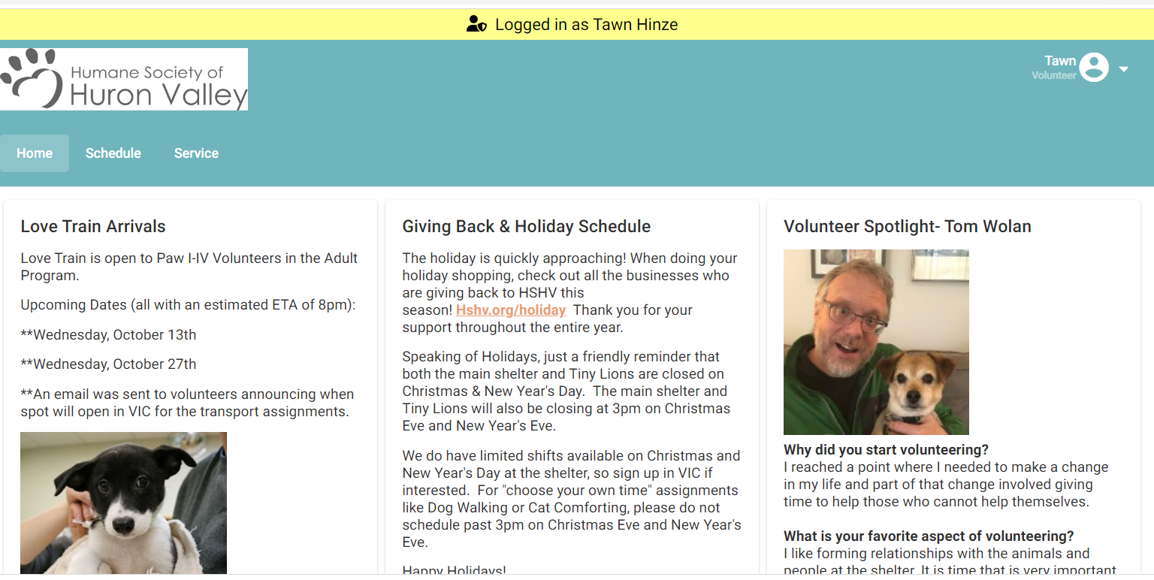
Welcome Screen: This is the main page you will see every time you log into VIC. Be sure to check here for the most important and up to date information about upcoming trainings, happenings at the shelter, or events you can participate.
VIC Homepage
If you volunteer before 11:00 AM, the shelter doors will be locked. The morning door code will unlock the door. Please be mindful to not let someone from the public in the building before 11 AM.
Door code = 8318#

Slide 37
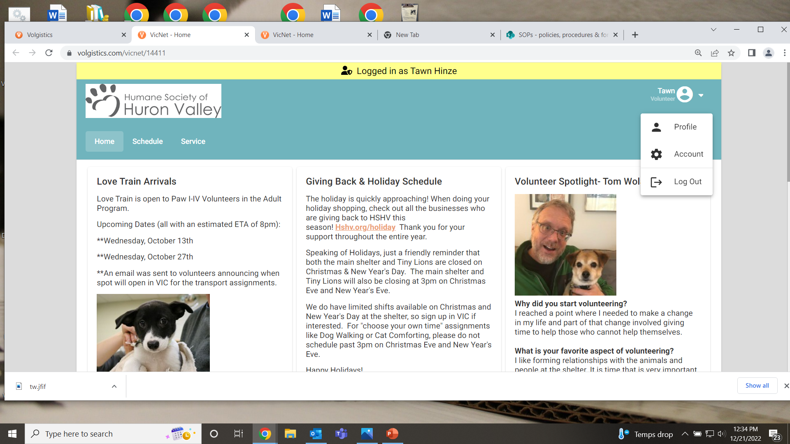
My Profile Tab: Make sure all your information is filled out correctly. You can update your current contact information, email and your photo. Please make sure you are the only human and that your face is clearly showing in your photo.
Account & Profile Tabs
Account Tab: This is where you can change your password, set your email and text messaging preferences. Note: if you choose to not receive “important information” you will miss out on most emails regarding upcoming events, information important to your role as a volunteer, training reminders and any job openings.
Click small arrow next to your name for drop down menu

Slide 38
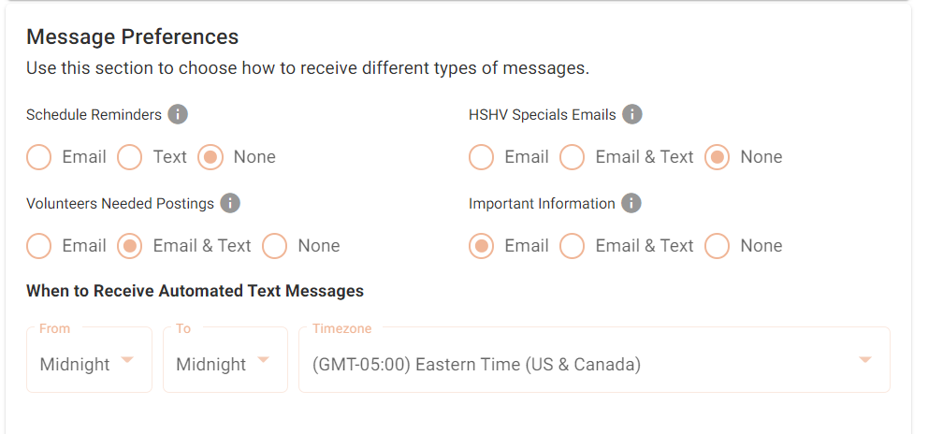
Email Preferences
Communication through email in VIC is how we send information on trainings, shelter news, schedule changes, and help needed.
Please check your message preferences in VIC under the “Profile” section
Always keep Important Information checked!

Slide 39
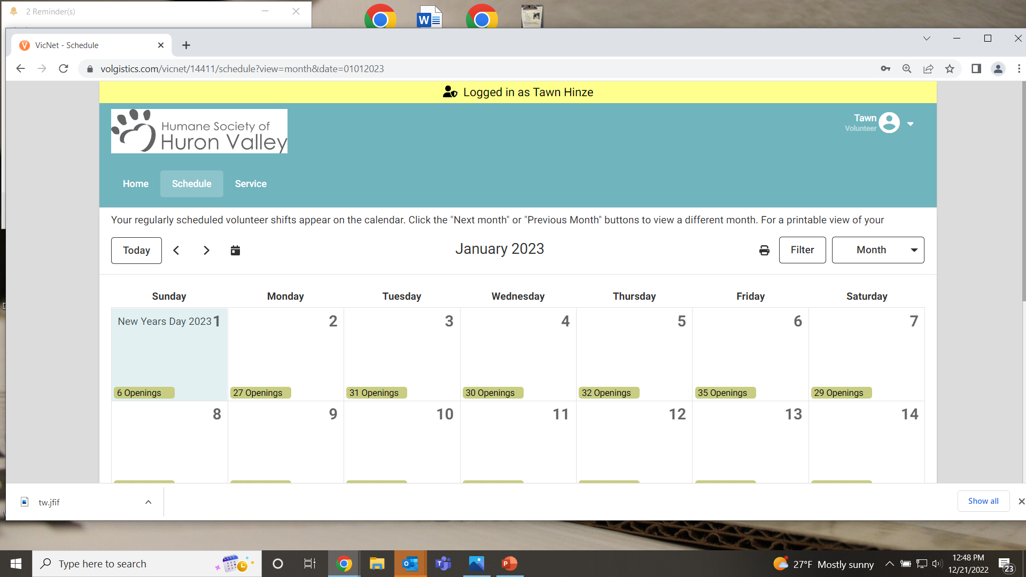
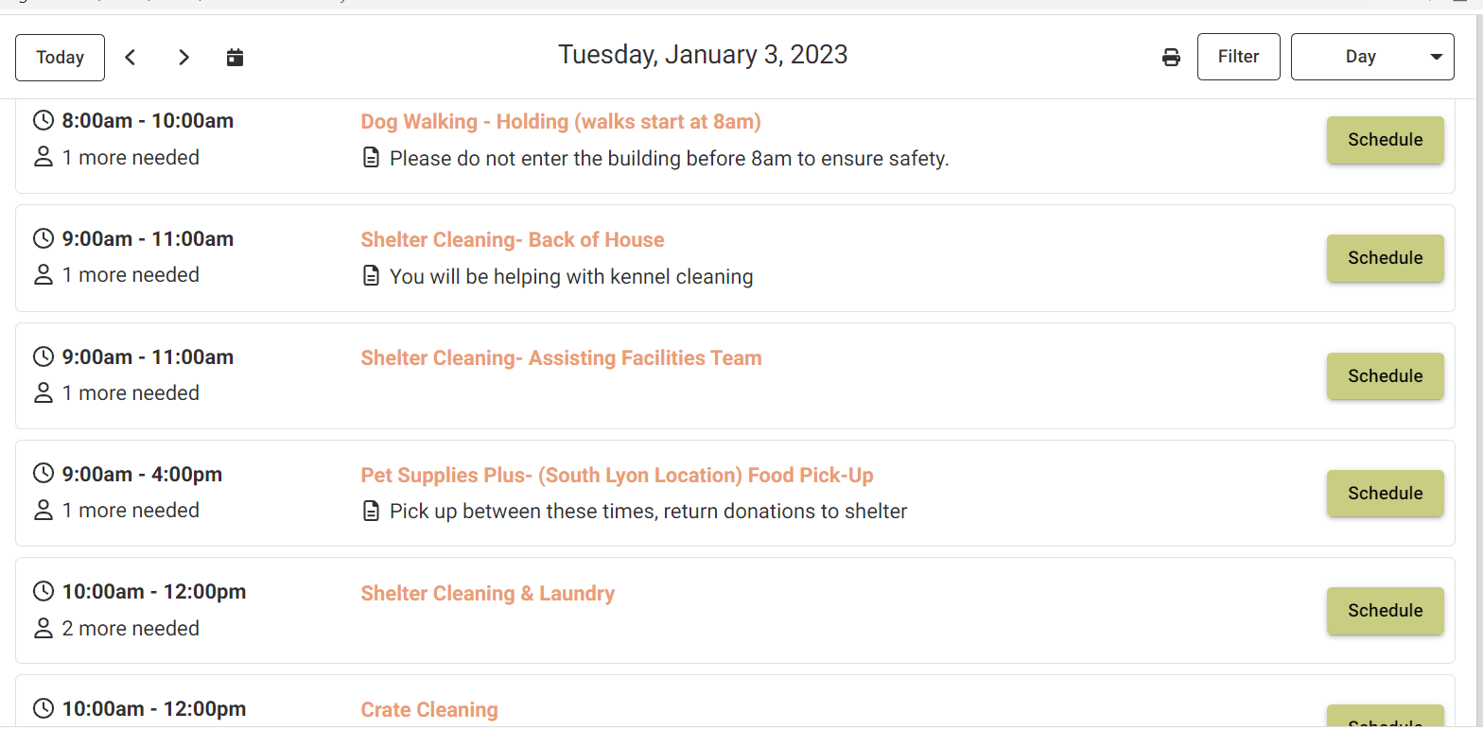
Schedule Tab: This is where you schedule yourself for volunteer assignments.
Scheduling
Click on a specific date to see what assignments are available (this will be specific to your volunteer Paw Level, training, etc
You will see a list of assignments available when you click on a specific date
Notes:
This is where you pre-register for all of your volunteer assignments

Slide 40

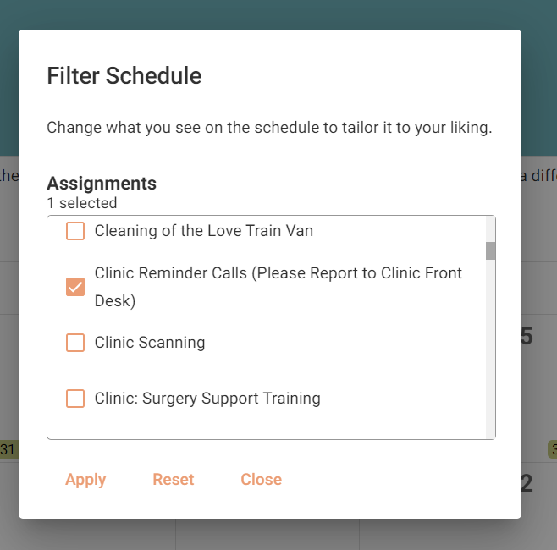
Choosing Assignments
In addition to clicking a particular date to see assignment, you can search for a specific assignment by using the “Filter” feature
Select the assignment you want to search for and then click “apply”

Slide 41
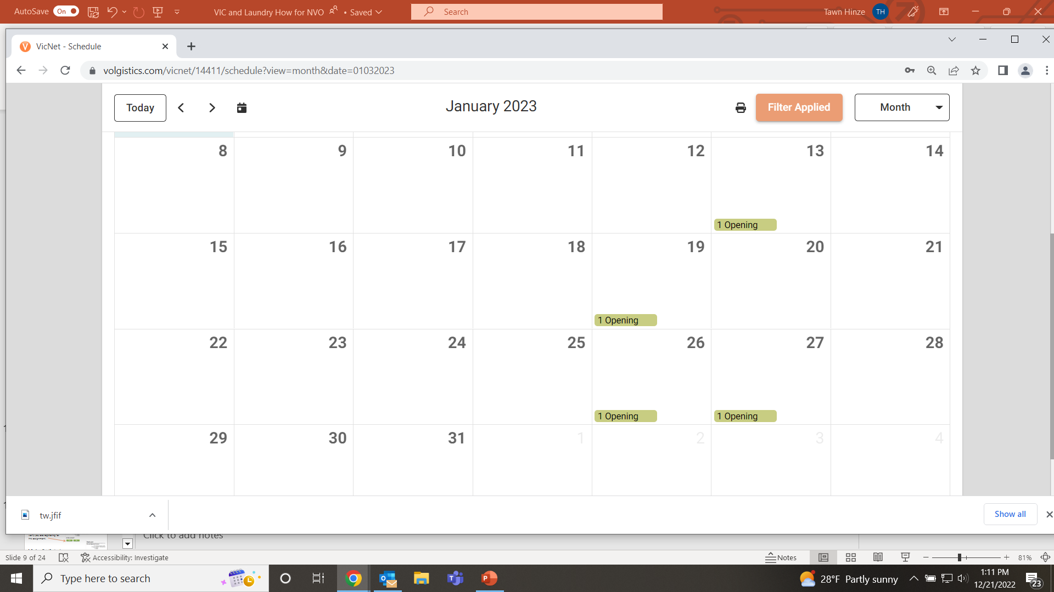
Choosing Assignments
You will now see the filter has been applied and any dates that have an opening for Clinic Reminder Calls, will show on the calendar as “1 opening”.

Slide 42
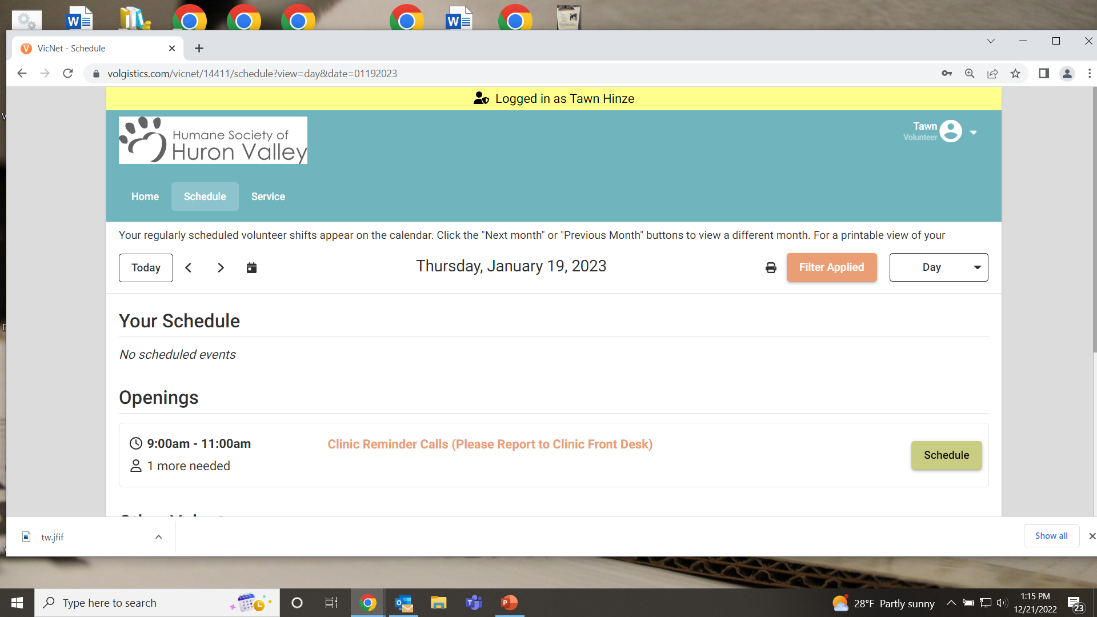
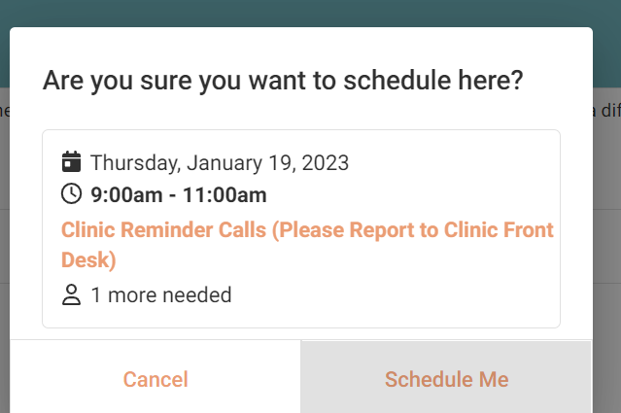
Scheduling & Job Description
Click the name of the assignment to get the Job Description.
Learn more about the specific tasks associated with that volunteer assignment. If that assignment is something you would like to schedule yourself for, click on the green “Schedule Me”
Click on assignment name for job description

Slide 43
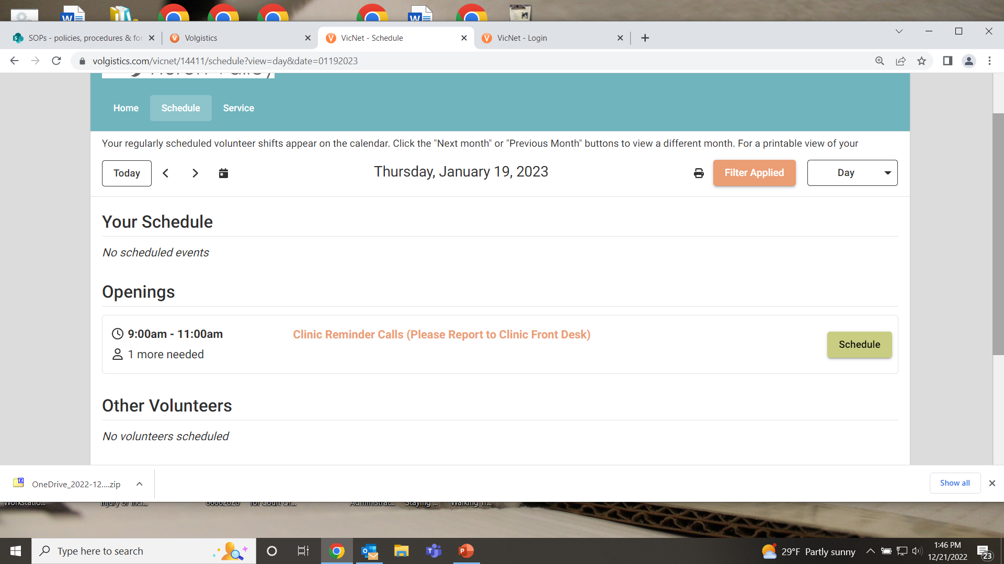
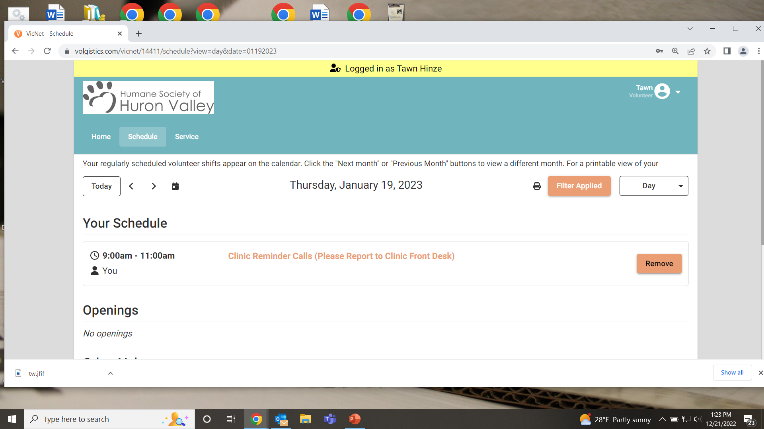
1. Click the green “Schedule” button for the shift you want to sign up for.
Confirming Assignment
2. Click “Schedule Me” to verify you are registering for this assignment.
3. You will now see that you are scheduled

Slide 44
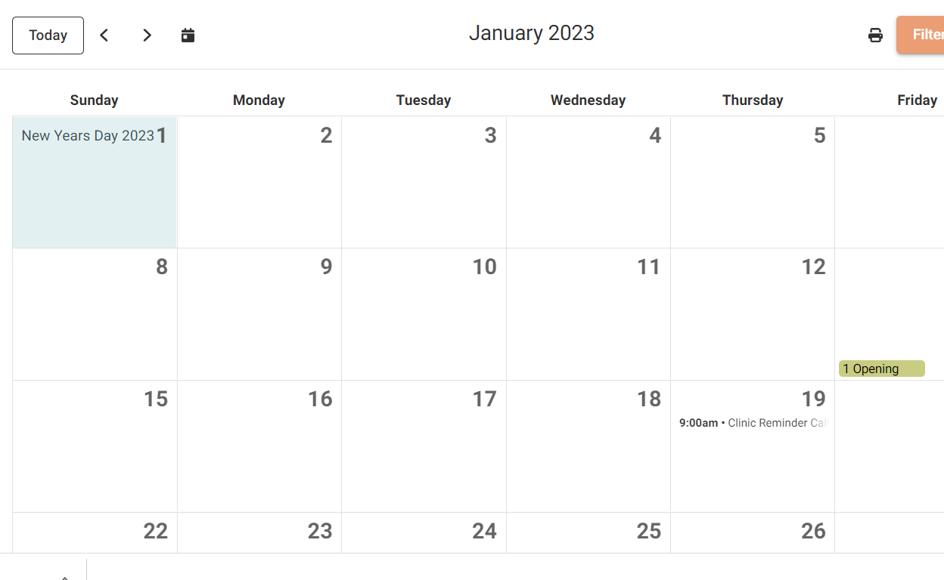

Removing Yourself: Please don’t over schedule yourself . Click on the date you need to cancel. In this example, it’s the 19th.
Click the “remove” button and that will take you off of the schedule.
You may remove yourself from any scheduled assignment up to 36 hours before you are to perform that assignment. Just click “Remove Me”
If the REMOVE button option is NOT available, please email the volunteer department at volunteers@hshv.org
Canceling Assignments
Reminder: 3 unexplained absence means you are done volunteering at HSHV. Communication is the key. Just let us know if you cannot make an assignment so we can plan.

Slide 45
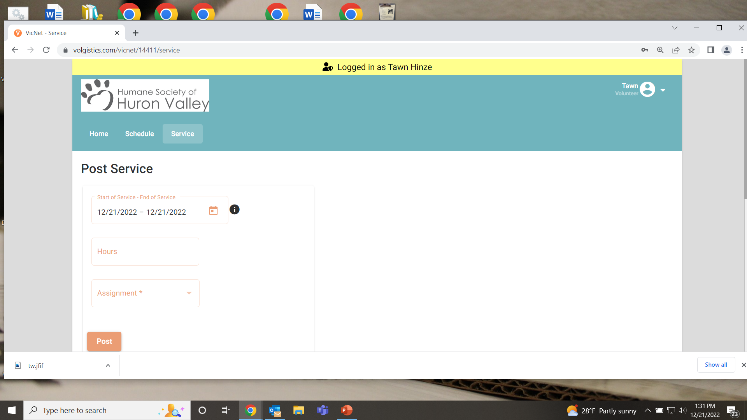
Recording Hours From Home
If you sign in and out at the volunteer computer, you do not need to log your hours from home.
You will use the Service tab to record foster hours, or off-site event/assignment hours. Here are the steps:
Select the beginning and ending date of your service.
Enter how many hours you served.
Choose Your Assignment from the drop-down menu
Click Post
Click “Yes” to confirm or “No” if you wish to not post.

Slide 46

Welcome Screen: This is the main page you will see every time you log into VIC. Be sure to check here for the most important and up to date information about upcoming trainings, happenings at the shelter, or events you can participate.
VIC Homepage
If you should need to visit the shelter before 11:00 AM, the shelter doors will be locked. The morning door code will unlock the door. Please be mindful to not let someone from the public in the building before 11 AM.

Slide 47
VIC Sign-In Stations
Locations to log-in at the café
  At the front desk
  In the kitchen
The café is a busy place with different events and guests, so please sign in at the kitchen station.

Slide 48
Need to Cancel?
More than 36 Hours to your assignment
Log into VIC
Click the “remove me” button
Less than 36 Hours to your assignment
You will no longer see the “remove me” button in VIC
Email TinyLions@hshv.org to let us know you aren’t coming in
No notification? You will marked “absent”. 3 or more absences could result in dismissal from the volunteer program.

Slide 49
Staying Active as a Volunteer
90 days with no activity on your volunteer account
We will email you, you will have 3 weeks to log hours
Your account becomes inactive if you don’t come in
Contact us if you will be gone for an extended period!
Notes:
A monthly inactive report is completed
Looks at which volunteers have not logged any time in the past 90 days.
You will receive email notification that you are on the inactive list
If you do not complete a shift prior to the date given in the email, your account will be archived.
Need to take time off (a month or more)? Email volunteers@hshv.org so we can update your account to vacation mode.
Absences without Notification
Will be marked in your account
3 absences without notification=possible dismissal from volunteering

Slide 50

Welcome to Volunteering!
You will receive a “Welcome to Volunteering” email after orientation. Once you receive this email your account will be “active” in VIC.

